Slide 1
Experiments with REINFORCE algorithm A purely experimental and empirical study
Rajesh Siraskar
14-Jun-2023

Slide 2
Agenda
Study objective
The RL environment
Evaluation strategy
Implementation architectures
Results
Findings
Discussion - What could I possibly be doing wrong?

Slide 3
Study Objective
Stable Baselines 3 implementations | Custom REINFORCE
Advanced algorithms – A2C and PPO Earlier algorithm – DQN | Very early algorithm – REINFORCE
Industry grade implementation | Custom, extremely naïve
Stable implementation | Un-stable (no effort made to improve stability)
Architecture: 2 layers x 64 | Tanh | Single layer 64 | ReLU
Important: This forms justification for how we choose the model file to be tested.

Slide 4
Study Objective (contd.)
My “proposal” goal is “Deep RL for predicting RUL”
Current sub/related goal: An optimal predictive maintenance policy for replacement of milling tool
REINFORCE - implemented from “scratch” – with hope of refining over time
This is a purely experimental (empirical) exercise.
Audience:
RL/CS Researchers
Practitioners, who do not understand algorithms deeply and deep learning or deep RL hyper-parameter tuning. Will want to use “default” algorithms

Slide 5

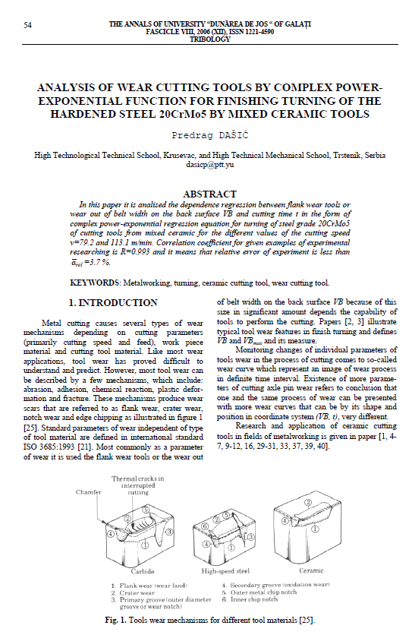

RL environment
Two different sources – simulated and real milling data
 Simulated. Dašić, Predrag (2006): Analysis of wear cutting tools by complex power exponential function for finishing turning of the hardened steel 20CrMo5 by mixed ceramic tools.
 Real data. IEEE – PHM Society

Slide 6
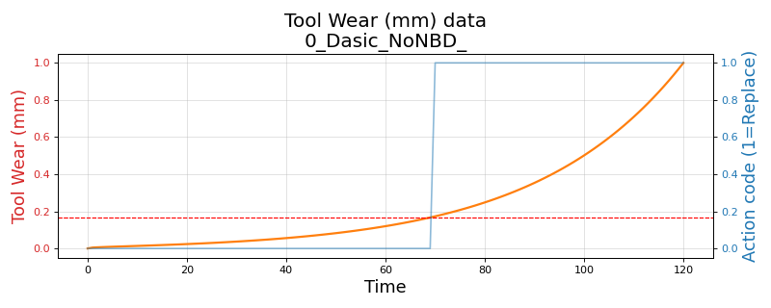
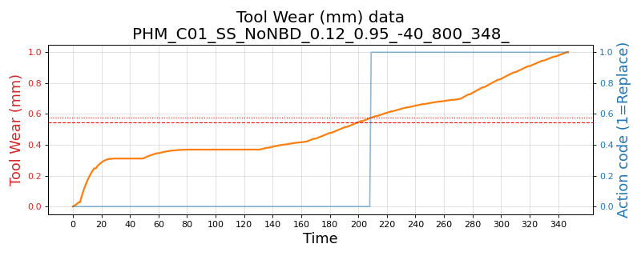
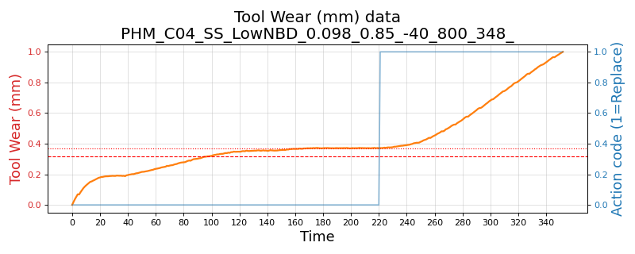
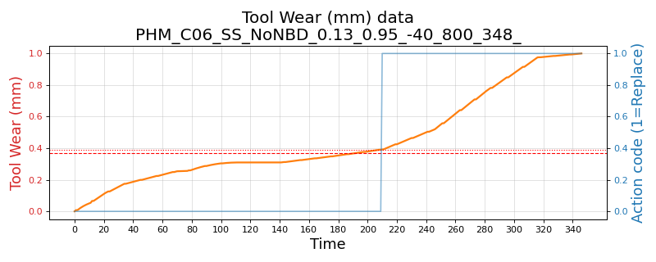
RL environment - Variants
Three environments and their variants:
Simulated. Based on Dašić (2006). Simple single-variate state (tool wear)
Variants: (1) No noise (2) Low noise and low break-down chance and (3) High noise and high break-down chance
PHM 2010 real data – Simple single-variate state (tool wear)
Variants: C-01, C-04 and C-06 data-sets
Variants: (1) No noise (2) Low noise and low break-down chance and (3) High noise and high break-down chance
PHM 2010 real data – Complex multivariate state (tool wear, 3-axis forces, 3-axis vibration and acoustic data)
Variants: C-01, C-04 and C-06 data-sets

Slide 7
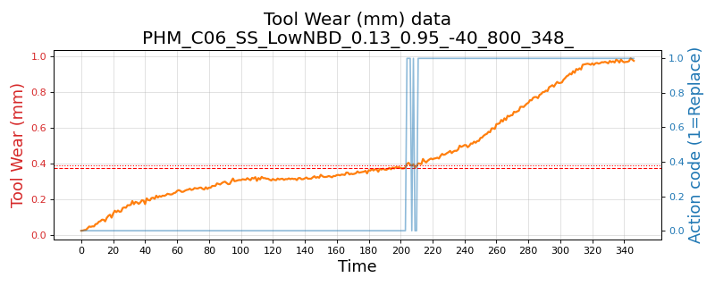
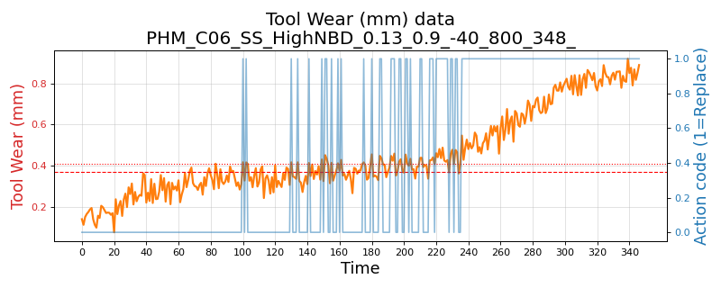
Wear plot - real data and its variants
PHM 2010 C-06 data-set
No noise, no break-down chance
Low noise: 1e-3 and break-down chance 5%
High noise: 1e-2 and break-down chance 10%

Slide 8
Evaluation strategy
RL policy decides when to replace tool
Compare against “human” replacement action
Train for 5 rounds. Each model tested over 10 rounds of randomly sampled 40 points
Selecting the models to test (“justification”)
REINFORCE – model performance sometimes dropped to 0.5 or even 0.0. Select ones that performed > 0.7
SB-3 – almost always 0.5-0.6 on average, sometimes showing high performance (0.8)
Compute Precision, Recall and F1
Compare mean and std. deviations

Slide 9
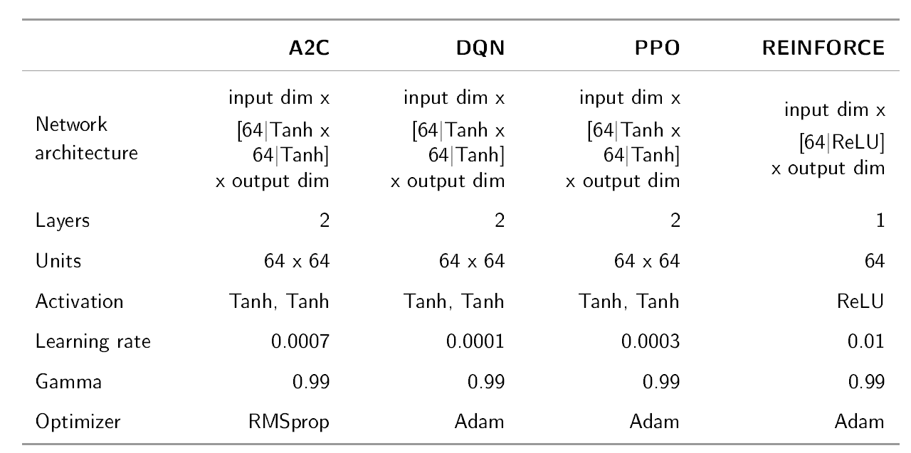
Architectures

Slide 10
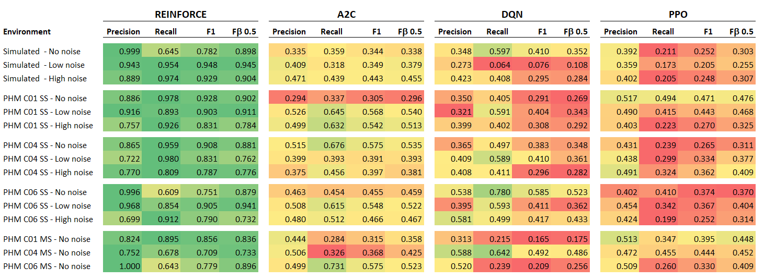
Results

Slide 11
Results: Overall – all environments and their variants

Slide 12
Results: Simple single variate state. Including noise variants
Simulated – Dašić, Predrag (2006).
PHM 2010: Single-variate environment, across three data sets C-01, C-04 and C-06

Slide 13
Results: Complex, multi-variate environment
PHM 2010: Complex, multi-variate environment, across three data sets C-01, C-04 and C-06
No noise or break-down

Slide 14
Training time: Avg. over different variants
Average training time in secs.
Variant | A2C | DQN | PPO | REINFORCE
Dasic 2006 Simulated - Single variate state | 33.53 | 3.04 | 34.23 | 182.76
PHM-2010 Real data - Single variate state | 21.53 | 2.37 | 24.27 | 313.99
PHM-2010 Real data - Multi-variate state | 37.23 | 6.06 | 42.46 | 632.05
Overall average | 27.07 | 3.24 | 29.90 | 351.36
Average training time per 1,000 time-steps, in secs. Stable-baseline algorithms are trained for 10,000 time-steps, while REINFORCE uses 96,800 for simulated and 278,400 for PHM based environments
Variant | A2C | DQN | PPO | REINFORCE
Dasic 2006 Simulated - Single variate state | 3.35 | 0.30 | 3.42 | 1.89
PHM-2010 Real data - Single variate state | 2.15 | 0.24 | 2.43 | 1.13
PHM-2010 Real data - Multi-variate state | 3.72 | 0.61 | 4.25 | 2.27
Overall average | 9.23 | 1.15 | 10.10 | 1.73

Slide 15
Findings
The naïve implementation of REINFORCE algorithm was implemented in PyTorch with an extremely simple architecture: Three layers and ReLU activation and an Adam optimizer.
In training, the SB-3 algorithms were extremely stable, but the F1 performance was always between 0.38-0.67. The naïve REINFORCE, on the other-hand, is unstable in training.
We saved models that performed better than 0.7 and these cases, the REINFORCE performs surprisingly better than DQN, A2C and PPO in all cases
The SB-3 algorithms almost always perform at about F1 0.47-0.50
REINFORCE performed between 0.78 (for complex real data environment) to 0.88 (for simulated environment)
Across precision, recall and F1; REINFORCE was better than the best performing SB-3 algorithm by 0.252 basis-points. The difference¹ in variance (σ²) was also lower, though near negligible, for REINFORCE at -0.0003
Across precision on tool replacement, REINFORCE was better by 0.354, a lower variance of -0.004
w.r.t. lowest of SB-3 algorithms
Reference data-sheet: “1. Analysis_model_performance_summary_V3 (PPT ref.).xls”

Slide 16
Some plots

Slide 17
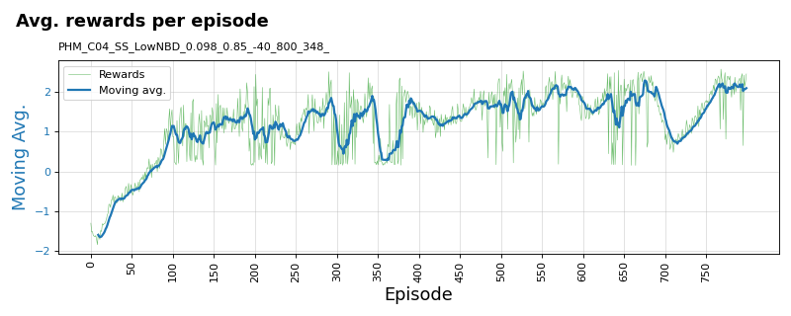
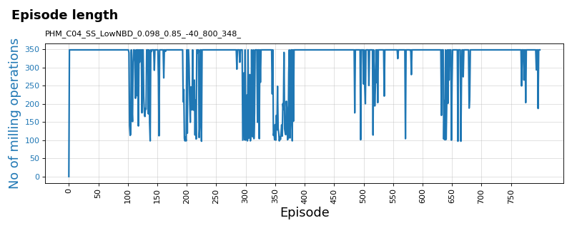
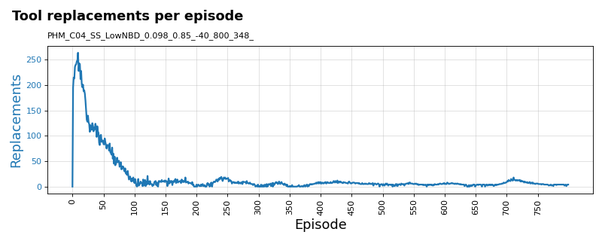
Training plots for REINFORCE algorithm
PHM 2010 C-04 data-set: Variant: Single-state tool-wear with low noise (1e-3) and low break-down chance (5%)

Slide 18
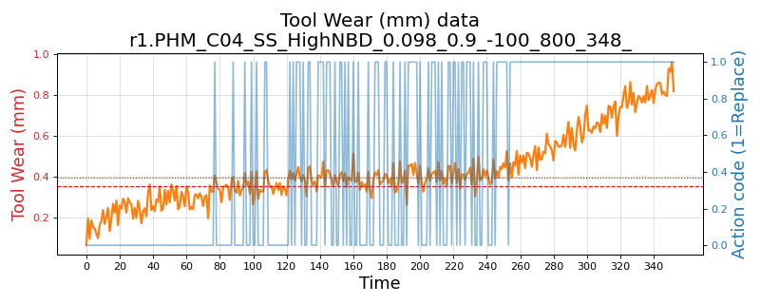
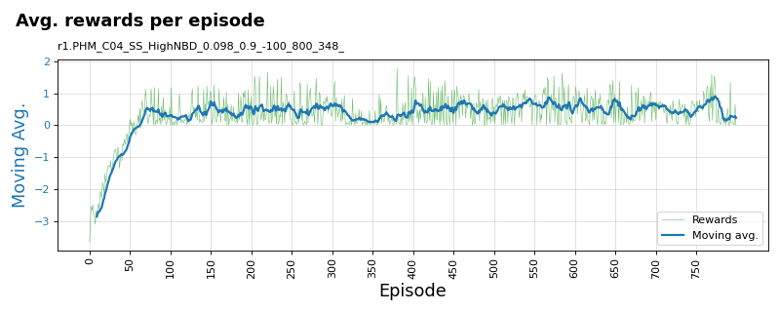
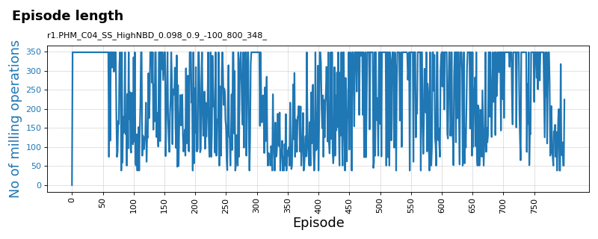
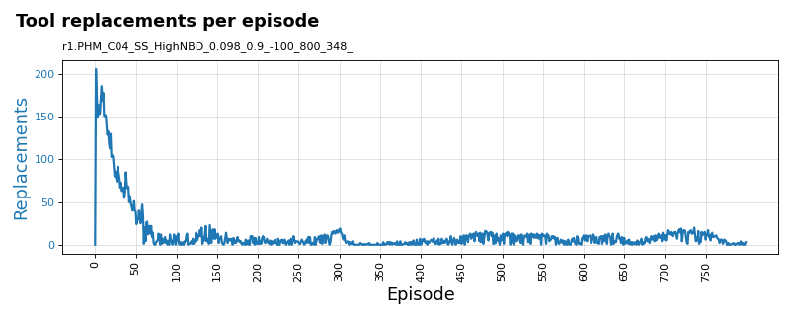
Training plots for REINFORCE algorithm
PHM 2010 C-04 data-set: Variant: Single-state tool-wear with high noise (1e-2) and low break-down chance (10%)

Slide 19
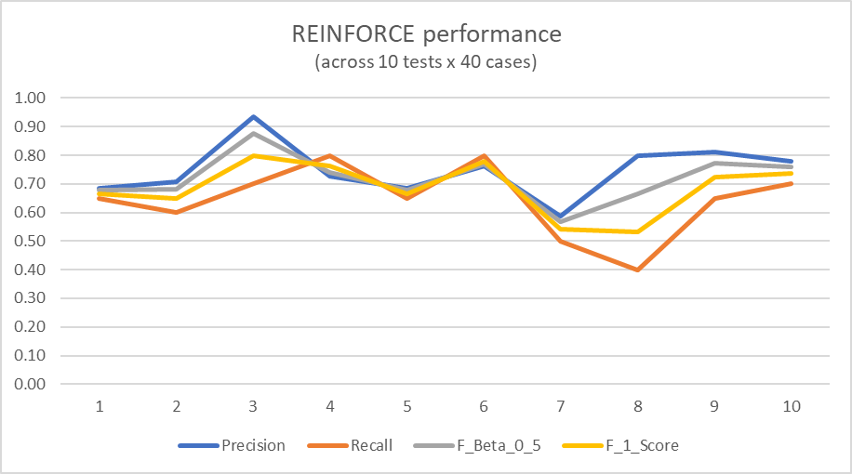
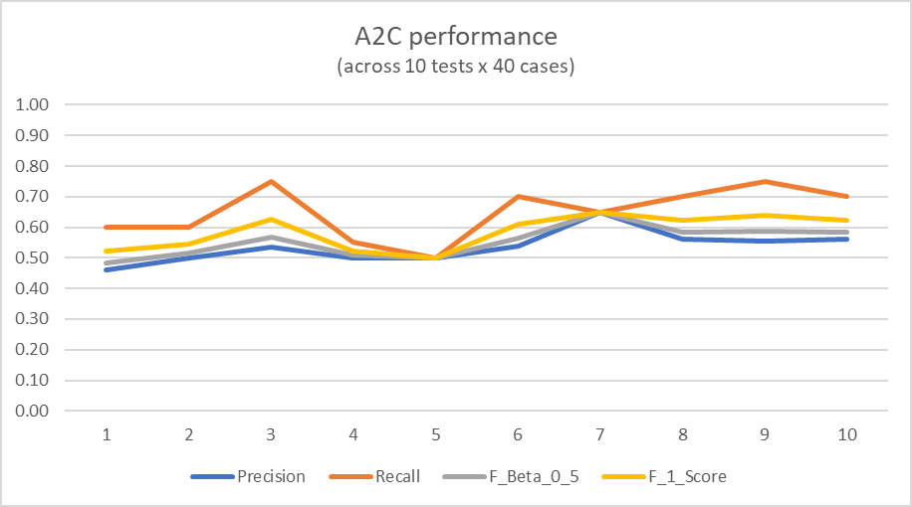
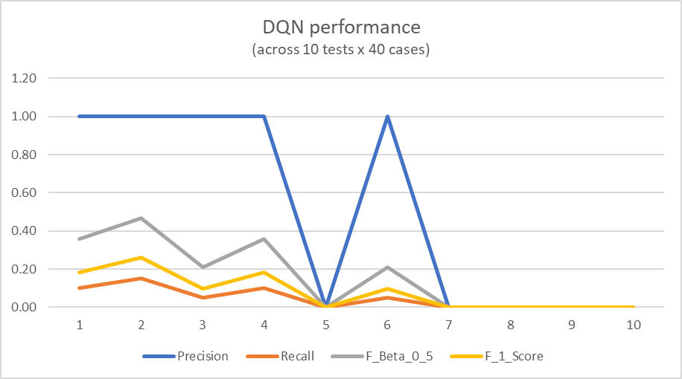
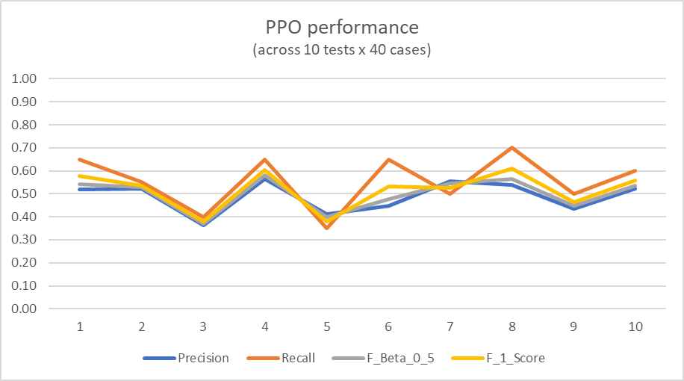
Sample test plots for algorithms
PHM C-04 data-set: Variant: Multi-variant state with no noise or break-down chance

Slide 20
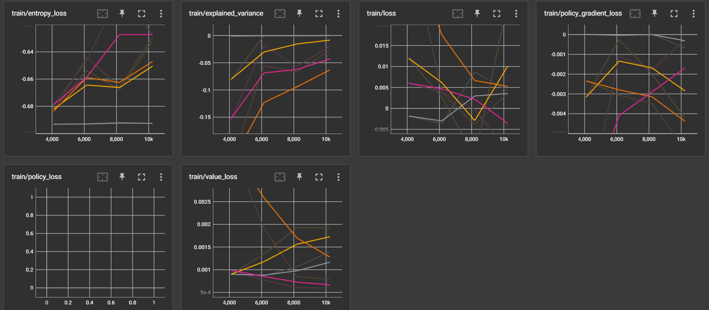
Tensorboard plots for SB-3 algorithms - PPO

Slide 21
SB-3 stability doubts

Slide 22
SB-3 stability issue?
Earlier runs with same episodes = 800
But REINFORCE has an internal loop of 348
Increased SB-3 algo runs to 10,000, then 800 x 348 then 20,000
Re-installed SB-3 and upgraded the version
Tested on cart-pole and mountain-car environment
Re-trained SB-3 models and re-ran experiments for 10,000 and 20,000 episodes– see next slide

Slide 23
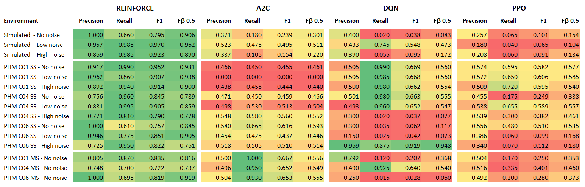
Results: Dell Laptop: SB-3 (10 K episodes) – single training round
Same results on another laptop, fresh installations

Slide 24
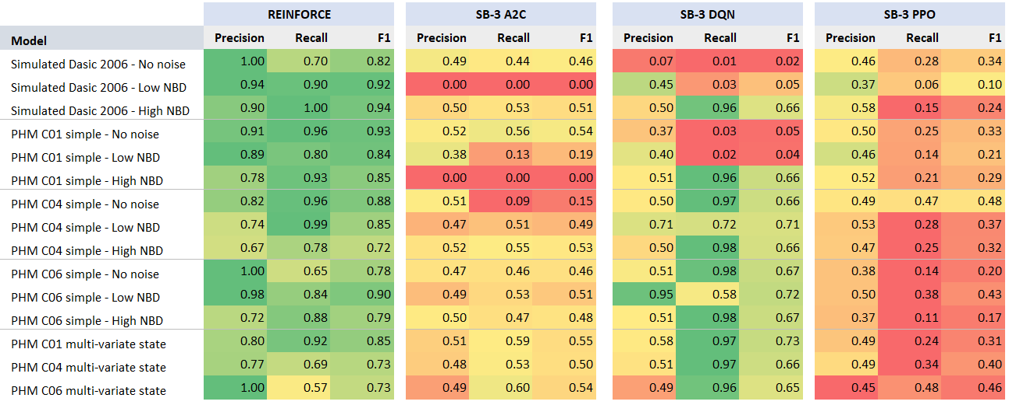
Results: SB-3 (10 K episodes) – single training round
SB-3 algorithms do perform well sometimes (green). On an average their performance is poor (red-orange-yellow).

Slide 25
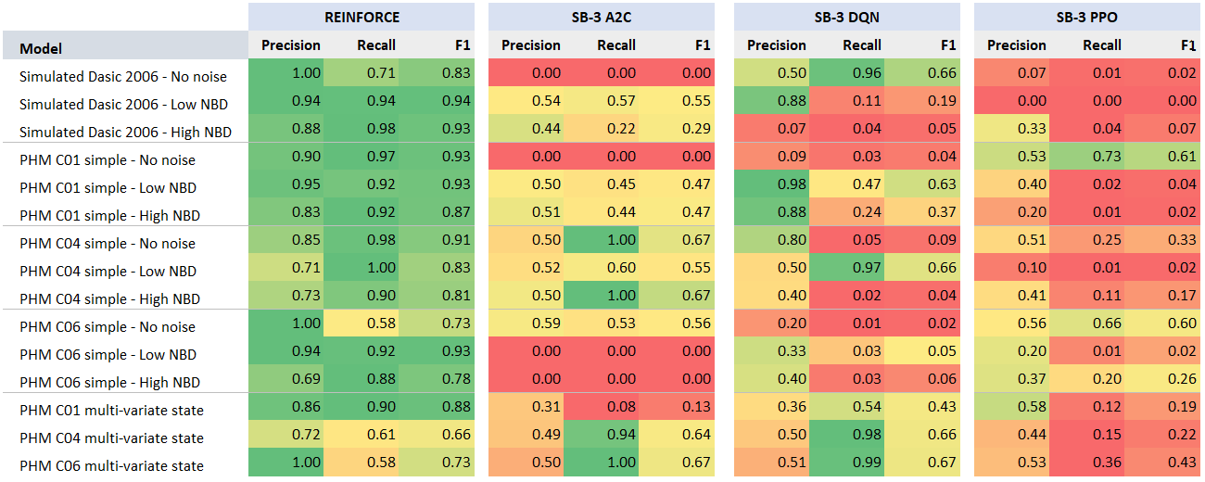
Results: SB-3 (20 K episodes) – single training round
SB-3 algorithms do perform well sometimes (green). On an average their performance is poor (red-orange-yellow).

Slide 26
Thank you

