Slide 1
Experiments with REINFORCE algorithm
Rajesh Siraskar
14-Jun-2023

Slide 2
Agenda
Objective of this presentation
The RL environment
Evaluation strategy
Findings
What could I possibly be doing wrong?
Discussion

Slide 3
Objectives
Research goal*: An optimal predictive maintenance policy for replacement of milling tool
Experiment with the very basic, naïve, REINFORCE algorithm
Implemented from “scratch”
Compare against industry gold-standard Stable-Baselines-3 implementation of DQN, A2C and PPO
REINFORCE trained for 800 episodes, with an inner loop of 300. SB-3 trained with 10,000 episodes
This is a purely experimental (empirical) exercise.
* Note: My “proposal” goal is “Deep RL for predicting RUL”, this is a sub/related goal

Slide 4

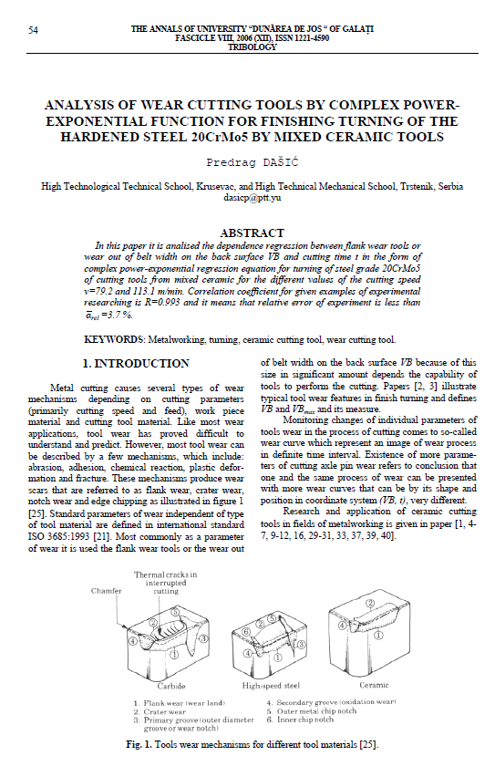

RL environment
Two different sources – simulated and real milling data
 Simulated. Dašić, Predrag (2006): Analysis of wear cutting tools by complex power exponential function for finishing turning of the hardened steel 20CrMo5 by mixed ceramic tools.
 Real data. IEEE – PHM Society

Slide 5
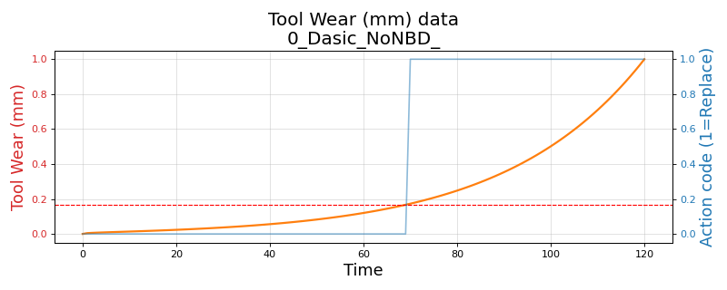
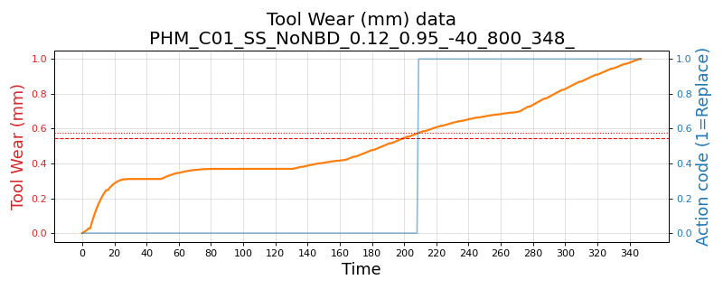
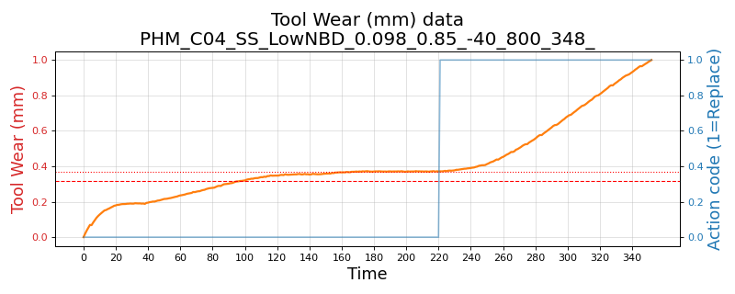
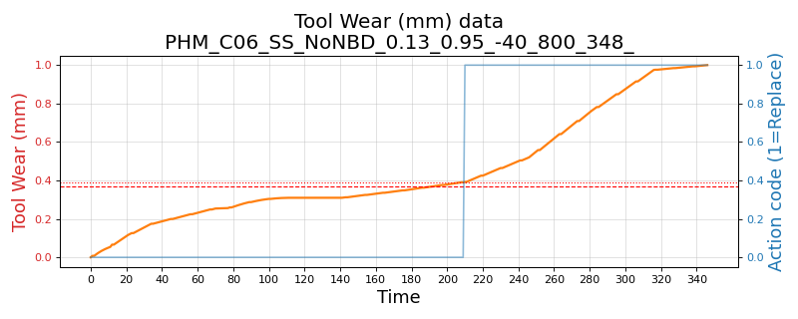
RL environment - Variants
Three environments and their variants:
Simulated. Based on Dašić (2006). Simple single-variate state (tool wear)
Variants: (1) No noise (2) Low noise and low break-down chance and (3) High noise and high break-down chance
PHM 2010 real data – Simple single-variate state (tool wear)
Variants: C-01, C-04 and C-06 data-sets
Variants: (1) No noise (2) Low noise and low break-down chance and (3) High noise and high break-down chance
PHM 2010 real data – Complex multivariate state (tool wear, 3-axis forces, 3-axis vibration and acoustic data)
Variants: C-01, C-04 and C-06 data-sets

Slide 6
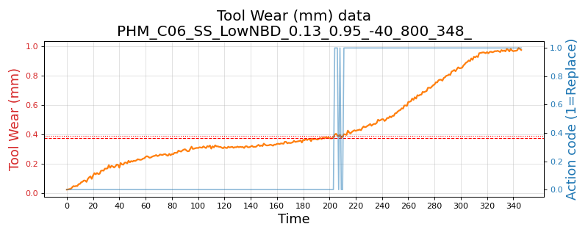
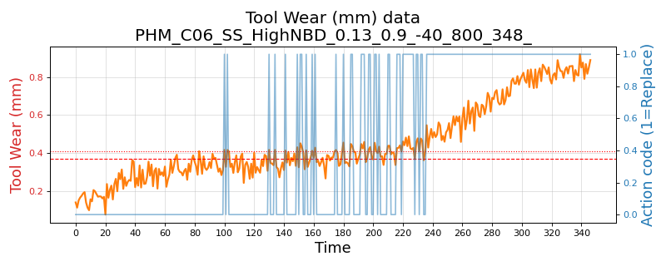
Wear plot - real data and its variants
PHM 2010 C-06 data-set
No noise, no break-down chance
Low noise: 1e-3 and break-down chance 5%
High noise: 1e-2 and break-down chance 10%

Slide 7
Evaluation strategy
RL policy decides when to replace tool
Compare against “human” replacement action
Test from randomly sampled 40 points, 5 rounds
Compute Precision, Recall and F1
Compare mean and std. deviations

Slide 8
Findings
The naïve implementation of REINFORCE algorithm was implemented in PyTorch with an extremely simple architecture: Three layers and ReLU activation and an Adam optimizer.
In training, the SB-3 algorithms were extremely stable, but the F1 performance was always between 0.38-0.67. The naïve REINFORCE, on the other-hand, is unstable in training.
We saved models that performed better than 0.7 and these cases, the REINFORCE performs surprisingly better than DQN, A2C and PPO in all cases
The SB-3 algorithms almost always perform at about F1 0.47-0.50
REINFORCE performed between 0.72 (for complex real data environment) to 0.89 (for simulated environment)
Across precision, recall and F1; REINFORCE was better than the best performing SB-3 algorithm by 0.252 basis-points. The difference¹ in variance (σ²) was also lower, though near negligible, for REINFORCE at -0.0003
Across precision on tool replacement, REINFORCE was better by 0.354, a lower variance of -0.004
w.r.t. lowest of SB-3 algorithms
Reference data-sheet: “1. Analysis_model_performance_summary_V3 (PPT ref.).xls”

Slide 9
Results: Overall – all environments and their variants
 | Precision |  | Recall |  | F1-score
Algorithm | Mean | Std.Dev | Mean | Std.Dev | Mean | Std.Dev
A2C | 0.431 | 0.090 | 0.397 | 0.065 | 0.383 | 0.059
DQN | 0.475 | 0.175 | 0.657 | 0.030 | 0.471 | 0.029
PPO | 0.504 | 0.121 | 0.391 | 0.066 | 0.402 | 0.070
REINFORCE | 0.861 | 0.039 | 0.843 | 0.051 | 0.836 | 0.041

Slide 10
Results: Simple single variate state. Including noise variants
Simulated – Dašić, Predrag (2006).
 | Precision |  | Recall |  | F1-score
Algorithm | Mean | Std.Dev | Mean | Std.Dev | Mean | Std.Dev
A2C | 0.292 | 0.041 | 0.083 | 0.024 | 0.128 | 0.030
DQN | 0.517 | 0.012 | 0.963 | 0.032 | 0.673 | 0.015
PPO | 0.478 | 0.244 | 0.093 | 0.048 | 0.150 | 0.074
REINFORCE | 0.928 | 0.032 | 0.883 | 0.041 | 0.895 | 0.039
PHM 2010: Single-variate environment, across three data sets C-01, C-04 and C-06
 | Precision |  | Recall |  | F1-score
Algorithm | Mean | Std.Dev | Mean | Std.Dev | Mean | Std.Dev
A2C | 0.459 | 0.115 | 0.422 | 0.077 | 0.417 | 0.067
DQN | 0.486 | 0.236 | 0.559 | 0.029 | 0.413 | 0.035
PPO | 0.502 | 0.094 | 0.479 | 0.071 | 0.467 | 0.073
REINFORCE | 0.845 | 0.040 | 0.892 | 0.051 | 0.855 | 0.038

Slide 11
Results: Complex, multi-variate environment
PHM 2010: Complex, multi-variate environment, across three data sets C-01, C-04 and C-06
No noise or break-down
 | Precision |  | Recall |  | F1-score
Algorithm | Mean | Std.Dev | Mean | Std.Dev | Mean | Std.Dev
A2C | 0.485 | 0.067 | 0.637 | 0.072 | 0.534 | 0.065
DQN | 0.398 | 0.156 | 0.647 | 0.031 | 0.444 | 0.025
PPO | 0.537 | 0.080 | 0.423 | 0.068 | 0.458 | 0.055
REINFORCE | 0.842 | 0.040 | 0.657 | 0.062 | 0.721 | 0.052

Slide 12
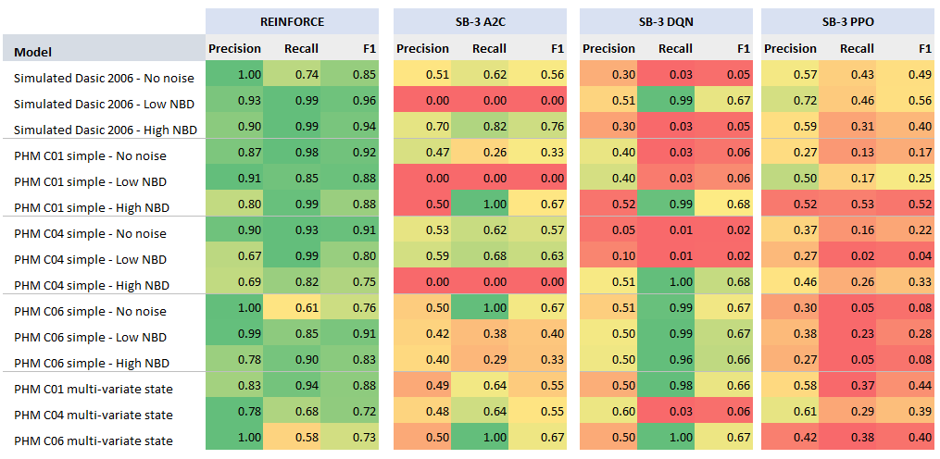
Results Summary (13-Jun-2023 run)

Slide 13
Training time: Avg. over different variants
Average training time in secs.
Variant | A2C | DQN | PPO | REINFORCE
Dasic 2006 Simulated - Single variate state | 33.53 | 3.04 | 34.23 | 182.76
PHM-2010 Real data - Single variate state | 21.53 | 2.37 | 24.27 | 313.99
PHM-2010 Real data - Multi-variate state | 37.23 | 6.06 | 42.46 | 632.05
Overall average | 27.07 | 3.24 | 29.90 | 351.36
Average training time per 1,000 time-steps, in secs. Stable-baseline algorithms are trained for 10,000 time-steps, while REINFORCE uses 96,800 for simulated and 278,400 for PHM based environments
Variant | A2C | DQN | PPO | REINFORCE
Dasic 2006 Simulated - Single variate state | 3.35 | 0.30 | 3.42 | 1.89
PHM-2010 Real data - Single variate state | 2.15 | 0.24 | 2.43 | 1.13
PHM-2010 Real data - Multi-variate state | 3.72 | 0.61 | 4.25 | 2.27
Overall average | 9.23 | 1.15 | 10.10 | 1.73

Slide 14
Some plots

Slide 15
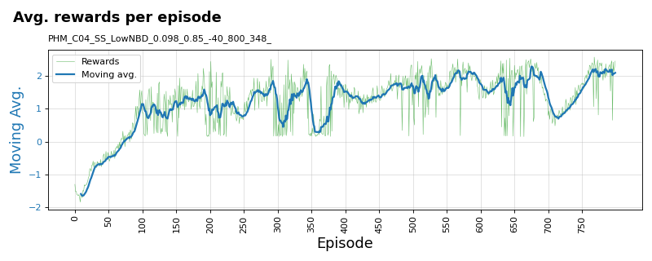
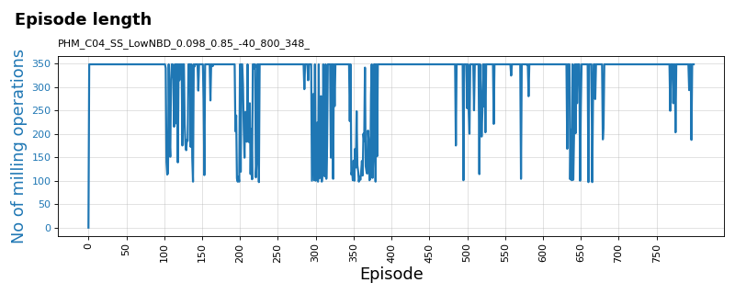
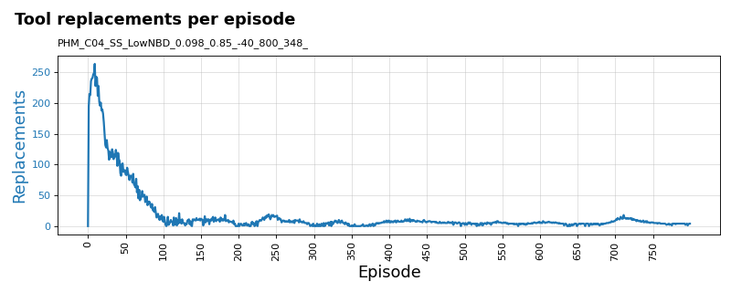
Training plots for REINFORCE algorithm
PHM 2010 C-04 data-set: Variant: Single-state tool-wear with low noise (1e-3) and low break-down chance (5%)

Slide 16
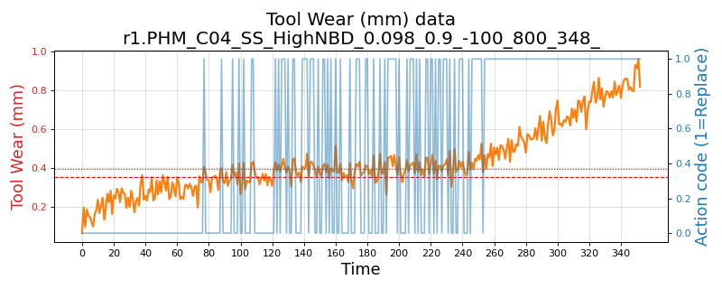
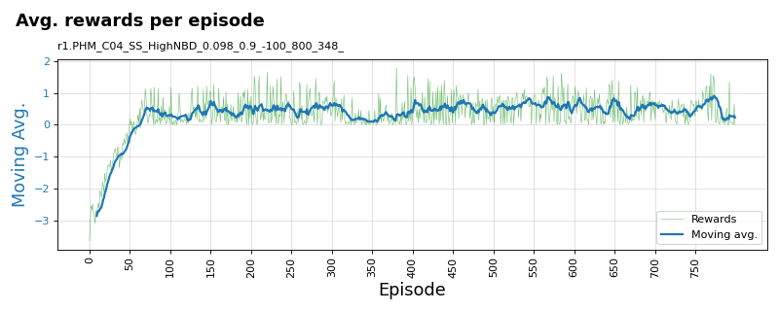
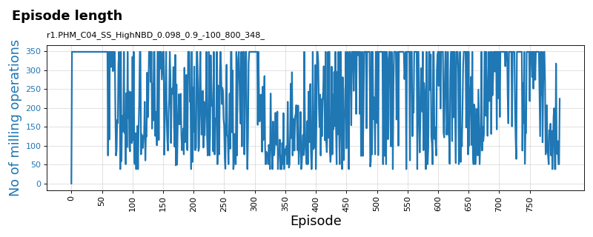
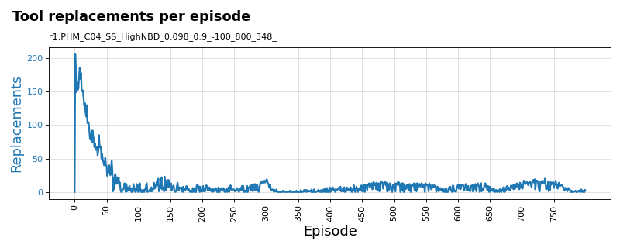
Training plots for REINFORCE algorithm
PHM 2010 C-04 data-set: Variant: Single-state tool-wear with high noise (1e-2) and low break-down chance (10%)

Slide 17
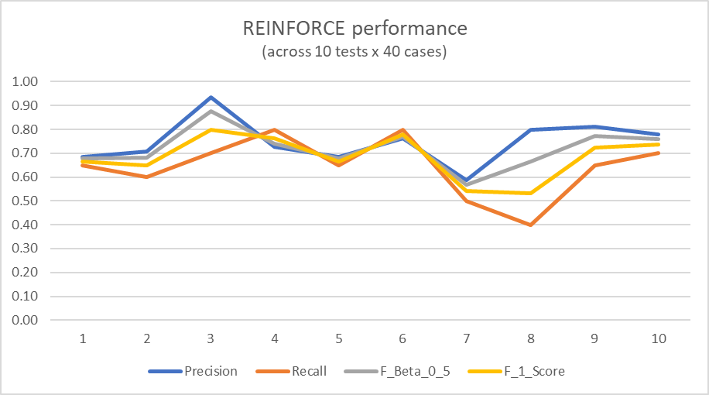
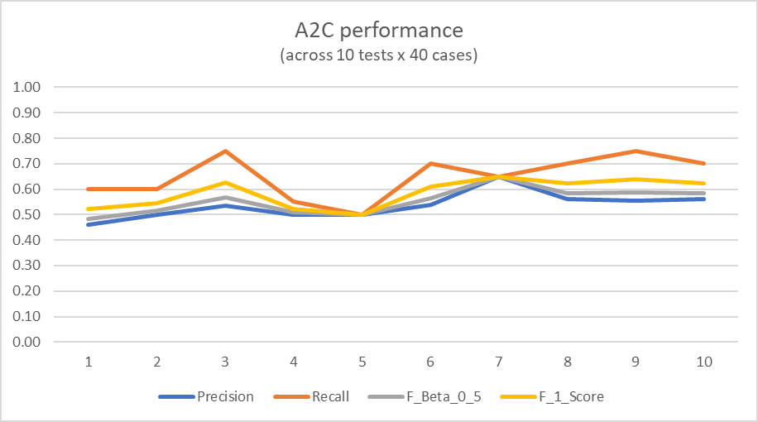
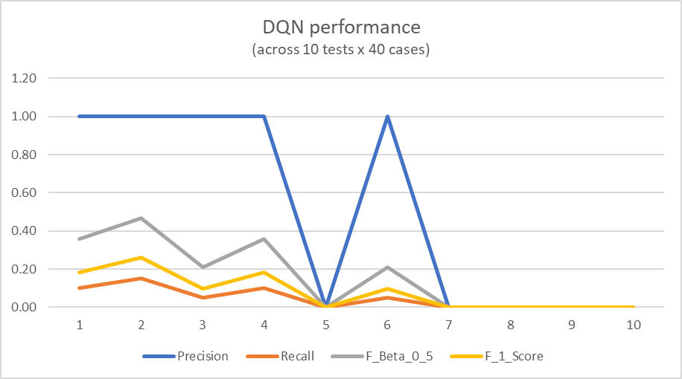
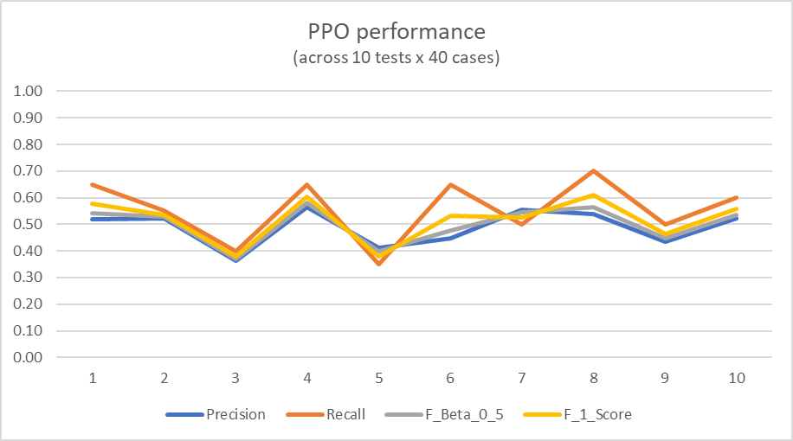
Sample test plots for algorithms
PHM C-04 data-set: Variant: Multi-variant state with no noise or break-down chance

Slide 18
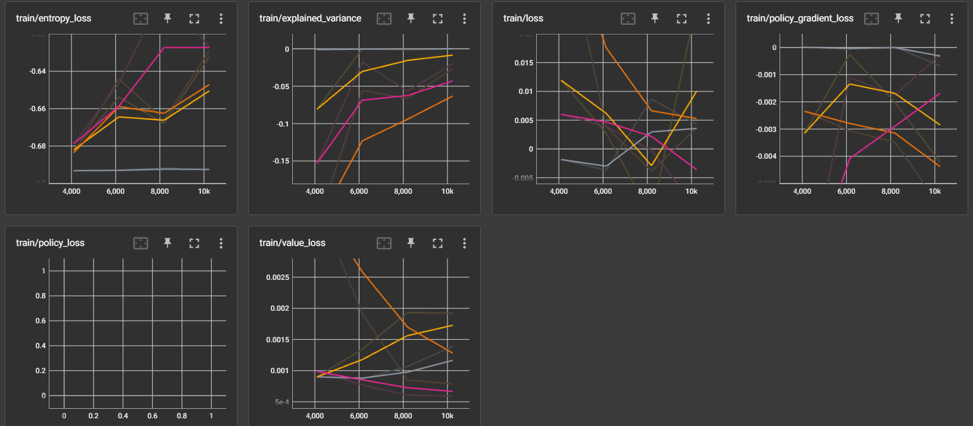
Tensorboard plots for SB-3 algorithms - PPO

Slide 19
SB-3 stability doubts

Slide 20
SB-3 stability issue?
Earlier runs with same episodes = 800
But REINFORCE has an internal loop of 348
Increased SB-3 algo runs to 10,000, then 800 x 348 then 20,000
Re-installed SB-3 and upgraded the version
Tested on cart-pole and mountain-car environment
Re-trained SB-3 models and re-ran experiments for 10,000 and 20,000 episodes– see next slide

Slide 21
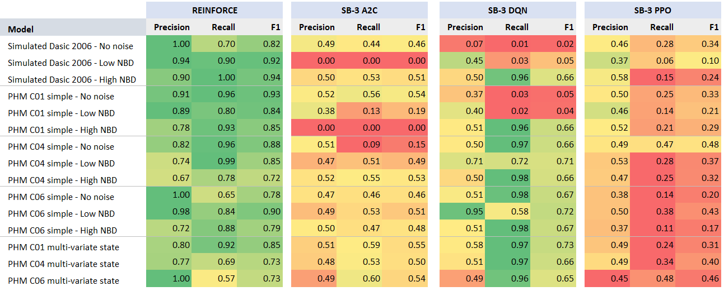
Results: SB-3 (10 K episodes)
SB-3 algorithms do perform well sometimes (green). On an average their performance is poor (red-orange-yellow).

Slide 22
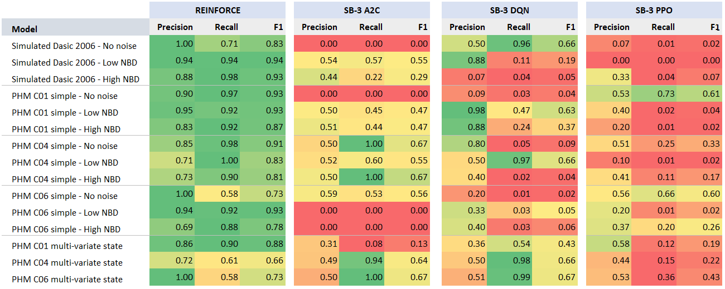
Results: SB-3 (20 K episodes)
SB-3 algorithms do perform well sometimes (green). On an average their performance is poor (red-orange-yellow).

Slide 23
Thank you

Slide 24
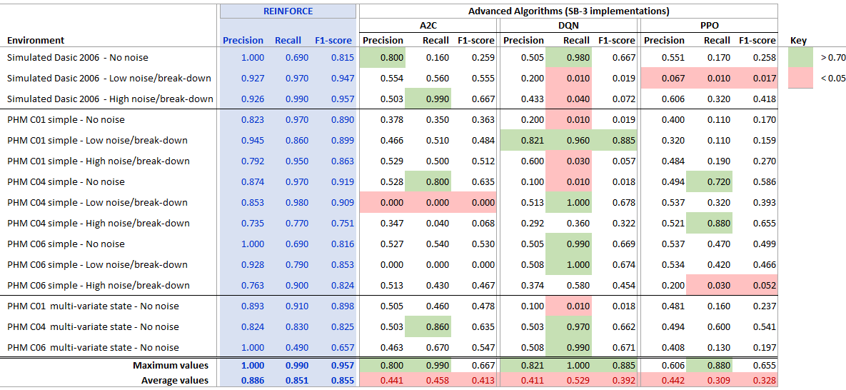
Results: SB-3 (10 K episodes)

