Slide 1
Matrix Hackathon Team Maverick
Unmasking Phishing URLs : A Machine
Learning Approach

Slide 2
Introduction
Phishing is a type of cyber attack where attackers use social engineering tactics to trick users into divulging sensitive information such as passwords, credit card numbers, and other personal data.
Phishing attacks are becoming more sophisticated, with attackers using advanced techniques to create realistic-looking websites that mimic legitimate ones.

Slide 3
Support Vector Machine
Support Vector Machines (SVMs) are a type of machine learning algorithm that can be used for classification tasks. They work by finding the best hyperplane that separates different classes of data points.
SVMs have several advantages over other machine learning algorithms, including their ability to handle high-dimensional data and their ability to find non-linear decision boundaries.

Slide 4
Feature Extraction
This involves identifying the most relevant features of a URL that can be used to distinguish between phishing and non-phishing URLs.
IP Address
Length of URL
Short URL service
‘@’ symbol
Double slash Redirection
Prefix Suffix
Subdomains
Response
Domain Registration Length
Favicon Icon
Port
HTTPS token
Request URL
Google Index
Fraud IP
Links in tags
Number of link
Submitting to email
Page Rank
Abnormal URL
On mouseover
Right click
Popup Window
Iframe
Age of Domain

Slide 5
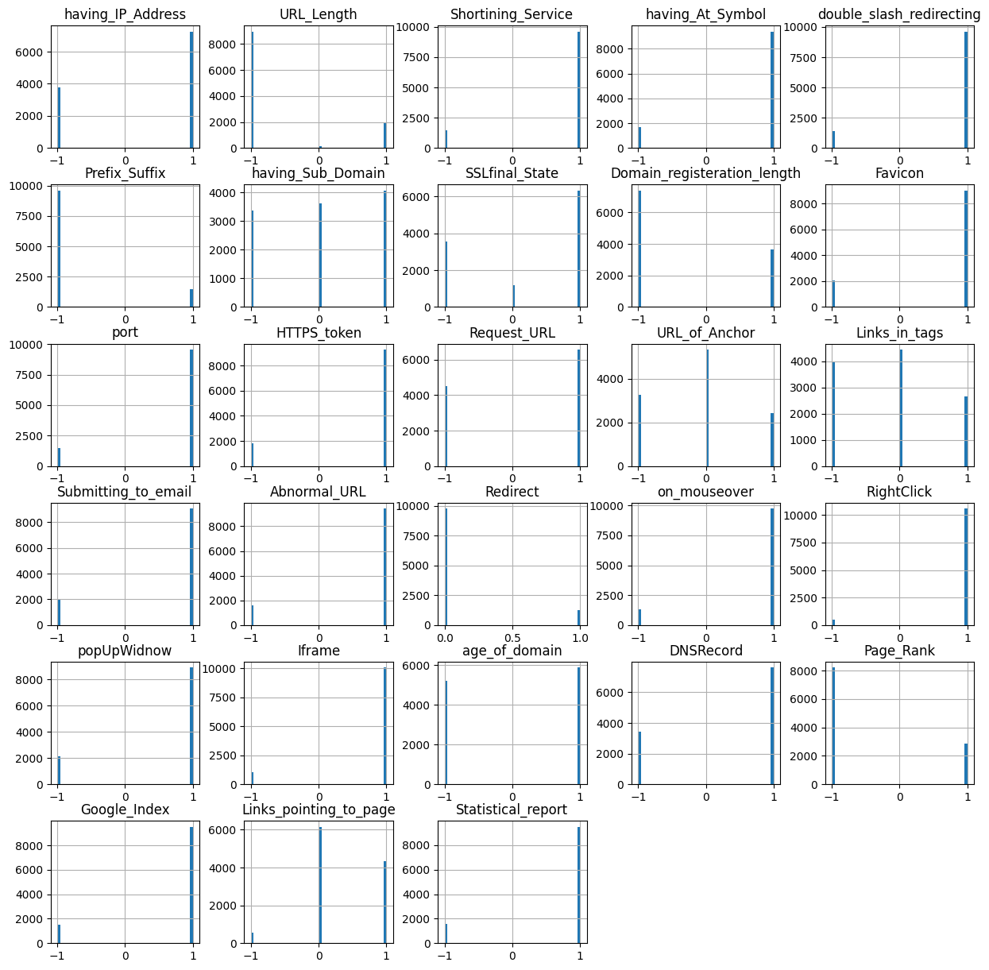
Dataset

Slide 6
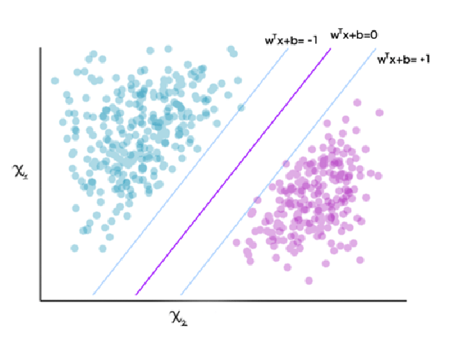
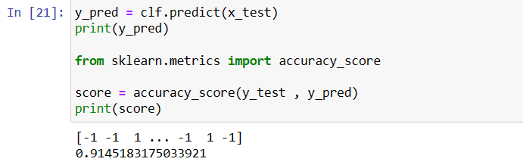
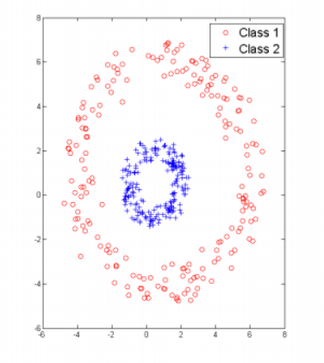
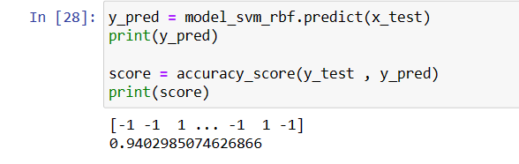
SVM Kernal
Linear kernel
RBF Kernel

Slide 7
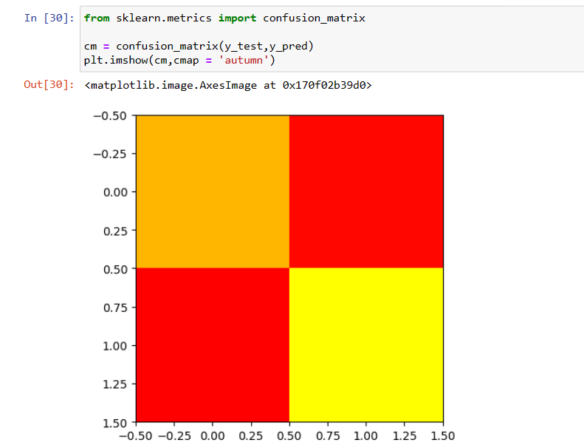
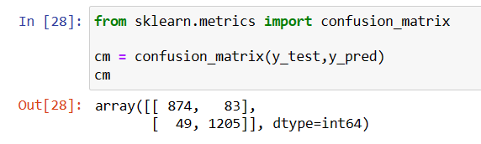
Confusion Matrix
20 % of data is used for Validation and 80 % of data is used for Training the model.

Slide 8

Application
Prevents users from losing their credentials.
Creates awareness on effects of phishing.
Can be implemented for filtration
Integrated with browser to avoid access to phishing links.
Supervised machine Learning Approach can be implemented to make the model learn from new data.

Slide 9
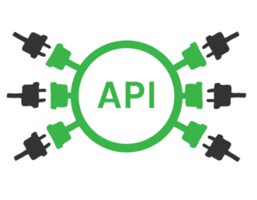

Future plan
Provided this service as an API
Browser extensions

