Slide 1
Supervising
Supervised Algorithms
-Prudhvi

Slide 2
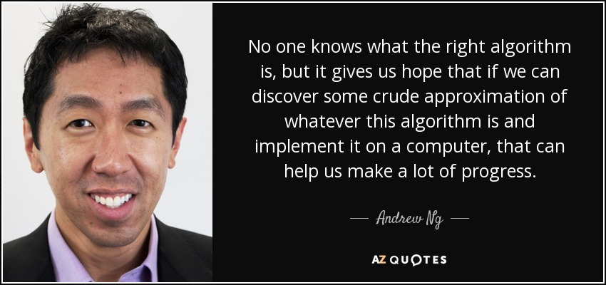

Slide 3
Regression Algorithms
(regression analysis estimates the relationship between two or more variables. )

Slide 4
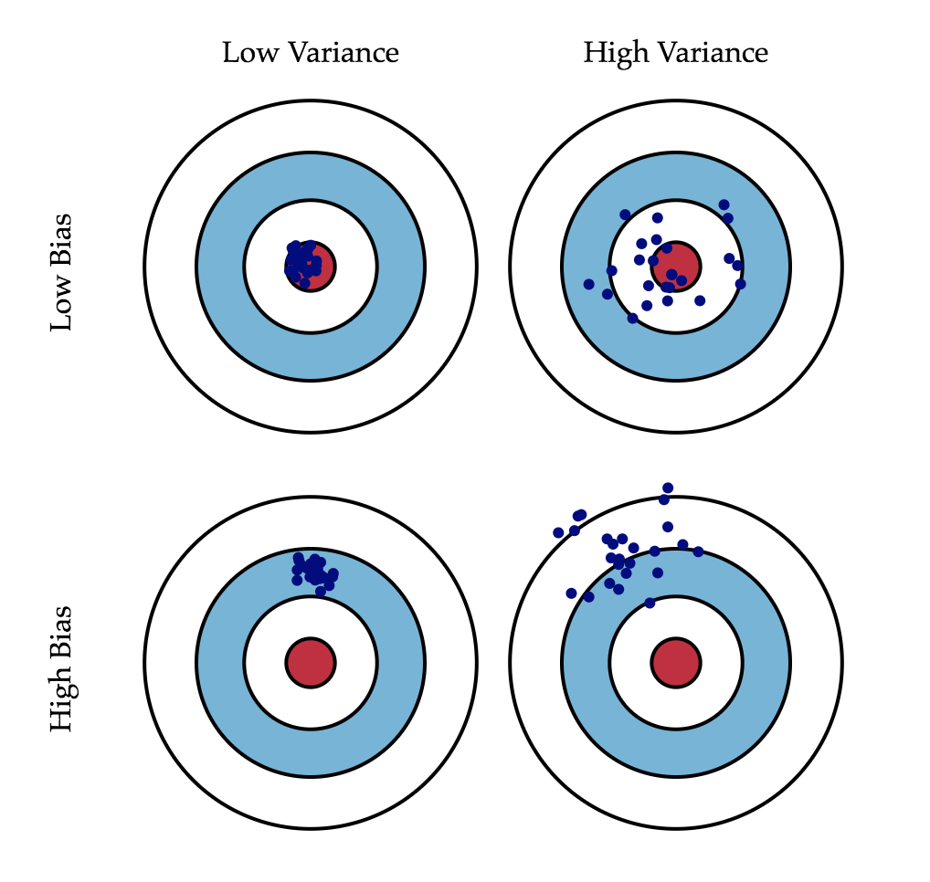
Bias and Variance

Slide 5
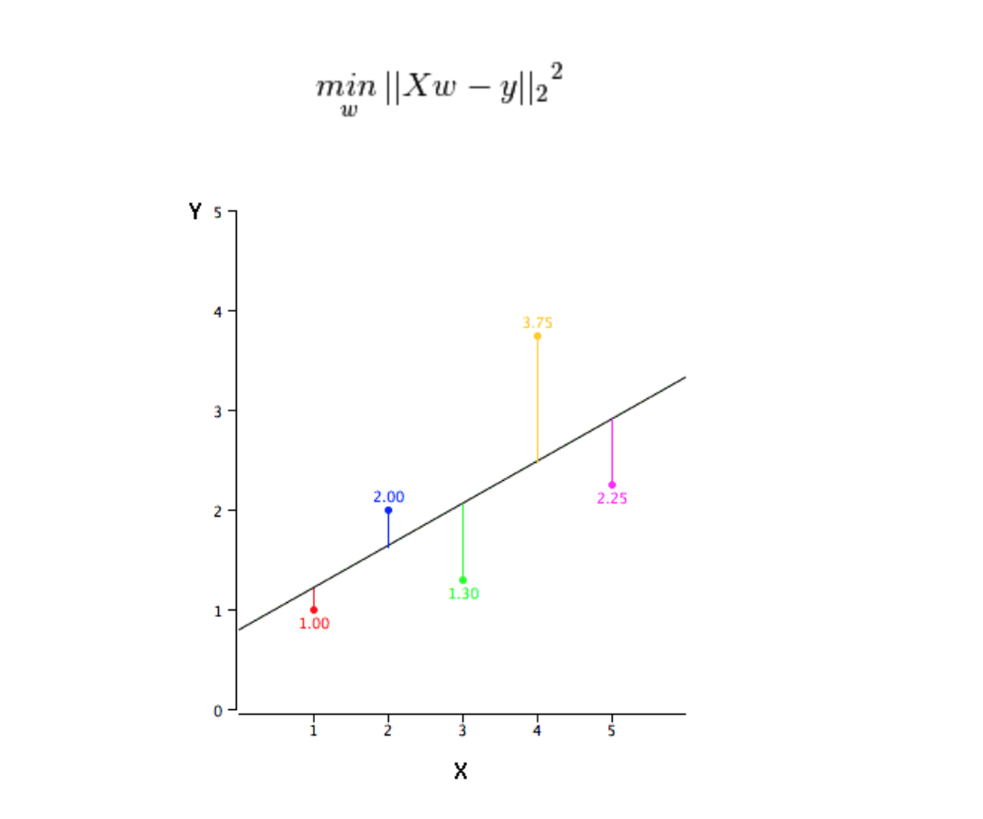
Linear Regression:
In this technique, the dependent variable is continuous, independent variables can be continuous or discrete, and nature of regression line is linear.
Linear Regression establishes a relationship between dependent variable (Y) and one or more independent variables (X) using a best fit straight line (also known as regression line).
Equation ( Y = W*X+b) [Y=dependent X=independent, b = bias]
The difference between simple linear regression and multiple linear regression is that, multiple linear regression has (>1) independent variables, whereas simple linear regression has only 1 independent variable.
We obtain the best fit by least squares method

Slide 6
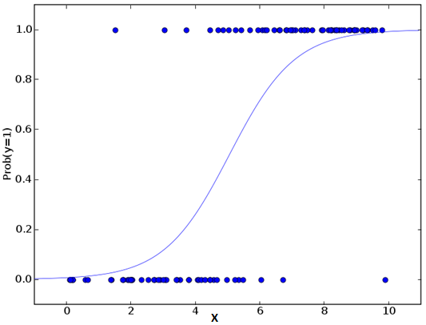
Logistic Regression:
We should use logistic regression when the dependent variable is binary (0/ 1, True/ False, Yes/ No) in nature. Here the value of Y ranges from 0 to 1 and it can represented by following equation.
Simply it can be defined as applying sigmoid function to linear regression.
Y = sigmoid(A.X+b)
Logistic regression doesn’t require linear relationship between dependent and independent variables. It can handle various types of relationships because it applies a non-linear log transformation to the predicted odds ratio
The independent variables should not be correlated with each other i.e. no multi collinearity.

Slide 7
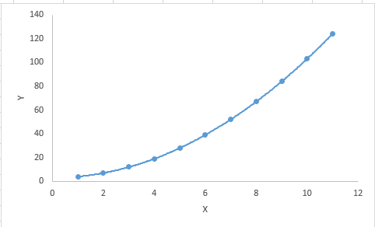
Polynomial Regression
A regression equation is a polynomial regression equation if the power of independent variable is more than 1.
Think of it in terms of features like area (length*width)
Y = a+b*x^2
We should be careful that higher polynomial might fit our data but it might lead to overfitting
Always plot and see the better fit

Slide 8
Stepwise Regression
This is considered when we deal with multiple independent variables.
In this technique, the selection of independent variables is done with the help of an automatic process, which involves no human intervention.
Stepwise regression basically fits the regression model by adding/dropping covariates one at a time based on a specified criterion.
Standard stepwise regression does two things. It adds and removes predictors as needed for each step.
Forward selection starts with most significant predictor in the model and adds variable for each step.
Backward elimination starts with all predictors in the model and removes the least significant variable for each step.
Good while handling higher dimensionality datasets

Slide 9
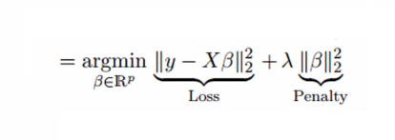
Ridge Regression:
Ridge Regression is a technique used when the data suffers from multicollinearity ( independent variables are highly correlated).
y=a+y= a+ b1x1+ b2x2+....+e, for multiple independent variables.
Multicollinearity increases the variance so we solve the prediction error of variance by introducing a shrinkage parameter lambda using this method.
L2 regularization is used
It shrinks the value of coefficients but doesn’t reaches zero, which suggests no feature selection feature

Slide 10
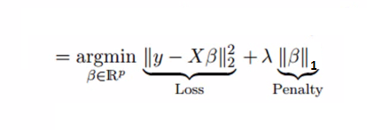
Lasso Regression:
Similar to Ridge Regression, Lasso (Least Absolute Shrinkage and Selection Operator) also penalizes the absolute size of the regression coefficients. In addition, it is capable of reducing the variability and improving the accuracy of linear regression models.
uses absolute values in the penalty function, instead of squares like in ridge (L1 Regularization)
It shrinks coefficients to zero (exactly zero), which certainly helps in feature selection
If group of predictors are highly correlated, lasso picks only one of them and shrinks the others to zero

Slide 11

ElasticNet Regression:
ElasticNet is hybrid of Lasso and Ridge Regression techniques. It is trained with L1 and L2 prior as regularizer. Elastic-net is useful when there are multiple features which are correlated. Lasso is likely to pick one of these at random, while elastic-net is likely to pick both
It encourages group effect in case of highly correlated variables
There are no limitations on the number of selected variables
It can suffer with double shrinkage

Slide 12
Classification
classification task is to find a functional mapping between the input data X, describing the input pattern, to a class label Y (e.g. −1 or +1), such that Y = f(X).

Slide 13
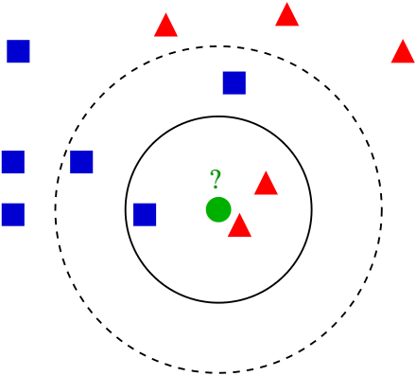
k-Nearest Neighbor
Here the k points of the training data closest to the test point are found, and a label is given to the test point by a majority vote between the k points.
This method is highly intuitive and attains – given its simplicity – remarkably low classification errors, but it is computationally expensive and requires a large memory to store the training data.

Slide 14
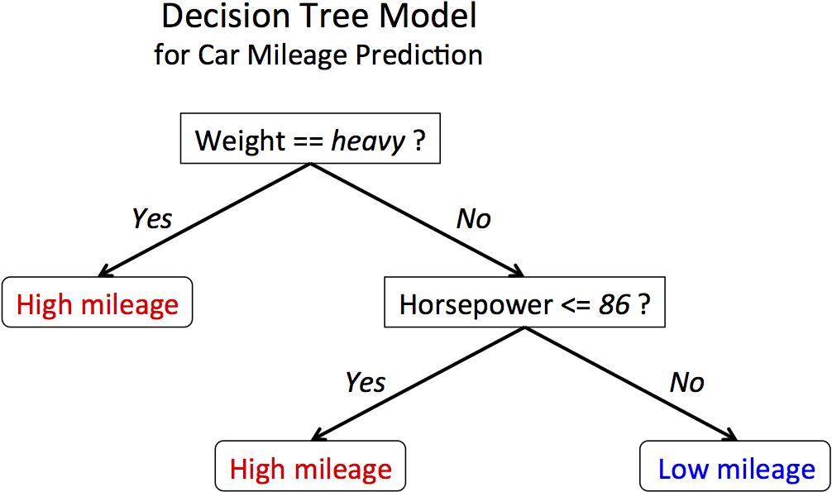
Decision Trees
Another intuitive class of classification algorithms are decision trees. These algorithms solve the classification problem by repeatedly partitioning the input space, so as to build a tree whose nodes are as pure as possible (that is, they contain points of a single class).
Classification of a new test point is achieved by moving from top to bottom along the branches of the tree, start- ing from the root node, until a terminal node is reached.
Decision trees are simple yet effective classification schemes for small datasets.
The computational complexity scales unfavorably with the number of dimensions of the data. Large datasets tend to result in complicated trees, which in turn require a large memory for storage.

Slide 15
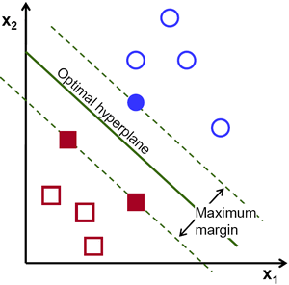
Support Vector Machines
They work by mapping the training data into a feature space by the aid of a so-called kernel function and then separating the data using a large margin hyperplane.
Intuitively, the kernel computes a similarity between two given examples. Most commonly used kernel functions are RBF kernels ′ and polynomial kernels.
The SVM finds a large margin separation between the training examples and previously unseen examples will often be close to the training examples.
Hence, the large margin then ensures that these examples are correctly classified as well, i.e., the decision rule generalizes.
SVMs have an interpretation as a hyperplane separation in a high dimensional feature space.
Support Vector Machines have been used on million dimensional data sets.

Slide 16
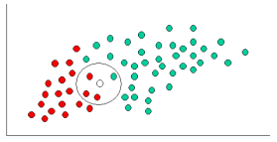
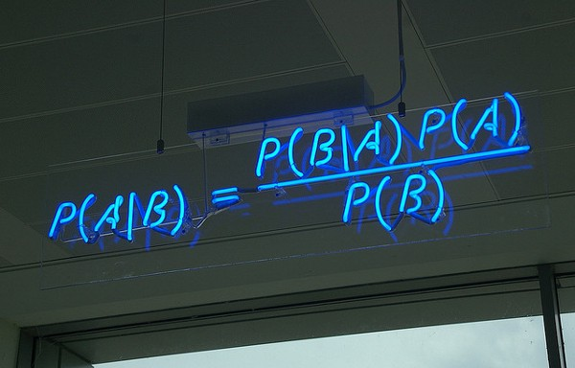
Naive Bayes:
Naive Bayes classifiers are a family of simple probabilistic classifiers based on applying Bayes’ theorem with strong (naive) independence assumptions between the features.
with P(A|B) is posterior probability, P(B|A) is likelihood, P(A) is class prior probability, and P(B) is predictor prior probability.
Useful when we we have high dimensions

Slide 17


Slide 18
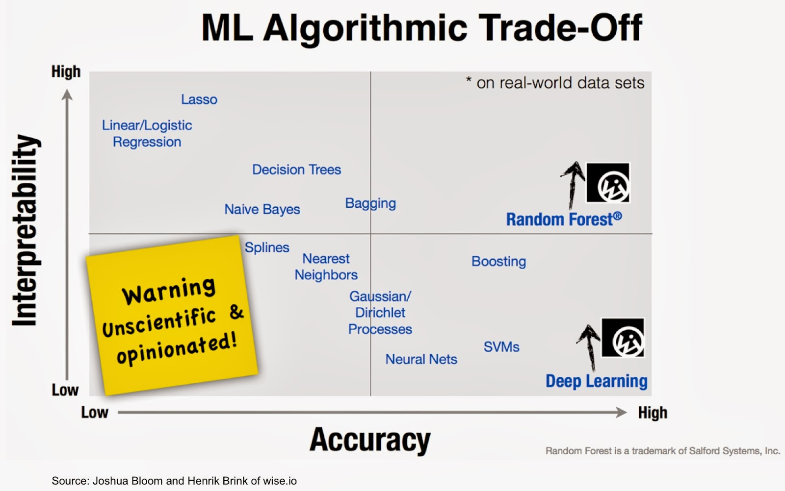

Slide 19
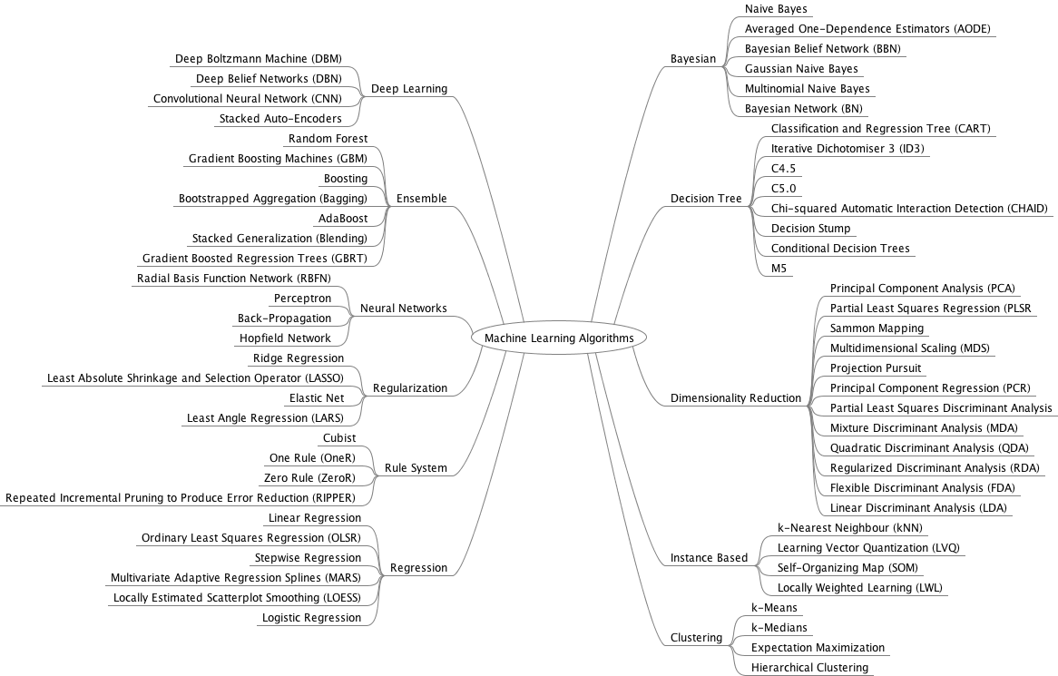

Slide 20
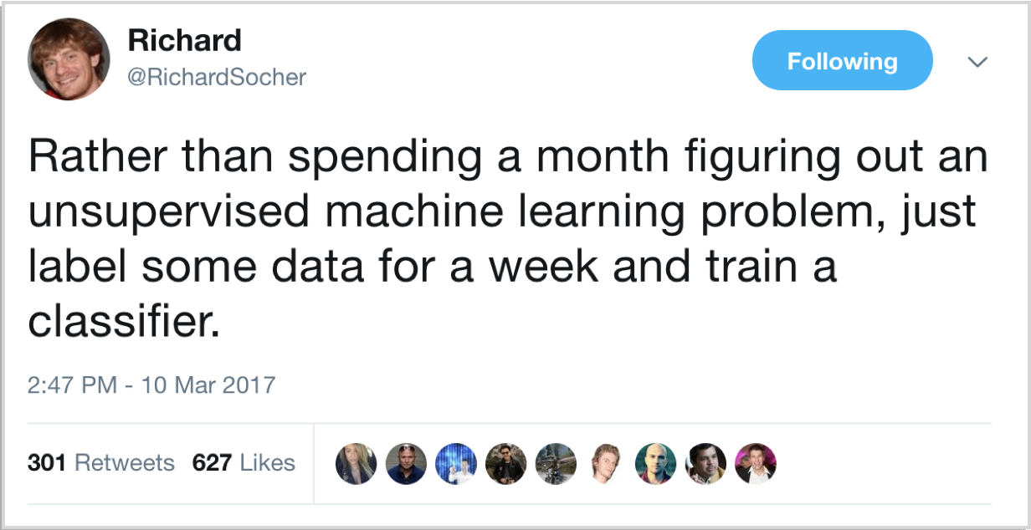
Just for fun

Slide 21
Thank you :)

