Slide 1
ORACLE PL/SQL
PL/SQL Basic Blocks
LEVEL – LEARNER

Slide 2








Icon Used
Hands on Exercise
Reference
Questions
Points To Ponder
Coding Standards
Lend A Hand
Summary
Test Your Understanding

Slide 3

Overview
PL/SQL Basic Blocks session provides knowledge and understanding of the use of PL/SQL Blocks in Oracle 10G and finally apply the syntax learned as part of this session in a case study provided.

Slide 4

Objective
To understand the PL/SQL Fundamental concepts that a developer needs to know to work with it.
PL/SQL and its advantages
PL/SQL Architecture.
PL/SQL Block Structure.
Fundamentals of PL/SQL Language
How to Execute a PL/SQL Block?

Slide 5
Scenario
For complete understanding of ANSI SQL we are going to make use of Product Management System (PMS) for ABC Traders.
ABC Traders is a company which buys collectable model cars, trains, trucks, buses, trains and ships directly from manufacturers and sells them to distributors across the globe. In order to manage the stocking, supply and payment transactions the above software is developed.
As per the requirement of the trading company a inventory system is developed to collect the information of products and customers and their payment processing.

Slide 6
Database tables
There are many entities involved in Product Management System. PMS as given below which we will be dealing with throughout this course
Offices
To maintain information of Offices e.g. Office code, address, city etc.
Customer
To maintain customer details e.g. Customer Name, address
Employees
To maintain employee
details e.g. id,
Name etc.
Products
To maintain information of products e.g. product id, name etc.
Payments
To maintain information of payments done e.g. payment date, amount etc.
Orders
To maintain Orders done by customers e.g. order no ,date etc.
OrderDetails
To maintain Orders done by customers e.g. order no ,date etc.

Slide 7
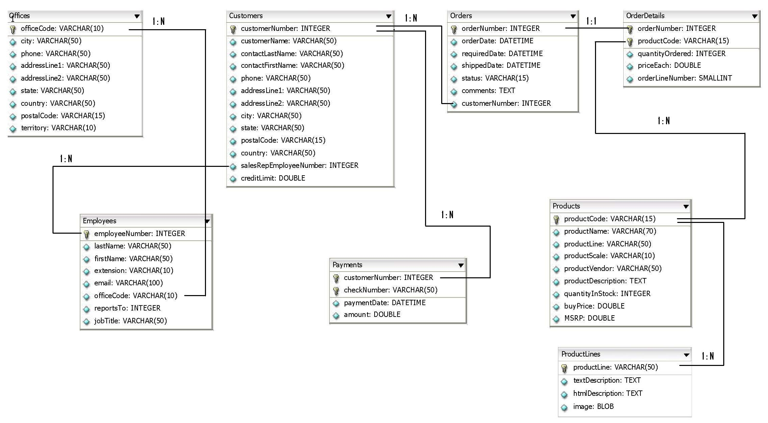
Schema diagram
Notes:
Trainer Note:
You can use a computer to type documents, send email, and browse the internet.
You can also use it to handle spreadsheets, accounting, database management, presentations, games, and more.
Software
Set of instructions for the hardware to accomplish a task.
List down any ten hardware parts of computer.
List down any five storage devices.
List down any five input devices.
What is the device which converts picture on a paper to an electronic image in computer ?

Slide 8

PL SQL Fundamentals
Hi!
I want to calculate final buy price for all the products i.e. 5% discount on its MSRP. If final buy price is greater than old buy price then use old buy price as final buy price. I Solved using Java program which iterated through all the million products stored in the database and calculated the final buy price for products. It took more than three hours for the batch process to run as it needs to access the database for each product. I want the process to complete in 30 minutes
We need to redevelop the batch process using Oracle stored procedure.
It will run within the database engine, data access/updates will be very fast. Batch process will complete the data access/update of million records in 30 minutes.
Lets learn about Oracle PL/SQL which will help up to meet TIM’s requirements.

Slide 9

Do you Know
What is PL/SQL
?

Slide 10
Introduction to PL/SQL
What is PL/SQL?
PL stands for “Procedural Language” and PL/SQL is the procedural extension to SQL with design features of any programming language.
Few details about PL/SQL:
PL/SQL allows to mix SQL statements with Procedural Statements like IF statement, Looping structures etc.
PL/SQL allows DDL,DML,DQL,TCL and DCL Statements of SQL to be part of the block structured unit of codes making PL/SQL a powerful transaction processing language.
DDL
DML
DQL
Loops, IF etc.
Can Contain
PL/SQL

Slide 11
Introduction to PL/SQL (Cont)
PL/SQL extends SQL by adding constructs found in other procedural languages like
Defining variables and types
Using control structures (IF-THEN-ELSE)
Defining procedures and functions
Defining Object types
Notes:
Arithmetic operators Cont..
When the declared type of either operand of an arithmetic operator is approximate numeric, the declared type of the result is an implementation-defined approximate numeric type.
The monadic arithmetic operators <plus sign> and <minus sign> (+ and –, respectively) specify monadic plus and monadic minus, respectively.
Monadic plus does not change its operand. Monadic minus reverses the sign of its operand.
The dyadic arithmetic operators <plus sign>, <minus sign>, <asterisk>, and <solidus> (+, –, *, and /, respectively) specify addition, subtraction, multiplication, and division, respectively. If the value of a divisor is zero, then an exception condition is raised: data exception — division by zero.
If the operator is not division and the mathematical result of the operation is not exactly representable with the precision and scale of the result data type, then an exception condition is raised: data exception— numeric value out of range.

Slide 12
Advantages of PL/SQL
These are the advantages of PL/SQL,
Reusable - Block Structures: PL/SQL consists of blocks of code. Each block contains SQL statements which forms a unit of a task or a logical module. PL/SQL Blocks can be stored in the database and reused.
Easy to develop - Procedural Language Capability: PL/SQL uses procedural language constructs such as conditional statements (if else statements) and loops like (FOR loops).
Better Performance: PL SQL engine processes multiple SQL statements simultaneously as a single block within the database engine, thereby reducing network traffic. Also, the set of instructions are stored as database objects in a compiled form, thus improving performance.
Easy Error Handling: Easy to handle exceptions, PL/SQL handles errors or exceptions effectively during the execution of a PL/SQL program.

Slide 13
How PL/SQL runs?
Assume there is a procedure “generate_Invoice” in oracle database. Lets look at the illustration how it executes?
Oracle Server
3. PL/SQL engine executes the procedural statement.
PL/SQL Engine
1. Client Executes the procedure
2. PL/SQL engine loads procedure in SGA.
SGA
Procedural statement Executor`
Database Clients
generate_Invoice
Begin…
……
END
4. SQL executor executes SQL statement in the procedure.
SQL
PL/SQL Executor

Slide 14
PL/SQL Block Structure
PL/SQL code structure is built using basic elements called blocks.
Syntax:
DECLARE
/*Declarative Section -PL/SQL variables,
cursors and types */
BEGIN
/* Executable section -procedural and SQL
statements */
EXCEPTION
/* Exception handling section -error handling
statements */
END;
Declarative block
Executable block
Exception block

Slide 15
PL SQL Block Structure
Section | Description | Inclusion
Declarative | Declaration of variables ,constants, cursors and user defined exceptions that are referenced in the executable is declared in this block. | Optional
Executable | Contains procedural and SQL statements which is the core logic of any procedure. Example: Late charge calculation will be developed inside this block. | Mandatory
Exception Handling | Used for handling errors under abnormal conditions arising in the executable section. | Optional
Some important points:
1.It is mandatory to give “End” at the end of executable block.
2.In the presence of exception block “End” comes after the exception block.

Slide 16
PL/SQL Block Structure Example
PL SQL Block
DECLARE
v_variable VARCHAR2(5);
My_Exception Exception;
Declaration Section
BEGIN
SELECT column_name INTO v_variable FROM table_name;
…………
END;
Execution Section
EXCEPTION
WHEN My_Exception THEN
...
END;
Exception Section

Slide 17
Executable block
Displaying Output from PL/SQL:
In order to display output from a PL/SQL block, use DBMS_OUTPUT .PUT_LINE Statement.
Example:
DBMS_OUTPUT.PUT_LINE(‘The employee Name is’ || v_Employee_Name);

Slide 18

Types of PL/SQL Block
Hi Buddy!
Can you explain in detail the appropriate types of PL/SQL blocks usage in an application?
Sure! Let us take the example of Online Banking System with use cases defined below:
Application Error should be raised on the fund transactions done on national holidays
Account Balance should be provided on the receipt of Account Number
Summary of Accounts should be provided inclusive of Deposits, Loans, Account Balances when login into the application.
Can u try to match the types of PL/SQL blocks which can be appropriate to the above use cases 1,2,3?

Slide 19

Types of PL/SQL Block
Let me try the appropriate matches for the use cases
Use case 1 - Anonymous Block
Use case 2 – Functions
Use case 3 – Stored Procedures
Yes Absolutely!
For raising application error on national holidays a trigger can be written with the anonymous PL/SQL block
A Named Function can be written to return the account balance on the receipt of Account Number
A Named stored procedure can be written to provide the summary of accounts

Slide 20
Types of PL/SQL Block
Types of PL/SQL blocks
Anonymous Blocks
Named Blocks
An Anonymous Blocks (Procedure) is an unnamed block. It is placed where it is to be run, normally attached to a database trigger or application event.
A Named block can be a named Procedure or Function
Declare
/* variables*/
Begin
/*SQL statements */
Exception
/* Error handling */
End;
Create or Replace Procedure Validate_Date AS
/* variables*/
Begin
/*SQL statements */
Exception
/* Error handling */
End Validate_Date;

Slide 21
Fundamentals of PL/SQL Language
The PL/SQL Character Set
A PL/SQL block/program consists of a sequence of statements and each Statements are made up of one or more of the following characters.
Type | Character Set
Letters | A-Z, a-z
Digits | 0-9
Symbols | ~ ! @ # $ % & * ( ) _ - + = | [ ] { } : ; " ' < > , . ? /
Whitespace | Tab, space, carriage return
Note: PL/SQL is a case-insensitive language that is “varchar2” and “VARCHAR2 “ are same.

Slide 22
PL/SQL statement Building elements
PL SQL statement building element:
A statement of PL/SQL block is built using a one or more of building elements known as lexical units.
Lexical units, also called atomics of the language, because they are the smallest individual components.
Types of Lexical Units
Identifier
Literal
Semicolon Delimiter
Comments

Slide 23
Identifiers
Identifiers are used in PL/SQL blocks/program to name constants, variables, exceptions, cursors, cursor variables, subprograms, and packages.
Examples:
Emp_Last_Name Emp_Salary
Identifier Naming Rules:
Up to 30 characters in length
Must start with a letter
Can include numerals, $ (dollar), _ (underscore), and # (pound sign)
Cannot contain spaces, hyphens and slashes
Reserved words are not allowed

Slide 24
Literals
Literal is a value which is represented by an identifier. A literal can be one of the data type and a value set to it.
Example:
EMP_NAME VARCHAR2(20):=
Following are some data types for literals.
‘Sam’
Sam is a String Literal
Literal Data type | Example
Numeric | 415, 21.6,-11.0
Character | ‘a’,’c’
String | `This is my sentence'
DateTime | '1998-12-25‘, '1997-10-22 13:01:01'
Boolean | TRUE, FALSE, or NULL

Slide 25
Delimiter
The Semicolon Delimiter:
A PL/SQL block/program is made up of a series of statements. The statements are demarcated with a semicolon ( ; ).
Example:
salary = salary + salary*.25;
Salary = salary /21;

Slide 26
Comments
Comments:
Comments are used for inline documentation , for describing the purpose and use of each code segment. Adding comments to your program promotes readability and aids to understand complex logic developed.
PL/SQL supports two comment styles
Single-Line Comments
Multi-Line Comments

Slide 27
Comments Types
Single Line Comments:
Single-line comments begin with a double hyphen (--) used for commenting a single statement.
Example:
-- Function returns minimum salary for year.
Multi Line Comments:
Multi-line comments begin with a slash-asterisk (/*) end with an asterisk-slash (*/), and for commenting multiple statements.
PL/SQL considers all characters found between these two sequences of symbols to be part of the comment, and they are ignored by the compiler.
Example: /* Program: Calculate revenue
Author: ABC */

Slide 28
PL/SQL Data Types
PL/SQL Data Types
Scalar Data Types
LOB Types
Reference Type
Composite/
Vector Type
A Scalar type holds a single value.
LOB are used for storing large objects such as graphic , images, music files etc.
A vector data type is like an array to hold a group of data.
A reference type holds address values pointing to a user defined object.

Slide 29
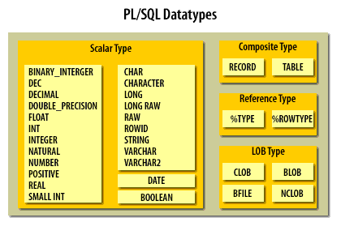
PL/SQL Data Types

Slide 30
Check Your Understanding
What are the basic sections of PL/SQL block?
What is the use of LOB data type?
What is a literal?
How do you print output in PL/SQL block?
What is a identifier?

Slide 31
Operators In PL/SQL
PL/SQL Supports all the Operators and Functions you studied in SQL
Types | Operators
Arithmetic Operators | +,-,*./
Character Operators | ||
Comparison Operators | <,>,>=,<=,!=,<>
Assignment operator | :=
Logical Operators | AND,NOT,OR
Other Operators | ( , ) , : , @ , ; , ..

Slide 32
Variables in PL/SQL
What are Variables?
Variables are memory locations, which can store data values.
Information from database can be stored to a variable or the contents of a variable can be inserted into the database.
The variables are declared in the declarative section of the block.
Every variable has a specific data type which describes what kind of information it can store.
Note: Adopt a naming convention for PL/SQL identifiers: for example, v_employee_id
Syntax:
variable_name datatype [NOT NULL := value ];
Example:
v_Join_Date Date;
v_Dept_Id Number(3) NOT NULL:=25;
v_Dept_Head Varchar2(10):=‘Ramesh’;
v_Dept_Tax CONSTANT Number:=12;
Assignment operator allows a value to be stored in a variable
variable := value;

Slide 33
Usage Of Default in Variables
Use DEFAULT:
The DEFAULT keyword can be used instead of the assignment operator(:=) to initialize variables.
Example:
gender_type CHAR := ‘M';
gender_type CHAR DEFAULT ‘M‘;

Slide 34
Variables of datatype %TYPE
The %TYPE data type when used with variable represents a database table column.
Syntax:
Declare
<Variable name> <table_name>.<column_name>%type;
Example:
Declare
Emp_Name EMPLOYEES.FirstName%type;
When used?
This is used when declaring variables to hold database table values.
The variable Emp_Name is declared similar to FirstName column data type in Employees table.

Slide 35
Scope of a Variable
The scope of the variable depends on where the variable is declared.
DECLARE
v_number NUMBER(3,2);
BEGIN
…
DECLARE
v_Character VARCHAR2(10);
BEGIN
…
END;
END;
v_number scope is within this block.
Scope of v_character is within this block.

Slide 36
Lend A Hand
Now we are well versed with commands lets test our understanding using short case study
Case Study Scenario:
This case study is to develop a Course Management System (CMS) for ABC University. The following are the two use cases for which the database needs to be designed.
Add Course
– To add the course details into the course management system.
Retrieve Course
– Retrieve the courses stored in the system and display it.
The courses to be added will have the following attributes Course Code, Course Name, Number of participants, Course Description, Course Duration, Course start date and Course Type.
Course Management System (CMS) ABC University

Slide 37
Lend A Hand - Prerequisites
Pre-requisite # 1 :Associates should ensure that the tables specified in the document are available in the oracle database with each table followed by the employee id .
Pre-requisite # 2: Load the table with necessary data using the DML statements.

Slide 38
Lend a Hand - Declaration Section
Let us all develop our first PL/SQL block for the CMS case study.
Declaration Section:
Let us declare two variables to hold the course name and course description from course_info table.
Another variable, v_course_message should be declared to hold a message.
Solution:
Declare
v_Course_Name Varchar2(10);
v_Course_Desc Varchar2(20);
v_Course_Message Varchar2(75);

Slide 39
Lend a Hand - Executable Section
Executable Section:
Here, the data is retrieved from the tables through SQL queries and stored in the variables.
The SELECT INTO Statements are used here to retrieve data from one or more database tables, and assigns the selected values to variables.
Problem Statement: Retrieve the course name and course description for course code 2 and store it in the variables declared earlier. The course name and course description should be concatenated and stored in the variable v_Course_Message.
Ensure to convert Course name into upper case and course description in lower case before concatenation. Print the v_course_message.

Slide 40
Lend a Hand - Executable Section
Begin
-- Get Name, Description of the Courses with Course Code 2
SELECT Course_Name, Course_Description INTO v_Course_Name ,
v_Course_Description FROM Course_Info WHERE Course_Code=‘2’;
-- Create course_message
V_Course_Message:=Upper(v_Course_Name ) || ‘ ‘|| Lower(v_Course_Description );
-- Print the course message
DBMS_OUTPUT.PUT_LINE(v_Course_Message );
END
Now, construct the final PL SQL block by combining the declarative and executable block.

Slide 41
Lend a Hand – Complete solution
Develop the solution in a notepad save it as BlockDemo.SQL in folder c:\test.
Declare
v_Course_Name Varchar2(10);
v_Course_Description Varchar2(20);
v_Course_Message Varchar2(75);
Begin
-- Get Name, Description of the Courses with Course Code 2
SELECT Course_Name, Course_Description INTO v_Course_Name ,
v_Course_Description FROM Course_Info WHERE Course_Id='111116';
-- Create course_message
V_Course_Message:=Upper(v_Course_Name ) || ' '|| Lower(v_Course_Description );
-- Print the course message
DBMS_OUTPUT.PUT_LINE(v_Course_Message );
END;
/

Slide 42
Lend a Hand – How to Run the SQL Block
Follow the procedure given below to create and run the above block.
Logon into SQL*PLUS and issue the command SET SERVEROUTPUT ON to enable SQL*PLUS to display the output
Use START command to execute the program that is in the file BlockDemo.SQL.
Example:
SQL> start C:\Test\ BlockDemo.SQL
Output:
When No Errors the below message will be displayed in SQL *PLUS and the output will be shown below
PL/SQL procedure successfully completed
Note: When saving the .sql file enclose the file name and extension in double quotes as “BlockDemo.SQL” else Notepad will add the extension .TXT to the file, say BlockDemo.SQL.txt

Slide 43
Check Your Understanding
What block handles exception in PL/SQL statement?
What are variables?
Which block is used for handling exceptions?
How can I set default values to variables?

Slide 44

Summary
We have learnt following
PL/SQL and its advantages
PL/SQL Architecture.
PL/SQL Block Structure.
Fundamentals of PL/SQL Language
How to Execute a PL/SQL Block?

Slide 45
Source
http://en.wikipedia.org/wiki/SQL
Disclaimer: Parts of the content of this course is based on the materials available from the Web sites and books listed above. The materials that can be accessed from linked sites are not maintained by Cognizant Academy and we are not responsible for the contents thereof. All trademarks, service marks, and trade names in this course are the marks of the respective owner(s).

Slide 46
PL/SQL
You have successfully completed
PL/SQL Basic Blocks

Slide 47
Change Log
Version Number | Changes made
V1.0 | Initial Version
V1.1 | Slide No. | Changed By | Effective Date | Changes Effected

