Slide 1
ORACLE PL/SQL
PL/SQL Statements
LEVEL – LEARNER

Slide 2








Icon Used
Hands on Exercise
Reference
Questions
Points To Ponder
Coding Standards
Lend A Hand
Summary
Test Your Understanding

Slide 3

Overview
PL/SQL Statements session provides knowledge and understanding of the use of PL/SQL control structures in Oracle 10G and finally apply the syntax learned as part of this session in a case study provided.

Slide 4

Objective
To understand the PL/SQL Fundamental concepts that a developer needs to know to work with it.
PL/SQL Control Structures.
PL/SQL Switch Statement
PL/SQL FOR LOOP
PL/SQL While LOOP.

Slide 5
Scenario
For complete understanding of ANSI SQL we are going to make use of Product Management System (PMS) for ABC Traders.
ABC Traders is a company which buys collectable model cars, trains, trucks, buses, trains and ships directly from manufacturers and sells them to distributors across the globe. In order to manage the stocking, supply and payment transactions the above software is developed.
As per the requirement of the trading company a inventory system is developed to collect the information of products and customers and their payment processing.

Slide 6
Database tables
There are many entities involved in Product Management System. PMS as given below which we will be dealing with throughout this course
Offices
To maintain information of Offices e.g. Office code, address, city etc.
Customer
To maintain customer details e.g. Customer Name, address
Employees
To maintain employee
details e.g. id,
Name etc.
Products
To maintain information of products e.g. product id, name etc.
Payments
To maintain information of payments done e.g. payment date, amount etc.
Orders
To maintain Orders done by customers e.g. order no ,date etc.
OrderDetails
To maintain Orders done by customers e.g. order no ,date etc.

Slide 7
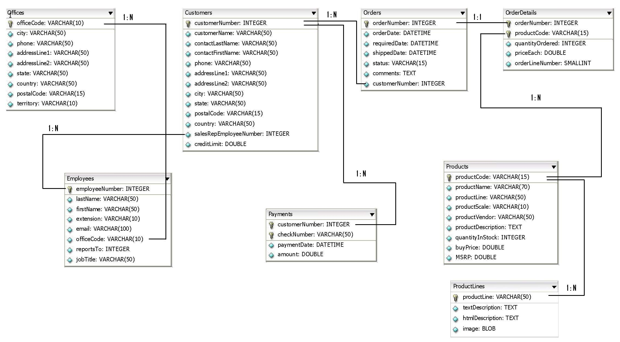
Schema diagram
Notes:
Trainer Note:
You can use a computer to type documents, send email, and browse the internet.
You can also use it to handle spreadsheets, accounting, database management, presentations, games, and more.
Software
Set of instructions for the hardware to accomplish a task.
List down any ten hardware parts of computer.
List down any five storage devices.
List down any five input devices.
What is the device which converts picture on a paper to an electronic image in computer ?

Slide 8

PL SQL Fundamentals
Hi!
I want to categories our customers based on their credit limits. If the credit limit is above 1000 $ then categories them as Platinum customers. Similarly categories the customers based on below mentioned credit limit.
750$ - 1000$ Diamond
500$ - 750$ Gold
Less than 500$ Silver
Assume there are millions of customers.
Lets learn about Oracle PL/SQL control structures which will help us to meet TIM’s requirements.

Slide 9

Do you Know
What are PL/SQL Control Structures
?

Slide 10
PL/SQL Control Structures
What are PL SQL Control Structures ?
PL SQL control structures are used control the flow of execution in a PL/SQL program. It is used to
Control the execution of statements based on some conditions being met (or)
Iterate through a set of statements and execute it based on some conditions.
Example: Assume there is a program which displays a message based on the age of the citizen “You are a senior citizen”
Display “You are a senior citizen”
Display “You are Not a senior citizen”
If age is greater than > 60
Else age < 60

Slide 11
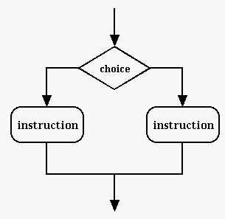
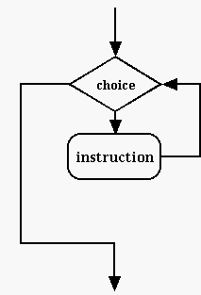
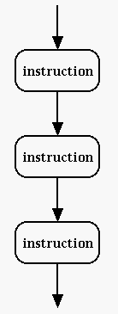
Types of Control Structures
Control Structures
Selection (Conditional Execution)
Iteration (Circular Execution)
Sequential (Sequential Navigation)
True
False
False
True

Slide 12
Selection Statements
Selection Statements or Conditional Execution statements refers to the ways of executing code depending on a condition being met.
If statement is used to check the condition and execute statements depending upon the result of the condition
The CASE statement allows you to execute one sequence of statements out of many possible sequences
Conditional Execution Statements
If Statements
Case Statements
IF-THEN-END IF
IF-THEN-ELSE-END IF
IF-THEN-ELSIF-END IF
Different Types of IF statements

Slide 13
IF-THEN END IF
The most basic conditional evaluation is the IF-THEN END IF statement.
Syntax:
IF condition
THEN
... Block 1 statements...
END IF;
The condition is a logical condition which evaluates to a boolean variable (or/and) boolean constant (or/and) combination of boolean variables and relational operators that valuates to TRUE,FALSE, or NULL.
The sequence of statements (Block 1) is executed only if the condition is true.
When the condition is false or null, the IF statement does nothing. In either case, control passes to the next statement which comes after ENDIF.

Slide 14
IF-THEN END IF Example
DECLARE
price Number(10);
Product_Logo VARCHAR2(35);
BEGIN
SELECT buyprice INTO price FROM products WHERE ProductCode ='S10_4757';
IF price >500
THEN Product_Logo :=‘Costlier Product';
DBMS_OUTPUT.PUT_LINE(Product_Logo);
END IF;
DBMS_OUTPUT.PUT_LINE('The End');
END;

Slide 15
IF-THEN-ELSE-END IF
Second form of if then statement where else block is included to execute few statements in case conditions does not meet.
Syntax:
IF condition THEN ... Block 1 statements
ELSE ... Block 2 statements
END IF;
If condition evaluates to TRUE, the block 1 statements are executed.
If condition evaluates to FALSE or NULL, the block 2 statements are executed.

Slide 16
IF-THEN-ELSE-END IF Example
DECLARE
price Number(10);
Product_Logo VARCHAR2(35);
BEGIN
SELECT buyprice INTO price FROM products WHERE ProductCode ='S10_4757';
IF price >500 THEN
Product_Logo :=‘Costlier Product';
ELSE
Product_Logo :=‘Low Cost Product';
END IF;
DBMS_OUTPUT.PUT_LINE(Product_Logo);
DBMS_OUTPUT.PUT_LINE('The End');
END;

Slide 17
IF-THEN-ELSIF-END IF
Third form of if then statement where an elseif block is included to execute the else block statements based on some conditions.
Syntax:
IF condition 1 THEN ... Block 1 statements
ELSIF condition 2 THEN ... Block 2 statements ELSE ... Block 3 statements
END IF;
If condition 1 evaluates to TRUE, the block 1 statements are executed.
If condition 2 evaluates to TRUE, the block 2 statements executed.
If both the conditions evaluates to FALSE or NULL, the block 3 statements that come after the ELSE keyword are executed.

Slide 18
IF-THEN-ELSIF-END IF Example
DECLARE
price Number(10);
Product_Logo VARCHAR2(35);
BEGIN
SELECT buyprice INTO price FROM products WHERE ProductCode ='S10_4757';
IF price >500 THEN
Product_Logo :=‘Costlier Product';
ELSIF price < 500 and price > 300 THEN
Product_Logo :=‘Average Priced Product';
ELSE
Product_Logo :=‘Low Cost Product';
END IF;
DBMS_OUTPUT.PUT_LINE(Product_Logo);
DBMS_OUTPUT.PUT_LINE('The End');
END;

Slide 19
Lend A Hand
Now we are well versed with commands lets test our understanding using short case study
Case Study Scenario:
This case study is to develop a Course Management System (CMS) for ABC University. The following are the two use cases for which the database needs to be designed.
Add Course
– To add the course details into the course management system.
Retrieve Course
– Retrieve the courses stored in the system and display it.
The courses to be added will have the following attributes Course Code, Course Name, Number of participants, Course Description, Course Duration, Course start date and Course Type.
Course Management System (CMS) ABC University

Slide 20
Lend A Hand - Prerequisites
Pre-requisite # 1 :Associates should ensure that the tables specified in the document are available in the oracle database with each table followed by the employee id .
Pre-requisite # 2: Load the table with necessary data using the DML statements.

Slide 21
Lend A Hand-IF THEN ELSIF ELSE
Pre Requisites: Use the Course_Info and Course_Fees Tables for this exercise.
Problem: Develop a PL/SQL Block which will update the base fees and special fees for the course code 2 , course type is ‘CLR’ and durations are as specified in the below table.
Condition to be evaluated | Logic to be executed
COURSE_DURATION IS ABOVE 31 Days and COURSE_TYPE is ‘CLR’ | BASE_FEES = 3000, SPECIAL_FEES = 500 and DISCOUNT= 10 % of ( BASE_FEES+SPECIAL_FEES)
COURSE_DURATION IS between 10 and 30 Days and COURSE_TYPE is ‘CLR’ | BASE_FEES = 2500 and SPECIAL_FEES = 400 DISCOUNT= 7 % of ( BASE_FEES+SPECIAL_FEES)
COURSE_DURATION IS below 09 Days and COURSE_TYPE is ‘CLR’ | BASE_FEES =1000 and SPECIAL_FEES = 200 DISCOUNT=5 % of ( BASE_FEES+SPECIAL_FEES)

Slide 22
Lend A Hand-Solution

Slide 23
Case Statements
The CASE statement allows you to select one block of statements to execute out of many possible blocks based on a evaluation of a single expression.
CASE - Get electrical appliance name
fan
true
Use fan switch;
false
light
true
Use light switch;
false
A.C
true
Use A.C switch;
false
ELSE block statements

Slide 24
How to write CASE Statement
Syntax:
CASE[Selector] {
WHEN expression1 THEN
// statement sequence1;
WHEN expression2 THEN
// statement sequence2;
WHEN expressionN THEN
// statement sequence N;
ELSE
//statement sequence N+1:
END CASE;
Let us now see how the case statement works?

Slide 25
Case Statements Example
DECLARE
discount Number(10);
BEGIN
SELECT msrp-buyprice INTO discount FROM products WHERE ProductCode ='S10_4757';
CASE
WHEN discount=10 THEN
DBMS_OUTPUT.PUT_LINE(‘Less Discount');
WHEN discount=20 THEN
DBMS_OUTPUT.PUT_LINE(‘Average Discount');
WHEN COURSE_DAYS =30 THEN
DBMS_OUTPUT.PUT_LINE(‘Best Buy');
ELSE
DBMS_OUTPUT.PUT_LINE(‘No Discount');
END CASE;
END;

Slide 26
Check Your Understanding
What is the alternative for the CASE Statement ?.
What is the difference between CASE and Decode ?
What are the different flavor of IF statements?

Slide 27
Iteration Blocks
Iteration or Circular execution refers to the ability to repeatedly execute code until some condition is met. PL/SQL uses 3 different types of loops to accomplish this.
Types of loops
Simple Loops
FOR Loops
While Loops

Slide 28
Simple Loop
Simple Loops:
The simple loop used for executing a block of statements repeatedly till the EXIT (or) EXIT WHEN (or) RETURN is executed within the body of the loop.
Syntax :
LOOP
statements;
EXIT; {or EXIT WHEN condition;}
END LOOP;

Slide 29
Simple Loop Example
declare l_loops number := 0;
begin
dbms_output.put_line('Before my loop');
loop
if l_loops > 4 then
exit;
end if;
dbms_output.put_line('Looped ' || l_loops || ' times');
l_loops := l_loops + 1;
end loop;
dbms_output.put_line('After my loop');
end;
Loop counter initialized to 0
Exit out of the loop counter if counter > 4
Message is printed in the console and the counter is incremented every time till counter >4

Slide 30
Numeric For Loop
A For Loop is used to execute a set of statements for a predetermined number of times.
Iteration occurs between the start and end integer values given.
The counter is always incremented by 1. The loop exits when the counter reaches the value of the end integer.
Syntax:
FOR <loop_counter> IN [REVERSE] <start_number>..<end_number> LOOP ... sequence of executable statements ... END LOOP;

Slide 31
For Loop Example
Example:
DECLARE BEGIN FOR counter IN 1..5 LOOP DBMS_OUTPUT.PUT_LINE(counter); END LOOP; END;
Counter value will be incremented from 1 to 5. Value printed 5 times.

Slide 32
Lend A Hand
Now we are well versed with commands lets test our understanding using short case study
Case Study Scenario:
This case study is to develop a Course Management System (CMS) for ABC University. The following are the two use cases for which the database needs to be designed.
Add Course
– To add the course details into the course management system.
Retrieve Course
– Retrieve the courses stored in the system and display it.
The courses to be added will have the following attributes Course Code, Course Name, Number of participants, Course Description, Course Duration, Course start date and Course Type.
Course Management System (CMS) ABC University

Slide 33
Lend A Hand-For Loop
Pre Requisites: Use the Course_Info Tables.
Problem Statement: Develop a PL SQL Block which will display the COURSE_CODE,COURSE_NAME and COURSE_DESCRIPTION of the courses with COURSE_DURATION less than 15.
Output Format:
'The Following Are The Details of Courses with Duration Less Than 15 Days‘
<COURSE_CODE> + <COURSE_NAME> + <COURSE_DURATION>

Slide 34
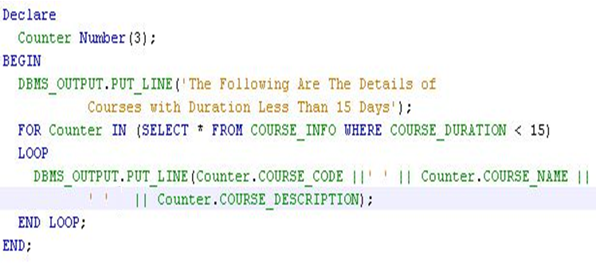
Lend A Hand-Solution

Slide 35
While Loops
The WHILE loop executes as long as the condition is TRUE.
Syntax:
WHILE condition LOOP ... Block 1 statements ... END LOOP;
The condition is a Boolean variable, constant, or combination of boolean variables and relational operators that evaluates to TRUE,FALSE, or NULL.
If condition evaluates to TRUE, the block 1 statements would be executed in iteration till the condition fails.
If condition evaluates to FALSE or NULL, then the loop terminates and execution continues after end loop statement.

Slide 36
While Loop Example
DECLARE
counter NUMBER := 2;
BEGIN
WHILE counter < 6 LOOP
counter := counter + 1;
DBMS_OUTPUT.PUT_LINE(counter);
END LOOP;
END;
Counter value Initialized to 0
Exit out of the loop if counter > 6
The Counter value will be increment by 1 and the counter value will be printed for four times.

Slide 37
Lend A Hand
Now we are well versed with commands lets test our understanding using short case study
Case Study Scenario:
This case study is to develop a Course Management System (CMS) for ABC University. The following are the two use cases for which the database needs to be designed.
Add Course
– To add the course details into the course management system.
Retrieve Course
– Retrieve the courses stored in the system and display it.
The courses to be added will have the following attributes Course Code, Course Name, Number of participants, Course Description, Course Duration, Course start date and Course Type.
Course Management System (CMS) ABC University

Slide 38
Lend A Hand-While Loop
Pre Requisites: Use the Course_Info Table.
Problem statement: Develop a PL SQL Block which will display the details of the course such as Course Name and Course Duration starting with Course Code 1 and Ending with Course Code 4.
The Output should be in the following format
‘The Duration for the Course’+<Course_Name> + ‘ is ‘+<Course_Duration > +’days.’;

Slide 39
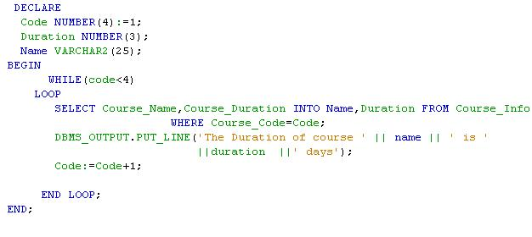
Lend A Hand-Solution

Slide 40
Sequential Navigation Statement
GOTO Statement:
GOTO Statement transfers control to the named label.
The label must be unique and should precede an executable PL/SQL statement or PL/SQL block.
Syntax:
GOTO <label_name>;
NOTE: Oracle recommends not to use GOTO Statements as GOTO statements can result in complex codes and maintenance issues.

Slide 41
Nesting of Blocks
What are Nested Blocks ?
Defining a block within another block inside an Executable Part is called Nested Block.
The outer PL/SQL Block is called Parent Block and the inner PL/SQL Block is known as Child Block.
The Child Block can have a Declartion, Execution and Exception Part.
The Parent and Child Block can be named using labels.
Syntax:<<block-name>>
Example:<<Tax calculation Block>>
Variables accessibility in nested blocks:
Variables declared in the outer block is accessible in both the inner,outer blocks.
Variables declared in the inner block is accessible only in the inner block not in the outer block.

Slide 42
Nesting of Blocks with labels
<<Employee>>
Declare
employee_Salary Number(6):=120;
Begin
<<Manager>>
Declare
Employee_Age(6):=60;
Begin
………
……….
End;
…………………
End;
Scope of Variable employee_Salary is within the outer block.
Scope of Variable employee_Age is within the inner block.
NOTE:
Where Employee and Manager are the names of the outer and inner block respectively.
If the variables names of the outer and inner blocks are same then labels have to be used within the inner block to avoid ambiguity.

Slide 43
Check Your Understanding
What are the types of loops?
How can one break a loop from execution?
Can one access a variable defined in outer block from inner block?
Can one access a variable defined in inner block from outer block?

Slide 44

Summary
We have learnt following
PL SQL Control Structures.
PL SQL Switch Statement
PL SQL FOR LOOP
PL SQL While LOOP.

Slide 45
Source
http://en.wikipedia.org/wiki/SQL
Disclaimer: Parts of the content of this course is based on the materials available from the Web sites and books listed above. The materials that can be accessed from linked sites are not maintained by Cognizant Academy and we are not responsible for the contents thereof. All trademarks, service marks, and trade names in this course are the marks of the respective owner(s).

Slide 46
Oracle PL/SQL
You have successfully completed - PL/SQL Statements

Slide 47
Change Log
Version Number | Changes made
V1.0 | Initial Version
V1.1 | Slide No. | Changed By | Effective Date | Changes Effected

