Slide 1
ORACLE PL/SQL
PL/SQL Sub Programs
LEVEL – LEARNER

Slide 2








Icon Used
Hands on Exercise
Reference
Questions
Points To Ponder
Coding Standards
Lend A Hand
Summary
Test Your Understanding

Slide 3

Overview
PL/SQL Sub Programs session provides knowledge and understanding of the use of PL/SQL Sub Programs in Oracle 10G and finally apply the syntax learned as part of this session in a case study provided.

Slide 4

Objective
To understand the PL/SQL Sub programs that a developer needs to know to work with it.
PL/SQL Sub Programs
PL/SQL Procedures
PL/SQL Functions
PL/SQL Packages

Slide 5
Scenario
For complete understanding of ANSI SQL we are going to make use of Product Management System (PMS) for ABC Traders.
ABC Traders is a company which buys collectable model cars, trains, trucks, buses, trains and ships directly from manufacturers and sells them to distributors across the globe. In order to manage the stocking, supply and payment transactions the above software is developed.
As per the requirement of the trading company a inventory system is developed to collect the information of products and customers and their payment processing.

Slide 6
Database tables
There are many entities involved in Product Management System. PMS as given below which we will be dealing with throughout this course
Offices
To maintain information of Offices e.g. Office code, address, city etc.
Customer
To maintain customer details e.g. Customer Name, address
Employees
To maintain employee
details e.g. id,
Name etc.
Products
To maintain information of products e.g. product id, name etc.
Payments
To maintain information of payments done e.g. payment date, amount etc.
Orders
To maintain Orders done by customers e.g. order no ,date etc.
OrderDetails
To maintain Orders done by customers e.g. order no ,date etc.

Slide 7
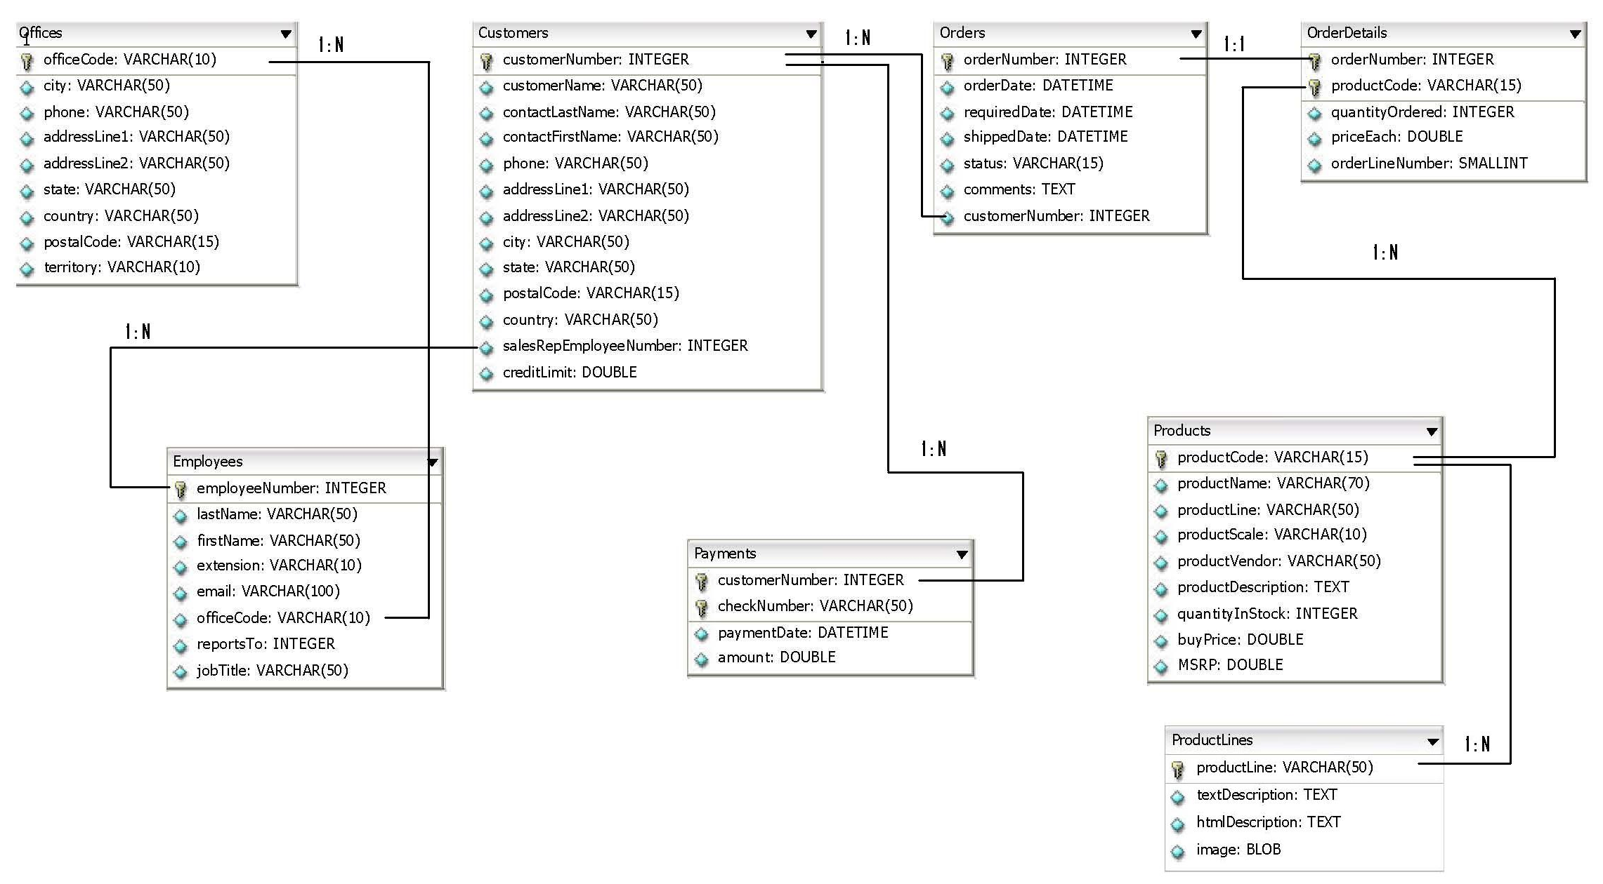
Schema diagram
Notes:
Trainer Note:
You can use a computer to type documents, send email, and browse the internet.
You can also use it to handle spreadsheets, accounting, database management, presentations, games, and more.
Software
Set of instructions for the hardware to accomplish a task.
List down any ten hardware parts of computer.
List down any five storage devices.
List down any five input devices.
What is the device which converts picture on a paper to an electronic image in computer ?

Slide 8

Do you Know
What are PL/SQL Sub Programs
?

Slide 9
Overview Of Sub Programs
A Sub Program is a named PL/SQL Block that can accept parameters and perform some logic.
PL/SQL Sub Programs
Procedures
Functions
Sub Programs once compiled gets stored in the database as a schema object namely stored procedure or functions.

Slide 10
Advantages of Sub Programs
Advantages of sub programs,
Modularity – Refers to the logical grouping common logic and placing it in a sub program (or) modules. Example: The logic of calculating the course fees, discount can be logically grouped and placed in a subprogram module.
Reusability - Since they are modular they are reusable, refers to reusing the same code in multiple places. Thus preventing repeated development of the same logic. Example: The subprogram calculating the course fees can be used in multiple places.
Maintainability- The code is easy to maintain. Example: Since the logic is developed in modules it is easy it understand the logic and maintain it.
Improved Performance- Since it is a compiled code which is available inside the database engine the logic developed inside it executes fast.
Improved Code Clarity- Since the programs are modular it is clear and can be easily understood.

Slide 11

PL/SQL Sub Programs
Hi!
I want a reusable block which calculate and print the discount provided for a particular product considering product id as argument
Lets learn about PL/SQL Procedures which will help us to meet TIM’s requirements..

Slide 12
PL/SQL Stored Procedure
What is a PL/SQL Stored Procedure?
A PL/SQL Stored Procedure is a PL/SQL block that is stored in the database with a name.
A stored procedure can be invoked using its name.
PL/SQL Stored Procedure building blocks-
A Stored Procedure consist of a header and a body section.
Procedure
<Name of Procedure>
<Parameters or variables passed to the procedure>
Header Section
Declaration Section
Execution Section
Exception Section
Similar to general PL/SQL Block
Body Section

Slide 13
Syntax Of Procedure
CREATE [OR REPLACE] PROCEDURE <procedure-name>
[parameter1 ,parameter2, ...]
IS|AS
[local variable declarations]
BEGIN
executable statements;
[EXCEPTION]
[exception handlers]
END [<procedure-name> ];
Head Section
Body
The “OR REPLACE” keyword indicates that if a procedure with the same name exists, then it will be replaced by this new procedure.
Oracle creates procedure even though the procedure is not valid (has errors) but it displays the message saying that the procedure is created with errors.

Slide 14
Procedures - Parameters
Types of procedures:
Procedure Without Parameter.
Procedure With Parameter.
Example: Procedure Without Parameter
CREATE OR REPLACE PROCEDURE MY_FIRSTPROCEDURE
AS
BEGIN
DBMS_OUTPUT.PUT_LINE('My First PL SQL Procedure');
END MY_FIRSTPROCEDURE;
How to Execute Procedure without Parameter?.
Execute or exec MY_FIRSTPROCEDURE;

Slide 15
Procedure With Parameters
Procedure with parameters:
PL/SQL Procedures can take Parameters. Parameters are values that can be passed and retrieved by the users.
Parameters are declared when a procedure is declared.
Types of parameter
IN
OUT
IN/OUT

Slide 16
Procedure With Parameters
IN Parameter:
Default Parameter Mode, declared using the IN Keyword.
Value which need to be passed to the procedure for processing.
IN parameter is a constant whose value cannot be changed in the invoked stored procedure.
OUT Parameter:
The value returned by the procedure
Declared using the OUT Keyword.
The default value of an OUT parameter is NULL.
Cannot be initialized and cannot be assigned a default value.
INOUT Parameter:
The same parameter will serve as input and output.
Specified using the IN OUT Keyword.

Slide 17
Example Of Procedure with IN Parameter
Problem: Procedure to print the TOTAL DISCOUNT given for a particular product id.
CREATE OR REPLACE PROCEDURE CALCULATE_DISCOUNT(PRODUCT_ID IN VARCHAR2)
IS
TOTAL_DISCOUNT NUMBER(10);
BEGIN
-- Update TOTAL FEES
SELECT MSRP-BUYPRICE INTO TOTAL_DISCOUNT FROM PRODUCTS WHERE PRODUCTCODE= PRODUCT_ID;
-- Printing the total DISCOUNT
DBMS_OUTPUT.PUT_LINE(‘Total Discount For the Product Code ‘ || Product_ID || ‘ is’ || TOTAL_discount );
END CALCULATE_DISCOUNT;
How to Execute Procedure With IN Parameter?
Execute or exec CALCULATE_DISCOUNT (45 );
Product_Id is got as an input parameter
Product_Id is passed as an input parameter to the query

Slide 18
Example of Procedure with OUT Parameter
Problem: Procedure to increase the DISCOUNT of a particular PRODUCT by 25 and return it.
CREATE OR REPLACE PROCEDURE CALCULATE_DISCOUNT(PRODUCT_ID IN VARCHAR2, DISCOUNT OUT NUMBER) IS
BEGIN
SELECT MSRP-BUYPRICE INTO DISCOUNT FROM PRODUCTS WHERE PRODUCTCODE= PRODUCT_ID;
DISCOUNT :=DISCOUNT+25;
END CALCULATE_DISCOUNT;
How to Execute Procedure With OUT Parameter?
Declare a Host Variables to hold the OUT Parameter
Variable TOTAL_DISCOUNT Number
Execute the Procedure by passing the course code (IN) and the bind parameter. Bind parameter, binds the output value to it.
Execute or exec CALCULATE_DISCOUNT (45,: TOTAL_DISCOUNT ); 3. Print the bind variable:
Print TOTAL_DISCOUNT

Slide 19
Examples Of Procedure with INOUT Parameter
Problem: Stored procedure to format the employee number suffixed with job title and return it.
CREATE OR REPLACE PROCEDURE FORMAT_EMP_NO(EMP_NO IN OUT VARCHAR2) IS
JOB_TITLE VARCHAR2(25);
BEGIN
SELECT JOBTITLE INTO JOB_TITLE FROM EMPLOYEES WHERE EMPLOYEENUMBER=EMP_NO;
EMP_NO :=EMP_NO || ‘_’ || JOB_TITLE;
END FORMAT_EMP_NO;
How to Execute Procedure With IN AND OUT Parameter?
Declare a Host Variables to hold the OUT Parameter
Variable EMPLOYEE_NO Varchar2(50);
Develop a PL SQL Block to initialize the value for IN parameter in the bind variable
Begin
:EMPLOYEE_NO:=‘1002’;
End;
Execute the Stored Procedure by passing the IN Parameter
Execute or exec FORMAT_EMP_NO (:EMPLOYEE_NO );
Print the bind variable:
Print EMPLOYEE_NO

Slide 20
Invoking Procedure From Another Procedure-Example
Procedure 1:
CREATE OR REPLACE PROCEDURE CALCULATE_PRICE_DISCOUNT(
PRODUCT_ID IN VARCHAR2,DISCOUNT OUT NUMBER)
IS
TOTAL_DISCOUNT NUMBER(10);
BEGIN
SELECT MSRP-BUYPRICE INTO TOTAL_DISCOUNT FROM PRODUCTS WHERE PRODUCTCODE= PRODUCT_ID;
TOTAL_DISCOUNT := TOTAL_DISCOUNT+25;
DISCOUNT:=TOTAL_DISCOUNT;
END CALCULATE_PRICE_DISCOUNT;
Procedure 2 invoking Procedure 1:
CREATE OR REPLACE PROCEDURE DISPLAY_DISCOUNT(PRODUCT_ID IN VARCHAR2)
IS
PRODUCT_DISCOUNT NUMBER(8);
BEGIN
--Invoking the Procedure CALCULATE_PRICE_DISCOUNT
CALCULATE_PRICE_DISCOUNT(PRODUCT_ID, PRODUCT_DISCOUNT);
DBMS_OUTPUT.PUT_LINE(PRODUCT_DISCOUNT);
END DISPLAY_DISCOUNT;

Slide 21
How to Compile and Run a Stored Procedure
Step 1: Type the PL SQL Block in a text editor such as Notepad and save it in a text file.
Assume the file is saved under the name “Example.SQL”. Also, be sure to know the directory where the file is saved.
Step 2: Get into SQL*PLUS. Start it and Logon and issue the command
SET SERVEROUTPUT ON to enable SQL*PLUS to display the output.
Step 3: Use START command to execute the PL/SQL block is in the file “Example.SQL”
Example:
SQL> start C:\Test\ Example.SQL
When No Errors are present, the below message will be displayed and the output will be shown as below
“PL/SQL procedure successfully completed”
Step 4: Execute the Procedure by passing the value for IN parameter
Execute or exec CALCULATE_PRICE_DISCOUNT (‘S18_1589’ );

Slide 22
Lend A Hand
Now we are well versed with commands lets test our understanding using short case study
Case Study Scenario:
This case study is to develop a Course Management System (CMS) for ABC University. The following are the two use cases for which the database needs to be designed.
Add Course
– To add the course details into the course management system.
Retrieve Course
– Retrieve the courses stored in the system and display it.
The courses to be added will have the following attributes Course Code, Course Name, Number of participants, Course Description, Course Duration, Course start date and Course Type.
Course Management System (CMS) ABC University

Slide 23
Lend a Hand – Procedures
Pre Requisites: Use the Course_Info and Course_Fees Tables.
Data Setup: Load the course and relevant tables for course code 4,5,6 with number of participants 5, 23, 35 respectively.
Problem Statement: Develop a PL SQL Procedure named “Course_HeadCount” which will take the Course Code as the input. The procedure should perform the following based on the Participant Strength.
When the Participant Strength goes above 30
Display the following message ‘Over Crowded’
When the Participant Strength is between 10 and 30
Display the following message 30-<No-Of Participants> Seats Available’
When the Participant Strength goes below 10 make the Course Type as ‘EL’.
Invoke the stored procedure for course code 4.

Slide 24
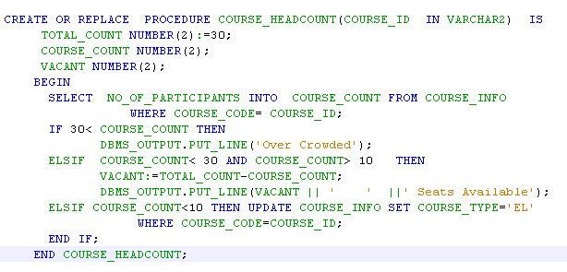
Lend a Hand – Solution

Slide 25
PL SQL Sub Programs
Hi!
I want a reusable block which calculate and return the discount provided for a particular product considering product id as argument
Lets learn about PL/SQL Function which will help us to meet TIM’s requirements..

Slide 26
Functions
What is a PL SQL Function?
A PL/SQL Function is a named PL/SQL Block which is similar to a procedure, but can return a value.
A Function can be stored in the database as a schema object for repeated execution.
Functions can also be invoked as part of select statement
Where can we use functions?
Select, Insert and update query.
Invoked from other Anonymous Block, Procedures and other Functions.

Slide 27
Function Syntax
Syntax:
CREATE [OR REPLACE] FUNCTION <function-name>
[parameter1,parameter2, …]
RETURN data type
IS | AS
[local declarations;]
BEGIN
executable statements;
RETURN value;
…….
[EXCEPTION] [exception handlers];
END <function-name>;
Declares the data type of the value to be returned by the function.
This returns the value. Should be of the same data type as of the declaration.
NOTE: Function can only take IN Parameters.
It cannot take OUT or INOUT parameters

Slide 28
Functions Example
Example : Function to calculate the DISCOUNT and return it.
CREATE OR REPLACE FUNCTION DISCOUNT_CALCULATION
(PRODUCT_ID Varchar2)
RETURN NUMBER
IS
TOTAL_DISCOUNT Number(10);
BEGIN
SELECT MSRP-BUYPRICE INTO TOTAL_DISCOUNT FROM PRODUCTS WHERE PRODUCTCODE= PRODUCT_ID;
RETURN TOTAL_DISCOUNT ;
END DISCOUNT_CALCULATION;
Declares Number as the data type to be returned by the function.
Function logic and the calculated discount is returned.

Slide 29
Usage of Functions
A Function can be used in the following scenarios
Can be used in another function or stored procedure.
Discount := DISCOUNT_CALCULATION (Product_id);
As a part of a SELECT statement,
SELECT DISCOUNT_CALCULATION(Product_id) FROM Products;
In a anonymous PL/SQL blocks,
Begin
DBMS_OUTPUT.PUT_LINE(DISCOUNT_CALCULATION (Product_id) );
End;

Slide 30
Procedures Vs Functions
Procedures | Functions
Procedures can return one or many values | Functions can return only one value.
Procedures will have IN,OUT and IN OUT Parameters | Function will have only IN Parameters.
Procedures cannot be invoked in SELECT DQL statement | Functions can be invoked from the DQL SELECT statement

Slide 31
Lend A Hand
Now we are well versed with commands lets test our understanding using short case study
Case Study Scenario:
This case study is to develop a Course Management System (CMS) for ABC University. The following are the two use cases for which the database needs to be designed.
Add Course
– To add the course details into the course management system.
Retrieve Course
– Retrieve the courses stored in the system and display it.
The courses to be added will have the following attributes Course Code, Course Name, Number of participants, Course Description, Course Duration, Course start date and Course Type.
Course Management System (CMS) ABC University

Slide 32
Lend a Hand – Function
Pre Requisites: Use the Course_INFO Tables.
Problem: Develop a PL SQL Function named “Course_Fees_Calculator” which will calculate the fees of a particular course. Course fees is calculated based on the course duration as mentioned below,
Fees=Course_Duration * 100;
Develop a procedure named “Calculator” with Course_Code as input parameter which will invoke the above “Course_Fees_Calculator” for the course code and print the fee value returned.

Slide 33
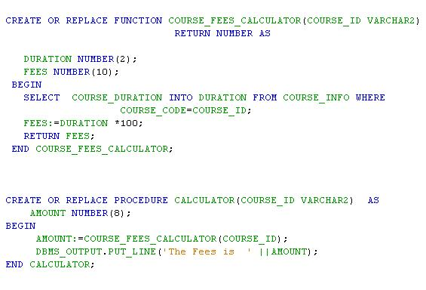
Lend a Hand – Solution

Slide 34
Check Your Understanding
Name the two sections of any subprogram?
List some important advantages of using stored procedures/functions?
Stored procedure/ function improves the performance how?
How can one specify a parameter as input and output in a stored procedure?
Can function return multiple values?
What is the primary difference between a procedure and function?

Slide 35
PL SQL Sub Programs
Hi!
I want all my reusable blocks grouped based on their functionalities for example all the product related blocks inside one bundle.
Lets learn about PL/SQL Package which will help us to meet TIM’s requirements..

Slide 36
Packages
What is a Package in PL/SQL ?.
A package is a logical grouping of procedures, functions, variables and data types.
Advantages of using Packages:
Developers can enhance and maintain applications more easily.
Implementation details can be hidden by placing them in PL/SQL packages with suitable access specifiers.
Packages provides name space for storing stored procedures.
A package typically contains two sections
Package Specification .
Package Body.

Slide 37
Package Specification
Package Specification:
This part declares the PL/SQL types, variables, constants, exception, cursor, functions and procedures.
Created using the CREATE PACKAGE Command.
Package body:
The specifications declared in the “package specification” are implemented in this section.
Created using CREATE PACKAGE BODY command.

Slide 38
Package – Few more details
A package specification can exist without a package body but not vice-versa.
An element of a package, whether it is a variable or a module, can either be
Public: When a element is declared public , it can be referenced from other PL/SQL blocks in other packages and the same package.
Private: When a element is defined in the body of the package, but does not appear in the specification, is considered as private.
A private element cannot be referenced outside the package, it can only be referenced by other elements within the package.

Slide 39
Package – Few more details (Cont)
The Subprograms that are present inside a package cannot exist separately as database objects.
A package cannot be invoked by itself.
Only the procedures and functions from within the package can be called with reference to the package using the dot (.) operator.
When one subprogram is invoked in a package, then all other subprograms in the package are also loaded into the memory.
This makes the subsequent invocations for any other subprograms in the package fast.

Slide 40
Package Syntax
Syntax of Package Specification:
CREATE [OR REPLACE] PACKAGE <PACKAGE-NAME>
IS | AS
Variable Declaration;
Procedure and Function Specification;
END <PACKAGE-NAME>;
Syntax Of Package Body:
CREATE [OR REPLACE] PACKAGE BODY <PACKAGE-NAME>
IS | AS
Variable Declaration;
Procedure and Function Body;
END <PACKAGE-NAME>;

Slide 41
Package Specification-Example
Example of Package Specification:
CREATE OR REPLACE PACKAGE PRODUCT_PACKAGE AS
PROCEDURE TOTAL_DISCOUNT(PRODUCT_ID VARCHAR2,DISCOUNT OUT NUMBER);
FUNCTION DISCOUNT_CALCULATOR(PRODUCT_ID VARCHAR2) RETURN NUMBER;
END PRODUCT_PACKAGE;
The above declaration indicates that the package body of PRODUCT_PACKAGE should implement
A procedure named “TOTAL_DISCOUNT” and
A function named “DISCOUNT_CALCULATOR”

Slide 42
Package Body - Example
The package body has a stored procedure “TOTAL_DISCOUNT” and function “DISCOUNT_CALCULATOR”
CREATE OR REPLACE PACKAGE BODY PRODUCT_PACK AS
PROCEDURE TOTAL_DISCOUNT (PRODUCT_ID IN VARCHAR2, DISCOUNT OUT NUMBER) IS
BEGIN
SELECT MSRP-BUYPRICE INTO DISCOUNT FROM PRODUCTS WHERE PRODUCTCODE=PRODUCT_ID;
DISCOUNT := DISCOUNT + 25;
END TOTAL_DISCOUNT;
FUNCTION DISCOUNT_CALCULATOR(PRODUCT_ID VARCHAR2) RETURN NUMBER IS
Discount Number(10);
BEGIN
SELECT MSRP-BUYPRICE INTO DISCOUNT FROM PRODUCTS WHERE PRODUCTCODE=PRODUCT_ID;
RETURN DISCOUNT;
END DISCOUNT_CALCULATOR;
END PRODUCT_PACK;

Slide 43
Overloading Procedures and Functions.
What is Overloading?
Creating multiple procedures with the same name, but with different parameters is called overloading.
A package may contains more than one procedure /function with same name, but one of the following should be different.
Number Of Parameters in Procedures/Functions (or)
Data Type Of Parameters in Procedures/Functions.

Slide 44
Dropping Procedures, Functions and Package.
There might be instances where we want to remove a package/procedure/function from the database.
The DROP keyword is used for this purpose
Dropping A Procedure:
Drop Procedure CALCULATE_DISCOUNT;
Dropping A Function:
Drop Function DISCOUNT_CALCULATOR;
Dropping A Package:
Drop Package PRODUCT_PACKAGE;
Drop Package Body PRODUCT_PACK;
Remove both the package
specification and the package body
Remove the package
body only

Slide 45
Check Your Understanding
What are a PL/SQL packages?
What are the sections of a PL/SQL package?
What are the two sections of a package?
Can a package contains more than one functions with a same name?
An function defined in a package body can it be accessed by another function in a different package?
Can a function invoke another procedure/function?

Slide 46

Summary
We have learnt following
Sub Programs
Procedures
Functions
Packages.

Slide 47
Source
http://en.wikipedia.org/wiki/SQL
Disclaimer: Parts of the content of this course is based on the materials available from the Web sites and books listed above. The materials that can be accessed from linked sites are not maintained by Cognizant Academy and we are not responsible for the contents thereof. All trademarks, service marks, and trade names in this course are the marks of the respective owner(s).

Slide 48
ORACLE PL/SQL
You have successfully completed -
PL/SQL Sub Programs

Slide 49
Change Log
Version Number | Changes made
V1.0 | Initial Version
V1.1 | Slide No. | Changed By | Effective Date | Changes Effected

