Slide 1
Oracle PL/SQL
PL/SQL Cursors
LEVEL – LEARNER

Slide 2








Icon Used
Hands on Exercise
Reference
Questions
Points To Ponder
Coding Standards
Lend A Hand
Summary
Test Your Understanding

Slide 3

Overview
PL/SQL Cursor session provides knowledge and understanding of the use of PL/SQL cursor in Oracle 10G and finally apply the syntax learned as part of this session in a case study provided.

Slide 4

Objective
To understand the SQL operators concepts that a developer needs to know to work with it.
Cursors
Reference Cursors

Slide 5
Scenario
For complete understanding of ANSI SQL we are going to make use of Product Management System (PMS) for ABC Traders.
ABC Traders is a company which buys collectable model cars, trains, trucks, buses, trains and ships directly from manufacturers and sells them to distributors across the globe. In order to manage the stocking, supply and payment transactions the above software is developed.
As per the requirement of the trading company a inventory system is developed to collect the information of products and customers and their payment processing.

Slide 6
Database tables
There are many entities involved in Product Management System. PMS as given below which we will be dealing with throughout this course
Offices
To maintain information of Offices e.g. Office code, address, city etc.
Customer
To maintain customer details e.g. Customer Name, address
Employees
To maintain employee
details e.g. id,
Name etc.
Products
To maintain information of products e.g. product id, name etc.
Payments
To maintain information of payments done e.g. payment date, amount etc.
Orders
To maintain Orders done by customers e.g. order no ,date etc.
OrderDetails
To maintain Orders done by customers e.g. order no ,date etc.

Slide 7
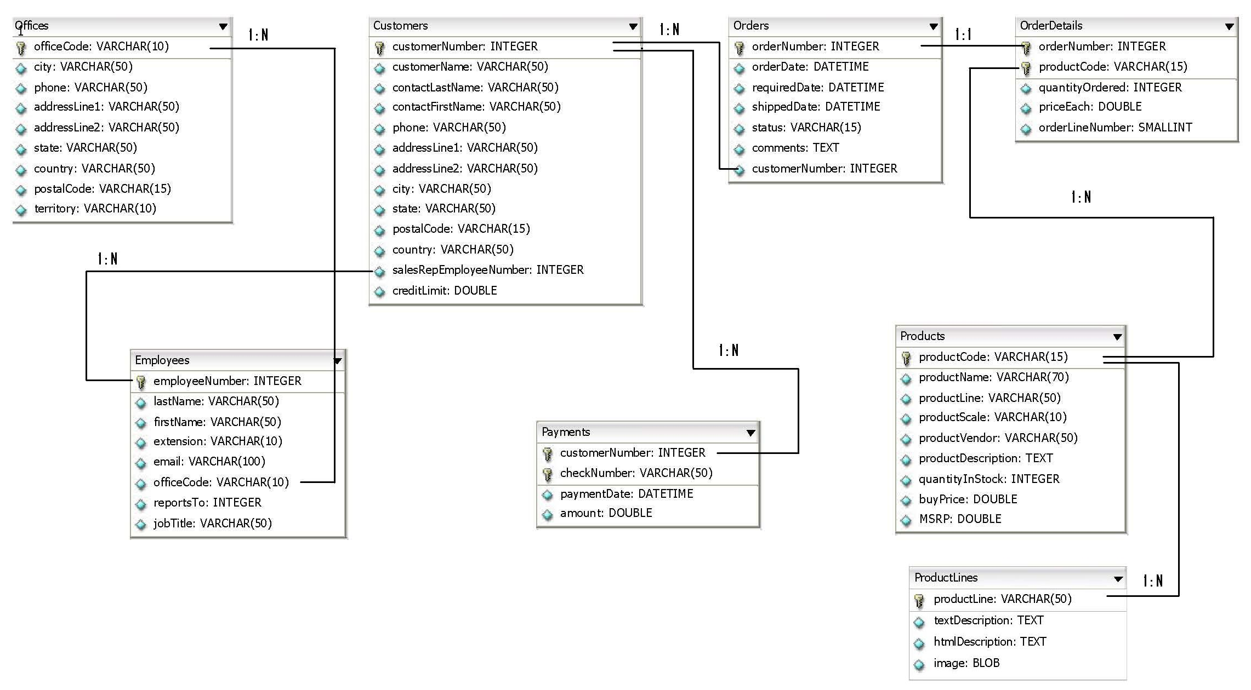
Schema diagram
Notes:
Trainer Note:
You can use a computer to type documents, send email, and browse the internet.
You can also use it to handle spreadsheets, accounting, database management, presentations, games, and more.
Software
Set of instructions for the hardware to accomplish a task.
List down any ten hardware parts of computer.
List down any five storage devices.
List down any five input devices.
What is the device which converts picture on a paper to an electronic image in computer ?

Slide 8

Scenario
Hi!
Out of product details available I want to read and process recent 1000 products details and calculate discount.
Lets learn about PL/SQL Cursors which will help us meet TIM’s requirements..

Slide 9

Do you Know
What are PL SQL Cursors
?

Slide 10
What is a Cursor?
What is a Cursor?
The cursor is a pointer referring to the address of memory area that oracle allocates to hold the data of the SQL statements. This is a storage space for the data returned by the select query.
Employee Name | Empl Id
Tim | 101
Ron | 121
Jack | 232
Louis | 123
Tom | 124
C1
Example: Assume there is a select query which retrieves 5 employee records.
Where C1 is the cursor pointing to the address where the employee records are stored. Using the address the data can be retrieved and processed.

Slide 11
Types of Cursors
Cursors
Implicit Cursors
Explicit Cursors
Implicit cursors are automatically created by oracle when a select query in PL/SQL is executed.
A cursor is explicitly attached to a select query by programmer.
In this session we will discuss about explicit cursors.

Slide 12
Explicit Cursors
Explicit cursors are created to refer the rows returned by a select query.
Using the cursor the rows can be processed one by one.
This is typically used with select statement that returns more than one row.
Explicit cursor is declared in the declaration section of the PL/SQL block.
Explicit
Cursors types
Explicit Cursor without parameter
Explicit Cursor with parameter

Slide 13
Steps to create explicit cursors
STEP 1 Declare the cursor:
A name is provided to the cursor along with the select statement.
STEP 2 Open the cursor:
By opening the cursor the select statement is executed.
STEP 3:
Fetch the results into PL/SQL variables.
This is done using a loop statement.
STEP 4:
Close the cursor.
This is to de-allocate the memory occupied by the cursor.

Slide 14
Step 1-Declaring a Cursor
Declaration of Cursor:
To use a cursor, it must be declared first.
Syntax: CURSOR cursor_name IS SELECT statement;
Without parameter:
Example:
CURSOR comp IS SELECT prod_id FROM product_dim;
With parameter:
Example:
CURSOR c_product (pv_product_id in number) IS
SELECT product_name
FROM product_dim
WHERE product_id = pv_product_id;
Input parameter

Slide 15
Step 2-Opening a Cursor
Once you have declared your cursor, the next step is to open the cursor.
The SELECT statement provided within the CURSOR statement gets executed when we open the cursor.
After the execution, all the rows get stored in memory called context area.
Now oracle allocates memory to it.
Syntax:
OPEN cursor_name;
Example:
OPEN comp;
What happens when we open a cursor?
The active set pointer is set to the first row.

Slide 16
Step 3-Fetching Rows from Cursor
After declaring and opening your cursor, the next step is to FETCH the rows from your cursor.
This is done to retrieve the rows from the cursor and process it.
Syntax:
FETCH cursor_name INTO list_of_variables;
(or)
FETCH cursor_name INTO PL/SQL_record;
Example:
FETCH comp INTO v_prod_id;
The above example fetches the product id and stores into v_prod_id, where v_prod_id is a variable.
After each FETCH, the pointer is moved to the next row.
Thus, each FETCH will return the next rows in the active set, until the last row of the cursor is fetched.

Slide 17
Step 4-Closing Cursor
The final step is to close the cursors to release the memory allocated.
Syntax:
CLOSE CursorName;
Example:
CLOSE comp;

Slide 18
Cursor Attributes
While using cursors, we may need to determine the status of your cursor.
To determine the status we use the following cursor attributes with the If Statements.
a
Attribute | Description | Example
%ISOPEN | Returns TRUE if the cursor is open, FALSE if the cursor is closed . | if comp%ISOPEN then close comp;
%FOUND | Returns NULL if cursor is only opened and fetch has not been executed. Returns TRUE if fetch has been executed and records found. Returns FALSE if no row was returned | if comp%FOUND then dbms_output.put_line(‘Records Available’);
%NOTFOUND | Return NULL if cursor is open, but fetch has not been executed. Returns FALSE if a successful fetch has been executed. Returns TRUE if no row was returned. | open comp; loop fetch comp into Emp_Id,Emp_Name; exit when comp%NOTFOUND; end loop;
%ROWCOUNT | Returns the number of rows fetched. | dbms_output.put_line(‘Number of Records Fetched is ' || comp%ROWCOUNT);

Slide 19
Cursor Without Parameter- Example
Scenario: Let us assume we have a table emp_info with columns Employee_Id,First_Name,Last_Name.
In this example we use a cursor named "Emp_Cursor" inside a stored procedure to fetch First_name,Last_Name of all the employees from the Emp_Info table.

Slide 20
Cursor Without Parameter- Example
Create a procedure to display all the employees first name and last name from employee table.
CREATE OR REPLACE PROCEDURE Print_Emp_Info IS
CURSOR Emp_Cursor IS SELECT First_Name,Last_Name FROM Employees;
Emp_First_Name Varchar2(25);
Emp_Last_Name Varchar2(25);
BEGIN
OPEN Emp_Cursor;
LOOP
FETCH Emp_Cursor INTO Emp_First_Name,Emp_Last_Name ;
DBMS_OUTPUT.PUT_LINE(Emp_First_Name||' '|| Emp_Last_Name);
EXIT WHEN Emp_Cursor %NOTFOUND;
END LOOP;
CLOSE Emp_Cursor;
END;
Variable to hold data from cursor
Cursor declared
Cursor iterated and records in cursor is assigned to the variable
Cursor opened
When no records found the loop is exited.
Cursor closed

Slide 21
Cursor With Parameter- Example
Scenario: Let us assume we have a table Emp_Info with columns First_Name,Last_Name. We need to display all the employees which starts with a particular character.
The example demonstrates a cursor named "Emp_Cursor" with character as input parameter and fetch all the employees with the name starting with the input character.

Slide 22
Cursor With Parameter- Example
Create a procedure to display the set employee names based on a particular character given by the user.
CREATE OR REPLACE PROCEDURE Print_Emp_Info(startChar IN Varchar2)
IS
CURSOR Emp_Cursor(startChar IN Varchar2) IS SELECT Firstname,Lastname FROM Employee Where Firstname like startChar;
Emp_First_Name Varchar2(25);
Emp_Last_Name Varchar2(25);
newChar Varchar2(15);
BEGIN
newChar :=startChar || '%';
OPEN Emp_Cursor(newChar);
LOOP
FETCH Emp_Cursor INTO Emp_First_Name,Emp_Last_Name ;
EXIT WHEN Emp_Cursor %NOTFOUND;
DBMS_OUTPUT.PUT_LINE(Emp_First_Name ||' ' || Emp_Last_Name);
END LOOP;
CLOSE Emp_Cursor;
END;
Cursor declared with input parameter.
Variable to hold data from cursor
Cursor iterated and records in cursor is assigned to the variable
Cursor opened and parameter passed
When no records found the loop is exited.
Cursor closed

Slide 23
Check Your Understanding
What are the types of explicit cursor?
When do you go for explicit cursors?
What is the difference between %FOUND and %NOTFOUND Attributes?

Slide 24
Lend A Hand
Now we are well versed with commands lets test our understanding using short case study
Case Study Scenario:
This case study is to develop a Course Management System (CMS) for ABC University. The following are the two use cases for which the database needs to be designed.
Add Course
– To add the course details into the course management system.
Retrieve Course
– Retrieve the courses stored in the system and display it.
The courses to be added will have the following attributes Course Code, Course Name, Number of participants, Course Description, Course Duration, Course start date and Course Type.
Course Management System (CMS) ABC University

Slide 25
Lend A Hand-Cursor Without Parameter
Prerequisites: Let us use CMS case study Course_Info table
Problem Statement: Retrieve the Course_Code, Course_Name, Course_Duration of all the courses available in the Course_Info table and order by course duration descending.
Expected Output: Print the following message for each of he courses.
“The Course Code of “ +<Course_Name> +“ is “ +<Course_Code> + ‘ and the duration is ‘ +<Course_Duration> + ‘Days’.

Slide 26
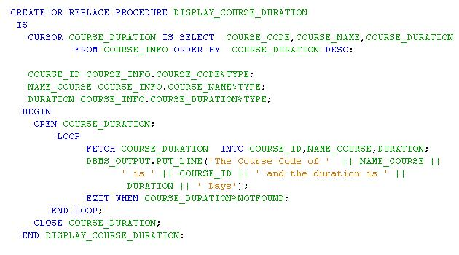
Lend a Hand - Solution
Execute the stored procedure and check output.

Slide 27
Lend A Hand-Cursor With Parameter
Prerequisites: Let us use CMS case study Course_Info table
Problem Statement: Retrieve the Course_Code, Course_Name, Course_Duration for a particular course available in the Course_Info table .
Expected Output: Print the following message for each of he courses.
“The Course Code of “ +<Course_Name> +“ is “ +<Course_Code> + ‘ and the duration is ‘ +<Course_Duration> + ‘Days’.

Slide 28
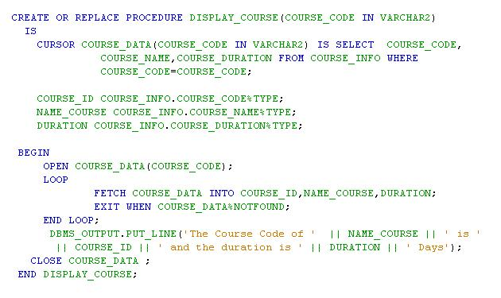
Lend a Hand - Solution
Execute the stored procedure with parameter and check output.

Slide 29
How to iterate cursors?
FOR loop is a used for iterating through explicit cursors.
While using FOR loop, the open, fetch, exit and close occurs implicitly.
The record is implicitly declared.
Syntax:
FOR record_name IN cursor_name LOOP
statement1;
statement2;
. . .
END LOOP;
Here the cursor is opened and records fetched implicitly.
Here record_name is the record which is declared implicitly
Note: You will be learning about records in the next session
Here the cursor is closed and loop is exited implicitly.

Slide 30
For Loop - Example
Create a procedure to examine the usage of cursors using for loop.
CREATE OR REPLACE PROCEDURE p_printEmps IS
CURSOR c_emp IS SELECT * FROM employee;
BEGIN
FOR i IN c_emp LOOP
DBMS_OUTPUT.PUT_LINE(i.first_Name||' '||i.last_name||' '||i.dept);
END LOOP;
END;
The cursor is opened, records are fetched and looped

Slide 31
FOR UPDATE Clause in Cursors
When you issue a SELECT statement against the database to query some records, no locks are placed on the selected rows. There are times, however, you will want to lock a set of records.
Oracle offers the FOR UPDATE clause to perform this locking.
When you issue a SELECT...FOR UPDATE statement, the RDBMS automatically obtains exclusive row-level locks on all the rows identified by the SELECT statement.
Thus the records are available "for your changes only".
No one else will be able to change any of these records until you perform a ROLLBACK or a COMMIT.
You can append the optional keyword NOWAIT to the FOR UPDATE clause to ensure that the rows are not locked by another user when firing the select query.

Slide 32
FOR UPDATE Clause Syntax and Example
Syntax:
CURSOR cursor_name
IS
select_statement
FOR UPDATE [OF column_list] [NOWAIT];
Example:
CURSOR c1
IS
SELECT employee_number, employee_name
FROM employee WHERE employee_name LIKE A
FOR UPDATE;
This retrieves all the employee whose name starts with “A” and locks the records from other users updating it.

Slide 33
WHERE CURRENT OF Clause in Cursors
If you want to update or delete records that are fetched using Select For Update clause you can use WHERE CURRENT OF clause.
This clause can be used with either update statement or delete statement inside a cursor.
This clause allows you to update or delete the record that was last fetched by the cursor.

Slide 34
WHERE CURRENT OF Clause in Cursors Example
Display all the product codes and product name from the products table.
DECLARE
CURSOR Products_Cursor IS SELECT productCode,productName FROM products
FOR UPDATE;
Product_Id Varchar2(20);
Product_Name Varchar2(30);
BEGIN
OPEN Products_Cursor;
LOOP FETCH Products_Cursor INTO Product_Id,Product_Name;
IF productCode=' S10_4698 '
UPDATE Products SET productName= 'Motorbike'
WHERE CURRENT OF Products_Cursor;
COMMIT;
END IF;
END LOOP;
CLOSE Products_Cursor;
END;

Slide 35
REF CURSOR in PL/SQL
What are REF CURSORS?
A Ref Cursor is basically a data type.
A variable created based on Ref Cursor is generally called a cursor variable.
What's the need for REF CURSOR ?.
If you want to specify cursor as a input or return value we can go for REF Cursor. The advantage of using ref cursor are they can be passed as parameter into sub programs like stored procedures, functions, packages etc.
Steps for creating REF CURSOR:
Step 1: Define a new data type which is of the type REF CURSOR.
TYPE MY_CURSOR IS REF CURSOR;
Step 2: Declare a cursor variable based on the new data type.
CURSOR_EMPLOYEE MY_CURSOR;

Slide 36
REF CURSOR-Example
Scenario: Let us assume we have a table Emp_Info with columns Emp_Id, First_Name,Last_Name,Emp_Salary. We need to display all the employees whose salary is less than 30000.
The example demonstrates a procedure named “Emp_Salary_Procedure“ inside a package “EMP_PACKAGE” with input parameter salaryRange and output should be a cursor named “Emp_Salary_Cursor” with all the details of employees whose salary is below 30000.
Develop a procedure named “Get_Emp_Salary_Procedure” inside the package which will invoke the "Emp_Salary_Procedure“ and display the details from the cursor returned

Slide 37
REF CURSOR-Example
Step #1: Create the package header
CREATE OR REPLACE PACKAGE EMP_PACKAGE
AS
TYPE EMP_SALARY_CURSOR IS REF_CURSOR;
PROCEDURE Emp_Salary_Procedure(salryRange IN Number,Emp_Details OUT Emp_Salary_Cursor);
PROCEDURE Get_Emp_Salary_Procedure;
END EMP_PACKAGE ;
Ref cursor declared.

Slide 38
REF CURSOR-Example
Step #2: Create the package body
CREATE OR REPLACE PACKAGE BODY EMP_PACKAGE
AS
PROCEDURE Emp_job_Procedure(salryRange IN Number,Emp_Details OUT Emp_job_Cursor)
IS
BEGIN
OPEN Emp_Details FOR SELECT Empnumber,Firstname,Lastname,Emp_Salary
FROM Employee Where jobtitle=salesrep;
END Emp_Salary_Procedure;
PROCEDURE Get_Emp_Salary_Procedure
IS
Emp_No Number(6);
Emp_First_Name Varchar2(25);
Emp_Last_Name Varchar2(25);
Emp_job Employee.jobtitle%type;
Emp_Details EMP_Package.Emp_job_Cursor;
BEGIN
Emp_job_Procedure(Emp_job,Emp_Details);
LOOP
FETCH Emp_Details INTO Emp_No,Emp_First_Name,Emp_Last_Name,Emp_job;
EXIT WHEN Emp_Details%NOTFOUND;
DBMS_OUTPUT.PUT_LINE(Emp_No || ' ' || Emp_First_Name || ' ' || Emp_Last_Name || ' ' || Emp_job);
END LOOP;
CLOSE Emp_Details;
END Get_Emp_job_Procedure;
END EMP_PACKAGE;
Ref cursor declared as out parameter.
Declare the cursor to store the output.
Execute the function.
Iterate through the cursor returned and print the details,

Slide 39
Cursor Vs Ref Cursor
Limitations of a normal cursors :
A PL/SQL program cannot pass a cursor as a parameter to another program.
A PL/SQL program can only open the cursor and process the information within the program itself.
To overcome these limitations REF CURSOR are used.
Features of REF CURSOR:
The ref cursor can be passed as a parameter to a procedure.
The ref cursor can take all the rows from the specified table.

Slide 40
Check Your Understanding
What is a ref cursor?
When do you go for Ref cursors?
How can one explicitly lock a set of rows from being updated by other users?

Slide 41

Summary
We have learnt following
Cursor
Reference Cursor.

Slide 42
Source
http://en.wikipedia.org/wiki/SQL
Disclaimer: Parts of the content of this course is based on the materials available from the Web sites and books listed above. The materials that can be accessed from linked sites are not maintained by Cognizant Academy and we are not responsible for the contents thereof. All trademarks, service marks, and trade names in this course are the marks of the respective owner(s).

Slide 43
ORACLE PL/SQL
You have successfully completed -
PL/SQL Cursors

Slide 44
Change Log
Version Number | Changes made
V1.0 | Initial Version
V1.1 | Slide No. | Changed By | Effective Date | Changes Effected

