Slide 1
Oracle PL/SQL
PL/SQL Triggers
LEVEL – LEARNER

Slide 2








Icon Used
Hands on Exercise
Reference
Questions
Points To Ponder
Coding Standards
Lend A Hand
Summary
Test Your Understanding

Slide 3

Overview
PL/SQL Triggers session provides knowledge and understanding of the use of PL/SQL Triggers in Oracle 10G and finally apply the syntax learned as part of this session in a case study provided.

Slide 4
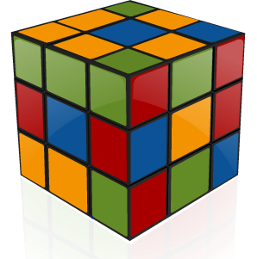
Objective
To understand the SQL operators concepts that a developer needs to know to work with it.
Triggers
Row Level Triggers
Statement Level Triggers.

Slide 5
Scenario
For complete understanding of ANSI SQL we are going to make use of Product Management System (PMS) for ABC Traders.
ABC Traders is a company which buys collectable model cars, trains, trucks, buses, trains and ships directly from manufacturers and sells them to distributors across the globe. In order to manage the stocking, supply and payment transactions the above software is developed.
As per the requirement of the trading company a inventory system is developed to collect the information of products and customers and their payment processing.

Slide 6
Database tables
There are many entities involved in Product Management System. PMS as given below which we will be dealing with throughout this course
Offices
To maintain information of Offices e.g. Office code, address, city etc.
Customer
To maintain customer details e.g. Customer Name, address
Employees
To maintain employee
details e.g. id,
Name etc.
Products
To maintain information of products e.g. product id, name etc.
Payments
To maintain information of payments done e.g. payment date, amount etc.
Orders
To maintain Orders done by customers e.g. order no ,date etc.
OrderDetails
To maintain Orders done by customers e.g. order no ,date etc.

Slide 7
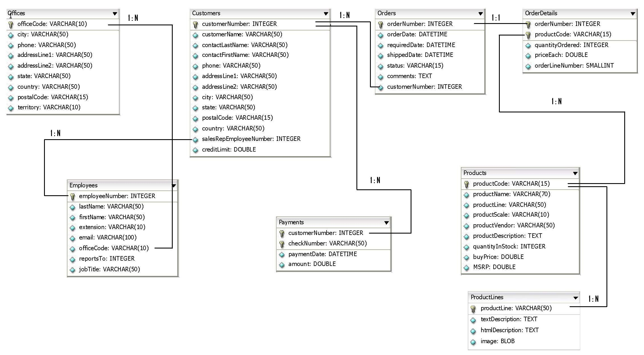
Schema diagram
Notes:
Trainer Note:
You can use a computer to type documents, send email, and browse the internet.
You can also use it to handle spreadsheets, accounting, database management, presentations, games, and more.
Software
Set of instructions for the hardware to accomplish a task.
List down any ten hardware parts of computer.
List down any five storage devices.
List down any five input devices.
What is the device which converts picture on a paper to an electronic image in computer ?

Slide 8

Scenario
Hi!
I want to ensure that no Orders to be made by customers during non business hours
Lets learn about PL/SQL Triggers which will help us meet TIM’s requirements..

Slide 9
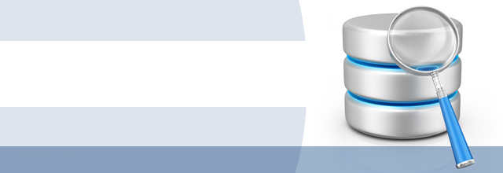
Do you Know
What are Triggers
?

Slide 10
Triggers
What is a Trigger?
Triggers are procedures that are stored in the database .
They are implicitly run i.e. they are fired whenever a particular event takes place.
Real World Example:
In a shop, whenever a customer tries to stealthily take out an unbilled item, a siren sounds at the gates.
Here, siren is the trigger fired and sneaking out an unbilled item is the event.
Oracle Example:
Whenever a row is deleted from the employee table a row is inserted into the employee_History table.
Here, Record deletion is the event which triggers a procedure a record in employee_history table

Slide 11
Features Of Triggers
It can be applied on any table or a view.
It can be applied before (or) after a query/instruction is executed.
It can work for all DML statements like INSERT, UPDATE, and DELETE.
It will not for DQL statements namely SELECT.
It can be used to overcome the limitation of CHECK constraints.
Do not define triggers to duplicate or replace the functionalities that are already built into the oracle database.
Example : Do not create triggers to implement unique constraint rule.

Slide 12
Triggers Syntax
For creating or replacing a trigger.
CREATE [OR REPLACE] TRIGGER triggername
{BEFORE | AFTER | INSTEAD OF}
{DELETE | INSERT | UPDATE [OF columns]}
ON table_name|SCHEMA
[REFERENCING [OLD AS old] [NEW AS new]]
[FOR EACH ROW [WHEN condition]]
<PL/SQL block>
Trigger timing
Trigger event
Trigger Type:
This option is included if the trigger is a row trigger, else by default it is statement trigger.
Trigger body

Slide 13
What is trigger timing?
Trigger timing:
It refer to the time when a trigger should fire (or) executed.
The possible trigger timing are BEFORE, AFTER , INSTEAD OF.
BEFORE:
Execute the trigger body before executing DML statement on a table.
AFTER:
Execute the trigger body after executing DML statement on a table.
INSTEAD OF:
Execute the trigger body instead of executing DML statement on the table.

Slide 14
Trigger Event & Body
Trigger Event:
The trigger event represents the events when the trigger needs to be trigger needs to be executed.
Example of events: can be INSERT, UPDATE, or DELETE.
Trigger Body:
This section specifies the action need to be performed by the trigger when an event occurs. It is typically a PL/SQL block that gets executed.

Slide 15
Triggers Types
Statement Level
Row level
Triggers

Slide 16
Statement Level Trigger
Statement Triggers:
In this, the trigger body is executed only once for the triggering event.
It is executed even if no rows are affected.
Statements triggers cannot be used to access the data that is being inserted , updated or deleted.
Let us learn statement level trigger with an example.

Slide 17
Statement Level Trigger-Example
Scenario: Let us assume that we have a table employee_details with columns deptno, ename, location.
The sample data is given below:
Assume that we have created a statement level trigger statement_trigger as follows,
CREATE OR REPLACE TRIGGER statement_trigger
AFTER UPDATE ON employees
BEGIN
DBMS_OUTPUT.PUT_LINE('After update Statement Level');
END;
DEPTNO | ENAME | LOCATION
10 | jack | newyork
20 | rose | newjersey
10 | ron | newyork
30 | lewis | iowa

Slide 18
Statement Level Trigger-Example
Let us see how this procedure works?
Assume that we update the location to ”auckland” for all department with number 10. If we execute the update statement as
UPDATE employees SET location='auckland' WHERE deptno=10
What happens now?
The trigger will be executed and oracle prints the message “After update Statement Level”. But if you look at the data two rows would have been updated but the message would have been printed only once.
Since it is a statement level trigger, message will be printed only once for each query statement.

Slide 19
Row Level Trigger
Row Triggers:
In this, the trigger body is executed once for each row affected by the triggering event.
It is not executed if no row is affected.
These triggers are useful if the trigger action needs to process the data changed and the data prior to the change.
Let us learn row level trigger with an example.

Slide 20
Row Level Trigger Example
Scenario: Let us consider the same employees_table. Let us create a row level trigger row_trigger as follows,
CREATE OR REPLACE TRIGGER row_trigger
AFTER UPDATE ON employees
FOR EACH ROW
BEGIN
DBMS_OUTPUT.PUT_LINE('After update row Level');
END;

Slide 21
Row Level Trigger-Example
Let us see how this procedure works?
Assume that we update the location to ”auckland” for all department with number 10. If we execute the update statement as
UPDATE employees SET location='auckland' WHERE deptno=10
What happens now?
The trigger will be executed and oracle prints the message “After update Statement Level”. But now it will be printed two times for each row updated in the system.

Slide 22
Row Level Triggers
While creating row level trigger, consider the following facts,
A row level trigger use :old and :new qualifiers to access the value of a column before and after the change of data by a DML operation.
Old and New qualifiers can only be used in row level triggers.
The following table illustrates the old and new value of a database table column before and after a DML operation:
DML Operations | Value Before Change (:OLD) | Value After Change (:NEW)
INSERT | NULL | Value that is inserted
UPDATE | Value before update | Value after update
DELETE | Value before delete | NULL

Slide 23
Row Level Triggers –Insert Example
Scenario: Assume that we have table loan_info with column interest_rate to store the interest rates of the loans.
Business Rule: If the user enters a loan record with interest less than 10% an error should be raised.
Solution: To do this a row level trigger is defined which checks the interest value whenever a loan row is inserted. If the interest amount is < 10% an error should be thrown.

Slide 24
Row Level Triggers –Insert Example
CREATE OR REPLACE TRIGGER interest_rate
BEFORE INSERT
ON loan_info
FOR EACH ROW
BEGIN
IF :NEW.interest_rate<10 THEN
RAISE_APPLICATION_ERROR(-20100, “interest rate should be greater than 10”);
END IF;
END;
Trigger raised when inserting records.
This checks if the new value passed to the DML statement is less than 10 we should raise error.
Here the “Before” keyword is used in trigger to ensure that the interest value is checked before executing DML insert statement.

Slide 25
Row Level Triggers –Update Example
Scenario: Assume that we have table emp_info which has a column salary.
Business Rule: Salary for employees should not be greater than 50000. Whenever the user updates a record system should ensure that salary is less than 50000.
If salary > 50000 an error should be raised.
Solution: A row level trigger is defined which checks the salary value whenever a row is updated. If the value is greater than 50000 raise an error.

Slide 26
Row Level Triggers –Update Example
CREATE OR REPLACE TRIGGER emp_salary
BEFORE UPDATE
ON emp_info
FOR EACH ROW
BEGIN
IF :NEW.salary>50000 THEN
RAISE_APPLICATION_ERROR(-20100,' Salary should be less than 50000');
END IF;
END;
Trigger raised when updating records.
This checks if the new value is greater than 50000 raise an error.
Here the “Before” keyword is used to ensure that the salary value is checked before executing DML update statement.

Slide 27
Row Level Triggers –Delete Example
Objective: Let us see how to use after delete trigger to store the deleted values into a history table along with the user name and date when the record was deleted.
This is done mostly for auditing purpose (To save history data).
Scenario Assume that we have a table emp_details which has columns empid, first_name, last_name, salary, dept.
We will use table employee_audit to store values which have been deleted.
Column sysdate is used for storing the date when record is deleted and column deleted_by to store the user who has deleted.

Slide 28
Row Level Triggers –Delete Example
CREATE OR REPLACE TRIGGER employee_after_delete
AFTER DELETE
ON Employees
FOR EACH ROW
DECLARE
v_name varchar2(10);
BEGIN
SELECT USER INTO v_name FROM DUAL;
INSERT INTO employee_audit
VALUES(:OLD.empid,:OLD.first_name,:OLD.last_name,:OLD.salary,:OLD.dept,SYSDATE,v_name);
END;
This trigger is fired on delete of a row in employee table
This gives the current user.
Data is inserted into an audit/history table

Slide 29
Activity
Now we are well versed with commands lets test our understanding using short case study
Case Study Scenario:
This case study is to develop a Course Management System (CMS) for ABC University. The following are the two use cases for which the database needs to be designed.
Add Course
– To add the course details into the course management system.
Retrieve Course
– Retrieve the courses stored in the system and display it.
The courses to be added will have the following attributes Course Code, Course Name, Number of participants, Course Description, Course Duration, Course start date and Course Type.
Course Management System (CMS) ABC University

Slide 30

Lend a Hand - Triggers
Problem Statement : To create a trigger which inserts records
into table course_fees_backup when inserting records into
course_fees table.
Prerequisite: Create the table course_fees_backup using the DDL statement which has all the columns of Course_fees table.

Slide 31
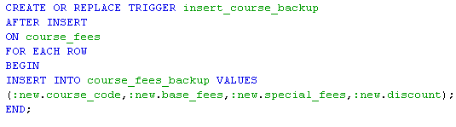
Lend a Hand - Solution
Solution:

Slide 32
Check Your Understanding
Can we use a trigger for a view?
Can one use a trigger for DQL queries?
What is the difference between statement and row type trigger?

Slide 33

Summary
We have learnt following
Triggers
Row Level Triggers
Statement Level Triggers.

Slide 34
Source
http://en.wikipedia.org/wiki/SQL
Disclaimer: Parts of the content of this course is based on the materials available from the Web sites and books listed above. The materials that can be accessed from linked sites are not maintained by Cognizant Academy and we are not responsible for the contents thereof. All trademarks, service marks, and trade names in this course are the marks of the respective owner(s).

Slide 35
Oracle PL/SQL
You have successfully completed -
PL/SQL Triggers

Slide 36
Change Log
Version Number | Changes made
V1.0 | Initial Version
V1.1 | Slide No. | Changed By | Effective Date | Changes Effected

