Slide 1
Advance Java
JSP Custom Tags
LEVEL – PRACTITIONER

Slide 2
About the Author
Created By: | Renjith(t-renjith)/ Shanmu (105110)
Credential Information: | Trainer/ Sr Architect
Version and Date: | 1.0, January 19’th 2012
Cognizant Certified Official Curriculum
Notes:
For tde animators:
tdis screen content needs to be rendered in tde flash, no animations needed.

Slide 3









Icons Used
Hands on Exercise
Questions
Tools
Coding Standards
Test Your Understanding
Case Study
Best Practices & Industry Standards
Demonstration
Workshop

Slide 4
Objectives
After completing this chapter you will be able to understand:
What is a custom tag?
Different types of custom tags?
How to develop custom tags?

Slide 5
Tim with a small problem
Tim was developing a web application where there were 75 developers developing 4000 web pages. The customer came up with a requirement were the current date in a specific format needs to be displayed in all the 4000 web pages in specific areas based on the layout of the page UI design. Tim’s architect proposed a solution which can be developed once and used in all the 4000 pages.
The solution proposed was to develop a custom tag which can be used in all the JSP page to display the custom date.

Slide 6
What is a custom tag ?
Custom tags are similar to the JSP tags.
The difference is these are user-defined tags.
So what is a user defined Tag?
User defined tags are nothing but tags which are developed by programmers for performing specific functionalities.
Example: <CustomDate></ CustomDate> // Custom tag developed by programmers to print the current Date in a specified format.
The above tag when used in JSP will print the current system date.
Tim and his project members used the above custom tag in their JSP to display the custom date.

Slide 7
Why Custom Tags?
Any common code which needs to be reused across the web application can be developed using custom tags.
Easy to maintain as the logic is centralized.
Any change to the logic just requires a one place change thus reducing the effort to change it.
Example: In the previous example if the date format changes only the custom tag “CustomDate” needs to be changed which gets automatically reflected throught the application.

Slide 8
Types of Tags
Simple Tags :
A simple tag contains no body and no attributes.
Example: <tt:CustomDate/>
Tags With Attributes :
A custom tag can have attributes. Attributes are listed in the start tag and have the syntax: attribute name ="value". Attribute are like configuration details for the custom tag
<tt:CustomDate attribute=“value”/>
Tags with Bodies :
A custom tag can contain custom, core tags, scripting elements and HTML text content between the start and end tag.
<tt:mytag>
<h1> This is body inside the tag </h1>
</tt:mytag>

Slide 9
How to create Custom Tags?
The following steps are to be taken to create a custom tag.
Step 1 : Create a tag handler class with the custom logic.
Step 2 : Create a tag library descriptor (TLD) and configure the custom handler.
Step 3 : Import the custom tag library in JSP using taglib directive.
Step 4 : Start using the custom tag in a JSP page.

Slide 10
Step 1 : Create Tag Handler
Tag handler is a Java class that holds the logic of the custom tag. This is triggered by the web container whenever it encounters the custom tag in a JSP file.
Custom tag must implement or extend any of the following interfaces or classes
Tag Interface
BodyTag interface
TagSupport class
BodyTagSupport class
SimpleTagSupport class
In this session we will be using the SimpleTagSupport class to create the custom tags.

Slide 11
SimpleTagSupport Class
The SimpleTagSupport class is the base class intended to be used for developing tag handlers.
The SimpleTagSupport class implements the SimpleTag interface and defines API’s which can be overridden by the custom tag handlers .

Slide 12
Methods in SimpleTagSupport
Method Name | Description
doTag() | The logic of the custom tag goes inside this method.
getParent() | Returns the parent of this tag.
setParent(JspTag tag) | Sets the parent of this tag.
setJspContext(JspContext context) | Stores the provided JSP context in the private jspContext field.
getJspContext() | Returns the page context passed in by the container via setJspContext.

Slide 13
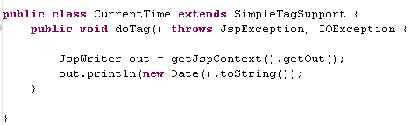
A Sample Tag Handler
Custom Tag Handler Name
Tag Handler extending the
SimpleTagSupport class
doTag() method which performs the tag’s logic.

Slide 14
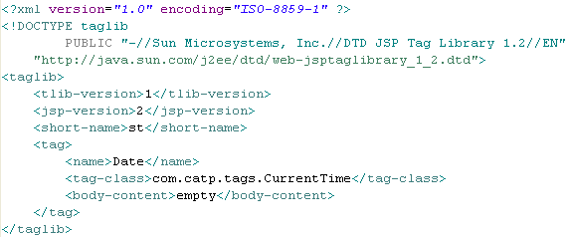
Step 2 : Create TLD File.
TLD stands for Tag Library Descriptor
TLD file is an XML file containing details of all the tags being created.
TLD should be placed in web-inf directory
Sample TLD
XML document type specification for TLD file
Root tag is taglib for a tld file
Specifies tag library and JSP version
Declares the tag name, specifies the tag-handler class and states that the body of the tag is empty.

Slide 15
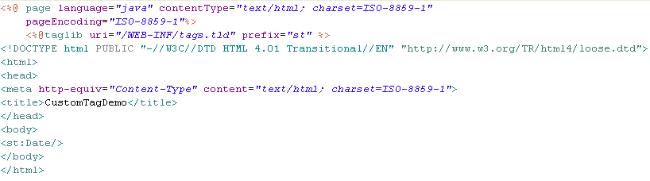
Step 3 & 4 : Import the tag lib and use in JSP.
Step 3: Import the custom tag uri using taglib directive
Step 4: Custom tag used in the JSP body.
When this tag is parsed by the web container the doTag() method of the CurrentTime tag handler is invoked.

Slide 16
Lend a Hand – Tag Without body
In this demo we are going to create a Date tag without a body which prints the Current Date on the jsp page.
Components to be developed:
CurrentDate: The tag handler class which displays the current date & Time.
Tags.tld : The tld file which holds the configuration details of the custom tag.
datePage.jsp : Jsp page which uses the date tag to display the current date

Slide 17
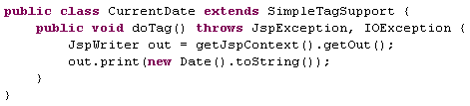
Lend a Hand : Develop the Tag Handler
Create the tag handler named CurrentDate that extends the SimpleTagSupport class
Gets the JSPwriter object for the current page from the current page context
Prints the current date

Slide 18
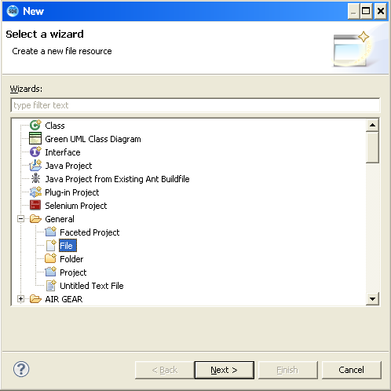
Lend a Hand : Create TLD file
Create a file named tags.tld and place it inside inside the web-inf directory
Right Click web-inf→ new → General→File and click next

Slide 19
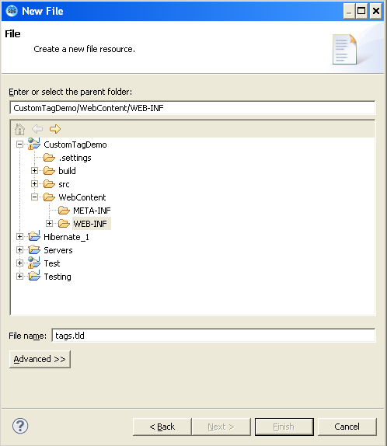
Lend a Hand : Create TLD file(cont)
Enter the file name as tags.tld

Slide 20
Lend a Hand – TLD file (Cont)
Open tags.tld and add the following Document Type Specification
<?xml version="1.0" encoding="ISO-8859-1" ?>
<!DOCTYPE taglib
PUBLIC "-//Sun Microsystems, Inc.//DTD JSP Tag Library 1.2//EN"
"http://java.sun.com/j2ee/dtd/web-jsptaglibrary_1_2.dtd">
<taglib>
<tlib-version>1</tlib-version>
<jsp-version>2</jsp-version>
<short-name>st</short-name>
</taglib>

Slide 21
Lend a Hand – TLD file (Cont)
Add the date tag inside the tag-lib root tag.
<tag>
<name>Date</name>
<tag-class>com.catp.tags.CurrentDate</tag-class>
<body-content>empty</body-content>
</tag>

Slide 22
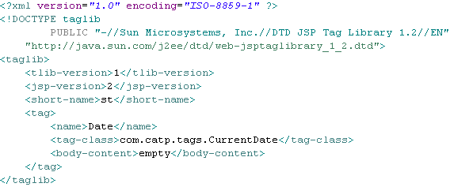
Lend a Hand – TLD File (Cont)
After adding all the components the TLD file should be as shown below

Slide 23
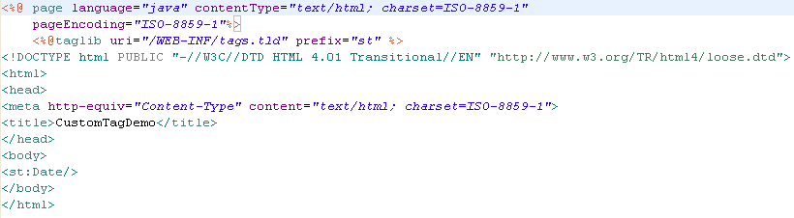
Lend a Hand – Create datePage.jsp
Imports the tag URI. Prefix specifies the prefix used to identify the tags from the URI
Use the date tag . Note: the prefix st is used to identify the Date Tag in the included tag URI

Slide 24
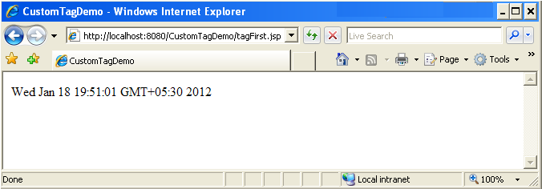
Lend a Hand – Create datePage.jsp
Output Expected

Slide 25
Lend a Hand – Deploy and Run
Step 1 : Deploy and run the application
Step 2 : Invoke datePage.jsp from the browser
http://localhost:8000/MyApplication/datePage.jsp
Step 2 : Notice the Date and Time displayed in the screen.

Slide 26
Tags with Attributes
Attributes are used to modify the behavior of a tag.
To add attributes to a tag the following additional tags must be done
Step 1 : Add a attribute as a property to the tag handler
Step 2 : Create setter method for the property following the bean setter naming convention
Step 3 : Add the attribute requirement specification in the tld file

Slide 27
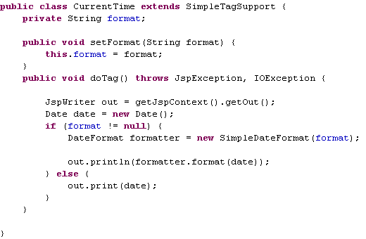
Step 1 : Adding property in Tag Handler.
Step 1: Property added.
Step 2: Setter method added for the attribute following the bean naming convention

Slide 28

Step 2 : Adding the attribute in the tld file
Specify the attribute configuration in the tld . It should be added inside the <tag> element for which the attribute is to be applied
Attribute Name should be same as the property name in the Tag Handler class
Specifies whether the attribute is optional . False denotes optional.
<attribute> element can have other inner elements like
<rtexprvalue> : To set whether the attribute can accept jsp expressions
<type> : to specify the java data type of the attribute. Example: java.lang.String. This is an optional element.
<description >: To give a description about the attribute

Slide 29
Lend a Hand : Adding a Attribute
Let us now add an attribute in the CurrentDate custom tag we developed.
Let us add a attribute which will help the programmers to specify the format in which the date can be displayed in the JSP file.
Step 1 : Add the date format attribute to the tag handler CustomDate.
Step 2 : Add the date format specification into the tags.tld file
Step 3 : Pass the date format as an attribute to the date tag in the datePage.jsp

Slide 30
Lend a Hand : Adding the attribute in TagHandler
Add the date format in the Tag Handler as shown below,
Attribute Name
Setter method for the attribute following the bean naming convention
Date formatter formats the date according to the format passed and displays the date based on the specified format.

Slide 31
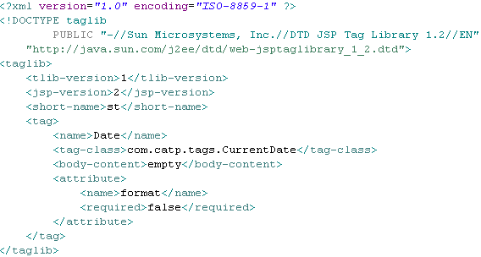
Lend a Hand : Add the attribute in the tld file
Add the attribute specification in the TLD.
Attribute Specification added.

Slide 32
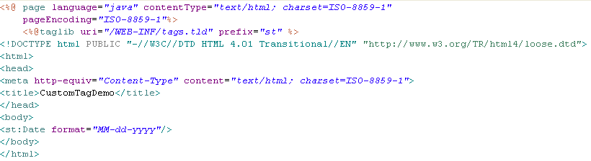
Lend a Hand : Pass the date format with the Date tag in datePage.jsp
Date format passed as an attribute to the date tag

Slide 33
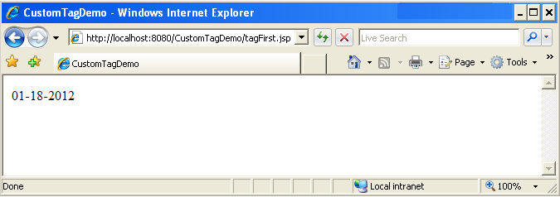
Lend a Hand : datePage.jsp
The date will be displayed as illustrated below "MM-dd-yyyy"

Slide 34
Lend a Hand – Deploy and Run
Step 1 : Deploy and run the application
Step 2 : Invoke the datePage.jsp from the browser
http://localhost:8000/MyApplication/datePage.jsp
Step 3 : Notice the Date and Time displayed in format MM-DD-YYYY.
Change the format of the date using the attribute and see how the date gets changed in the screen.

Slide 35
Tags With Body
We can create custom tags with body.
The tag handlers can access the tag body and can do some processing on the body content.
Example :
If we want some text to be always capitalized we can place it inside a custom tag body whose handler can read the text and capitalize and print it.
Create a Tag Handler for the Capital tag which can convert all the letters to uppercase.
<tt:Capital>Capitalize This Text </tt:Capital>

Slide 36
Steps in Creating a Custom Tag with Body
Step 1 : Create a Tag Handler extending the SimpleTagSupport class
Step 2 : Override the doTag() method .
Step 3 : Develop the logic in the doTag() method to read and process the text content.
Step 4 : Specify the body-content entry in the tld file.

Slide 37
Lend a Hand : Custom Tag
Let us now create a custom tag with a body tag.
We will create a body tag which can accept a text and convert it to upper case.
Components to be developed:
UpperCaseTag : Custom tag handler for developing tags with body.
bodyTagDemo.jsp : Jsp page which uses the custom tag.

Slide 38
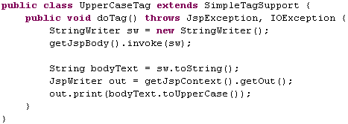
Lend a Hand : Create the Tag Handler
Creates a StringWriter object to hold the text specified in the custom tag.
This will load the custom tag text into the string writer
Converts the tags content into a String.
The String is then converted to upper case and returned to be displayed in the JSP file.

Slide 39
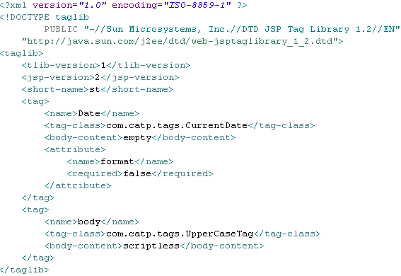
Step 4 : Add the tag to TLD
Custom Tag added to TLD
The body-content is set as scriptless which means The body accepts only static text, EL expressions, and custom tags. No scripting elements are allowed.

Slide 40
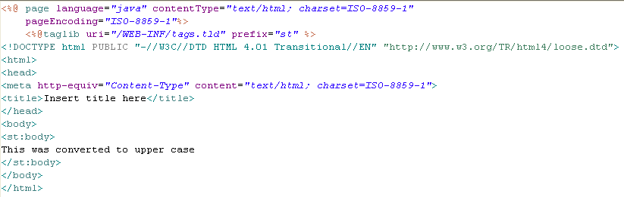
Lend a Hand : Create bodyTagDemo.jsp
Develop the JSP as shown below

Slide 41
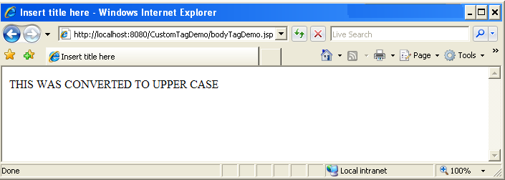
Lend a Hand : Output
Output Expected

Slide 42
Lend a Hand : Deploy and Run
Step 1 : Deploy and run the application
Step 2 : Call datePage.jsp from the browser
http://localhost:8000/MyApplication/bodyTagDemo.jsp
Step 3 : Any text which is specified within the tag gets automatically converted to uppercase and displayed.

Slide 43

Time To Reflect
Associates to reflect the following before proceeding.
What are the steps to create a custom tag?
When should we go for custom tags?
How can one set properties for custom tags?

Slide 44
Lend a hand : For Further Practice
Objective: Develop a custom tag with a complex functionality.
Here we are going to create a custom table tag which can accept the table headers and table data and dynamically generate a HTML table.
Components Developed:
TableTag : Tag Handler for displaying table data from a list of user Beans.
User bean class : A bean class which stores user information.
tableDemo.jsp : The jsp page which uses the tabel tag.
In this demo we pass a list of users (user bean) to the Table tag which should print them in tabular format in the jsp page . For the demo the user bean will be hard coded in the JSP and passed to the custom tag.

Slide 45
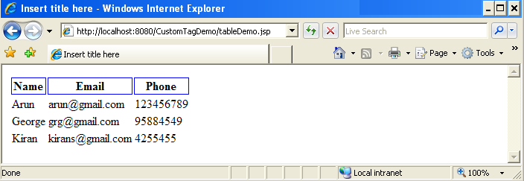
Lend a Hand : Output Expected
Each row in the table represents a user bean class.

Slide 46
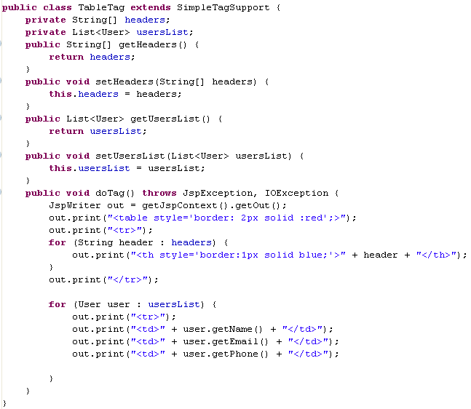
Lend a Hand : Develop TableTag
Headers :For holding the table headers (Column names)
usersList: For holding the list of user bean (table rows)

Slide 47
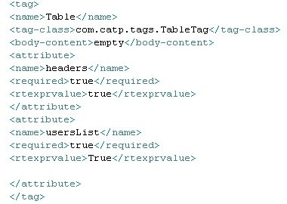
Lend a Hand : Add the TLD
Add the following to the TLD file
The rtexpvalue element is set to true to make the tag accept jsp expressions

Slide 48
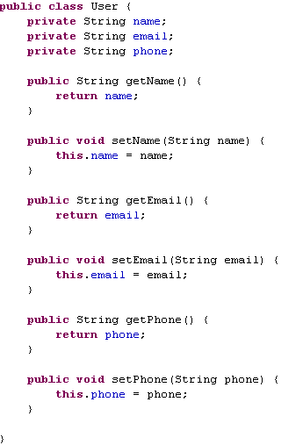
Lend a Hand : Develop User Bean
Create a user bean class named User to hold the user information. Create the bean inside the package named com.catp.beans

Slide 49
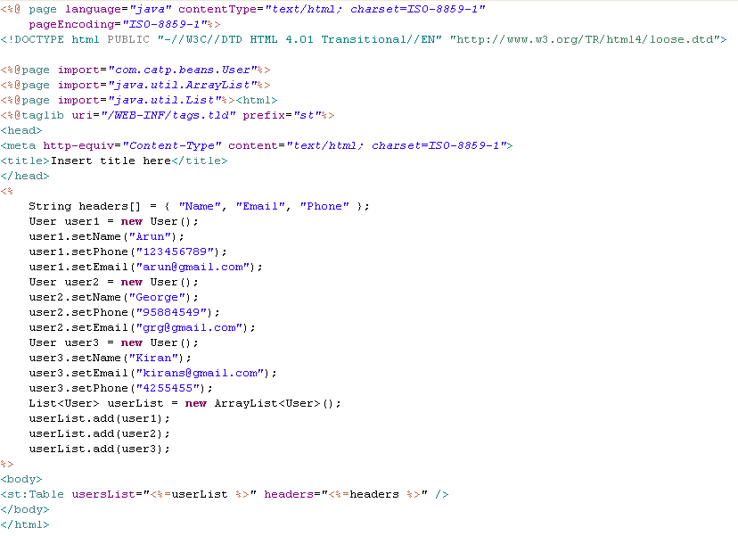
Lend a Hand : tableDemo.jsp code
Creates the table header
Creates three user bean objects
Creates an arraylist and adds the user bean objects to the list
Creates the table tag and passes header and userlist as arguments

Slide 50
Deploy and Run
Step 1 : Deploy and run the application
Step 2 : Call datePage.jsp from the browser
http://localhost:8000/MyApplication/tableDemo.jsp
Step 3 : The user information needs to be displayed in a tabular format.

Slide 51
Advance Java
You have successfully completed –
Custom Tags

