Slide 1
Advance Java
JSP Directives
LEVEL – PRACTITIONER

Slide 2
About the Author
Created By: | Renjith(t-renjith)/ Shanmu (105110)
Credential Information: | Trainer / Sr Architect
Version and Date: | 1.0, January 12’th 2012
Cognizant Certified Official Curriculum
Notes:
For tde animators:
tdis screen content needs to be rendered in tde flash, no animations needed.

Slide 3









Icons Used
Hands on Exercise
Questions
Tools
Coding Standards
Test Your Understanding
Case Study
Best Practices & Industry Standards
Demonstration
Workshop

Slide 4
Objectives
After completing this chapter you will be able to understand:
What is JSP directive
Type of Directives

Slide 5
What is a JSP Directive ?
A directive provides meta data information about the JSP file to the web container.
Web container uses this during the translation/compilation phase of the JSP life cycle.
Examples:
Importing tag libraries
Import required classes
Set output buffering options
Include content from external files

Slide 6
Types of Directives
The JSP specification defines three directives,
Directive | Purpose
Page | Provides information about page, such as scripting language that is used, content type, or buffer size etc.
Include | Used to include the content of external files.
Taglib | Used to import custom tags defined in tag libraries. Custom tags are typically developed by developers.
NOTE: Taglib directive will be explained in detail in JSP custom tags session.

Slide 7
JSP Directive Syntax
A JSP directive is declared using the following syntax.
<%@directive attribute="value" %>
Where
directive – The type of directive (page ,taglib or include)
attribute – Represents the behavior to be set for the directive to act upon.

Slide 8
Page Directive
The page directive is used to provide the metadata about the JSP page to the container.
Page directives may be coded anywhere in JSP page.
By standards, page directives are coded at the top of the JSP page.
A page can have any number of page directives .
Any attribute except the import attribute can be used only once in a JSP page.
Single can contain more than one attribute specified.
Syntax :
<%@page attribute1=“value” attribute2=“value” %>

Slide 9
Attributes for Page Directive
Attribute | Purpose
buffer | Specifies a buffering model for the output stream. Same as the servlet buffer. <%@ page buffer="none|8kb|sizekb" %>
autoFlush | Controls the behavior of the servlet output buffer. <%@ page autoFlush=“True\False" %>
contentType | Defines the character encoding scheme. <%@ page contentType="text/html;charset=ISO-8859-1" %>
errorPage | The errorPage directive takes a valid relative URL to a JSP file to which the control is redirected in case of any exceptions.. <%@ page errorPage="relativeURL" %>
isErrorPage | Works in tandem with the page errorPage directive and specifies that this JSP is an error page. <%@ page isErrorPage="true|false" %>

Slide 10
Attributes for Page Directive
Attribute | Purpose
extends | Specifies a super class that the generated servlet must extend <%@page extends="myServletClass"%>
import | Specifies a list of packages or classes to be imported for JSP to use similar to java import.. <%@page import="java.util.Date , java.io.FileReader"%> More than one package can be imported either by using separate page directive or using comma separated list in a single directive.
info | Defines a string that can be accessed with the servlet's getServletInfo() method. <%@ page info=“information" %>
isThreadSafe | Defines the threading model for the generated Servlet. <%@ page isThreadSafe="True|False" %>

Slide 11
Attributes for Page Directive
Attribute | Purpose
language | Defines the programming language used in the JSP page. <%@page language="java" %>
session | Specifies whether or not the JSP page participates in HTTP sessions <%@page language="java" session="true" %>
isELIgnored | Specifies whether or not EL expression within the JSP page will be ignored. <%@ page isELIgnored="True|False" %>
isScriptingEnabled | Determines if scripting elements are allowed for use. <%@ page isScriptingEnabled="True|False" %> Setting to false will throw error during translation if your page contains any scripting element such as scriplets , expression etc

Slide 12

Are you confused…
Confused on seeing so many directives?
Just relax and focus on the following 4 directives which are commonly used in application development.
Buffer
Error Page
Import
Session
Lets do some hands on these directives.

Slide 13

Include Directive
This directive inserts a HTML file or a JSP file into another JSP file at translation time as illustrated below,
User views the combined output of both the pages.
User requests for mypage.jsp
R
E
Q
U
E
S
T
R
E
S
P
O
N
S
E
header.jsp
3
During the translation phase the contents of header.jsp are translated along with mypage.jsp , gets included inside mypage_jsp.java as a single file
2
Includes
1
mypage.jsp
mypage_jsp.java
Translation
mypage.jsp
+
Header.jsp

Slide 14
More on Include Directive
The include process is static, it means that the text of the included file is added to the JSP file. (Similar to copy pasting the contents).
The included file can be a JSP file, HTML file, or text file.
If the included page is a JSP page it will be translated along with the main JSP page.
Note :
Be careful that the included file should not contain <html>, </html>, <body>, or </body> tags.
Because the entire content of the included file is added to the main JSP file, these tags would conflict with the same tags in the main JSP file, causing an error.

Slide 15
How to create an include directive?
Include directive is created using the following syntax
<%@include attribute =“value”%>
Include can have only file attribute.
<%@include file =“value”%>
Where file specifies the relative path of the file to be included.
Example :
<%@include file =“header.html”%>
Includes a file named header.html

Slide 16
Lend a Hand – Page and Include Directive
In this demo the associates will get familiarized with some of the commonly used page directives and the include directive.
We will be using the following page directive attributes and include directive in this demo
import
errorPage
isErrorPage
Session
buffer

Slide 17
Lend a Hand :Page and Include Directive
Scenario : You are asked to create an application which accepts a person’s name and prints a greeting . If the name user input is null the system should display an error page.
Develop the components as given below
welcome.jsp : The page which accepts the name from the user
errorPage.jsp : The page to be displayed in case of error
greetings.jsp : The page which displays the greetings to the user
header.html :- The header for all the pages which can be reused across pages
footer.html :- The footer for all the pages which can be reused across pages

Slide 18
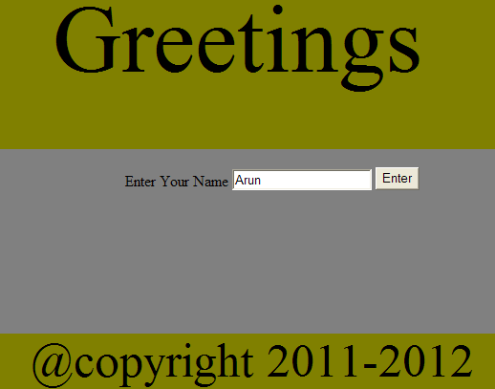
Lend a Hand :Welcome Page design
Create welcome.jsp as shown below . The page should contain the following fields,
1 : Text box to accept the name
2 : Submit button for form submit.
Header page to be included in all the pages.
The main page containing the form control.
Footer page to be included in all the pages.

Slide 19
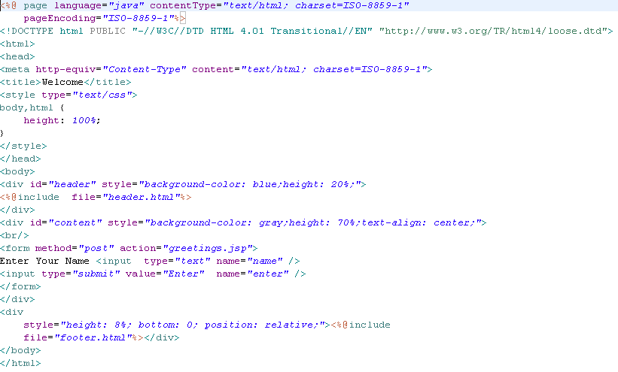
Lend a Hand : Develop Welcome Page
Includes header.html
Includes footer.html

Slide 20
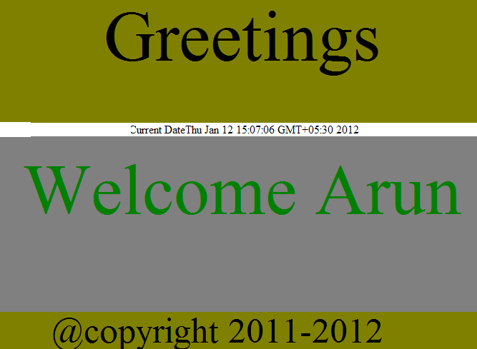
Lend a Hand :Greetings Page design
Greetings page should be created as shown.

Slide 21
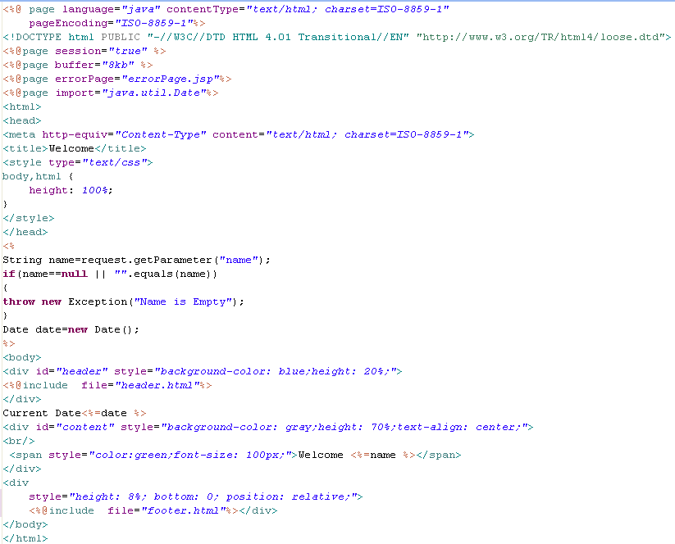
Lend a Hand – Develop Greetings page.
The session , buffer , errorPage , import attributes are set for the current page using the page directive
Throw Exception if name is null
Includes header.html
Includes footer.html

Slide 22
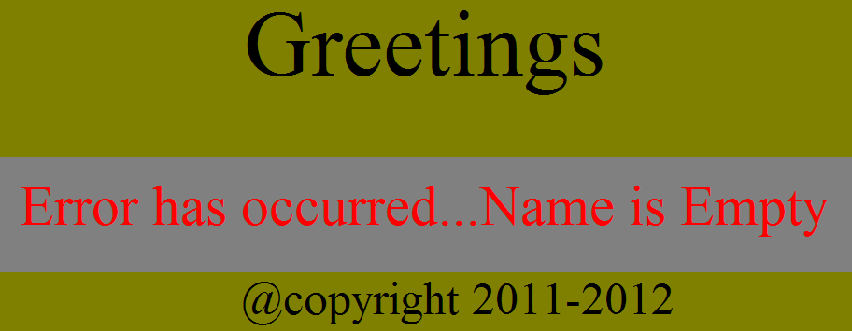
Lend a Hand – Error Page Design
Error page should be created as shown below

Slide 23
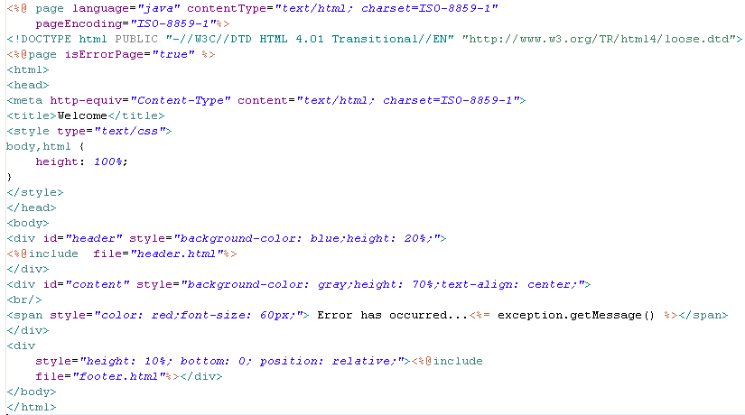
Lend a Hand – Develop Error Page
isErrorPage attribute is set
Implicit object exception is available since isErrorPage attribute is set true.

Slide 24
Lend a Hand – Develop Header and Footer
Header.html
footer.html

Slide 25
Lend a Hand – Deploy and Run
Step 1 : Deploy and Run the application
Step 2 : Invoke welcome.jsp from the browser http://localhost:5001/DirectivesDemo/welcome.jsp
The welcome page displayed with header and footer included.
Step 3 : Enter name and submit
Greetings page will be displayed with the greeting message.
Step 4 : Invoke the welcome page again from the browser . Submit the page without entering the name. Error page will be displayed.
Note : In case error page is not getting displayed in Internet Explorer uncheck the option “ show friendly error message “ under the advanced tab in internet option.

Slide 26

Time To Reflect
Associates to quickly summarize the following before ending the session
What are JSP directives?
What directive is used to set the error page for a jsp page?
What directive is used for importing packages into a jsp page?
How to disable session for a jsp page?
What directive is used for including external pages into a JSP page?

Slide 27
Advance Java
You have successfully completed –
JSP Directives

