Slide 1
Advance Java
Expression Language
LEVEL – PRACTITIONER

Slide 2
About the Author
Created By: | Renjith(t-renjith)/ Shanmu (105110)
Credential Information: | Trainer / Sr Architect
Version and Date: | 1.0, January 17’th 2012
Cognizant Certified Official Curriculum
Notes:
For tde animators:
tdis screen content needs to be rendered in tde flash, no animations needed.

Slide 3









Icons Used
Hands on Exercise
Questions
Tools
Coding Standards
Test Your Understanding
Case Study
Best Practices & Industry Standards
Demonstration
Workshop

Slide 4
Objectives
After completing this chapter you will be able to understand:
What is an Expression Language(EL)?
Implicit objects in EL?
EL operators ?

Slide 5
Expression Language (EL)
Expression Language (EL) is a simple language for accessing data stored in java beans.
This was introduced with the JSP 2.0 specification.
It can also be used to access the values from implicit objects like page context , header , cookie etc.
Expression languages are always specified within curly braces and prefixed with a dollar sign.
Example : ${person.name}

Slide 6
Advantages of EL
Concise access to stored objects : Easy to access the attributes stored in session, request or application scope.
Example :${name} search the PageContext, HttpServletRequest, HttpSession, and ServletContext (in that order) for an attribute named name.
Equivalent to <%= pageContext.findAttribute("name") %>
Short hand notation for bean properties : Easy to access bean properties.
Example : To print the property phoneNumber of a userBean we can use ${user.phoneNumber} instead of <%=user.getPhoneNumber()%>
Simple access to collection elements To access an element of an array, List, or Map, you use ${variable[indexOrKey]}.
Example: Consider an arraylist myList
${myList[0]} , Gets the first element in the list and prints it.

Slide 7
Advantages of EL (Cont)
Easy access to request parameters, cookies, and other request data.
To access the standard types of request data, you can use one of several predefined implicit objects.
Conditional output :To choose among output options, we do not have to resort to Java coding elements. Instead, you can use
${test ? option1 : option2}
There are lots of such advantages. You will come to know when you use it.

Slide 8
EL Implicit Objects in a nutshell
Object | Description
pageContext | The pageContext object refers to the PageContext of the current page.
param | To access a single value request parameter.
paramValues | Contains the array of parameter values
header | Contains the header values as a map
headerValues | Contains complete header values
cookie | Returns the incoming cookies as a map
initParam | For easy access of initialization parameters as a map
pageScope | Contains the page scope values as a map
requestScope | Contains the request scope values as a map
sessionScope | Contains the session scope values as a map
applicationScope | Contains the application scope values as a map
You Will learn about few of these in this session

Slide 9
What is Period (.) operator?
To access Implicit object’s attributes:
For example to read an attribute message in sessionScope we use
${sessionScope.message}
2. To access bean properties:
Consider a bean named person having a property name which can be accessed as
${person.name}
3. To access map values:
Consider a map named country having a key named ”ind” . Value of the key can be accessed as
${country. ind}

Slide 10
[] Operator
The [ ] operator can be used instead of the period operator, lets look at few examples,
To access beans: ${person[“name”]} reads the property named name in the person bean. Equivalent to ${person.name}
To access Map Values: ${country[“ind”]} retrieves the value for the key ind in the country map. Equivalent to ${country. Ind}
3.To access elements from arrays and list: ${fruits[1]} retrieves the value at index 1 in the fruits array (list).

Slide 11
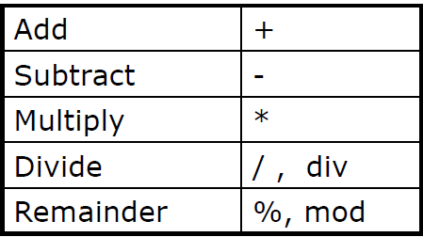
EL – Arithmetic Operators

Slide 12
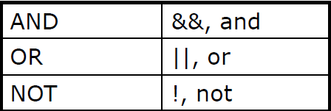
EL – Logical Operators

Slide 13
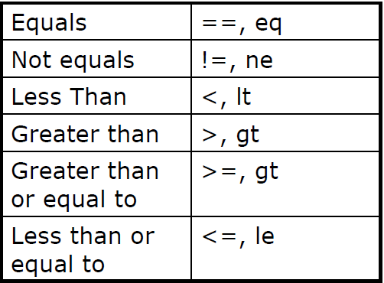
EL – Relational Operators

Slide 14
How to Read Request Parameter Values ?
Request parameter values can be read as shown
${param.userName} or ${param[“userName”]}
Reads the value of the parameter named userName set in the request
If a single request parameter name contains a array of values, example in the case of Check box parameter, we use
${paramValues.hobbies[0]} or ${paramValues.hobbies[0]}
Reads the first value of the check box hobbies.

Slide 15
How to read attributes ?
Consider a scenario in which you need to access an attribute with name Username stored in some scope we use
${Username}
Searches the PageContext, HttpServletRequest, HttpSession, and ServletContext (in that order) for an attribute named Username.
Suppose we if want to get the attribute with name name in a specific scope say session , we use
${sessionScope.name}
NOTE: Similiarly if you want to access a application scope parameter use the key word, “applicationScope”

Slide 16
How to Access Bean Properties ?
To read a property named firstName in a bean named customer we use
${customer.firstName}

Slide 17
How to access Collection Objects?
Consider attributeName is a scoped variable referring to an array, List or Map, an entry in the collection can be accessed by
${attributeName[entryName]}
Example 1: consider and a String array customerNames
${customerNames[0]} reads the first element in the array
Example 2: If customerNames is a List object
${customerNames[0]} reads the first element in the list
Example 3: If stateCapitals is a Map object containing the states of India as key and their capitals as value
${stateCapitals[“Rajasthan”]} returns the capital of Rajasthan.

Slide 18
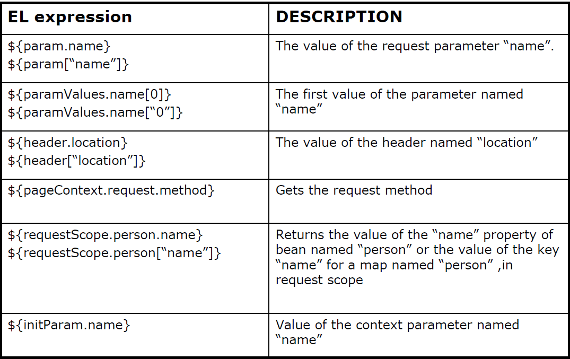
Accessing Implicit Objects using EL in a Nutshell.

Slide 19
Deactivating Expression Evaluation
If your application requires EL to be ignored it can be done by setting the isELIgnoredAttribute to true in the page directive.
<%@ page isELIgnored ="true" %>
Setting this parameter to “True” , EL tags will not be interpreted by the container.
Will print the EL tags as it is in the JSP page.

Slide 20

When to Use EL?
EL should be used for accessing and presenting data from implicit objects.
Don’t use EL operators and conditions for performing business logic which should be strictly done in business components.
Business components: Here refers to the Java classes which is developed with business logic and are invoked by controllers (Typically servlets)

Slide 21
A Simple Lend A Hand On EL.
This is a demo to get familiarized with basic usage of EL .
Objective: you will get familiar with,
How to access Implicit object such as params , header , requestScope , sessionScope , applicationScope
How to access bean properties?
Usage of period operator.
Usage of [ ] Operator.

Slide 22
Lend a Hand - Scenario
Scenario: Building a registration application, let us build a registration form where the user registers himself. The registered details is then displayed to the user.
Components to be developed:
Registration.jsp : Renders the registration form page
RegistrationServlet : Handles the registration process and forwards the request to success.jsp.
User Bean - To hold the user registration details.
success.jsp : Prints the user Registration details.
NOTE: For the demo purpose some values irrelevant to the problem statement is also printed such as the user-agent . This is purely for the associates to understand.

Slide 23
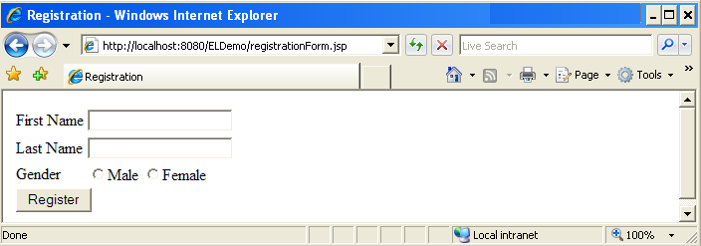
Lend a Hand : Registration page design
The registration page design is as follows.

Slide 24
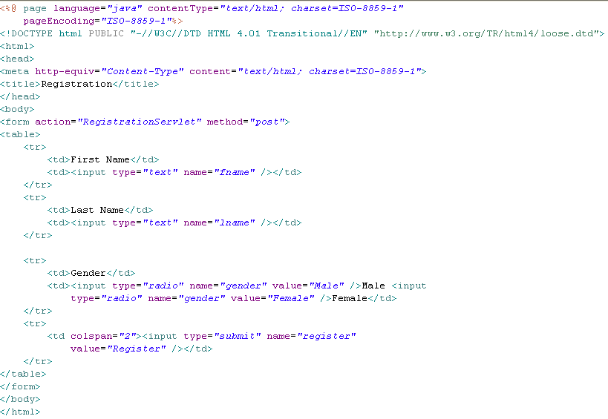
Lend a Hand : registration.jsp code
Develop the registration page.

Slide 25
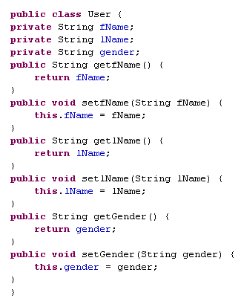
Lend a Hand : User – Bean Class
Create the User bean in a package named com.catp.beans as mentioned below.

Slide 26
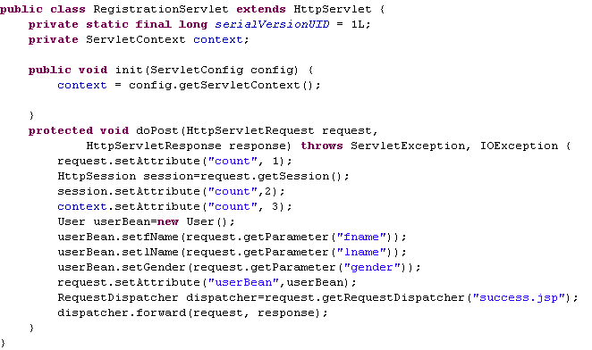
Lend a Hand : Develop RegistrationServlet
Develop the registration servlet and set a count variable in request, session and application context.
Sets a attribute named count to request
Sets a attribute named count to session
Sets a attribute named count to context
Creates user bean object , loads with request parameter values and sets this as a attribute to request

Slide 27
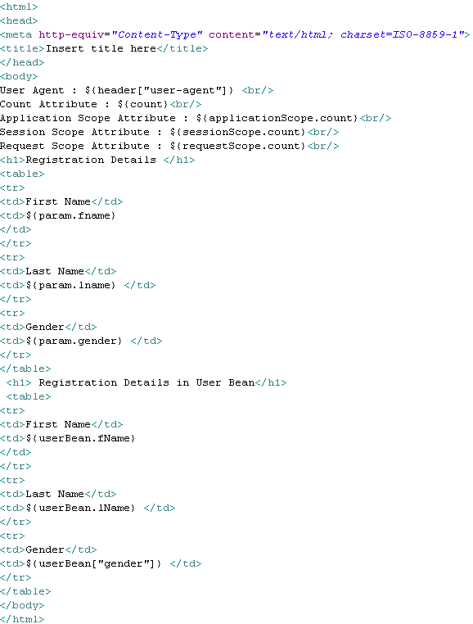
Lend a Hand : Develop Success.jsp
Reads the user agent value in the header.
Reads an attribute named count
Reads attribute named count in the various scope
Reads the request parameter values
Reads values from user bean object

Slide 28
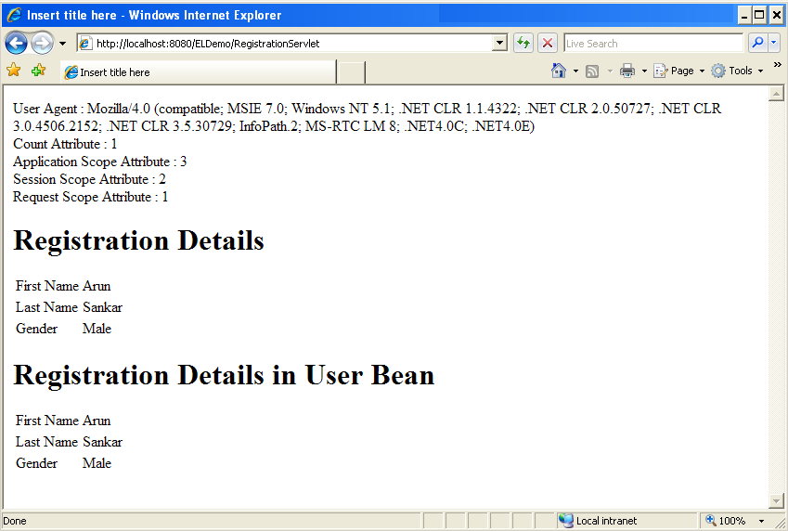
Lend a Hand : Success.jsp
User agent value in the header . Can be printed using ${header["user-agent"]}
Count attribute printed using ${count} . The value in the request object will be printed since the order is request-session-application
The values is the application , session and context scopes printed using
${applicationScope.count}
${sessionScope.count}
${requestScope.count}
Parameter values printed using param object
using ${param.fname}
Parameter values printed using bean object
using ${userBean.fName}

Slide 29
Lend a Hand – Deploy and Run
Step 1 : Deploy and run the application
Step 2 : Invoke registration.jsp from the browser
http://localhost:8080/ELDemo/registration.jsp
Step 2 : Look at the details displayed in the success page,
Details displayed from the header implicit object.
Details printed from request object.
Details displayed from session object.
Details displayed from application object.
Details displayed from user bean object.

Slide 30
Advance Java
You have successfully completed –
Expression Language

