Slide 1
Programming Concepts
Algorithm & Data Structures
LEVEL – LEARNER

Slide 2





Icons Used
Questions
Hands -on Exercise
Summary
Test Your Understanding
Reference

Slide 3

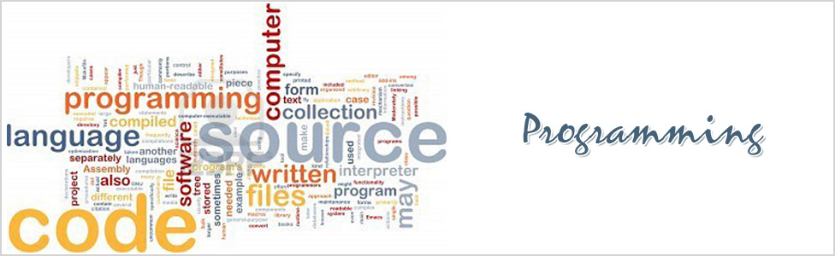
Programming Concepts
You already know what a computer is and about the need for an Operating system.
To make operating system understand our commands we need to write programs.
In this course, you will learn how to write program.
Welcome to Programming Concepts!

Slide 4







Content Overview
This session on Programming Concepts will provide knowledge and understanding of programming concepts like Algorithm, pseudo code, flow charts, data structures, control structures, functions, and File Handling.
Algorithm & Data structures
File Handling
Pseudo code
Programming Concepts
Functions
Flow Chart
Control Structures

Slide 5
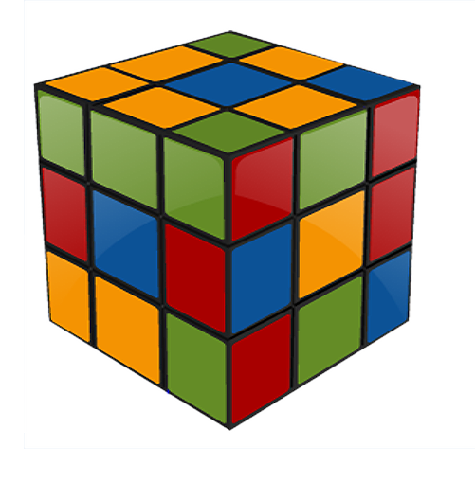
Objectives
At the end of this session you will be able to:
Define an Algorithm.
Define a Flowchart.
Define data structures.
Describe the process of writing a Pseudo code.

Slide 6

Programming Language
Let me explain why we need programming?
We need programming languages because:
Like all other languages, programming language is also a way of communication.
Human beings communicate with each other through different languages such as English, Hindi, etc. Similarly, to communicate with computers, the programming language has been invented.
Programming languages can be used to create programs that control the behavior of a machine.

Slide 7
Fundamentals of Programming
What is a program?
A Program is :
A Sequence of steps to solve a particular problem.
A Set of symbols, codes, and words used to write a program.
What can a program do?
A Program can:
Get Input
Calculate values
Store data (value)
Write Output

Slide 8
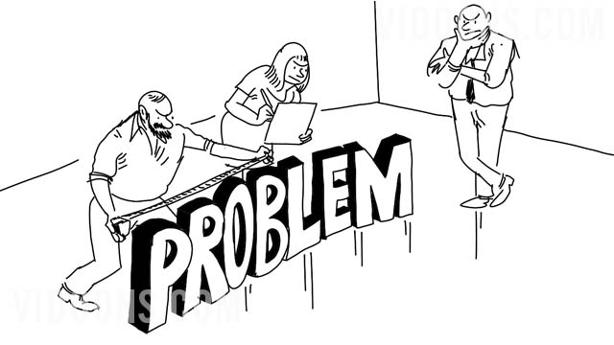

Ways to Solve a Problem
What are the different ways of solving a problem!
The three easy ways to solve the problem are given below:
Algorithm
Flowchart
Pseudo code

Slide 9
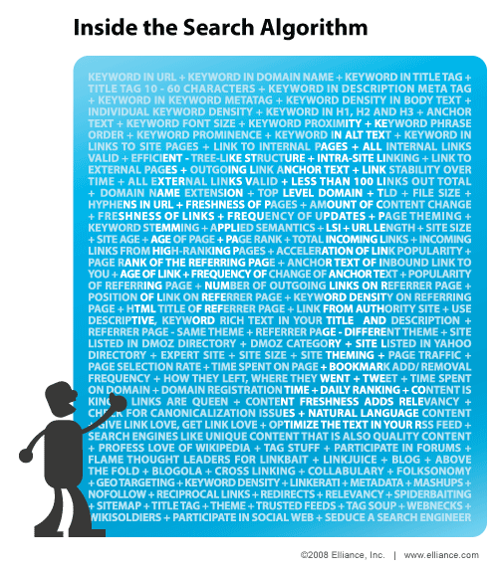
Algorithm
What is an algorithm?
An algorithm is a set of instructions used to solve any kind of problem.
It’s a well-organized, pre-arranged and defined functional block.
Algorithm receives a single value or set of values as input and provides a single or a set of values as output.

Slide 10
Example of an Algorithm
Write an algorithm for adding two numbers:
Step 1:
Take first number
(Numbers can be integers or decimals)
Step 2:
Take the second number
(Numbers Can be integers or decimals)
Step 3:
Add the two numbers
Step 4:
Display the Result

Slide 11
Definition of Flowchart
As I asked, is there an alternate way to represent algorithm in a easier way?
Yeah!
A flowchart !
Definition of flowchart:
Flowchart is a pictorial representation of Algorithm which shows steps in a process.
Flowchart is a diagram of the sequence of operations in a computer program.
Basic flowcharts are easy to create.
Flowcharts are programming language independent.
Program flow in a flowchart is more explanatory than the program flow in an algorithm.

Slide 12
Elements of Flowcharts
Processing Direction
Terminal
Pre-defined Process
Input/
Output
A File
On Page connector
Decision
Files
Off Page connector
Process Action
Entity

Slide 13
Flowchart -Representation
Flowchart representation of adding two numbers.
START
READ TWO NUMBERS A,B
SUM = A+ B
PRINT SUM
STOP

Slide 14
Definition of Pseudo Code
Can I implement my algorithm in a formal language ?
Yes, with Pseudo Code
Definition of Pseudo Code:
Pseudo Code is an informal language that helps programmers develop algorithms.

Slide 15
Most Commonly used Keywords
BEGIN:
Starting point of the operation .
WHILE:
A loop (repetition) with a simple conditional test at its beginning.
IF-THEN-ELSE:
A decision (selection) in which a choice is made between two alternative courses of action.
REPEAT-UNTIL:
A loop with a simple conditional test at the bottom.
END:
End of the execution.
Note: Looping & Control structures will be covered in detail later.

Slide 16




Pseudo Code
Pseudo code for adding two numbers:
Add Two Numbers
VARIABLES
First Number IS NUMBER
Second Number IS NUMBER
Sum IS NUMBER
BEGIN
READ First Value A READ Second Value B
Add A + B and store it to Sum
Print Sum
END

Slide 17

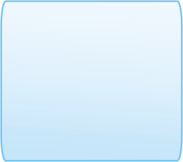



Data Structures
Now I understood algorithm, flowchart ,Pseudo code .
Please explain How & Where
Data is stored ?
Organization of data and its storage allocation is maintained by Data Structures.
Data structures can be classified into two types:
Linear
Non-Linear
Arrays
Linked lists
Stack
Queue
Tree
Graph
Table
Sets
Notes:
Linear data structure: A linear data structure traverses the data elements sequentially, in which only one data element can directly be reached. Ex: Arrays, Linked Lists
Non-Linear data structure: Every data item is attached to several other data items in a way that is specific for reflecting relationships. The data items are not arranged in a sequential structure.
Tree data structure is an example of a non linear data structure. A tree has one node called as root node that is the starting point that holds data and links to other nodes.
Ex: Trees, Graphs

Slide 18
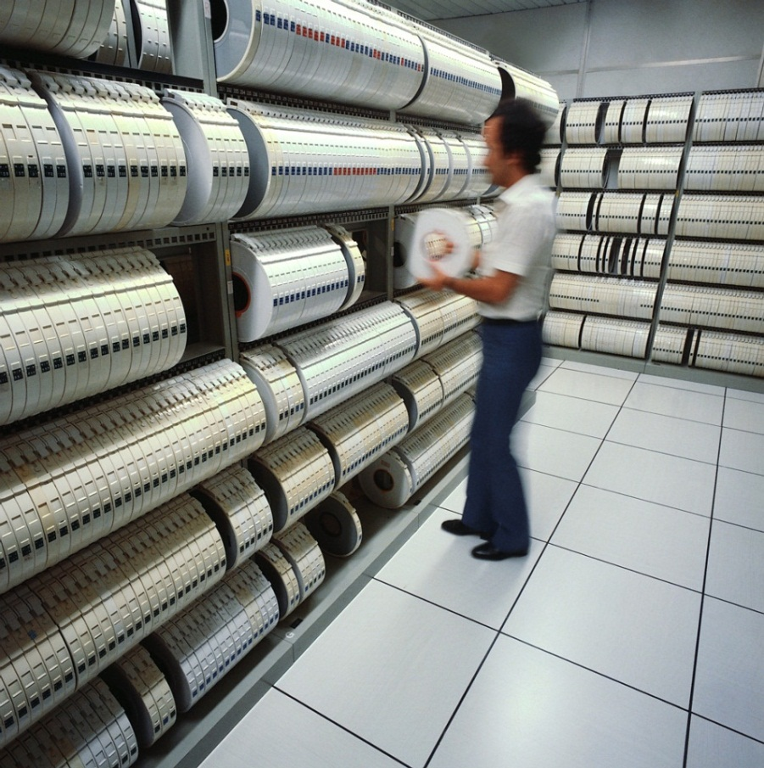
Data and its Types
What is Data ?
Data is the collection of facts and statistics for reference or analysis.
Any information can be considered as data. That Information can be a single value or multi-valued .
Different identifiable types of data is known as Data Type.
Some known Data Types are: Integer, Character, Float , String, and Boolean.

Slide 19


Example of Data
How Many Roses are here?
Answer is 3. Number is considered as Integer type
What is the color of the flower?
Answer is Red. Characters are considered as String Data Type.

Slide 20
Primitive Data Type
A Data Type is a term that refers to the type of data values that may be used for processing and computing.
Data structures that normally are directly operated upon by machine-level instructions are known as primitive data structures.
Following are the list of Primitive datatype:
Integers
Real
Logical data
Character data

Slide 21
Data Structures
Let us have a detailed discussion about Data structures in the next Presentation

Slide 22

Lend a Hand - I
Peter is planning to gift his friend on his birthday. Since he has limited time to buy a gift from the shop, he got an idea to buy a gift online.
Help him out with an algorithm and a flow chart for online shopping.

Slide 23
Lend a Hand - II
An old man runs a coffee shop in front of his home. He has got a habit of saving some money each day.
He saves 20% of the profit he makes.
He drops the money in a bag and makes a note of how much he has put in each day. One day, he found from his note book that he has saved around Rs. 5000.
To keep the money safe, he planned to deposit it in his account. He gave the bag to the cashier and requested him to deposit it in his account. The cashier found that the bag contains money in denominations of 10, 20, 50, and 100 rupees.

Slide 24
Lend a Hand - II
The cashier wished that there could be a program to help him determine the denominations of the cash as it would save him a lot of time.
Can you help the cashier with the pseudo code by reading the currencies from bag one by one and grouping them by denomination? You also have to print out how many currencies are there in each denominations.

Slide 25

Test Your Understanding
Explain Linear data structures
Explain Non-linear data structures
Relate real time examples with data structures.

Slide 26
Lend a Hand - III
Problem Statement:
Draw a flowchart for the following scenario.
Find Smallest Number:
Input: A list of numbers
Set Smallest to the largest possible number
While there are more numbers
If the current number is smaller than Smallest
Then
2.1.1 Set Smallest to current number
End if
End loop
3. Return Smallest
End

Slide 27
Lend a Hand - IV
2. Draw a flowchart for the following scenario
Find the Largest Number:
Input: A list of numbers
1. Set Largest to the smallest possible number
2. While there are more numbers
2.1 If the current number is larger than Largest
Then
2.1.1 Set Largest to current number
End if
End loop
3. Return Largest
End

Slide 28
Lend a Hand - V
Write an algorithm to read 5 numbers and sort the numbers in ascending order.
Let’s find out more about the different types of Sorting algorithms later.

Slide 29
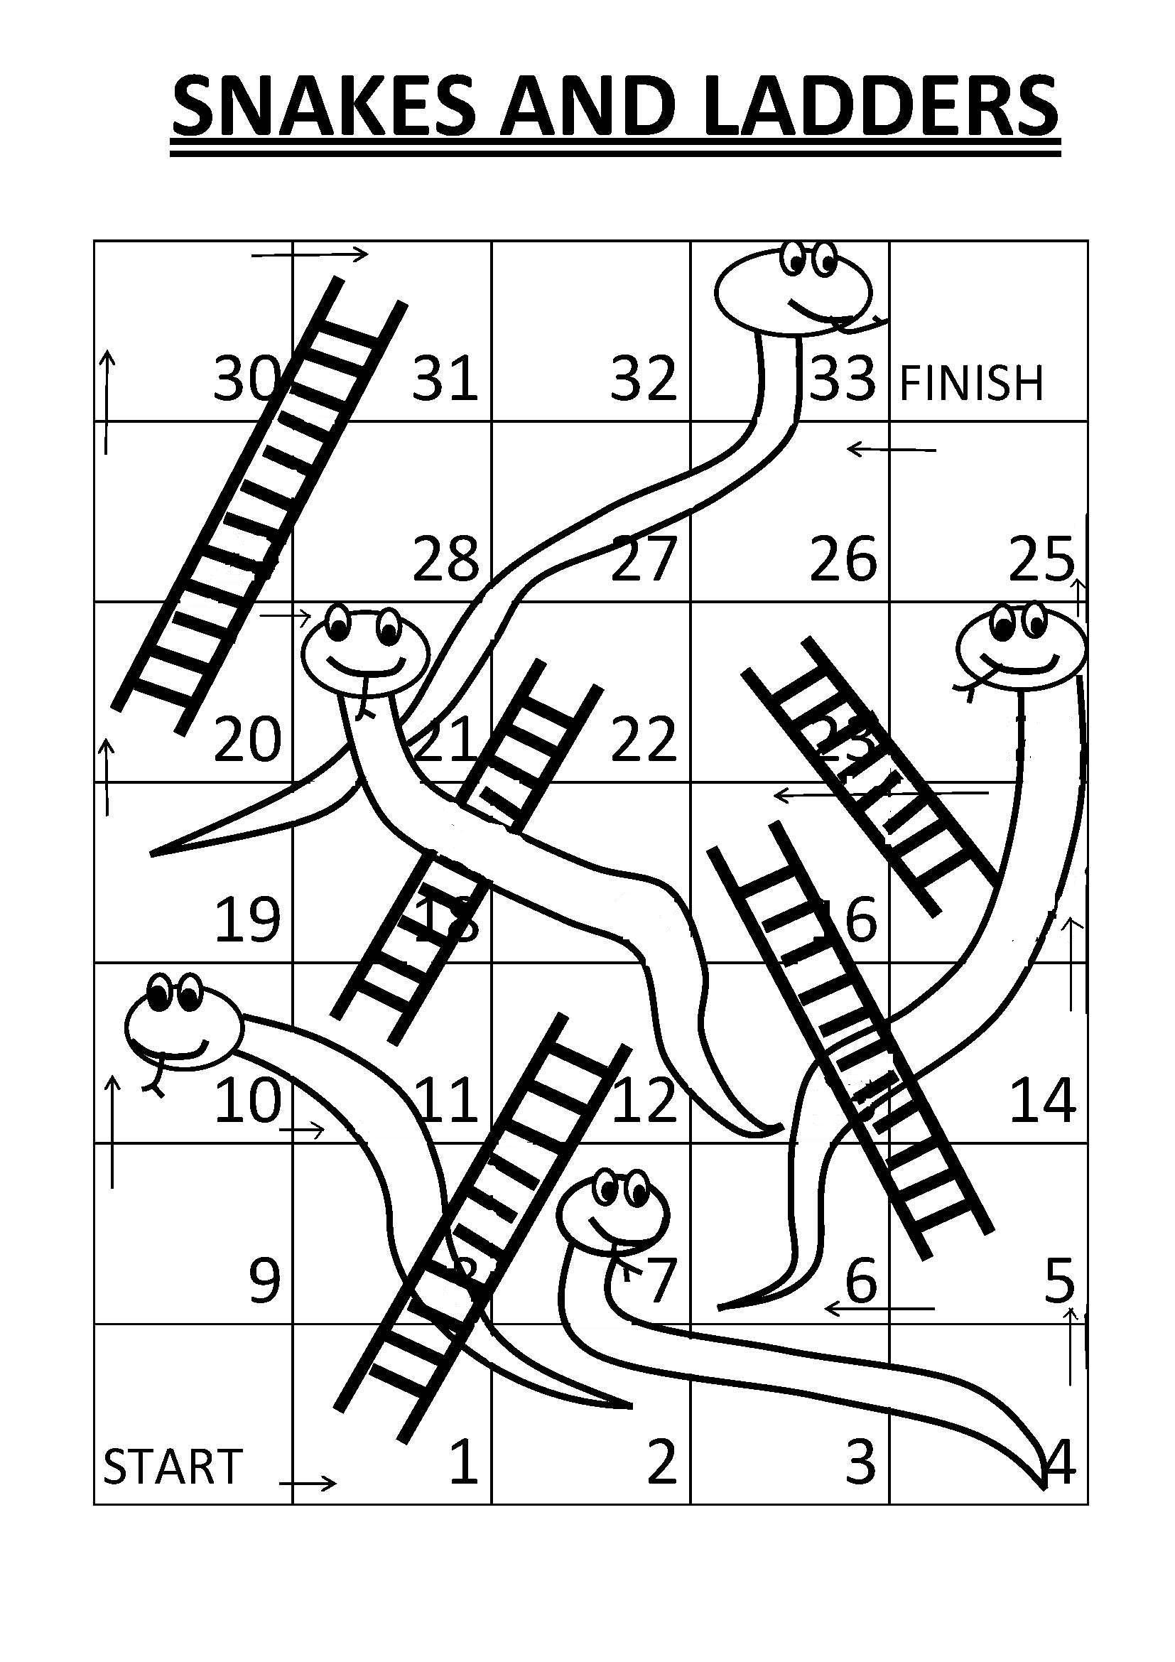
Lend a Hand - VI
Write an algorithm for a single player to play snakes & ladders
Rules: The dice can throw a value between 1 -12.

Slide 30
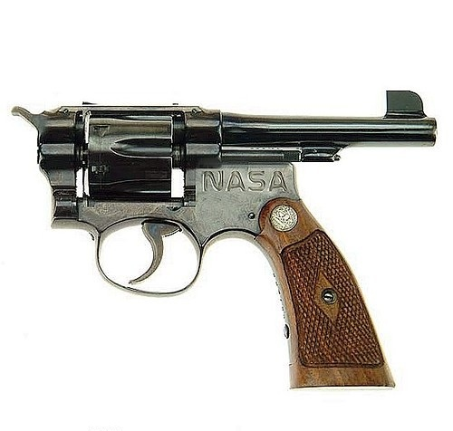

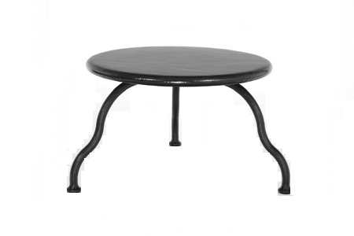
Bad Algorithm
Logic can be written in many ways. But the challenge is how to design it in an efficient way!
Here are some of the examples of bad design.

Slide 31
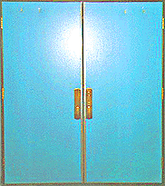
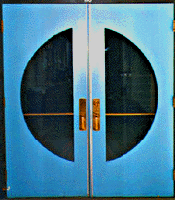
Bad Algorithm
This is an example
of a door without windows in the university building. Imagine reaching to pull open these doors just when someone on the other side is pushing them open.
Door Design
Best Design
In the Best design, These doors have built-in windows so that you can see if there are people on the other side
of the door.

Slide 32
Programming Concepts
Programming concepts is all about how to write logically for a program.
Logic can be Implemented through:
Algorithm
Pseudo Code
Flowcharts
Data Structures

Slide 33
Keywords
Algorithm
An algorithm is a set of instructions used to solve any kind of problem.
Flowchart is a pictorial representation of Algorithm.
Pseudo Code
It is an informal language that helps programmers develop algorithms.
Data
Any information can be considered as a data.
Flowchart
Notes:
transient
Persistence - the continuance of an effect after the cause is removed.

Slide 34
Questions

Slide 35
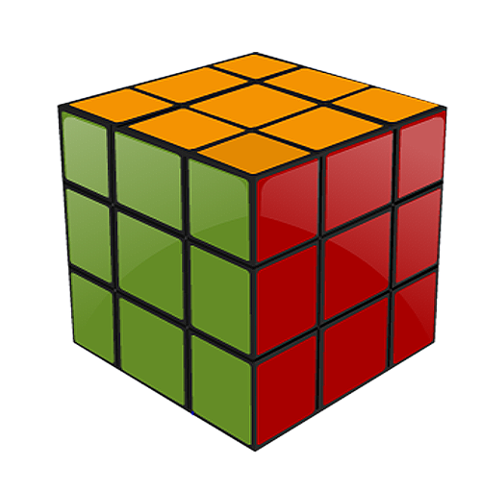
Summary
At the end of this course, you have learnt:
An algorithm is a set of well-organized, pre-arranged, and defined steps.
Flowchart is a pictorial representation of an algorithm.
Pseudo code is an informal language that helps programmers develop algorithms.
Data structures are useful for managing data in a structured way.
Arrays, linked lists, stacks, and queues are the linear data structures.
Tree, graph, table, and sets are Non linear data structures.

Slide 36
References
Data structures by Schaum Series.
www.cs.ccsu.edu
http://www.cs.cmu.edu/~adamchik/15-121/lectures/Stacks%20and%20Queues/Stacks%20and%20Queues.html
Data Structure & Algorithms by G. A. V. PAI .
Disclaimer: Parts of the content of this course is based on the materials available from the Web sites and books listed above. The materials that can be accessed from linked sites are not maintained by Cognizant Academy and we are not responsible for the contents thereof. All trademarks, service marks, and trade names in this course are the marks of the respective owner(s).

Slide 37
Programming Concepts
You have successfully completed -
Algorithm and Data Structures

Slide 38
Change Log
Version Number | Changes made
 | Initial Version | CATP Solutions Team | 01/31/2013
V1.1 | Slide No. | Changed By | Effective Date | Changes Effected
 | 1-38 | Cognizant Interactive Team CATP Technical Team | 17.05.2013 | Base-lining Content

