Slide 1
Programming Concepts
Arrays
LEVEL – LEARNER

Slide 2






Icons Used
Questions
Test Your Understanding
Hands-on Exercise
Demonstration
Summary
Reference

Slide 3
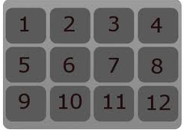

Programming Concepts
You know what an Algorithm, a flowchart, and a Pseudo code is.
You know what Primitive data types are and how to add single data.
Now, let’s take a look at how data structures can collectively hold groups of data of the same type together.
Array

Slide 4
Overview
Array provides knowledge and understanding of how data is been stored and different types of array.
Array
Single-dimensional Arrays
Multi-dimensional Arrays

Slide 5
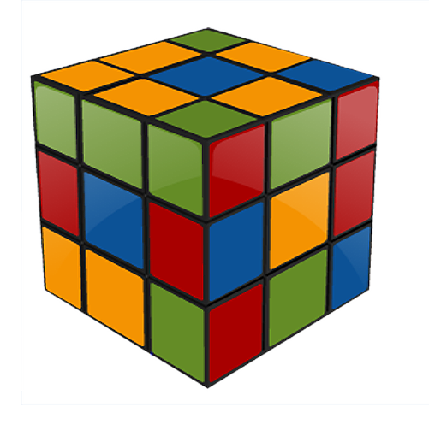
Objectives
At the end of this session, you will be able to:
Define the concept of array.
Define the concept of memory organization.
Write a program using single-dimensional arrays.
Write a program using multi-dimensional arrays.

Slide 6


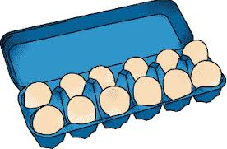
Need for an Array
John belongs to an HR team in ABT company. The company has recruited a new batch of employees on a specific date. He needs to collect their joining forms as and when they complete filling in the forms. Once all employees are done with the form filling, he has to enroll them in an alphabetical order. John is very much worried as to how to complete this task. Can you help him?

Slide 7
Array
Array is a derived data type which is used to store similar data items in contiguous memory locations under a single name.
It holds a fixed number of equally sized data elements, generally of the same data type such as an integer or a string.
The individual elements are accessed by specifying the subscript.
Arrays are commonly used in computer programs to organize data so that a related set of values can be easily sorted.

Slide 8


Memory Organization of an Array
Can you tell how an array is organized in memory ?
The elements in the array are always stored in consecutive memory locations.
2. An array of 4 integer elements, occupies 10 contiguous bytes in memory.
1000 1002 1004 1006
- Starting address is assumed to be 1000 and totally 8 bytes are allocated.

Slide 9
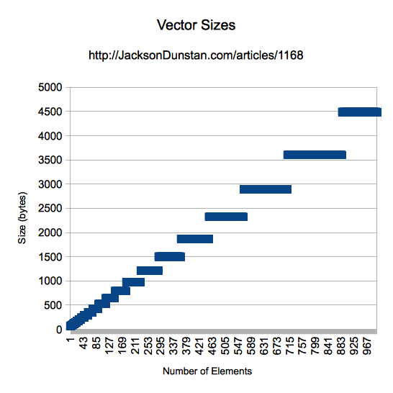
Array Declaration
The key points of array declaration are as follows:
Arrays are declared with appropriate data type and size.
An array declaration is very similar to a variable declaration.
Array declaration reserves space in memory.
An "array declaration" names the array and specifies the types of elements.
It can also define the number of elements in the array. A variable with array type is considered a pointer to the type of the array elements.
Syntax:
datatype array_name[size];

Slide 10
Array Declaration: Examples
Int x[5];
Defines an integer array x of 5 integers starting at x[0], and ending at x[4].
char str[16]="qwerty";
float sales_amt[10];
Defines an floating point array sales_amt of 10 floating point numbers starting at sales_amt[0] and ending at sales_amt[9]
Defines a character array which is used to represent a string of maximum of 16 characters

Slide 11
Accessing Array Elements
The array elements are accessed by specifying the subscript or index.
Syntax:
array_name[index or subscript]
Examples
x[0]to access the 1st element in array
x[4] to access the 5th element in array
str[2] to access the 3rd character in a string
sales_amt[8] to access the 9th sales amount

Slide 12
Array Initialization
Array can be initialized in the following ways:
Array elements can be initialized during declaration.
It can also be initialized in the program statements.
In partial initialization, the uninitialized array elements are initialized to zero or NULL.
Syntax:
datatype arrayname[size] = {value(s)};
OR
datatype arrayname[ ] = {value(s)};

Slide 13
Array Initialization (Contd.)
Note to SME: Can we add some content on the screen which will explain to the learners what this means?
Int a[5]={1,2,3,4,5};
- a[0]=1, a[1]=2, a[2]=3, a[3]=4 and a[4]=5
-all the array elements are initialized to zero
Int a[5]={1,2,3,4};
- a[4] = 0
int a[ ] = {1,2,3,4};
- a[0]=1, a[1]=2, a[2]=3, a[3]=4
Int a[5]={0};
Float b[2]={10.2,45.34};
- b[0] = 10.20, b[1] = 45.34

Slide 14
Array Initialization (Contd.)
To initialize the array to zero automatically, the keyword static can be used during initialization:
static int a[10];
/*all the array elements are initialized to zero automatically*/
The static keyword is used to retain the value of array between function calls.

Slide 15
Array Initialization: Example
void main()
{
int arr[10];
int i = 0;
int n =10;
for(i=0;i<n;i++)
{
arr[i] = i;
}
for(i=0;i<10;i++)
{
printf("%d",arr[i]);
}
}
An example for array initialization has been
provided in the table.
Note : Looping & Control structures will be covered in detail in the next few chapters.

Slide 16
Basic Operations on Array
Array:Basic Operations
Once an array element is deleted, the value in that location will be undefined or garbage .
Basic operations allowed on arrays are storing, retrieving, processing array elements, and deleting array elements.
Inserting an element in an array is not directly possible.
Array is a constant pointer, so the following expressions are illegal.
a++: Base address of array a is modified by adding one.
a+=2: Base address of array a is modified by adding two.

Slide 17
Getting the Value for Arrays
Example in C
int a[3];
scanf(“%d”, &a[0]);
/*get the value for 1st location*/
scanf(“%d%d%d”, a, a+1, a+2);
/*get the value for first 3 locations (array name has the base address)*/
for(i=0;i<3;i++)
scanf(“%d”,&a[i]);

Slide 18
Printing Out the Array Elements
Example in C
int a[3];
printf(“%d”, a[0]);
/*prints value of 1st location*/
printf(“%d%d%d”,a[0],a[1],a[2]);
/*prints value of first 3 locations*/
for(i=0;i<3;i++)
printf(“%d”,a[i]);

Slide 19



Need for a Multidimensional Array
Note to SME:
Not sure what the last bullet means. Can you please clarify?
Jose belongs to the HR team. His work is to collect the data and store the data. He needs to collect the project & resource details.
The manager has multiple projects and multiple resources. The resources are assigned to multiple projects under their manager.
Manager[Projects][Resources].Can you please help him?

Slide 20
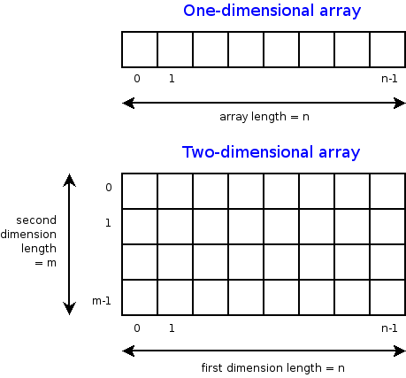
Multidimensional Arrays
Multidimensional Arrays
The elements of an array can themselves be arrays.
It is a data structure consisting of a vector of vectors.
Multidimensional arrays also occupies the contiguous memory locations.
Array elements are usually stored in row major order.

Slide 21
Two-dimensional Array: Declaration
Syntax:
datatype arrayname [row ][column]
Example:
int a[2][2];
/*creates 8 bytes of contiguous memory locations. (2*2 = 4 elements).*/
Assume that array starts at location 1000
a[0][0] will be in 1000 (row 0 and column 0)
a[0][1] will be in 1002 (row 0 and column 1)
a[1][0] will be in 1006 (row 1 and column 0)
a[1][1] will be in 1008 (row 1 and column 1)

Slide 22
Two-dimensional Array: Initialization
Two-dimensional or multidimensional arrays can also be initialized in the declaration statement.
For Example:
int num[2][3] = {1,2,3,4,5,6};
int num[2][3] = {1,2,3,4,5};
/*num[1][2] = 0*/
int num[2][3] = {{1,2,3},{1,2,3}};
/*row elements are initialized separately*/
int num[2][3] = {{1,2},{4}};
/*num[0][2] = 0, num[1][1]=num[1][2]=0*/

Slide 23
Array: Advantages and Limitations
The advantages and limitations of array are as follows:
Advantages
It is simple and easy to use.
It can be stored in contiguous locations.
Limitations
If you need m elements out of n locations defined, n- m locations are unnecessarily wasted.
No automatic array bounds checking during compilation.
Fast retrieval of arrays is possible because of its indexed nature.
No need for the user to worry about the allocation and de-allocation of arrays.

Slide 24

Test your understanding
State whether the following statements are True or False.
When an array is declared, C automatically initializes its element to Zero.
The declaration int x[2] = {1,2,3}; is illegal.
2. What will be the output of the following code?
main()
{
int a[4]={1,2,3,4};
int i;
for(i=0; i<4; i++)
printf(“ %d" , a[i]);
}

Slide 25
Learn How - Demonstration

Slide 26

Lend a Hand-l
Q:Write a program to find out the minimum and maximum number from 10 randomly generated numbers.

Slide 27
Lend a Hand - Solution
#include <stdio.h>
#include <stdlib.h>
main()
{
int i , min_value , max_value ;
int list[10] ;
for ( i=0 ; i<10 ; i++)
list[i] = rand() ;
/* Find the minimum value */
min_value = 0 ;
for ( i=0 ; i<10 ; i++)
if (list[i]<min_value)
min_value=list[i] ;
printf("Minimum value generated is %d\n" , min_value) ;

Slide 28
Lend a Hand – Solution(Contd.)
/* Find the maximum value */
max_value = 0 ;
for ( i=0 ; i<10 ; i++)
if (list[i]>max_value)
max_value=list[i];
printf("Maximum value generated is %d\n" , max_value) ;
getchar();
}

Slide 29
Questions

Slide 30
Lend a Hand-ll
Q:Write a program to develop the addition of 5 numbers using arrays.
Q:Write a program to demonstrate two dimensional arrays.

Slide 31
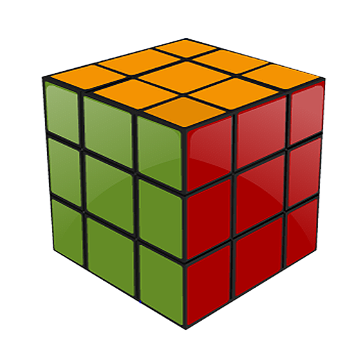
Summary
At the end of this course, you have learned:
An array can be defined as a collection of homogeneous elements stored in consecutive memory locations.
Array name is a constant pointer to the base address of the array.
Conventional arrays always have a predefined size and the elements of an array are referenced by means of an index or subscript.
An array can be of more than one dimension. There is no restriction on the number of dimensions.

Slide 32
References
C Reference Card (ANSI)
C Reference Manual by Dennis Ritchie
Programming in C:A Tutorial by Brian W. Kernighan, Bell Laboratories
Byron Gottfried, “Programming in C”, Tata McGraw Hill
Deitel & Deitel, “C How to Program”, Third Edition, Prentice Hall
Disclaimer: Parts of the content of this course is based on the materials available from the Web sites and books listed above. The materials that can be accessed from linked sites are not maintained by Cognizant Academy and we are not responsible for the contents thereof. All trademarks, service marks, and trade names in this course are the marks of the respective owner(s).

Slide 33
Programming Concepts
You have successfully completed -
Arrays

Slide 34
Change Log
Version Number | Changes made
 | Initial Version | CATP Solutions Team | 01/31/2013
V1.1 | Slide No. | Changed By | Effective Date | Changes Effected
 | 1-34 | Cognizant Interactive Team CATP Technical Team | 17.05.2013 | Base-lining Content

