Slide 1
Programming Concepts
Strings
LEVEL – LEARNER
1

Slide 2








Icons Used
Hands-on Exercise
Reference
Questions
Points To Ponder
Coding Standards
Lend a Hand
Summary
Test Your Understanding

Slide 3


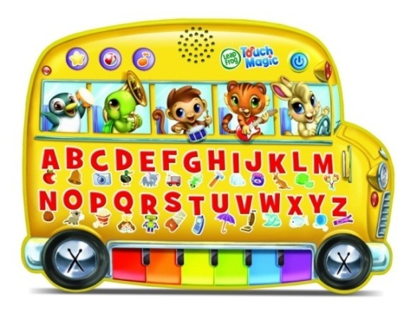

Programming Fundamentals
I hope you all well understood what is Data structure and what are the different types of data.
Now, let us start with character and string manipulation.
STRING

Slide 4

Content Overview
Note to the SME: The definition of string seems a bit far fetched. Can we add the following definition?
A string is traditionally a sequence of characters, either as a literal constant or as some kind of variable.
String provides knowledge and understanding of how string types are stored and types of string functions.
String Functions
String
Char Functions

Slide 5

Objectives
At the end of this session, you will be able to:
Define strings.
Apply string and character functions.

Slide 6

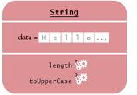
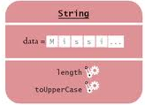
Need for String
Annie is working as a clerk in an ASH Trading Company. Her manager wanted her to pick the trading details for the last 5 years. She needs to search with the string “sales” or “trade”.
Can you help her to search for the details?

Slide 7

Strings
Let us learn about string in detail.
1.
Strings are sequence of characters.
2.
A character string is stored in an array of character type, one ASCII character per location.
3.
String should always have a NULL character(‘\0’)at the end.

Slide 8
Strings: Examples
char c[4]={‘s’,’u’,’m’,’\0’);
/*c[0] = ‘s’, c[1] = ‘u’, c[2] = ‘m’, c[3] = ‘\0’*/
char str[16]="qwerty";
This creates a string. The value at str[5] is the character ‘y’. The value at str[6] is NULL. The values from str[7] to str[15] are undefined.
char name[5] = “INDIA”
Strings are terminated by the null character, one extra storage location in an array is required.

Slide 9
Array of Strings: Declaration
Two dimensional character arrays are used to represent array of strings.
Syntax:
char arrayname [no. of strings] [max no. of chars in strings];
Example:
char studname[50][15];
50 student names each with 15 characters at the maximum.

Slide 10
Array of Strings: Initialization
The initializer for an array is a comma-separated list of constant expressions enclosed in braces ({ }).
Syntax:
char arrayname[r][c]={“values”};
Example:
char name[3][5] = {“bata”,”cat” ,”at”}
char name[3][5] = {{‘b’,’a’,’t’,’a’,’\0’},{‘c’,’a’,’t’,’\0’},{‘a ’,’t’,’\0’}}

Slide 11
Reading a String
A string can be read either character-by-character or as an entire string (using %s)
Example:
char name[20];
int i=0;
while((name[i]=getchar()) != ‘\n’)
i++;
scanf( “%s“ , name);

Slide 12

Illegal Operations on Strings
The following operations are considered illegal on strings:
Assigning a string to another string variable using=operator.
Comparing two strings using == operator.
Concatenating two strings using + operator.

Slide 13
String Functions -l
String Functions | Functionality
strlen(string) | Gives the length of a string
strrev(string) | Reverse the string and result is stored in same string.
strncat(string1, string2,n) | Append n characters from string2 to string1.
strncmp(string1, string2,n) | Compare first n characters of two strings.
strncpy(string1, string2,n) | Copy first n characters of string2 to string1.
strupr(string) | Converts a string to uppercase.
strlwr(string) | Converts a string to lowercase.

Slide 14
String Functions-ll
Special routines are available in the standard string library, string.h. Some string functions are:
String Functions | Functionality
strcpy(string1, string2) | Copy string2 into string1.
strcat(string1, string2) | Concatenate string2 onto the end of string1
strcmp(string1,str ing2) | Lexically compares the two input strings (ASCII comparison): returns 0 if string1is equal to string2 < 0 if string1is less than string2 > 0 if string1is greater than string2

Slide 15
String Functions-lll
String Functions | Functionality
atoi(string) | Converts the string to integer
atof(string) | Converts the string to long integer
atol(string) | Converts the string to long integer.
strchr(string,c) | Find first occurrence of character c in string.
strrchr(string,c) | Find last occurrence of character c in string.
strstr(s1,s2): | Locates the first occurrence of s2 in s1.

Slide 16

Learn How - Demonstration

Slide 17
Lend a Hand
Q. Write a program to find the length of a string.
#include <stdio.h> #include <string.h> void main(void) { char string[]="spark"; int len; len=strlen(string); printf("length of %s is %d\t",string,len); }

Slide 18

Check Your Understanding
List few library functions for string operations.

Slide 19
Questions

Slide 20
Lend a Hand
Q. Write a C program to reverse the given string?
Q. Write a C program to detect the palindrome?

Slide 21

Summary
At the end of this course, you have learned:
String is represented as an array of characters.
C supports a number of in-built string functions to manipulate strings.
Strings in C are represented by arrays of characters.
The end of the string is marked with a special character, the null character, which is simply the character with the value 0.
The null or string-terminating character is represented by another character escape sequence.

Slide 22
Reference
C Reference Card (ANSI)
C Reference Manual by Dennis Ritchie
Programming in C:A Tutorial by Brian W. Kernighan, Bell Laboratories
Byron Gottfried, “Programming in C”, Tata McGraw Hill
Deitel and Deitel, “C How to Program”, Third Edition, Prentice Hall
Disclaimer: Parts of the content of this course is based on the materials available from the Web sites and books listed above. The materials that can be accessed from linked sites are not maintained by Cognizant Academy and we are not responsible for the contents thereof. All trademarks, service marks, and trade names in this course are the marks of the respective owner(s).

Slide 23
Programming Concepts
You have successfully completed -
Strings
23

Slide 24
Change Log
Version Number | Changes made
 | Initial Version | CATP Solutions Team | 01/31/2013
V1.1 | Slide No. | Changed By | Effective Date | Changes Effected
 | 1-24 | Cognizant Interactive Team CATP Technical Team | 17.05.2013 | Base-lining Content

