Slide 1
Programming Concepts
Stack and Queue
LEVEL – LEARNER

Slide 2








Icons Used
Hands-on Exercise
Reference
Questions
Points To Ponder
Coding Standards
Lend a Hand
Summary
Test Your Understanding

Slide 3

Stack and Queue
I hope you all understood what data structure and array concepts are.
Now, we will discuss the data structures like Stack and Queue.

Slide 4
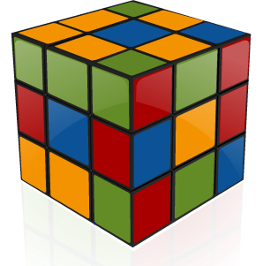
Objectives
Note to SME: The Overview slide is missing. Please provide the required slide
After completing this session, you will be able to:
Define a stack.
Recognize the need for stack.
Define the operations of stack.
Define a queue.
Define the operations of queue.

Slide 5


Stack
Do you know what a Stack is?
Is it a Data structure?
That’s right! It is a Data structure.

Slide 6
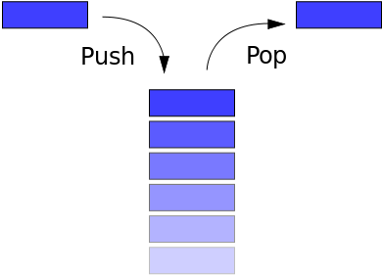
Stack
A Stack is a container of objects that are inserted and removed according to the last-in first-out (LIFO) principle.
In the Stack, two operations can be done:
PUSH: Inserting the item in Stack.
POP : Fetching the item out of Stack.
A Stack is an ordered list in which all insertions and deletions are made at one end.

Slide 7
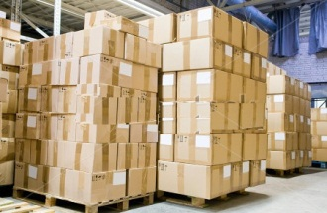
Why Do We Need Stack?
Applications like warehouse Management will run in the concept of Stack. Where the last entered element is easy to take away from the system.
Runs in Last-In-First-Out principle.

Slide 8
Stack Operations
The operations on the Stack can be done from the top .
Adding of elements in the Stack or PUSH :
procedure add(item); {add item to the global stack ; top is the current top of stack and n is its maximum size} begin if top equal to n then stack full; Add one to top; Place item to the top position of the stack
end:

Slide 9
Stack
Deleting element or elements from Stack:
procedure delete(item); {remove top element from the stack and put it in the item} begin if top equal to 0 then stack empty; Place Stack top to the item ;
Subtract one from the top; end;
Procedure delete actually combines the functions TOP and DELETE, Stack Full and Stack Empty are procedures which are left unspecified since they depend upon the particular application.

Slide 10
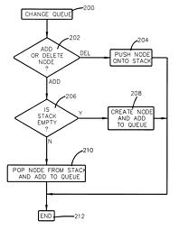
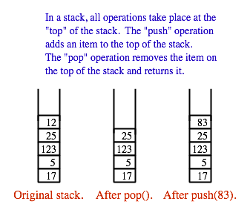
Stack PUSH or POP Operation

Slide 11
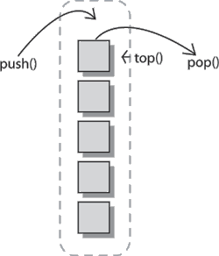
Lend a Hand - Stack
Q. Choose the concept of Stack from the following:
LIFO
FIFO
FILO
LILO
Q. Explain the operations of Stack.
Q. True or False :
Recent element inserted will be removed last
Push operation help to remove element from Stack
First element inserted will be removed last ?
Q. What do you mean by stack overflow and stack underflow?
Notes:
LIFO
PUSH & POP
False
False
True
Overflow – Push operation occurs on full stack. Underflow – Pop operation occurs on empty stack.

Slide 12
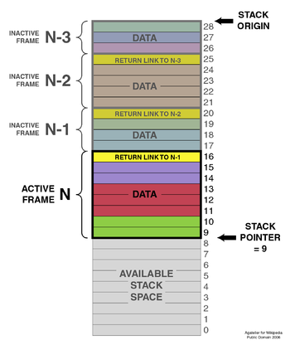
Lend a Hand - Stack
Q. The top pointer is increased
When push () operation is done
When pop () operation is done
Both (a) and (b)
None of the above
Notes:
A. When push() operation is done

Slide 13
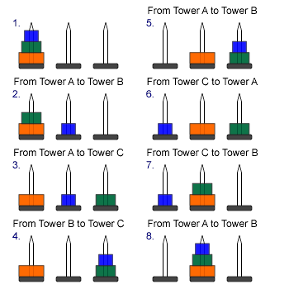
Lend a Hand - Tower of Hanoi
Q. Please identity the operation below and write the Algorithm of the operation :
Notes:
1.In the Tower of Hanoi Problem, we have been given n disks, and three towers. The disks are initially stacked on tower 1 in decreasing order of size from bottom to top. We are to move the disks to tower 2, one disk at a time, such that no disk is ever on top of a smaller one. We can have the value n = 2,3,4
We can use recursion to get the largest disk to the bottom of tower
Void TowersofHanoi(int n, int x, int y, int z)
{
int d// the disk.
If (n>0) {
TowersofHanoi(n-1,x,z,y);
S[x] -> Delete(d); //remove disk from x
S[y] -> Add(d); //Put this disk on tower y.
TowerOfHanoi(n-1,z,y,z);
}

Slide 14
Solution-l
The operations are POP & PUSH:
The solution of the Tower of Hanoi problem for n=3 appears in fig below. Observe that it consists of the following seven moves:
n=3: Move top disk from Peg A to Peg C
Move top disk from Peg A to Peg B
Move top disk from Peg C to Peg B
Move top disk from Peg A to Peg C
Move top disk from Peg B to Peg A
Move top disk from Peg B to Peg C
Move top disk from Peg A to Peg C
In other words,
n=3 A->C, A->B C->B A->C B->A B->C A->C
For completeness, we also give the solution to the Tower of Hanoi problem for n=1 and n=2,
n=1: A->C
n=2: A->B A->C B->C

Slide 15
Solution-ll
Note that n=1 uses only one move and that n=2 uses three moves.
Rather than finding a separate solution for each n, we use the technique of recursion to develop a general solution. First we observe that the solution of Tower of Hanoi problem for n>1 disks may be reduced to the following sub problems:
Move the top n-1 disks from peg A to peg B.
Move the top disk from peg A to peg C: A->C.
Move the top n-1 disks from peg B to peg C.

Slide 16
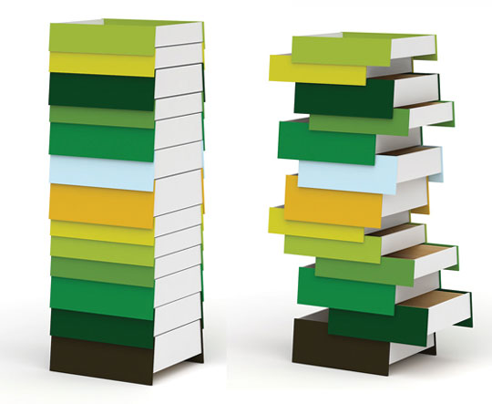
Stack – Applications
Stack is very useful in:
In keeping sequence of processing.
In solving arithmetic expressions.
In a large program, various functions are invoked by the main () function, all these functions are stacked in the memory.
Most of the calculators work on stack mechanism

Slide 17
Queue
I hope you understood the functionality of Stack .
Now, I am going to describe another Data structure implementation, QUEUE.

Slide 18
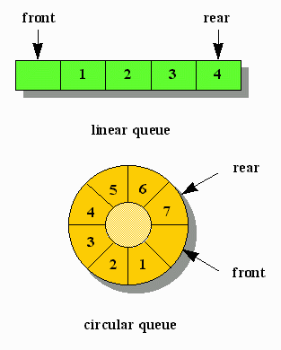
Queue
A Queue is an ordered list in which all insertions take place at one end (called Rear).
While all deletion takes place at the other end (called Front).
It is a First In First Out (FIFO) structure.

Slide 19
Why do we need a Queue?
We need queue in the following situations:
When Bulk or multiple requests will be made from clients to server.
Any specific requests need not be necessarily processed at the same time the request is made.
The request shall be processed by the server only when the server becomes available to process them.
The requests are to be processed in the same order it was received.
Example: Send and Receive mails by client.

Slide 20
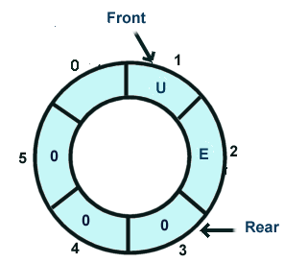
Dequeue-l
What is a Dequeue?
A dequeue, also known as a double-ended queue, is an ordered collection of items similar to the queue.
It has two ends, a front and a rear, and the items remain positioned in the collection.
What makes a dequeue different is the unrestrictive nature of adding and removing items.

Slide 21
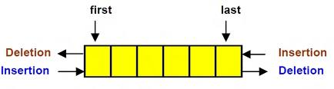
Dequeue-ll
Dequeue does not require the LIFO and FIFO orderings that are enforced by those data structures. It is up to the user to make consistent use of the addition and removal operations.

Slide 22
Queue Operations
Like stack, we can perform both the addition and deletion for the Queue.
Addition into a queue:
procedure addq (item); {add item to the queue q} begin if rear equal to n then queue full else begin Add one to rear; Add item to the queue of rear; end; end;
Deletion from a queue:
procedure delete (item ); {delete from the front of q and put into item} begin if front equal to rear then queue empty else begin Add one to front; Place queue Front to the item; end; end;

Slide 23

Test Your Understanding
List some real time examples of Queue.
List some devices which follows the Queue patterns.
Notes:
Queue of people in a bank, students queue in school, a travellers' queue for tickets at railway station are few examples of queue.
in a computer there may be a queue of tasks waiting for execution, few others for printing, and some are for inputting the data and instructions through the keyboard

Slide 24
Test Your Understanding
Q. What is pop and push ?
Q. What is a Dequeue ?
Q. How is Pointer related to a queue?
Notes:
Push operation is putting elements in the stack & POP operation is fetching the element out of Stack.
A de queue, also known as a double-ended queue, is an ordered collection of items similar to the queue.
Pointer is always related to first element in the queue.

Slide 25
Questions

Slide 26
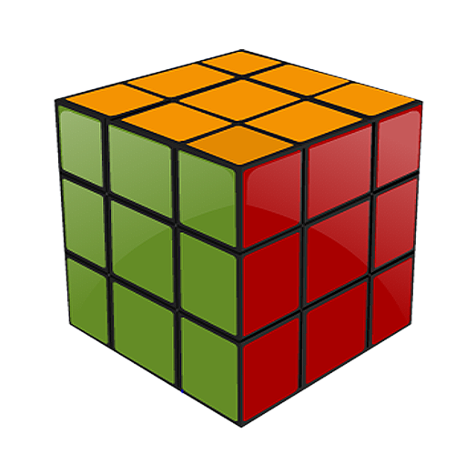
Summary
At the end of this course, you have learned:
A stack is a container of objects that are inserted and removed according to the Last-In First-Out (LIFO) principle.
A stack is a recursive data structure.
A queue is a container of objects (a linear collection) that are inserted and removed according to the First-In First-Out (FIFO) principle. An excellent example of a queue is a line of students in the food court.

Slide 27
Data Structures
I hope you have understood Stack and Queue and also their implementations.

Slide 28
References
Data structures by Schaum Series.
www.cs.ccsu.edu
http://www.cs.cmu.edu/~adamchik/15-121/lectures/Stacks%20and%20Queues/Stacks%20and%20Queues.html
Data Structure and Algorithms by G. A. V. PAI .
Disclaimer: Parts of the content of this course is based on the materials available from the Web sites and books listed above. The materials that can be accessed from linked sites are not maintained by Cognizant Academy and we are not responsible for the contents thereof. All trademarks, service marks, and trade names in this course are the marks of the respective owner(s).

Slide 29
Programming Concepts
You have successfully completed -
Stack and Queue

Slide 30
Change Log
Version Number | Changes made
 | Initial Version | CATP Solutions Team | 01/31/2013
V1.1 | Slide No. | Changed By | Effective Date | Changes Effected
 | 1-30 | Cognizant Interactive Team CATP Technical Team | 17.05.2013 | Base-lining Content

