Slide 1
Programming Concepts
Searching & Sorting Techniques
LEVEL – LEARNER

Slide 2








Icons Used
Hands-on Exercise
Reference
Questions
Points To Ponder
Coding Standards
Lend A Hand
Summary
Test Your Understanding

Slide 3

Overview
Now that you know what data structures are, in this session, you will learn how to do searching and sorting with the data.

Slide 4
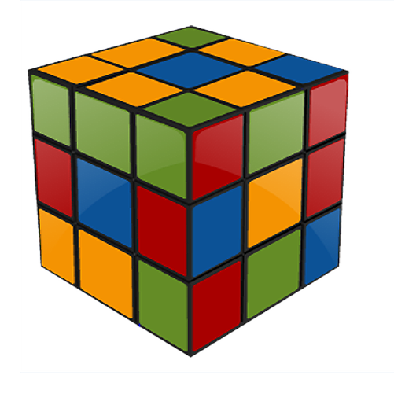
Objectives
After completing this session, you will be able to:
Identify the different types of Searching Techniques.
Identify the different types of Sorting Techniques.

Slide 5
Searching
Searching is the process of locating a particular element in a given list.
There are two types of searching techniques: Linear search and Binary search.
Data Searching
Linear Search
Binary Search

Slide 6
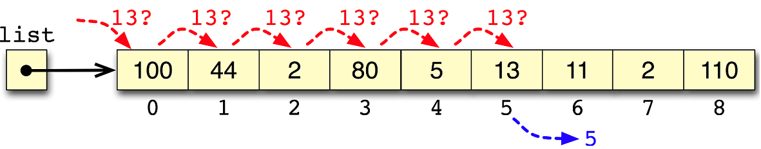
Linear Searching
The characteristics of Linear searching are as follows:
In Linear search, the list is searched sequentially.
The searching starts at the beginning.
All the elements preceding the search element must be traversed.
If the search value is at 10th position, all the elements from 1-9th positions must be checked before 10th .
The list need not be in sorted order.
Search 13 from the following list containing 9 elements

Slide 7
Example of Linear Searching
Example:
Input list: 120, 18, 215, 360, 45, 148, 50
Search element : 45
Iteration | Element | Compare | Found? | Continue Iteration?
1 | 120 | 120 = 45 | No | Yes
2 | 18 | 18=45 | No | Yes
3 | 215 | 215=45 | No | Yes
4 | 360 | 360=45 | No | Yes
5 | 45 | 45=45 | Yes | No

Slide 8
Binary Searching
The characteristics of Binary searching are as follows:
In Binary searching, the list must be in a sorted order
In a Binary search, the search is done over the entire list even if the element to be searched is not available.
Some of our improvements work to minimize the cost of traversing the whole data set.
Advantages of a sorted list:
If you start searching in the middle of the list you could determine which half the item is in (because the list is sorted).
This effectively divides the working range in half with a single test. This in turn reduces the time complexity.

Slide 9
Example of Binary Searching
Example:
Input Sequence: 12 18 25 36 45 48 50
Search element : 45
List/Sub-list | No. of Elements | Mid Position | Mid Element | Compare | Segment | Found | Continue Iteration
12 18 25 36 45 48 50 | 7 | 4 | 36 | 45>36 | Right | No | Yes
45 48 50 | 3 | 2 | 48 | 45>48 | Left | No | Yes
45 | 1 | 1 | 45 | 45=45 | N/A | Yes | No

Slide 10
Comparison of Linear and Binary Searching
Method of Search | Advantages | Disadvantages
Linear | Simple Elements need not be in order | Less efficient, since time complexity is more compared to Binary search: O(n)
Binary | More efficient since the time complexity is less compared to Linear search: O(log n) | Not simple as Linear search Elements must be in order

Slide 11
Lend a Hand - I
Scenario:
John has given his bike for servicing. He remembered later that he was supposed to drop a cheque at the bank for his credit card payment. He called his friend Britto for help and asked for his bike. Britto gave him the keys along with the bike’s registration number and told him that the vehicle was parked in the basement.
Q1. What type of searching must John do to locate Britto’s bike in the parking area?
Q2. Write an algorithm to find the bike.
Notes:
Linear Search.

Slide 12
Lend a Hand - II
Scenario:
Candidates have applied for a course. After the entrance exam, the selected candidate’s applications are separated. The clerk arranged those applications in an ascending order and he is aware of the total number of applications given to him. Candidates are requested to collect their application form from clerk for their counseling.
Q. Which searching technique can the clerk apply when any candidate ask for their application.
Q. Write an algorithm for this searching technique.
Notes:
Binary Search – Since the given list is in sorted order and the searcher knows the total count.

Slide 13
Sorting
Sorting is any process of arranging items in some sequence and/or in different sets, and accordingly.
Sorting can be done in two ways:
Ordering: Arranging items of the same kind, class, nature, etc. in some ordered sequence.
Categorizing: Grouping and labeling items with similar properties together (by sorts).
Sorting greatly improves the efficiency of searching. Example: Phone book having the names in sorted order helps you to find the person with less effort.

Slide 14
Different Sorting Algorithm
Sorting techniques
Bubble sort
Merge sort
Quick sort
Heap sort
Selection sort
Insertion sort

Slide 15
Bubble Sort
The simplest sorting algorithm is bubble sort.
The bubble sort works by iterating down an array.
To be sorted from the first element to the last
This process is repeated until the array is sorted.

Slide 16
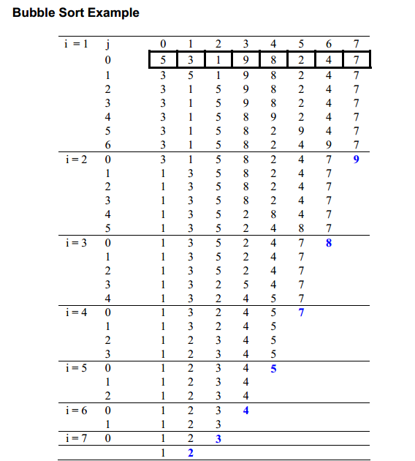
Example of Bubble Sort

Slide 17
Lend a Hand- Bubble Sort
Q. In the bubble sort, the sorting is done with comparing:
Successive elements
First and last elements
Last and middle elements
None of the above
Q. After the each iteration, the biggest element will be pushed to the last in that sub group.
True
False
Q. Write the pseudo code for Bubble Sort.
Notes:
A
True

Slide 18
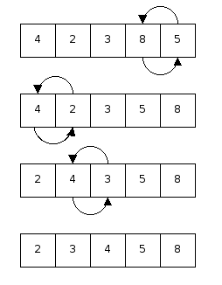
Lend a Hand – Methods of Sorting
Identify the sorting technique & name the method of sorting.
Notes:
Solution 2 : Bubble Sorting.

Slide 19
Questions

Slide 20

Test Your Understanding
Q1. What are the searching techniques?
Q2. What technique can to be used when the given elements are in the sorted order?
Q3. What are the Sorting techniques available?

Slide 21
Test Your Understanding-Solutions
Solution:
A1. Linear & non linear.
A3. Bubble sort ,quick sort, insertion sort, selection sort, merge sort and heap sort
A2. Binary search.

Slide 22
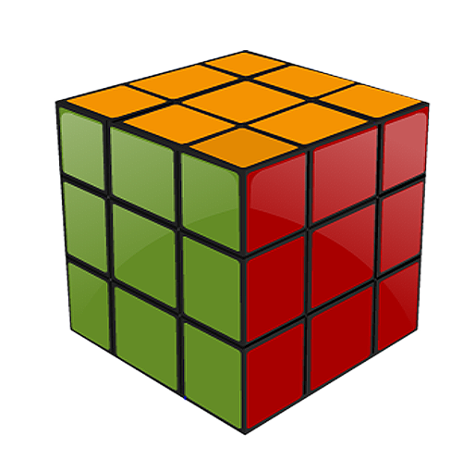
Summary
At the end of this course, you have learned:
Searching techniques helps in locating the element in a given list.
Sorting is the process of arranging items in some sequence.
In Linear search, the list is searched sequentially.
In a Binary search, the search is done through the entire list even if the element to be searched is not available.

Slide 23
References
Fundamentals of Data Structures, by Ellis Horowitz, Sartaj Sahni, Glagotia
An Introduction to Data Structures with applications, Jean-Paul Tremblay, Paul G Sorenson
Introduction to Data Structures”, Bhagat Singh, Thomas L Naps, Glagotia Book Source
http://www.ecs.soton.ac.uk/~mjb/refcalc-tut/search.html
http://en.wikipedia.org/wiki/Linear_search
http://www.csie.ntnu.edu.tw/~violet/cs93/Solutions/Ch-08.pdf
http://office.microsoft.com/en-in/visio-help/create-a-basic-flowchart-HP001207727.aspx
Disclaimer: Parts of the content of this course is based on the materials available from the Web sites and books listed above. The materials that can be accessed from linked sites are not maintained by Cognizant Academy and we are not responsible for the contents thereof. All trademarks, service marks, and trade names in this course are the marks of the respective owner(s).

Slide 24
Programming Concepts
You have successfully completed – Searching and Sorting Techniques

Slide 25
Change Log
Version Number | Changes made
V1.0 | CATP Solutions Team |  | 01/31/2013
V1.1 | Slide No. | Changed By | Effective Date | Changes Effected
 | 1-25 | Cognizant Interactive Team CATP Technical Team | 17.05.2013 | Base-lining Content

