Slide 1
Programming Concepts
Branching Statements
LEVEL – LEARNER

Slide 2





Icons Used
Questions
Hands-on Exercise
Summary
Test Your Understanding
Reference

Slide 3

Overview
Now that you have understood what control structures are, in this session, you will learn how to skip the execution using branching statements.

Slide 4
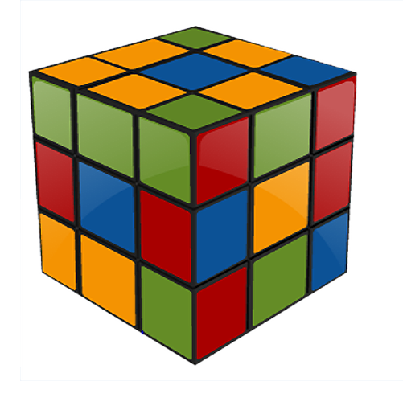
Objectives
After completing this session, you will be able to:
Implement the branching statements (break, continue, go to return), which allows redirection of program flow.

Slide 5
Branching Statements
Branching Statements
Break
Go To
Continue
Return
Branching statements allows you to redirect the flow of program execution.
There are four types of branching statements.

Slide 6
Why Do We Need Branching?
The needs for branching are as follows:
Sometimes an algorithm needs to interrupt the normal flow once the results are found.
Some steps in the logic can be skipped for the specific inputs based on the conditions.
In such cases we go for branching statements.
For Example:
Get input from user
If the input is not valid
Continue getting the input from user
If the input is valid print the input and stop the process.

Slide 7
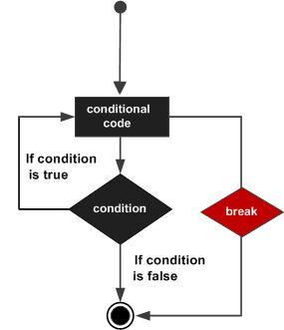
Break Statement
The characteristics of a break statement are:
When the break statement is encountered inside a loop statement, the loop is immediately terminated and the program control resumes at the next statement following the loop.
It can be used to terminate a case in the switch.

Slide 8

Break & Return - C
A program to find an average is given below:
include <stdio.h>
int main(){
float num,average,sum;
int i,n;
printf("Maximum no. of inputs\n");
scanf("%d",&n);
for(i=1;i<=n;++i){
printf("Enter n%d: ",i);
scanf("%f",&num);
if(num<0.0)
break;
//for loop breaks if num<0.0
sum=sum+num;
}
average=sum/(i-1);
printf("Average=%.2f",average);
getch();
return 0;
}

Slide 9
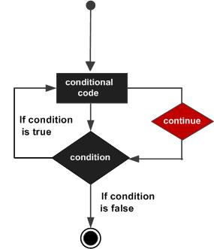
Continue Statement
The characteristics of a continue statement are:
The continue statement works somewhat like the break statement. Instead of forcing termination, the continue statement forces the next iteration of the loop to take place, skipping any code in between.
For the for loop, continue causes the conditional test and increment portions of the loop to execute. For the while and do...while loops, program control passes to the conditional tests.

Slide 10
Continue Statement - C
To continue the program when “0” is given:
# include <stdio.h>
int main(){
int i,num,item,product=1;
for(i=1,item=1;i<=4;++i){
printf("Enter num%d:",i);
scanf("%d",&num);
if(num==0)
continue;
product*=num;
}
printf("product=%d",product);
getch();
return 0;
}

Slide 11
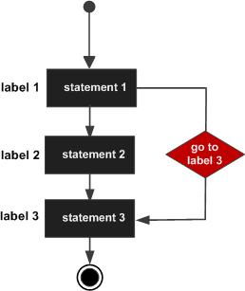
Goto Statement
The characteristics of the goto statement are:
A goto statement provides an unconditional jump from the goto to a labeled statement in the same function.
The goto statement has the following form:
goto label;
statement1;
statement2;
. . .
label: statement;

Slide 12
Lend a Hand
Draw a flow chart for goto statement.
Draw a flow chart for break statement.

Slide 13
Flowchart
The following figure shows the flowchart for goto and break statement:
Goto Statement:
Break Statement:

Slide 14
Lend a Hand -Goto
# include <stdio.h>
int main(){
float num,average,sum;
int i,n;
printf("Maximum no. of inputs: ");
scanf("%d",&n);
for(i=1;i<=n;i++)
{
printf("Enter num %d: ",i);
scanf("%f",&num);
if(num<0.0)
goto jump;
sum=sum+num;
}
jump:
average=sum/(i-1);
printf("Average: %.2f",average);
getch();
return 0;
}

Slide 15

Questions

Slide 16
Branching Statements
Branching & control structures are very interesting in programming. Let us discuss how the logic can be re-used in the form of functions next.

Slide 17
Lend a Hand
Instructions:
Write a program to get a number and print the number. If it is < 50 and skip the iteration if that is > 50 , if that number is <0 break the loop, and repeat the process till you get the input zero.
Notes:
1.

Slide 18
Lend a Hand-Solution
#include <stdio.h>
void main() {
int number;
do {
printf(" \nEnter the number :");
scanf("%d", &number);
if (number < 0) {
break;
}
if (number >50) {
printf("Skip the value\n");
continue;
}
printf("The number is: %d", number);
} while (number!= 0); }
Notes:
1.

Slide 19

Test Your Understanding
Select the correct option.
The ‘break’ statement:
Transfers the control to the top of the loop.
Transfers the control to a specified statement of the loop.
Transfers the control to the bottom of the loop.
Does not transfer the control at all.
Notes:
The break statement is used to break the execution and the control is transferred to the bottom of the loop.

Slide 20
Test Your Understanding
Q1. Write a program to make a simple calculator using switch case, break statements (Add, Subtract, Multiply, Divide).
Q2. Write a program to print the numbers up to 150 using goto statement.

Slide 21
Keywords
Break
The loop is immediately terminated and program control resumes at the next statement.
Continue
Continue forces the next iteration of the loop to take place, skipping any code in between.
GoTo
A go to statement provides an unconditional jump from goto to a labeled statement in the same function
Return
Return the value.

Slide 22
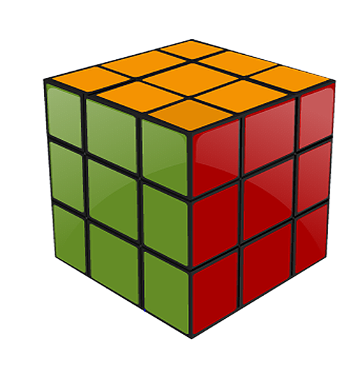
Summary
At the end of this course, you have learnt:
The types of Branching Statements are:
break
continue
goto
By using the break statement the loop is immediately terminated and the program control resumes at the next statement following the loop.
The continue statement forces the next iteration of the loop to take place, skipping any code in between.
A goto statement provides an unconditional jump from the goto to a labeled statement in the same function.

Slide 23
References
http://www.netinfocentre.com/ControlStructure.html
http://www.studiesinn.com/learn/Programming-Languages/C-Language/Control-Structure.html
Disclaimer: Parts of the content of this course is based on the materials available from the Web sites and books listed above. The materials that can be accessed from linked sites are not maintained by Cognizant Academy and we are not responsible for the contents thereof. All trademarks, service marks, and trade names in this course are the marks of the respective owner(s).

Slide 24
Programming Concepts
You have successfully completed -
Branching Statements

Slide 25
Change Log
Version Number | Changes made
 | Initial Version | CATP Solutions Team | 01/31/2013
V1.1 | Slide No. | Changed By | Effective Date | Changes Effected
 | 1-25 | Cognizant Interactive Team CATP Technical Team | 17.05.2013 | Base-lining Content

