Slide 1
Programming Concepts
Control Flow Statements
LEVEL – LEARNER
1

Slide 2






Icons Used
Questions
Hands-on Exercise
Summary
Test Your Understanding
Reference
Lend A Hand

Slide 3



Overview
Now that you have learnt all about data structures, you will learn how control structures play an important role in programming.
IF
IF-ELSE
FOR
Control Structures
WHILE
DO-WHILE

Slide 4
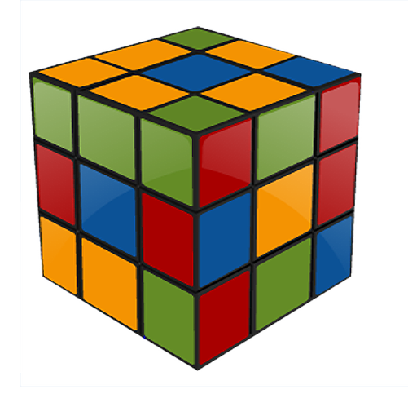
Objectives
After completing this session, you will be able to:
Apply decision control structures, namely if, if-else, and switch, which allow selection of specific sections of code to be executed.
Apply iteration control structures while, do-while, and for, which allow executing specific sections of code, a number of times.

Slide 5
Control Structures
Control structures allow you to change the ordering of how the statements in your programs are executed.
There are two types of control structures:
Decision Control Structures
Allows you to select specific sections of a code to be executed.
Repetition Control Structures
Allows you to execute specific sections of a code, a number of times.

Slide 6

Why Do We Need Control Structures
Sometimes an algorithm needs to be executed, based on some conditions.
Depending on such conditions, execution can be diverted.
Consider an example for finding an Odd or Even number.
Hence, we need control structures to skip or to take decisions accordingly.
If number mod 2 is equal to zero
Display('Even Number')
Else
Display('Odd Number')

Slide 7
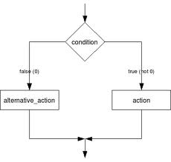
Decision Control Structures
Decision control structures are statements that allow you to select and execute specific blocks of code while skipping other sections.
Here are the different types of
decision control structures:
if-statement
if-else-statement
if-else if-statement

Slide 8
if Statement
The if-statement specifies that a statement (or a block of code) will be executed if and only if a certain boolean statement is true.
The if-statement has the form:
if( boolean_expression )
statement
or
if( boolean_expression )
{
statement1;
statement2;
}

Slide 9
if Statement
Note to the SME:
Is the highlighted text, a code/program?
The expression A>B is a logical expression. It describes a condition we want to test.
if A>B is true, that is (if A is greater than B), print the value of A.
if A>B is false that is (if A is not greater than B), print the value of B.
The algorithm for the flowchart is as follows:
If A>B then
print A
else
print B
End if
is
A>B
Y
N
Print A
Print B

Slide 10

Lend a Hand - if Statement
#include <stdio.h>
int main(){
int num;
printf("Enter a number.\n");
scanf("%d",&num);
if((num > 0)/*checking whether remainder is 0 or not.*/
printf(“Given number is positive number.");
return 0;
}

Slide 11
Lend a Hand
Write an algorithm that reads two values, determines the largest value and prints the largest value with an identifying message.
START
The algorithm for the flowchart is as follows:
Step 1: Input VALUE1, VALUE2
Step 2: if (VALUE1 > VALUE2) then
MAX ← VALUE1
else
MAX ← VALUE2
end if
Step 3: Print “The largest value is”, MAX
Input
VALUE1,VALUE2
Y
Is VALUE1 > VALUE 2
N
MAX ← VALUE1
MAX ← VALUE2
Print
“The largest value is”, MAX
STOP

Slide 12
if-else Statement
The if-else statement is used when you want to execute a certain statement if the condition is true, and a different statement if the condition is false.
The if-else statement has the form:
if(boolean_expression) {
// statement(s) will execute if the boolean expression is true
}
else {
// statement(s) will execute if the boolean expression is false
}

Slide 13
Lend a Hand – if-else Statement
#include <stdio.h>
int main()
{
int num;
printf("Enter a number you want to check.\n");
scanf("%d",&num);
if((num%2)==0) /*checking whether remainder is 0 or not.*/
printf("%d is even.",num);
else
printf("%d is odd.",num);
return 0;
}

Slide 14
Switch Statement
Switch allows branching on multiple outcomes.
Switch statement has the form:
switch(expression)
{
case constant-expression : statement(s);
break; /*optional */
case constant-expression : statement(s);
break; /* optional */
// you can have any number of case statements.
default : ; /* Optional statement(s) */
}
Notes:
What kind of restrictions are placed on the values of each case of a switch statement?
During compilation, the values of each case of a switch statement must evaluate to a value that can be promoted to an int value.
So Switch case accepts only an integer or a character.

Slide 15
Lend a Hand – Switch Case
# include <stdio.h>
int main(){
char operator;
float num1,num2;
printf("Enter operator +, - , * or / :\n");
operator=getche();
printf("\nEnter two operands:\n");
scanf("%f%f",&num1,&num2);
switch(operator)
{
case '+':
printf("num1+num2=%.2f",num1+num2);
getch();
break;
case '-':
printf("num1-num2=%.2f",num1-num2);
getch();
break;
case '*':
printf("num1*num2=%.2f",num1*num2);
getch();
break;
case '/':
printf("num2/num1=%.2f",num1/num2);
getch();
break;
default:
/* if operator is other than +, -, * or /, error message is shown */
printf("Error! operator is not correct");
getch();
break;
}
return 0;
}

Slide 16
Repetition Control Structures
Repetition control structures are statements that allow you to execute specific blocks of code, a number of times.
Here are the types of repetition control structures:
while-loop
do-while loop
for-loop

Slide 17
While loop
While loop is a statement or block of statements that is repeated as long as some condition is satisfied.
While loop has the following form:
The statements inside the while loop are executed as long as the boolean_expression evaluates to true.
while( boolean_expression )
{
statement1;
statement2;
. . .
}

Slide 18
Lend a Hand – While Loop
#include <stdio.h>
int main(){
int num,factorial;
printf("Enter a number.\n");
scanf("%d",&num);
factorial=1;
while (num>0){ /* while loop continues until test condition number>0 is true */
factorial=factorial*num;
--num;
}
printf("Factorial=%d",factorial);
return 0;
}

Slide 19
DO-WHILE Loop
Note to SME:
Is it written as DO WHILE loop or DO-WHILE loop?
Here are the features of the DO-WHILE loop:
It is similar to the while-loop.
The statements inside a do-while loop are executed several times as long as the condition is satisfied.
The main difference between a while and do-while loop is that the statements inside a do-while loop are executed at least once.
The do-while loop has the following form:
do
{
statement1;
statement2;
. . .
}
while( boolean_expression );

Slide 20
Lend a Hand - DO-WHILE Statement - C
Note to SME:
Should there be a lead-in sentence explaining as to what these are?
#include <stdio.h>
int main(){
int sum=0,num;
Do /* Codes inside the body of do...while loops are at least executed once. */
{
printf("Enter a number\n");
scanf("%d",&num);
sum+=num;
}
while(num!=0);
printf("sum=%d",sum);
getch();
return 0;
}

Slide 21
FOR Loop
For loop allows execution of the same code, a number of times.
It has the following form:
Here,
Initialization Expression initializes the loop variable.
Loop Condition compares the loop variable to some limit value.
Step Expression updates the loop variable.
for(Initialization Expression; Loop Condition; Step Expression)
{
statement1;
statement2;
. . .
}

Slide 22
Lend a Hand – FOR Loop - C
#include<stdio.h>
main()
{
int values[5],i;
for(i=0; i <5; i++)
scanf("%d",&values[i]); /* Get Inputs from user */
for(i=0; i <5; i++)
printf("%d",values[i]);
getch();
}

Slide 23
Questions

Slide 24
Lend a Hand
Write a program that accepts colors, (1: red, 2: green, 3: blue) and prints the input based on the color selected.
Use switch case with break statements.
#include <stdio.h> int main() { int color = 1; printf("Please choose a color(1: red,2: green,3: blue):\n"); scanf("%d", &color); switch (color) { case 1: printf("you chose red color\n"); break; case 2: printf("you chose green color\n"); break; case 3: printf("you chose blue color\n");
break;
default: printf("you did not choose any color\n"); } return 0; }
Notes:
1

Slide 25
Lend a Hand (Contd.)
Write a program to reverse an integer (12345 to 54321)
#include <stdio.h>
int main()
{
int n, reverse=0, rem;
printf("Enter an integer: ");
scanf("%d", &n);
while(n!=0)
{
rem=n%10;
reverse=reverse*10+rem;
n/=10;
}
printf("Reversed Number = %d",reverse);
return 0;
}

Slide 26

Test Your Understanding
Which of the following is true in the case of an ‘if’ statement?
This statement is used when there are two possible alternative actions.
The test condition may be a logical expression or an arithmetic expression.
The else part is optional.
More than one statement may be present in the if block and else block statements.
Notes:
The condition in the If Statement should be a logical expression. If the statement can exist without else part, we can include more than one statements inside If block as well as Else part.(i, iii, iv)

Slide 27
Test Your Understanding
2. Which of the following is not correct in the case of a ‘switch’ statement?
The expression involved in a switch statement may be an arithmetic expression.
The body of a case may be empty.
The default part is optional.
The body of a case should have the break statement.
Notes:
1. The switch statement allows for branching on multiple values of expression. The expression is evaluated, and if it matches any of the case values, execution jumps to that line. Execution continues until either the end of the switch statement or a break statement is encountered. If expression does not match any of the case statements, and if there is a default statement, execution switches to the default statement, otherwise the switch statement ends.

Slide 28
Test Your Understanding
Write a program to find the number of digits in a number.
Write a program to find the largest among three numbers.
Write a program to create a simple calculator (Add, Subtract, Multiply, Divide) functionality.
Write a program to check whether the given number is prime or not.
Write a program to calculate the power of a number – get base and exponent as input.
Write a program to calculate the sum of N natural numbers.
Write a program to check if the number is Armstrong (153 =1*1*1 + 5*5*5+3*3*3)

Slide 29
Keywords
IF
Statement will be executed if and only if a certain Boolean statement is true.
While
Do while
For
It is a statement or block of statements that is repeated as long as some condition is satisfied.
Statements inside a do-while loop are executed several times as long as the condition is satisfied. Here statements inside a do-while loop are executed at least once.
For loop allows execution of the same code a number of times.
Notes:
transient
Persistence - the continuance of an effect after the cause is removed.

Slide 30

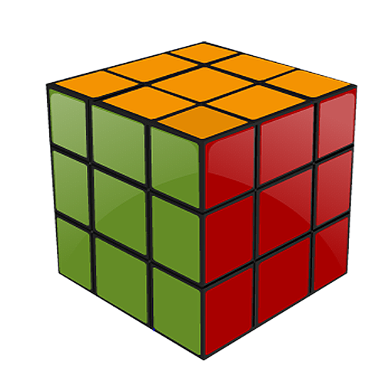
Summary
The key points covered in this chapter are:
Types of decision control structures are:
if-statement
if-else-statement
if-else if-statement
The types of Repetition Control Structures are:
while
do-while
For

Slide 31
Summary
The only legal expression in an if- statement is a boolean expression. In other words, an expression that resolves to a boolean or a boolean variable is a legal expression.
Boolean assignments (=) can be mistaken for boolean equality (==) tests.
Curly braces are optional for If blocks that have only one conditional statement. But some indentations can also be misleading.
Switch statements can evaluate only to enums or the byte, short, int, and char data types.

Slide 32
Summary
The case constant must be a literal or final variable, or a constant expression, including an enum. You cannot have a case that includes a variable that is not final, or a range of values.
The default keyword can be located anywhere in the switch block.

Slide 33
References
http://msdn.microsoft.com/enus/library/66k51h7a(v=vs.80).aspx
http://www.indiastudychannel.com/experts/26091-Explain-Switch-statement-C-programming-with.aspx
http://www.programiz.com
Disclaimer: Parts of the content of this course is based on the materials available from the Web sites and books listed above. The materials that can be accessed from linked sites are not maintained by Cognizant Academy and we are not responsible for the contents thereof. All trademarks, service marks, and trade names in this course are the marks of the respective owner(s).

Slide 34
Control Structures
Let us have a detailed discussion about branching statements in the next presentation.

Slide 35
Programming Concepts
You have successfully completed -
Control Flow Statements

Slide 36
Change Log
Version Number | Changes made
 | Initial Version | CATP Solutions Team | 01/31/2013
V1.1 | Slide No. | Changed By | Effective Date | Changes Effected
 | 1-36 | Cognizant Interactive Team CATP Technical Team | 17.05.2013 | Base-lining Content

