Slide 1
Programming Concepts
Functions
LEVEL – LEARNER

Slide 2








Icons Used
Hands-on Exercise
Reference
Questions
Points To Ponder
Coding Standards
Lend A Hand
Summary
Test Your Understanding

Slide 3

Overview
Now that you have learnt all about Data Structures and Control Structures, we will start with our next topic, “ Functions”.

Slide 4
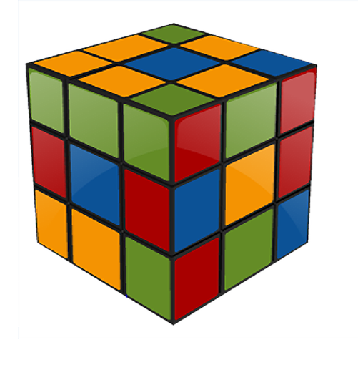
Objectives
After completing this session, you will be able to:
Define functions.
Identify the need of functions.
Apply the method of passing arguments to functions.
Write programs using functions.

Slide 5


Function
Can any one tell me what a function in programming means?
A function is a block of code that has a name and a property that is reusable. This means that it can be executed from as many different points in a program as required.

Slide 6







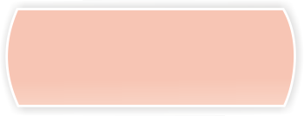
Why Do We Use Functions ?
It can be used to build a customized library of frequently used routines.
It avoids the need for
redundant code .
It facilitates reusability.
Benefits
Maintenance Effects
No specific testing is required on logic when the function is invoked from new place.
It facilitates top-down modular programming.

Slide 7
Function
Main() is the first function that will be executed by the Operating System.
OS will execute all the codes written inside the main program one by one.
If any of the function call occurs, the control execution will be moved to the sub-function and it will execute all the code from the sub-function and return the value to the main function.
Then, the next step in our main function will be executed.
Thus, the structure of the program itself needs one function to control the statements.

Slide 8
Need For Functions
As real world applications become more complex and large, several problems arise.
Algorithm’s implementation becomes more difficult because of the size of the program.
As programs become larger, testing, debugging, and maintenance will be a difficult task.
So, complex problems can be modularized and can be implemented by using user defined functions.

Slide 9
Need For Functions (Contd.)
Suppose, we are checking the User authentication for each page in one shopping site with the following conditions:
User_ID in Existing_User_ID and password is Existing_User_pwd and Country in (India, Korea, Mexico, England)
Instead of checking each time in each page, user authentication code can be moved to a separate function and can be called at any time wherever necessary.

Slide 10
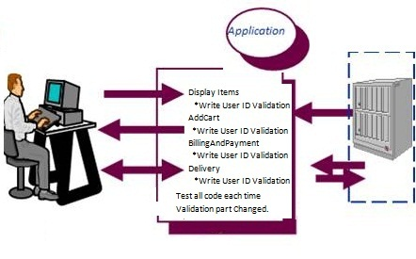
Need For Functions (Contd.)
Consider, there are web pages called “Display Items”, “Add Cart, “Billing and Payment,” and “Delivery” in our application.
Here, the user writes codes for each time the validation needs to be executed and the testing needs to be done, for all the modules.

Slide 11
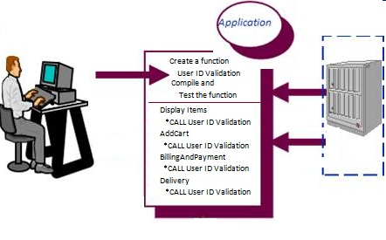
Need For Functions (Contd.)
Here the user creates one function “User ID validation” and calls that function wherever required.
If there is any change in the function, the user needs to test only that function and not the entire code.

Slide 12
Need For Functions (Contd.)
Instead of repeating the code across all pages, we can create one function and call it whenever required.
Function Validate_User(User_ID, Country)
{
If (User_ID in Existing_User_ID and password is Existing_User_pwd and Country in (India, Korea, Mexico, England))
Say “Valid User”
Or Say “In-valid User or Session expired, please login again.”
}

Slide 13
Need For Functions (Contd.)
Now, call these functions in all the pages.
DisplayItems Call Validate_User
AddCart Call Validate_User
BillingAndPayment Call Validate_User
Delivery Call Validate_User
For e.g., when we need to include one more country, like “Ireland”, there is no need to modify the check in each page. Instead we can modify only the function “Validate User” so that only that particular function can be tested.

Slide 14
Function Prototypes
A declaration of a function is called a function Prototype.
A prototype specifies the signature of the function, the return type, and number and data types of the arguments.
Functions must be declared before they are called.
Let us consider the example, int find_big(int , int);
Function find_big returns integer value, and takes 2 integer arguments.
void swap(int ,int ); Here the function swap does not return any value, and takes 2 arguments.
float add(float, int); Here the function add returns float value, takes 1 float variable, and 1 integer variable.

Slide 15
Function Definition
A function definition is used to define the function with appropriate name, parameters, and the task to be carried out by the function. It can be defined in any location in the program.
A function definition has two principle components, which are the Function header (first line) and the Function body.

Slide 16
Function Definition (Contd.)
Syntax:
return-type function fn-name(type arg1, type arg2, ……)
{
local variables declaration;
executable statement 1;
executable statement 2;
:
return expression; }
Here, “arg1, arg2 …” are called formal arguments.

Slide 17
Function Definition
Here are the characteristics of a function body:
A function can have declaration statements and any number of valid executable statements.
The return statement is used to transfer the control back to the calling program.
Syntax:
expr can be a variable name, constant value, or any single valued expression.
Functions can be invoked by specifying its name, followed by a list of parameters enclosed within the parentheses.
Syntax:
return; or return(expr);
[vble name] = fn-name(actual arguments);

Slide 18
Lend a Hand – Multiply Two Numbers
#include <stdio.h>
#include <stdlib.h>
float product(float x, float y)
{
float result;
result = x*y;
return result;
}
int main(void)
{
float a;
float b;
float answer;
// Get Input values
printf("Please input two values to be multiplied:");
scanf("%f %f",&a,&b);
// call the function product
answer=product(a,b);
printf("The product of %f and %f is %f\n",a,b,answer);
system("pause");
return 0;
}

Slide 19
Lend a Hand – Factorial
#include <stdio.h>
main()
{
int number;
prompt(); /*function call no parameters */
scanf( "%d" , &number );
factor(number); /* function call with parameters */
getchar();
getchar();
}
prompt() /* function */
{
printf("Input a number... ");
}
factor(int t) /* function */
{
long sum = 1;
int i ;
for (i = 1 ; i <= t ; i++)
sum = sum*i;
printf("Factorial %d is %ld\n" , t , sum);
}

Slide 20
Passing Arguments
A function is referenced by using its name and providing appropriate values for the arguments.
Functions may be classified as:
Functions with no arguments and no return value
Functions with no arguments but with return value
Functions with arguments but with no return value
Functions with arguments and return value

Slide 21
Passing Arguments (Contd.)
Here is a feature of Passing Arguments to a Function.
There are two approaches to pass the information to a function via arguments. They are:
Call by Value
Call by Reference

Slide 22

Passing Arguments (Contd.)
Call by Value
Call by Reference
The values of the actual arguments are copied into the respective formal arguments.
The Actual and Formal parameters refer to the different memory locations and only the value of the actual argument is copied into the formal argument.
The value of the actual argument will remain same.
The addresses of the actual arguments are passed to the formal arguments.
Formal arguments refer to the same memory location of the actual arguments.
Formal arguments should be a pointer variable or array.

Slide 23
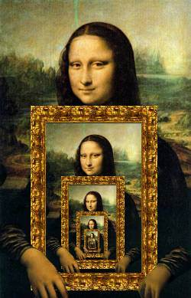
Recursion
If a function has a self-reference, it is called recursion. It is a process by which a function calls itself.
A recursive function must have the following properties:
The problem must be written in a recursive form.
There must be a base criterion or a terminating condition, for which the function doesn’t call itself.

Slide 24
Lend a Hand – Fix the Issues
This program should pass an array containing the age of a person, to a function. This function should find the average age and display the average age in the main function. Run this program and fix the compile time as well as run time issues.

Slide 25
Fix the Issues- Solution
#include <stdio.h>
float average(float a[],int n);
int main(){
float avg, c[20];
int n;
printf("Enter total number of values");
scanf("%d",&n);
for(i=1;i<=n;i++)
scanf("%d",&c[i]);
avg=average(c,n); /* Only name of array is passed as argument. */
printf("Average age=%.2f",avg);
getch();
return 0;
}
float average(float a[],n)
{
int i;
float avg, sum=0.0;
for(i=1;i<=n;i++)
{
printf("%f",a[i]);
sum+=a[i];
}
avg =(sum/n);
printf("average= %f",avg);
return avg;
}
Notes:
Issues Fixed in this Program.
#include <stdio.h>
float average(float a[],int n);
int main(){
float avg, c[20];
int i,n;
printf("Enter total number of values");
scanf("%d",&n);
for(i=1;i<=n;i++)
scanf("%f",&c[i]);
avg=average(c,n); /* Only name of array is passed as argument. */
printf("Average age=%.2f",avg);
getch();
return 0;
}
float average(float a[],int n)
{
int i;
float avg, sum=0.0;
for(i=1;i<=n;i++)
{
printf("%f",a[i]);
sum+=a[i];
}
avg =(sum/n);
printf("average= %f",avg);
return avg;
}

Slide 26
Questions

Slide 27
Lend a Hand
Here are the instructions:
Write a program to find the area of a rectangle by passing value to a function.

Slide 28
Lend a Hand (Contd.)
#include <stdio.h>
main()
{
intl,b;
int area(int);
printf("Enter Length of Rectangle\n");
scanf("%d",&l);
printf("Enter Breadth of Rectangle\n");
scanf("%d",&b);
printf("Area of Rectangle = %d",Area(l,b));
getch();
return 1;
}
int Area(intlength,int breadth)
{
int area=0;
area =length * breadth;
return(area);
}

Slide 29
Lend a Hand (Contd.)
Find a max number from a given set of 5 numbers.

Slide 30
Lend a Hand (Contd.)
#include <stdio.h>
int maximum( int [] );
int maximum( int values[5] )
{
int max_value, i;
max_value = values[0];
for( i = 0; i < 5; ++i )
if( values[i] > max_value )
max_value = values[i];
return max_value;
}
main()
{
int values[5], i, max;
printf("Enter 5 numbers\n");
for( i = 0; i < 5; ++i )
scanf("%d", &values[i] );
max = maximum( values );
printf("\nMaximum value is %d\n", max );
}

Slide 31
Lend a Hand (Contd.)
Write a program to generate the Fibonacci series.
#include<stdio.h>
void printFibonacci(int);
int main(){
int k,n;
long int i=0,j=1,f;
printf("Enter the range of the Fibonacci series: ");
scanf("%d",&n);
printf("Fibonacci Series: ");
printf("%d %d ",0,1);
printFibonacci(n);
return 0;
}
void printFibonacci(int n){
static long int first=0,second=1,sum;
if(n>0){
sum = first + second;
first = second;
second = sum;
printf("%ld ",sum);
printFibonacci(n-1);
}
}

Slide 32

Test Your Understanding
What are the advantages of functions?
What are the different types of passing arguments?
Notes:
1. Modularity... Create and test a function once, use it multiple times throughout your code. Local variables are contained and valid only as needed. Activity inside the function does not impact code outside the function. Need to change the calculation? Change it in one place, recompile, and everything is updated.

Slide 33
Test Your Understanding
Write a program to calculate the sum of Natural Numbers using functions, accepting N as input.
Write a program to check whether the number is Armstrong Number using function. (153 = 1*1*1 + 5*5*5 + 3*3*3).
Write a program to find the largest number among three float Numbers using function.
Write a program to check whether the passing character is alphabet or Not.

Slide 34

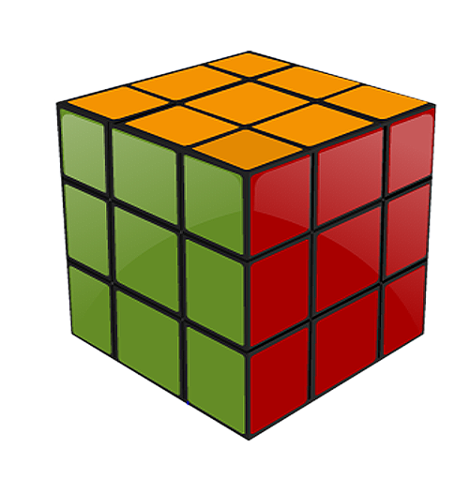
Summary
The key points covered in this session are:
Functions are smaller self-contained components that carry out some specific and well defined tasks.
Functions facilitate reusability and bring logical clarity to our programs.
C functions should be considered with three aspects:
Function definition
Function call
Function prototyping
Arguments can be passed to a function via call by reference method or by call by value method.

Slide 35
References
http://www.programiz.com
http://www.cs.utah.edu/~germain/PPS/Topics/C_Language/c_functions.html
Disclaimer: Parts of the content of this course is based on the materials available from the Web sites and books listed above. The materials that can be accessed from linked sites are not maintained by Cognizant Academy and we are not responsible for the contents thereof. All trademarks, service marks, and trade names in this course are the marks of the respective owner(s).

Slide 36
Programming Concepts
You have successfully completed -
Functions

Slide 37
Change Log
Version Number | Changes made
 | Initial Version | CATP Solutions Team | 01/31/2013
V1.1 | Slide No. | Changed By | Effective Date | Changes Effected
 | 1-37 | Cognizant Interactive Team CATP Technical Team | 17.05.2013 | Base-lining Content

