Slide 1
Programming Concepts
File Handing
LEVEL – LEARNER

Slide 2








Icons Used
Hands-on Exercise
Reference
Questions
Points To Ponder
Coding Standards
Lend a Hand
Summary
Test Your Understanding

Slide 3
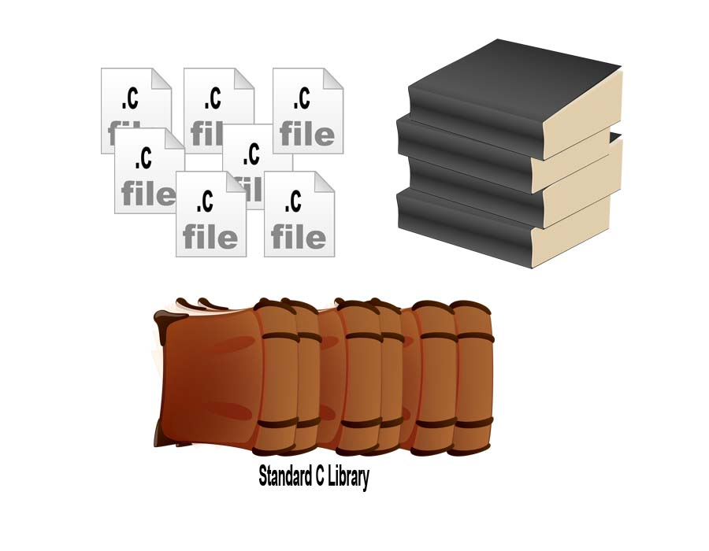

Overview
Now you know about data structure, control structure, and functions. In this session, you will learn about file handling.

Slide 4

Objectives
After completing this session, you will be able to:
Define the basic concepts of pointer
Define the concept of file
Define the types of file
List the basic file operations
List the formatted, unformatted, and block file I/O operations

Slide 5
What is a Pointer?
The characteristics of a pointer are as follows:
Pointer is a variable which contains the address in the memory of another variable. We can have a pointer to any variable type.
The operator “&” gives the ''address of a variable‘’.
The operator “*” gives the ''contents of an object pointed to by a pointer‘’.
To declare a pointer to a variable type:
int *pointer;

Slide 6
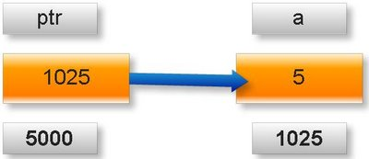
Pointer (Contd.)
int a=5; int*ptr; ptr=&a
About variable a:
Value of variable which it keeps: 5. Address where it has stored in memory : 1025(assumed)
About variable ptr:
Value of variable which it keeps: 1025.
Address where it has stored in memory : 5000(assumed)

Slide 7
Pointer Declaration
int x, *px;
px = &x;
x = 5;
printf(“ x = %d “ , x); /*prints 5*/
printf(”address of x = %d “ , &x); /*prints 1000 (Address of x) */
printf(“address pointed by pointer = %u”, px); /*prints 1000*/
printf(“address of the pointer = %u”, &px); /*prints 3000*/
printf(“content pointed by pointer = %d”, *px
Example of a pointer declaration:
Check the output:

Slide 8


File
A file is a collection of bytes stored on a secondary storage device, which is generally a disk of some kind.
Do you know what a File is?

Slide 9
Need for Files
John works in a government office. He stores all the data and information about the employees and customers, on paper.
His boss wants to review AGT Customer details. So, he asks John to bring the details. John has stored all the data on paper. Now, when he tries to search and collect the customer’s details of the requisite data from 2009 to present, he finds out that he has lost some papers. He is now in panic!
How can we help him to store data so that he won’t lose any data in future? Why don’t you help him out?

Slide 10

Introduction to Files
How is a file stored?
Stored as sequence of bytes, logically contiguous (may not be physically contiguous on disk).
When a large volume of data is involved:
The input data can be stored on disks.
The program may access the data from disks for processing.
The results may also be stored on disks.

Slide 11
Introduction to Files (Contd.)
File manipulations may be done in two ways:
Low-level I/O using system calls.
High-level I/O using functions from standard I/O library.
Files can be classified into:
Stream-oriented files.
System oriented files.

Slide 12
File Operations
There are four types of file operations.
File Operations
Reading a File
Writing a File
Closing a File
Opening a File

Slide 13
Pseudo Code for File Handling
The pseudo code for file handling is as follows:
Begin
open myInFile for Input
open myOutFile for Output
while myInFile is not equal to blank
Get prodID (1-10) from myInFile
Get prodName(11-20) from myInFile
Get ProdCost(21-25) from myInFile
Create file myOutFile
Write prodID, prodName, prodCost to myOutFile
close myInFile
close myOutFile
End

Slide 14
File Operation Modes
File Mode | Functionality
r | Read text mode
w | Write text mode (truncates file to zero length if it already exists or creates new file)
a | Append text mode for writing (opens or creates file and sets file pointer to the end-of-file)
rb | Read binary mode
wb | Write binary mode (truncates file to zero length if it already exists or creates new file)
Ab | Append binary mode for writing (opens or creates file and sets file pointer to the end-of-file)

Slide 15
File Operation Modes (Contd.)
File Mode | Functionality
r+ | Read and write text mode
w+ | Read and write text mode (truncates file to zero length if it already exists or creates new file)
a+ | Read and write text mode (opens or creates file and sets file pointer to the end-of-file)
r+b or rb+ | Read and write binary mode
w+b or wb+ | Read and write binary mode (truncates file to zero length if it already exists or creates new file)
a+b or ab+ | Read and write binary mode (opens or creates file and sets file pointer to the end-of-file)

Slide 16
File Operations in C
The different types of file operations in C are as follows:
Character I/O
Get char() , Put char() , getc() , putc()
String I/O
fputs( str, fptr ) ,f gets(str , n, fptr)
Integer I/O
fprintf(fptr, format-string, variable-list); fscanf( fptr, format-string, addresses- list);
Formatted I/O
put w( i, fptr) , i= get w(fptr)

Slide 17
Character I/O (Contd.)
Reading from a file: The function is used to read a byte from a file.
If the end-of-file (EOF) is encountered, then EOF is returned and the end-of-file indicator is set.
If an error occurs then the error indicator for the stream is set and EOF is returned.

Slide 18
String I/O (Contd.)
Writing a string into a file:
Writes a string to the specified stream up to its entire length but not including the null character.
On success a non-negative value is returned.
Reading a string from a file:
It stops when either (n-1) characters are read, the newline character is read, or the end-of-file is reached, whichever comes first.
Reads a line from the specified stream and stores it into the string pointed to by str.
On error EOF is returned.
The newline character is copied to the string.
A null character is appended to the end of the string.
On success a pointer to the string is returned.
On error a null pointer is returned.

Slide 19
Integer I/O
Writing integer into a file:
The function used is putw().
Writes an integer to a file.
Reading integer from a file:
The function used is getw().
On success a nonnegative value is returned.
On error EOF is returned.
Reads an integer from the file and assign it to the program defined numeric variable specified at the left hand side.

Slide 20
Formatted I/O
Writing formatted data to a file:
On success, the number of characters printed are returned.
Reading formatted data from the file:
Reading an input field ends when an incompatible character is met, or the width field is satisfied.
If an error occurred, -1 is returned
On success the number of input fields converted and stored are returned.
If an input failure occurred, then EOF is returned.

Slide 21
Programming Fundamentals
Now that you have understood the programming concepts and how to write programs. In this session, you will learn how to use object oriented concepts in programming.

Slide 22
Lend a Hand
/* compare.c : compare two files */
#include <stdio.h>
void main()
{
FILE *fp1, *fp2, *fopen();
int ca, cb;
char fname1[40], fname2[40] ;
printf(“Enter first filename:”) ;
gets(fname1);
printf(“Enter second filename:”);
gets(fname2);
fp1 = fopen( fname1, “r” ); /* open for reading */
fp2 = fopen( fname2, “r” ) ; /* open for writing */

Slide 23
Lend a Hand
if ( fp1 == NULL ) /* check does file exist etc */
{
printf(“Cannot open %s for reading \n”, fname1 );
exit(1); /* terminate program */
}
else if ( fp2 == NULL )
{
printf(“Cannot open %s for reading \n”, fname2 );
exit(1); /* terminate program */
}
else /* both files opened successfully */
{
ca = getc( fp1 ) ;
cb = getc( fp2 ) ;

Slide 24
Lend a Hand
while ( ca != EOF && cb != EOF && ca == cb )
{
ca = getc( fp1 ) ;
cb = getc( fp2 ) ;
}
if ( ca == cb )
printf(“Files are identical \n”);
else if ( ca != cb )
printf(“Files differ \n” );
fclose ( fp1 );
fclose ( fp2 );
}
}

Slide 25
Lend a Hand: Character I/O
/*count.c : Count characters in a file*/
#include <stdio.h>
void main()
/* Prompt user for file and count number of characters
and lines in it*/
{
FILE *fopen(), *fp;
int c , nc, nlines;
char filename[40] ;
nlines = 0 ;
nc = 0;
printf(“Enter file name: “);
gets( filename );

Slide 26
Lend a Hand (Contd.)
fp = fopen( filename, “r” );
if ( fp == NULL )
{
printf(“Cannot open %s for reading \n”, filename );
exit(1); /* terminate program */
}
c = getc( fp ) ;
while ( c != EOF )
{
if ( c == ‘\n’ )
nlines++ ;
nc++ ;
c = getc ( fp );
}

Slide 27
Lend a Hand (Contd.)
fclose( fp );
if ( nc != 0 )
{
printf(“There are %d characters in %s \n”, nc, filename );
printf(“There are %d lines \n”, nlines );
}
else
printf(“File: %s is empty \n”, filename );
}

Slide 28
Lend a Hand: String I/O
# include <stdio.h>
#define MAXLINE 20
int main(void)
{
char line[MAXLINE];
while (fgets(line, MAXLINE, stdin) != NULL && line[0] != '\n') fputs(line, stdout);
return 0;
}

Slide 29
Lend a Hand: Formatted I/O
#include<process.h>
#include<dos.h>
#include<stdio.h>
#include<conio.h>
#include<dir.h>
#include<io.h>
void main()
{
char name[10],c,ch;
unsigned attrib;
int d,n,f,p;
clrscr();
printf("\t\tMAIN MENU OF PERMISSION\n\t--------------------------------\n");
printf("1.Only Read\n2.Only Write\n3.Exit\nEnter your choice:\n");

Slide 30
Lend a Hand: Formatted I/O (Contd.)
scanf("%d",&n);
switch(n)
{
case 1:
printf("\nEnter the File Name:\n");
scanf("%s",name);
attrib |= _A_RDONLY;
printf("%s file read permission Accepted",name);
break;
case 2:
printf("\nEnter the File Name:\n");
scanf("%s",name);

Slide 31
Lend a Hand : Formatted I/O (Contd.)
attrib = _A_ARCH;
printf("%s excute permission accepted",name);
break;
case 3:
exit(0); }
if(_dos_setfileattr(name,attrib)!=0)
{
perror("\nUnable to set");
getch();
return 0;
}
getch();
}

Slide 32
Lend a Hand
Problem Statement:
Q. Write a program to read a file and find out the count of each character in the file. Print it on screen with the count.
Q. Write a program to find a word in a file. Print the line number and the line.

Slide 33

Questions

Slide 34

Test Your Understanding
Instructions:
Q2. What is EOF, and what value does it usually have?
Q1. What is the output of the following code?
int main()
{
while(i<10)
{
fprintf(stdout,"hello-out");
sleep(1);
i++;
}
return 0;
}

Slide 35
Keywords
r mode
Read text mode.
Write text mode.
a mode
Append text mode for writing.
rb mode
Wb mode
ab mode
File operations
Read binary Mode.
Write binary mode .
Append binary mode for writing .
How it operate on the string, integer , character i/o.
W mode
Notes:
transient
Persistence - the continuance of an effect after the cause is removed.

Slide 36


Summary
At the end of this session, you have learned:
Files are used to store bulk amount of related information in secondary storage.
Files can be classified as system oriented and stream oriented files.
fopen() and fclose() functions are used for opening and closing of files.
Input and output operations on files can be of character I/O, string I/O, formatted I/O, and block I/O.

Slide 37
References
C Reference Card (ANSI)
C Reference Manual by Dennis Ritchie
Programming in C:A Tutorial by Brian W. Kernighan, Bell Laboratories
Byron Gottfried, “Programming in C”, Tata McGraw Hill
Deitel and Deitel, “C How to Program”, Third Edition, Prentice Hall
Disclaimer: Parts of the content of this course is based on the materials available from the Websites and books listed above. The materials that can be accessed from the linked sites are not maintained by Cognizant Academy and we are not responsible for the contents thereof. All trademarks, service marks, and trade names in this course are the marks of the respective owner(s).

Slide 38
Programming Concepts
You have successfully completed -
File Handling

Slide 39
Change Log
Version Number | Changes made
 | Initial Version | CATP Solutions Team | 01/31/2013
V1.1 | Slide No. | Changed By | Effective Date | Changes Effected
 | 1-39 | Cognizant Interactive Team CATP Technical Team | 26.04.2013 | Base-lining Content

