Slide 1
Advance Java
Servlet Chaining
LEVEL – PRACTITIONER

Slide 2
About the Author
Created By: | Renjith(t-renjith) / Shanmu (105110)
Credential Information: | Trainer/Sr Architect
Version and Date: | 1.0, April 15’td 2011
Cognizant Certified Official Curriculum
Notes:
For tde animators:
tdis screen content needs to be rendered in tde flash, no animations needed.

Slide 3









Icons Used
Hands on Exercise
Questions
Tools
Coding Standards
Test Your Understanding
Case Study
Best Practices & Industry Standards
Demonstration
Workshop

Slide 4
Objectives
After completing this chapter you will be able to understand:
What is Response Buffering?
What is Servlet Chaining?
What is request forwarding?
How to include files in servlet response?
Difference between forward and send redirect.

Slide 5
What is Response Buffering ?
By default, any content written to the output stream is immediately sent to the client as HTTP response.
Buffering is the process by which the content are written into a buffer (temporary storage in server) before being sent to the client, thus providing the servlet a better control on the response being sent.
Buffering also makes effective use of network bandwidth since response is send to the client after a specified buffer size is reached.

Slide 6

How Servlet works without buffering?
Assume that a client request for payroll details and payroll servlet responds back with 200 bytes of data.
Web container
Client requests payroll information .
Payroll Servlet
01011010101
Output Stream
Employee
Browser
As soon as the first Kb data response is written (out.println) in the output stream it is pushed to the client. So before the servlets is able to process the entire request the client starts receiving the response.

Slide 7
How Servlet works with buffering?
Web container
Client requests payroll information .
Payroll Servlet
01011010101
Buffer
Employee
Browser
Data pushed to client after
buffer size reaches 150 bytes.
01011010101
Buffer data reached 150 bytes
Assuming buffer size is set to 150 Kb only if the buffer is filled with 150 bytes of data the response will be sent to client.
So buffering allows the servlet to control the response till the buffer gets filled up.

Slide 8
Response Buffering API
The following methods of HTTPResponse interface helps in the buffering the response
setBufferSize(int size) : informs the web container the buffer size to be set for the servlet response, the values represents the number of bytes of data.
getBufferSize() : returns an int indicating the current buffer size.
isCommitted() : returns a boolean indicating whether any part of the response has actually been sent. If this method returns true, the status code and headers cannot be changed.
reset() : method can be used any time before commit to empty the buffer and unset the headers.
flushBuffer() : sends content in the buffer to the client and commits the response.

Slide 9
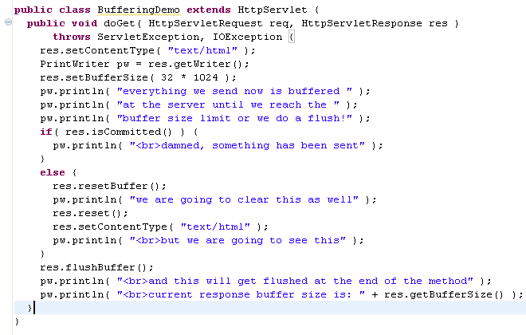
Sample code for response buffering ?
Setting the buffer size as 32 Kb
Checks the whether the response is committed .
Clears the buffer
clears buffer, status codes and headers
1
Commits the response
Since the buffer is reset before the committing the response the contents above the mark “1” will not be printed .

Slide 10
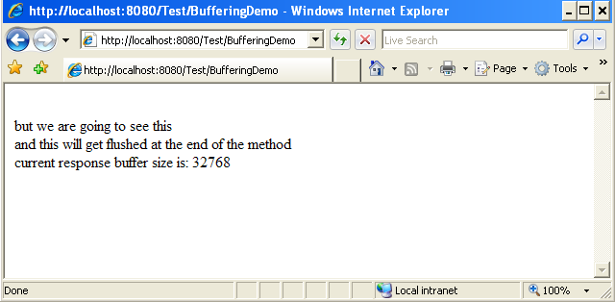
Output Screen
We can see that all the contents printed before the reset method invocation is cleared because they were not committed to the user.

Slide 11
What is Servlet Chaining ?
Servlet chaining is a technique in which two or more servlets orchestrate in servicing a single request. In servlet chaining, one servlet’s response is piped to the next servlet’s input. This process continues until the last servlet is reached. Its output is then sent back to the client. The same request and response object are available across all the servlets in the process.
Servlet Container
The request is processed by three servlets before giving back the response to the client
Request
ServletA
ServletB
Response
ServletC

Slide 12
Two ways of Servlet Chaining
This refers to the process of including the response of one or more servlets with the response of the servlet being requested and the collated response sent to the client by the servlet being requested.
Servlet Chaining
Include
Forward
The servlet being requested by the client forwards the request to one or more servlet and finally the response is sent to the client by last servlet invoked in the chain.

Slide 13
Forward Request - How it works?
Consider the Scenario in which the employee requests their company’s web portal to retrieve their payroll information . The developers have developed a EmployeeServlet for validating the employee details and PayrollServlet to implement the logic of retrieving the pay roll information.
Web container
Employee Servlet validates the employee details and forwards the request to Pay roll servlet.
Employee requests payroll information (R1)
Employee
Servlet
R1
Payroll Servlet
Employee
Browser
Payroll servlet process the original request (R1) and sends the pay roll information response to the employee.
NOTE: In the above original request (R1) is forwarded to all the servlet in chain. As illustrated in the example the developers can chain as many servlets as they want.

Slide 14
Include Request - How it works?
Consider the scenario in which a bank customer logins to his netbanking application to retrieve the account details and his one month transaction details in his account. The implementation is done using include as follows,
Web container
Customer Servlet validates the customer details and requests AccountDetails
Servlet for the account details.
Account
DetailsServlet
Customer requests account information (R1)
Customer
Servlet
Account Details response
Requests Transaction
details
Employee
Browser
Customer servlet collates the account details and transaction details and sends the response to customer.
TransactionDetailServlet
Transaction detail response
NOTE: In the above original request (R1) is visible to all the servlet in chain. As illustrated in the example the developers can include as many servlets as they want.

Slide 15
How to Chain Servlets?
Step 1 : Create the RequestDispatcher for the resources to be chained.
Step 2 : Set attributes to request if needed.
Step 2 : Call the include or forward method on the RequestDispatcher object
Note : The include/forward can be performed only in the service methods (get/post) of a servlet and in turn can be handled in the service method of the included/forwarded servlet.
Example: Include from a get method in first servlet can be handled only by get method in the included servlet. Same applies to post method also.

Slide 16
RequestDispatcher Interface
Request Dispatcher is an object which accepts the request from the client and redirects them to any resource(Servlets, jsp, html etc).
The servlet container creates the RequestDispatcher object, which is used as a wrapper around a server resource located at a particular path or identified by a particular name.
How to create Dispatcher object ?
RequestDispatcher dispatcher= request.getRequestDispatcher(“FooterServlet”);
Where, FooterServlet is the servlet to which the request needs to be dispatched.

Slide 17
Methods in RequestDispatcher
forward() : Used to forward request to another resource.
Syntax:
dispatcher.forward(request, response);
include() : Includes the content of a resource (servlet, JSP page, HTML file) in the response.
Syntax:
dispatcher.include(request,response);

Slide 18
How to share value in servlet chain?
Values can be shared among the included/forwarded servlets by setting attributes, we can set values as attributes in the request object and share between the servlets.
Request attribute is available only in the request scope which means the attribute is lost once the response is send to the user.
Syntax
request.setAttribute(attributeName,value);
Example :
request.setAttribute(“userName”,”arun”);

Slide 19
How to include a Servlet?
Step 1 : Create the RequestDispatcher object
RequestDispatcher dispatcher= request.getRequestDispatcher(“SecondServlet”);
Step 2 : Set request attributes it needed.
Step 3 : Call the include method to include the servlet
dispatcher.include(request,response);

Slide 20
Include Vs Forward
Where to use include ?
Include is used for reusing common code. Like a servlet to print the user login information in all pages, the common servlet can be included in all the pages.
Use include if you want to present a collated response from a set of components(Servlets, jsp etc).
Include can also be used for including static content to a page such as the page footer can be reused across all the pages in the application.
Where to use Forward ?
Forward is also used again for code reusability.
Forward are typically used to forward a request to a success or error page after some processing. Example: After login credentials validated if success the control will be forwarded to home page else sent to error page.

Slide 21
Lend a Hand – Including a Servlet
This is a demo to showcase the associates how to include other resources to a Servlet. We will develop a Servlet which includes a footer and a message servlet.
Step 1 : Create a servlet UserHome. This is the home page for the user
Step 2 : Create another servlet named Footer which contains the footer. Since footer is common area for all the page we write it as a separate component and include it wherever required.
Step 3 : Create a Servlet named WelcomeMessage which returns a welcome message for the user. WelcomeMessage accepts the user name which is passed as and attribute from HomeServlet and dynamically generates the welcome message.

Slide 22
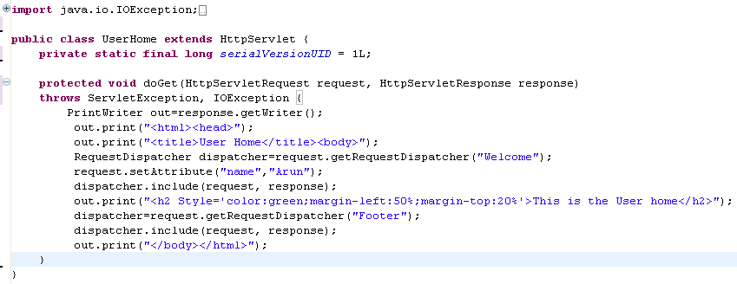
Lend a Hand - UserHome
The following servlet needs to be created by the developers.
Creates RequestDispatcher object
Sets a request attribute
Includes welcome servlet
Includes Footer servlet

Slide 23
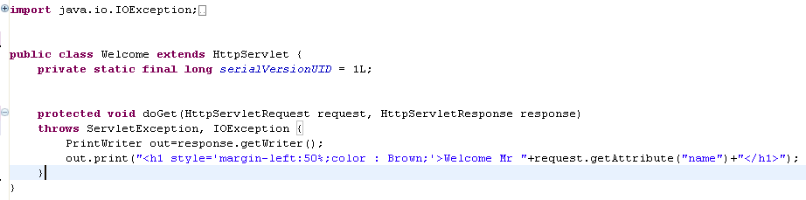
Lend a Hand – Welcome Servlet
The following servlet needs to be created by the developers.
Reads the request parameter

Slide 24
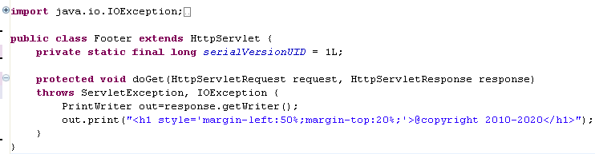
Lend a Hand – Footer Servlet
The following servlet needs to be created by the developers.

Slide 25
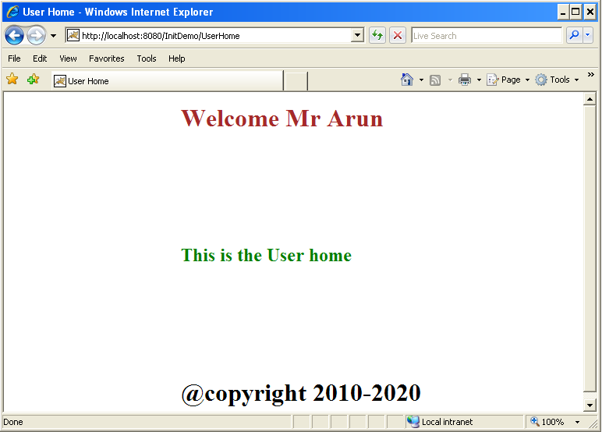
Lend a Hand – Deploy and Run
Deploy the application and call UserHome from The browser.
Note the URL . It will be “UserHome”
Text by the Welcome servlet
Text by the UserHome Servlet
Text by the Footer servlet

Slide 26
How to forward request ?
Step 1 : Create the RequestDispatcher object
RequestDispatcher dispatcher= request.getRequestDispatcher(“SecondServlet”);
Step 2 : Set request attributes if needed.
Step 3 : Call the include method to include the page
dispatcher.forward(request,response);

Slide 27
Guide Lines in Forwarding Request
Forward should be called before the response has been committed to the client
If the response already has been committed, this method throws an IllegalStateException.
Uncommitted output in the response buffer is automatically cleared before the forward.

Slide 28
Lend a Hand – Forwarding Request
This is a demo to showcase the associates how to forward a request to another servlet. The demo will illustrate how to print the current system date.
Step 1 : Create a CurrentDate Servlet which calculates the current date.
Step 2 : Set the date as a message and forward to DisplayServlet whose responsibility is to display the response to the user.
Step 3 : Create DisplayServlet for printing the date.

Slide 29
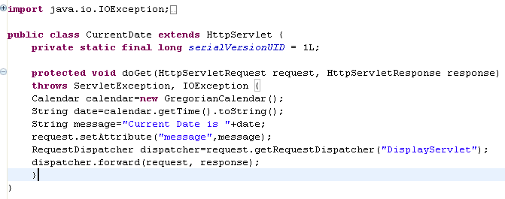
Lend a Hand – CurrentDate Servlet
The following servlet needs to be created by the developers.
Sets the date message as a request attribute
Creates RequestDispatcher object
Forwards the request

Slide 30
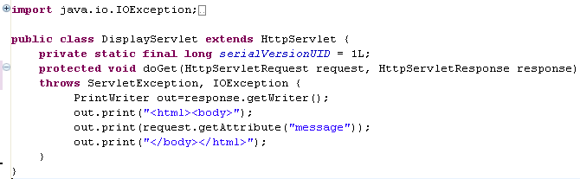
Lend a Hand – DisplayDate Servlet
The following servlet needs to be created by the developers.
Reads the date message from request and print it

Slide 31
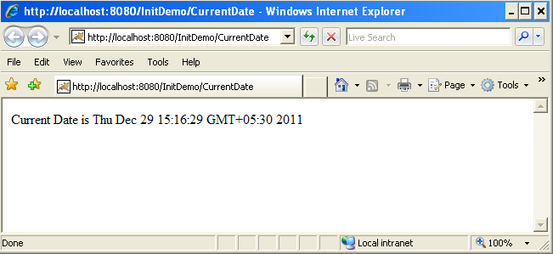
Lend a Hand - Deploy and Run
Deploy the application and call CurrentDate from the browser
Note that the URL is still CurrentDate which means forwarding is an internal process of the server which is invisible to the client.

Slide 32
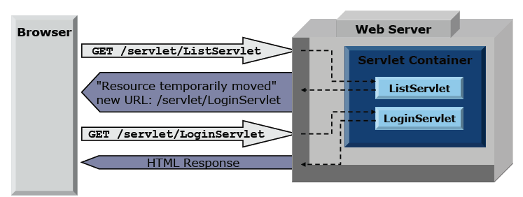
Send Redirect Vs Forward
How Send Redirect works ?
User requests a URL to the server
Server sends the browser a status to redirect to a new URL
Browser locates the new URL and sends a new request.
Disadvantages:
Requires a round trip process
The original request parameters are not included in the new HTTP request.
Notes:
To the Trainer
In the case of sendRedirect the server is sending a status to the browser to go to a new URL. So it is similar to the client accessing the URL directly. In this case the browser and hence the client is notified about the change in the URL. Here when the response is redirected to a new URL, the original request parameter values are lost.

Slide 33
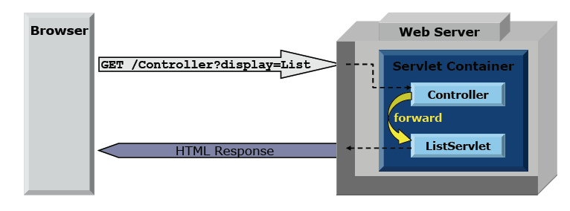
Send Redirect Vs Forward
How Forward works ?
User request for a resource in server.
Server redirects the request to a new resource.
New resource sends the response to the client.
Advantages:
Internal to the servlet engine hence it is faster
Forward is invisible to browser
The original request received is preserved in the redirected resource.
Notes:
To The Trainer
This is an internal process of the server. It is like the server seeking the help of an internal servlet. The user/browser is unaware about this deal happening inside the server. The URL in the browser address bar remains unchanged.

Slide 34
Lend a Hand - SendRedirect Vs Forward
Using this small demo associates can get familiarized with difference between sendRedirect and forward.
Create the following components :
Servlet1 : Which can either forward/redirect the user .
Servlet2 : The servlet to which the user will be forwarded or redirected to.

Slide 35
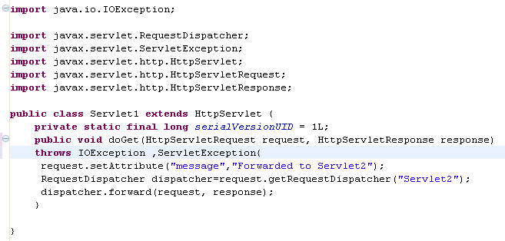
Lend a Hand - Step 1 : Create Servlet1
Create Servlet1 as shown below which sets a message as attribute and forwards the user to Servlet2 using Forward

Slide 36
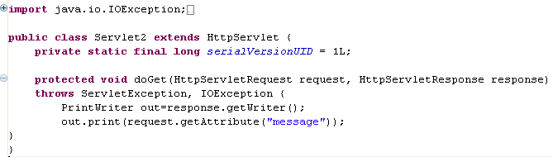
Lend a Hand - Step 2 : Create Servlet2
Create Servlet2 and display the message set in Servlet1
Reads the attribute value and prints it.

Slide 37
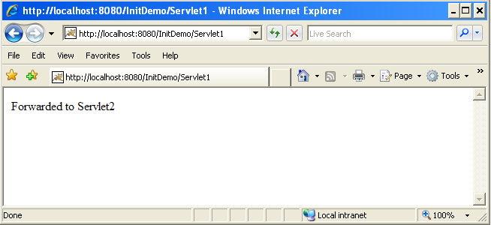
Lend a Hand - Step 3 : Deploy and Run
Deploy the application and call Servlet1 from browser.
Note the URL it will be still Servlet1 even though the request is forwarded to Servlet2
Request attribute value printed.

Slide 38
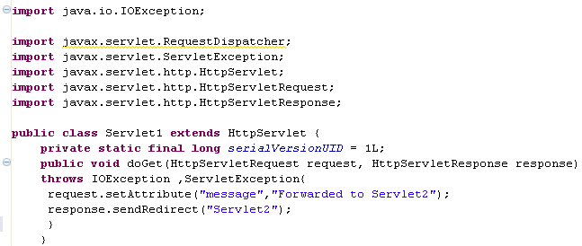
Lend a Hand - Step 4 : Using send redirect
Repeat the same example using send redirect. Change the forward method as sendRedirect.
Here the forward is changed to sendRedirect

Slide 39
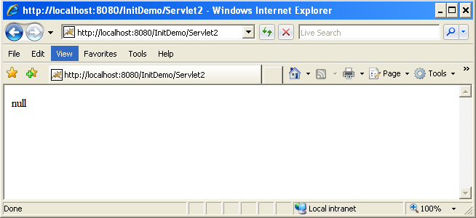
Lend a Hand - Step 5 : Deploy and Run
Deploy the application and call Servlet1 from the browser
Note the URL is changed to Servlet2 since the browser requested the new URL based on the redirect status from the server
Note even though request attribute was set in Servlet1 we get the value null printed in Servlet2 . This is because the initial request object is lost on redirecting to a new URL

Slide 40
SERVLETS
You have successfully completed -
Servlet Config and Context

