Slide 1
ANSI SQL
Views and Indexes
LEVEL – LEARNER
1

Slide 2








Icons Used
Hands-on Exercise
Reference
Questions
Points To Ponder
Coding Standards
Lend A Hand
Summary
Test Your Understanding
2

Slide 3

Overview
This session will give an overview of Views and Indexes.

Slide 4

Objectives
At the end of this session, you will be able to:
Describe Views
Identify Inline View
Define Index
Define Index Architecture: Non-clustered and Clustered
Describe Unique Index

Slide 5
Scenario
For the complete understanding of ANSI SQL, we are going to make use of Product Management System (PMS) for ABC Traders.
ABC Traders is a company which buys collectable model cars, trains, trucks, buses, and ships directly from manufacturers and sell them to distributors across the globe. In order to manage the stocking, supply, and payment transactions, the above mentioned software is developed.
As per the requirement of the trading company, an inventory system is developed to collect the information of the products, customers, and their payment processing.
5

Slide 6
Database Tables
There are many entities involved in Product Management System.
We will be dealing with PMS throughout this session.
Offices
To maintain information of offices, for example, office code, address, city, and so on.
Customer
To maintain customer details, for example, customer name, address, and so on.
Employees
To maintain employee
details, for example, ID,
name, and so on.
Products
To maintain information of products, for example, product id, name, and so on.
Payments
To maintain information of payments done, for example, payment date, amount, and so on.
Orders
To maintain Orders done by customers, for example, order no, date, and so on.
Order Details
To maintain Orders done by customers, for example, order no, date, and so on.

Slide 7
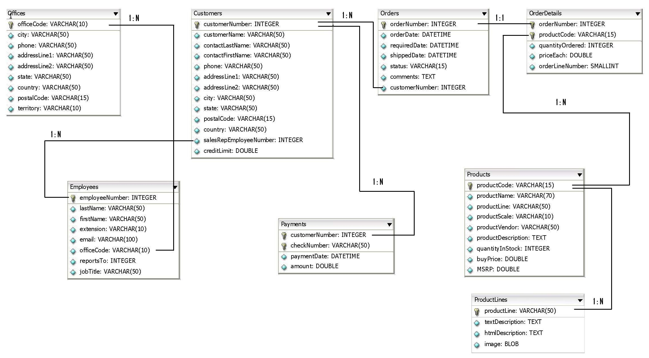
Schema Diagram

Slide 8

Scenario
Hi! Good work so far. You have helped me meet my requirements using different ANSI SQL statements, constraints, clauses, operators, functions, joins, and sub-queries. However, this time I want to limit the degree of exposure of a table or tables to the outer world. Also, is there a way to improve the speed of data retrieval operations on a database table?
Let us use Views and Indexes to meet Tim’s requirements.

Slide 9


Database Objects
Which of the database objects have we used so far?
So far, we have seen Tables and Constraints which fall into the category of database objects.
Names of database objects vary according to vendors in the market.
The following generic list depicts the objects which are common across vendors.
Tables
Constraints
Already covered
Sequence
Out of scope of this course
Views
Indexes
Triggers
Routines (Stored Procedures, Functions)

Slide 10
Views
What is a View?
A view is a subset of a database that is generated from a query and stored as a permanent object. In other words, a view is simply a structured query language (SQL) query stored as an object.
Although the definition of a view is permanent, the data contained therein is dynamic depending on the point in time at which the view is accessed.
Views represent a subset of the data contained in a table. They can join and simplify multiple tables into one virtual table.
Advantages:
They take up very little storage space because the database contains only the view definition, not the data.
They can provide results for different calculations (like sum and average) along with the stored data.
They can limit the degree to which tables are exposed to the outer world.

Slide 11
Views (Contd.)
Syntax
A view can be used to access data in one or more tables or views. You can create a view by using a SELECT statement.
ANSI Syntax
CREATE VIEW <table name> [(<VIEW column list>)]
AS <query expression>
[WITH [<levels clause>] CHECK OPTION]
<levels clause> ::= CASCADED | LOCAL
If WITH CHECK OPTION is specified, the VIEWed table has to be updatable.
It is a little known and less used feature and we shall not cover it in the scope of this course.

Slide 12

Scenario
I wish to create a subset of office information which displays only city, state, and country details.
Let us use a simple view to meet Tim’s requirement.

Slide 13
Simple View
We can create a simple view as shown in the example below:
CREATE VIEW view_offices AS SELECT city, state, country FROM offices;
The above view ‘view_offices’ is a subset of data contained in Offices table.
It displays only city, state, and country columns from the table.
In case, we want a view that displays columns from more than one related tables, we can make use of joins as shown below.
CREATE VIEW view_offices_employees AS SELECT a.city, b.employeenumber
FROM offices a JOIN employees b
WHERE a.officecode = b.officecode;

Slide 14
Inline View
What is Inline View?
An Inline view is a SELECT statement in the FROM-clause of another SELECT statement.
Inline views are commonly used to simplify complex queries by removing join operations and condensing several separate queries into a single query.
This feature is commonly referred to in the MSSQL community as a derived table. The Postgres community simply refers to it as a sub select (sub selects are inline views + sub-queries in Oracle nomenclature).
Because the result set from an inline view is referenced by other elements of the containing query, you must give your inline view a name and provide aliases for all ambiguous columns.
Similar to other types of sub-queries, inline views may join multiple tables and include GROUP BY, HAVING, and ORDER BY clauses.
Inline views are particularly useful when you need to combine data at different levels of aggregation.
ANSI Syntax:
SELECT … FROM <subquery> WHERE…

Slide 15
Scenario
I wish to create an Inline view which displays customers, customer numbers, orders, and order numbers based on a given condition.
Let us meet Tim’s requirement by creating an Inline view, as specified.

Slide 16
Inline View (Contd.)
The above query uses Inline view to display records from customernumber and ordernumber columns from customers and orders tables, respectively, wherever the customer number in both the tables matches.
SELECT a.customernumber, b.ordernumber
FROM (SELECT customernumber FROM customers) a, orders b
WHERE a.customernumber = b.customernumber;

Slide 17
Index
What is Database Index?
A database index is a data structure that improves the speed of data retrieval operations on a database table at the cost of slower writes and increased storage space.
Indices can be created using one or more columns of a database table, providing the basis for both rapid random lookups and efficient access of ordered records.
Some databases extend the power of indexing by allowing indices to be created on functions or expressions.
For example, an index could be created on upper(last_name), which would only store the upper case versions of the last_name field in the index.
Another option sometimes supported is the use of "filtered" indices, where index entries are created only for those records that satisfy some conditional expression.
Database systems, usually, implicitly create an index on a set of columns declared as PRIMARY KEY.

Slide 18

Index Architecture
The features of Non-clustered index are as follows:
The data is present in arbitrary order, but the logical ordering is specified by the index.
The data rows might be spread throughout the table regardless of the value of the indexed column or expression.
The non-clustered index tree contains the index keys in sorted order, with the leaf level of the index containing the pointer to the record (page and the row number in the data page in page-organized engines; row offset in file-organized engines).
The physical order of the rows in a non-clustered index is not the same as the index order.
A non-clustered index is typically created on non-primary key columns used in JOIN, WHERE, and ORDER BY clauses.
Rule: There can be more than one non-clustered index on a database table.

Slide 19
Index Architecture (Contd.)
The features of Clustered index are as follows:
Clustering alters the data block into a certain distinct order to match the index, resulting in the row data being stored in order.
Clustered indices can greatly increase the overall speed of retrieval, but usually only where the data is accessed sequentially in the same or reverse order of the clustered index, or when a range of items is selected.
Since the physical records are in this sort order on disk, the next row item in the sequence is immediately before or after the last one, and so, fewer data block reads are required.
The primary feature of a clustered index is, therefore, the ordering of the physical data rows in accordance with the index blocks that point to them. Some databases separate the data and index blocks into separate files, others put two completely different data blocks within the same physical file(s).
Rule: Only one clustered index can be created on a given database table.

Slide 20
Indexes
Indexes are special objects built on top of tables that speed up many data manipulation operations, such as SELECT, UPDATE, and DELETE statements.
When an index is created, the location and spread of values (called statistics) are built for the column that is indexed.
CREATE INDEX Syntax:
CREATE INDEX index_name ON table_name (column_name1 [,…column_nameN])
One reason is that some DBMS vendors use the CREATE INDEX command to direct how the data in a given table is physically sorted and arranged on disk.
Note: The syntax for creating indexes varies amongst different databases.
Vendor | Command
SQL Server | Supported, with variations
MySQL | Supported, with variations
Oracle | Supported, with variations
PostgreSQL | Supported, with variations

Slide 21
Scenario
I want an index to be created on the country column of the customers table and drop the same after creating.
Let us meet Tim’s requirement of creating a simple index on the specified column.

Slide 22
Indexes (Contd.)
In the below example, index_customers_country is the index created on the country column of customers.
CREATE INDEX index_customers_country ON customers (country);
Like CREATE INDEX syntax, the syntax for DROP INDEX is also vendor-specific. For this example, let us consider the MySql syntax.
ALTER TABLE customers DROP INDEX index_customers_country ;

Slide 23
Scenario
I do not want to have two equal values in my indexed column! Can you help me to do that?
Let us use unique index to meet Tim’s requirement.

Slide 24
Unique Index
What is a unique index?
An index, which creates an implicit constraint on the underlying table may be declared as UNIQUE.
A unique index on a column is an index on that column that also enforces the constraint that you cannot have two equal values in that column in two different rows.
Example:
CREATE UNIQUE INDEX uindex_USA_Offices_phone ON USA_Offices(phone);
The column ‘phone’ with unique index ‘uindex_USA_Offices_phone’ cannot have same phone numbers in two different records of the table USA_Offices.
Unique index is dropped just like a normal index.

Slide 25
Questions

Slide 26
Activity
Now that we are well versed with commands, let’s test our understanding using a short case study.
Course Management System (CMS) ABC University
Case Study Scenario:
This case study is to develop a Course Management System (CMS) for ABC University. The following are the two use cases for which the database needs to be designed.
Add Course
To add the course details into the course management system.
Retrieve Course
Retrieve the courses stored in the system and display them.
The courses to be added will have the following attributes course code, course name, number of participants, course description, course duration, course start date, and course type.
54

Slide 27
Lend a Hand
Requirement 1: Create a view which displays the course code, course name, and course duration only for the courses with course code greater than 167.
Requirement 2: Develop a view which has the following details: course code, course name, base fees, and special fees from two tables, namely, course info and course fees.
Note: We are using inner join in the view definition.
Requirement 3: Drop the view which you have created earlier to meet Requirement 2.
Requirement 4: Create an index on course description column of course info table.
Requirement 5: Drop the previously created index.
Requirement 6: Create a unique index on the course description column of course info table.

Slide 28
Lend a Hand: Solution
Solution 1:
CREATE VIEW view_course_details
AS SELECT course_code, course_name, course_duration
FROM course_info
WHERE course_code > 167 ;
Solution 2:
CREATE VIEW discount_coursedescription
AS SELECT discount, course_description
FROM course_fees JOIN course_info
ON course_fees.course_code=course_info.course_code;

Slide 29
Lend a Hand: Solution (Contd.)
Solutions 3:
DROP VIEW discount_coursedescription;
Solution 4:
CREATE INDEX index_course_description ON course_info (course_description);
Solution 5:
ALTER TABLE course_info DROP INDEX index_course_description;
Solution 6:
CREATE UNIQUE INDEX index_course_description ON course_info (course_description);

Slide 30
Hands-on
Yeah!
Now that we are well versed with Views and Index, let us help Tim to find answers to his complicated queries for online feedback system.
Please check the hands-on document for more details.

Slide 31

Check Your Understanding
What are the advantages of View?
What is Inline View?
What is View?
What is Index?
What is Index Architecture: Non-clustered and Clustered?
What is Unique Index?

Slide 32

Summary
The key points covered in this session are:
A view is a subset of a database that is generated from a query and stored as a permanent object.
An Inline view is a SELECT statement in the FROM-clause of another SELECT statement.
A database index is a data structure that improves the speed of data retrieval operations on a database table at the cost of slower writes and increased storage space.
An index, which creates an implicit constraint on the underlying table may be declared as UNIQUE.

Slide 33
Source
Web Links:
http://en.wikipedia.org/wiki/Database_index
http://en.wikipedia.org/wiki/View_(database)
http://publib.boulder.ibm.com/infocenter/iseries/v5r3/index.jsp?topic=%2Fsqlp%2Frbafywcohdg.htm
https://www.simple-talk.com/sql/learn-sql-server/sql-view-basics/
Books:
OReilly SQL In NutShell Page No: 68
Disclaimer: Parts of the content of this course is based on the materials available from the Web sites and books listed above. The materials that can be accessed from linked sites are not maintained by Cognizant Academy and we are not responsible for the contents thereof. All trademarks, service marks, and trade names in this course are the marks of the respective owner(s).

Slide 34
Change Log
Version Number | Changes made
V1.0 | Initial Version
V1.1 | Slide No. | Changed By | Effective Date | Changes Effected
 | 1-35 | Learning Content Team CI Team CATP Technical Team | 17-05-2013 | Base-lining content

Slide 35
ANSI SQL
You have successfully completed this session on Views and Indexes
35

