Slide 1
BMS

Slide 2
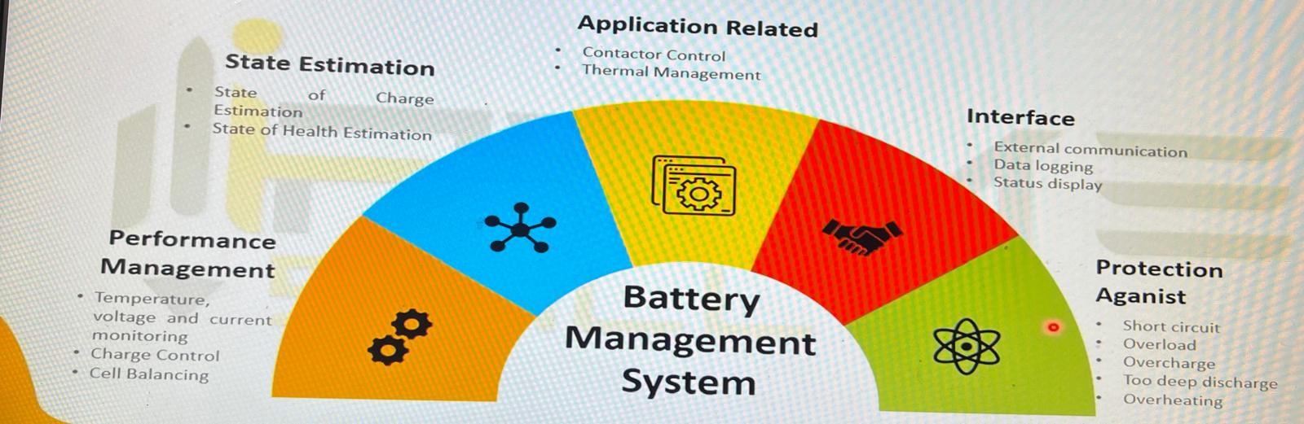

Slide 3
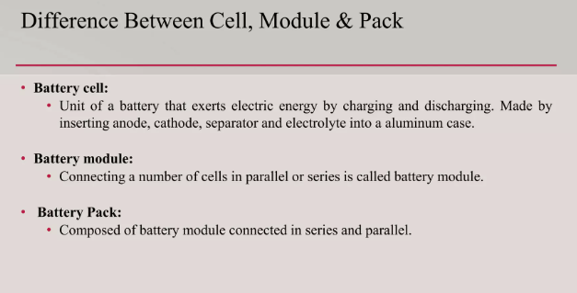
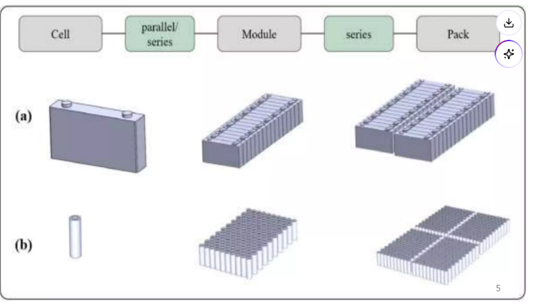
Battery Composition

Slide 4
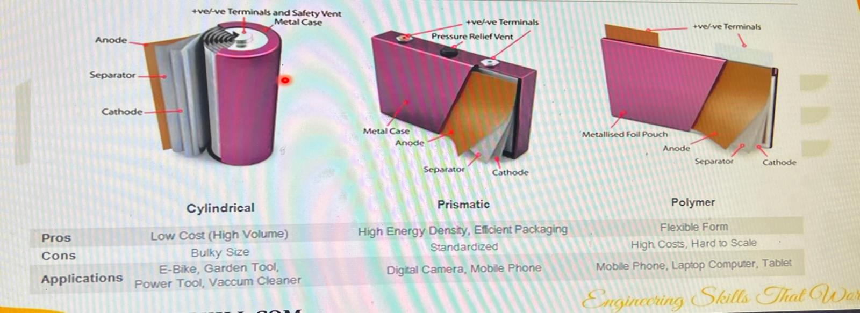
Battery

Slide 5
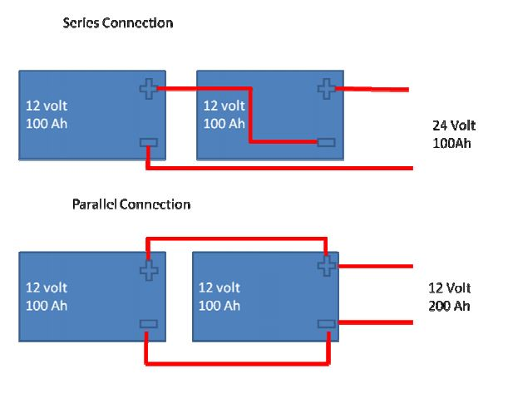
Series and Parallel
Series :
Volatge Adds
Current: Constant
Parallel :
Volatge constant
Current adds

Slide 6
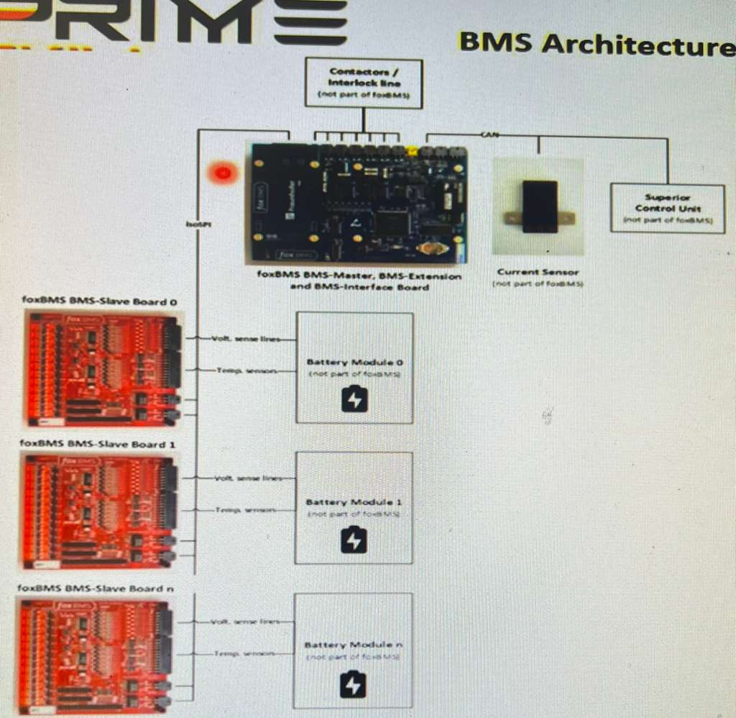
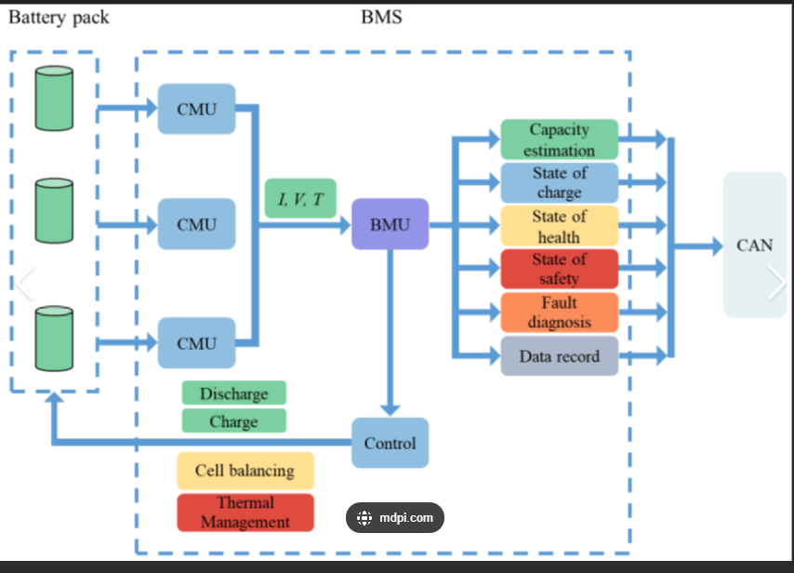
BMS Architecture

Slide 7
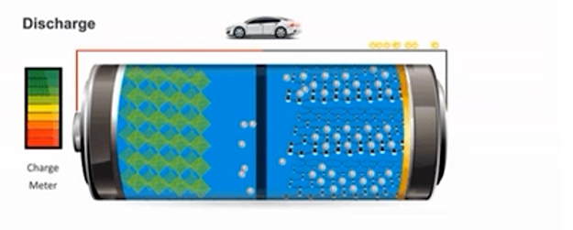
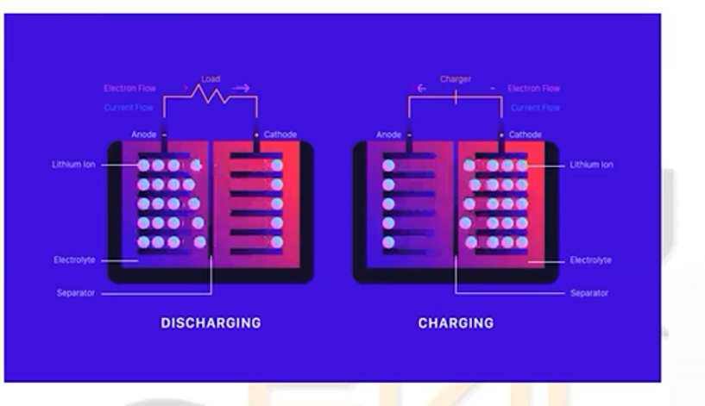
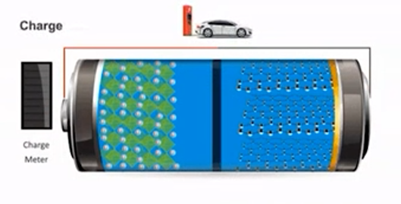
Charging and Discharging

Slide 8
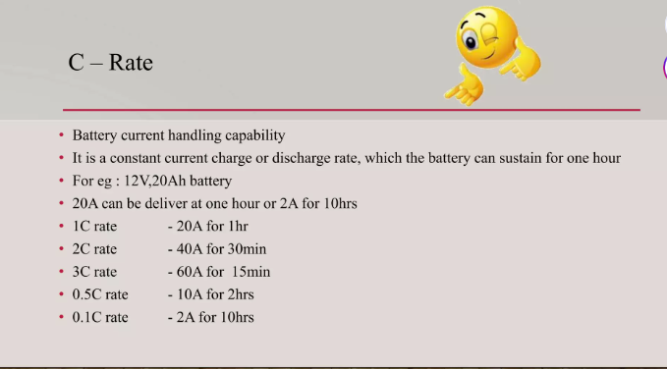
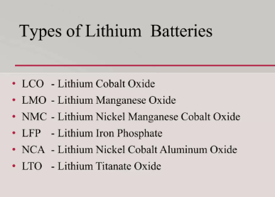
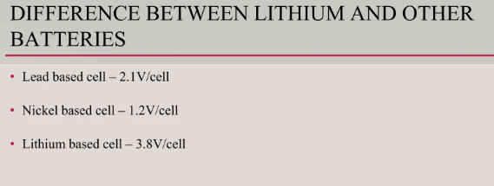
Working and Controls

Slide 9
Charge rate
Battery Capacity : 100Ah - 1C rate
It can hold up to 5C
At 1C charge rate = 100A – 1hr
At 0.5C charge rate = 50A – 2hrs
At 5C charge rate = 500A – 20 mins

Slide 10
LV and HV Operation
Low Voltage:
BMS is turned and monitoring the cell voltages butnot connected to battery through HV cables.
High Voltage:
BMS is turned on and the contactors are closed HV bus from battery is connected to load.

Slide 11
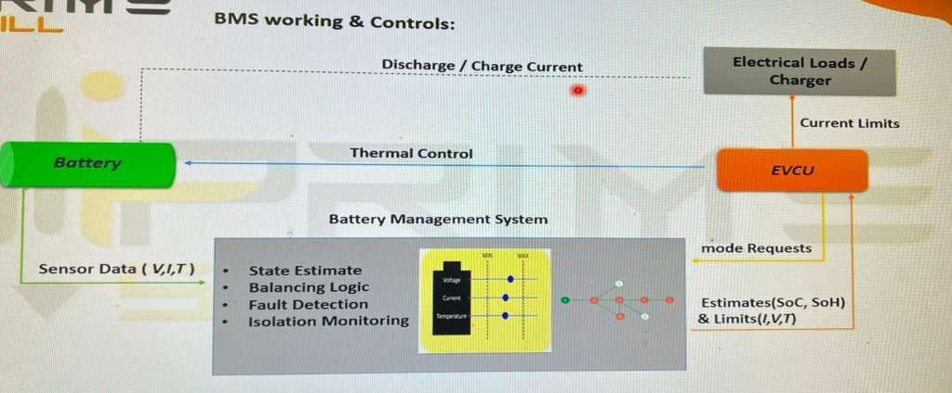
Working of BMS

Slide 12
Key Parameters
The BMS shall monitor and/or compute:
Battery-side Voltage (V_batt) – battery pack terminal voltage.
Bus-side Voltage (V_bus) – load/motor side voltage.
Pack Current (I_pack) – charging/discharging current.
Pack Temperature (T_pack) – battery temperature(s).
Contactor Feedback – status confirmation of precharge and main contactors.
SOC (State of Charge) – remaining battery capacity in %.
SOH (State of Health) – available capacity relative to new, in %.
Cycle Count – number of charge–discharge cycles completed.

Slide 13






Battery
Load

Slide 14
Operating States
OFF: Key switch OFF or system fault exit. All contactors open.
WAIT: Key switch ON, pre-checks, all contactors open.
PRECHARGE: Precharge sequence in progress. Precharge contactor closed until |V_batt – V_bus| ≤ 3V (within timeout).
HV: Main contactors closed, HV active on bus. Precharge contactor open.
FAULT: Any unsafe condition. Contactors opened immediately, logged.

Slide 15
Precharge
Precharge protects power electronics from inrush current
Precharge resistor limits current when connecting battery to load/DC bus
BMS controls Precharge relay & main contactor
Sequence:
1.BMS checks voltage
2. Precharge relay closes – DC bus charges via resistor
3. When bus voltage ≈ pack voltage → Main contactor closes
4. Precharge relay opens
Fault → abort and open relays

Slide 16
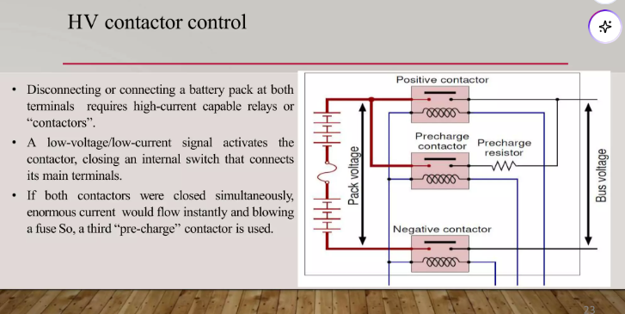
Contactor Control

Slide 17
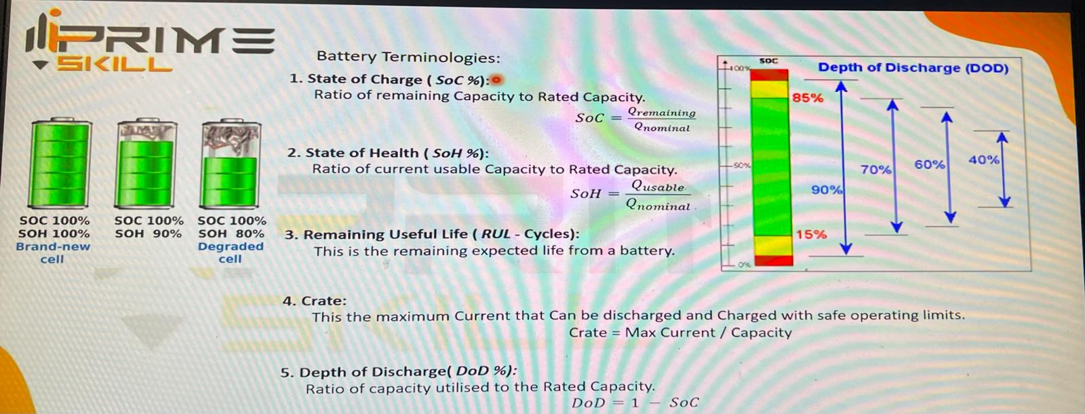

Slide 18
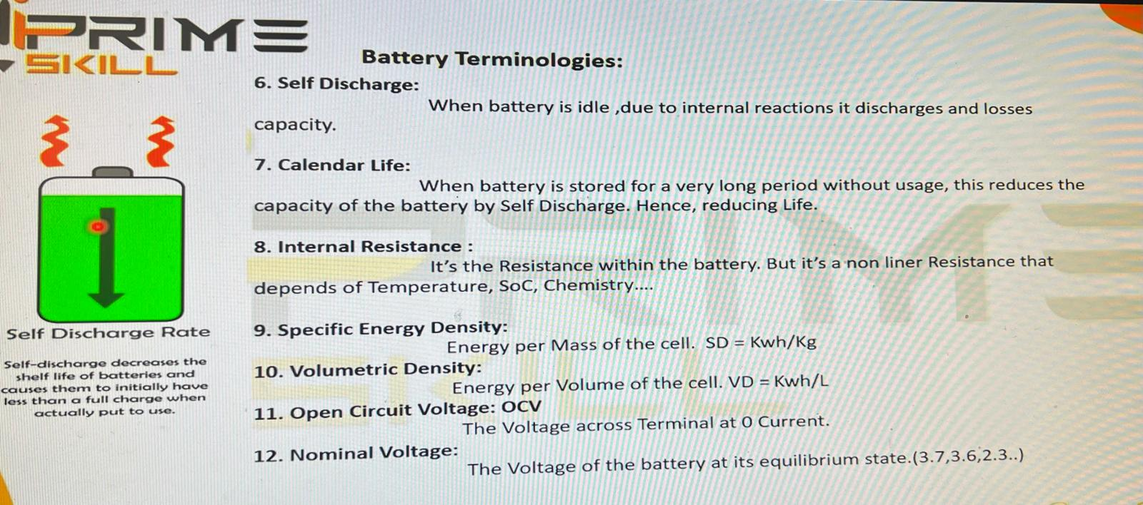

Slide 19
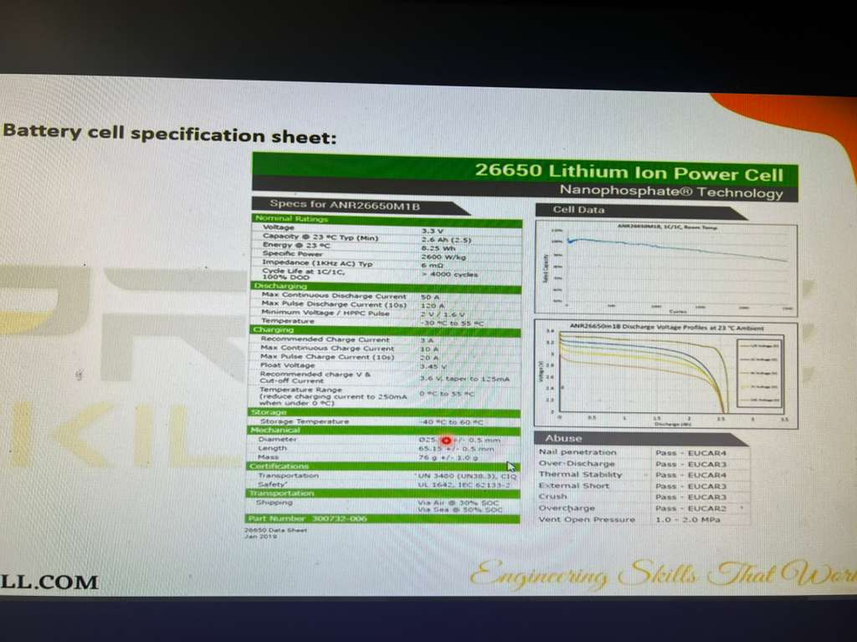

Slide 20
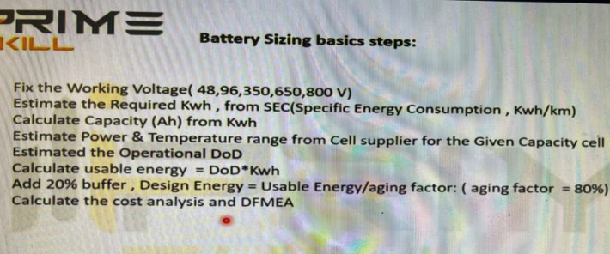
Battery Sizing

Slide 21
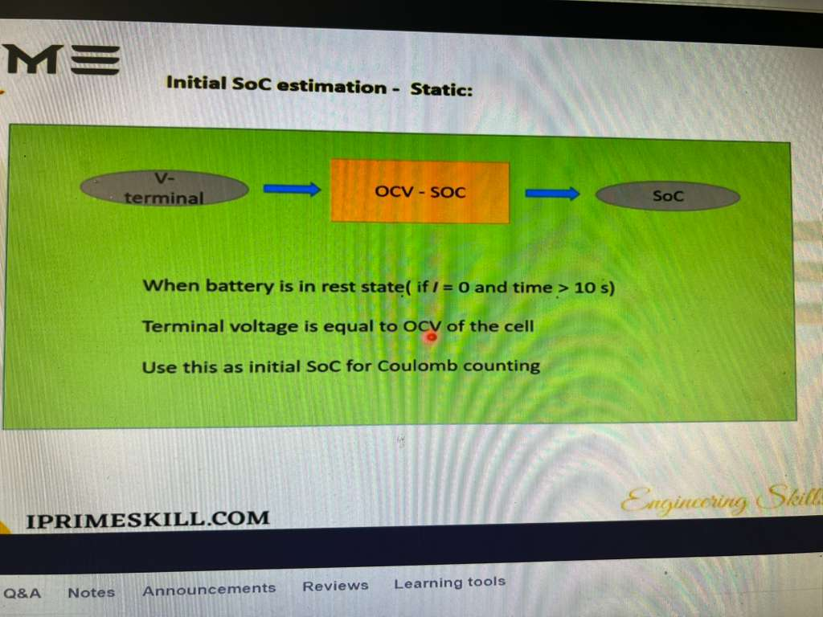
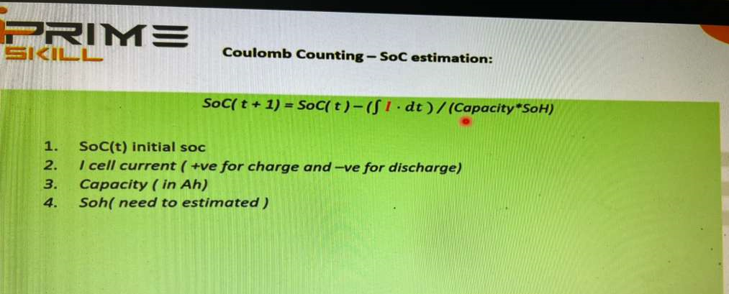

Slide 22
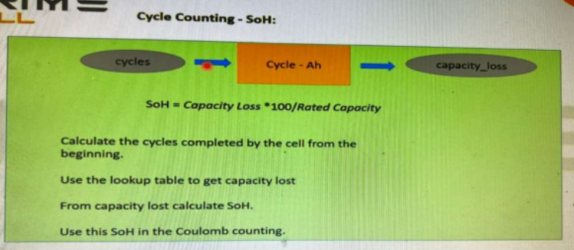
SOH

Slide 23
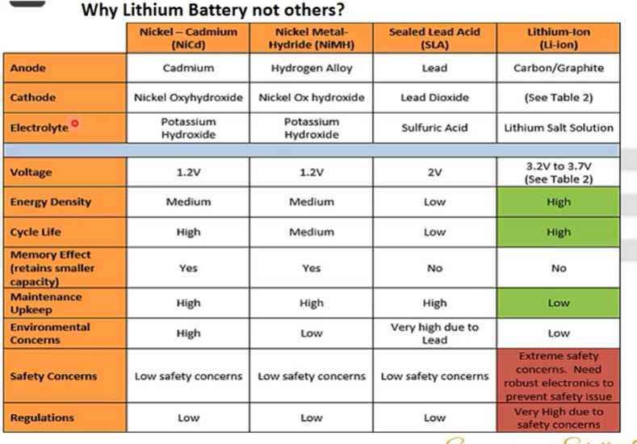

Slide 24
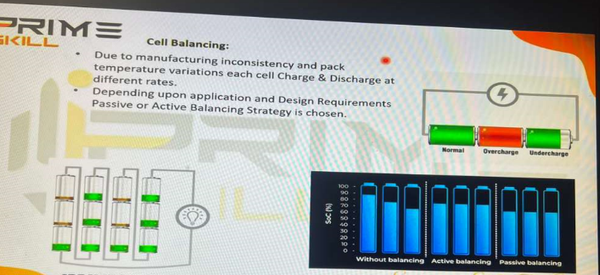
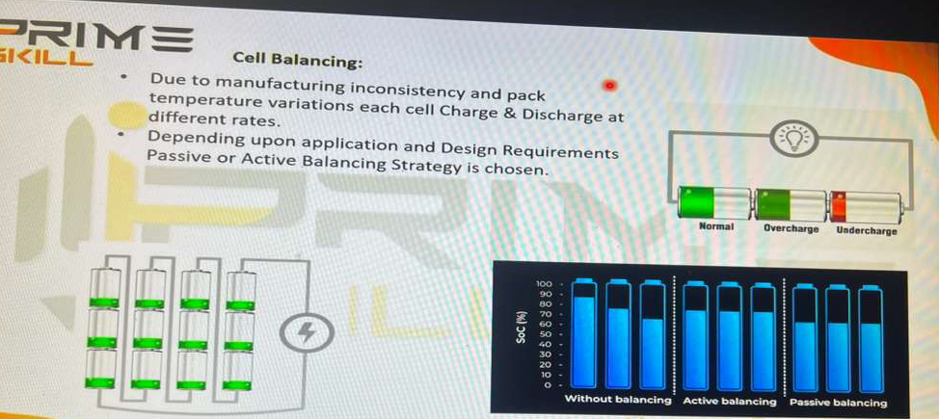

Slide 25
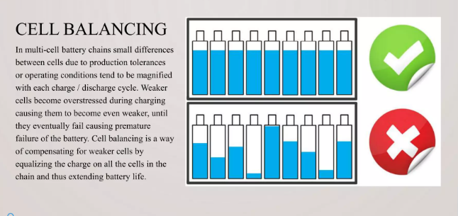

Slide 26
Contactor Monitoring Strategy

Slide 27
Temperature Monitoring Strategy

