Slide 1

Title: The Best IELTS English Listening App
Presented by
Rajesh Chaudhari
21IT017

Slide 2

Introduction
Welcome to the world of enhanced English language learning with the Best IELTS English Listening App.
Our app is designed to help users improve their English listening skills for the IELTS exam, making the learning process engaging and effective.
In this presentation, we will showcase the UI/UX designs that set our app apart and create an exceptional user experience.

Slide 3
User-Centric Design
Our app's UI/UX is centered around the needs and preferences of our users.
Intuitive navigation: A simple and clean interface ensures easy navigation for users of all ages and tech-savviness.
Personalization: Customizable themes, font sizes, and audio playback speed cater to individual learning styles.
Progress tracking: Users can monitor their learning progress, motivating them to achieve their language goals.

Slide 4
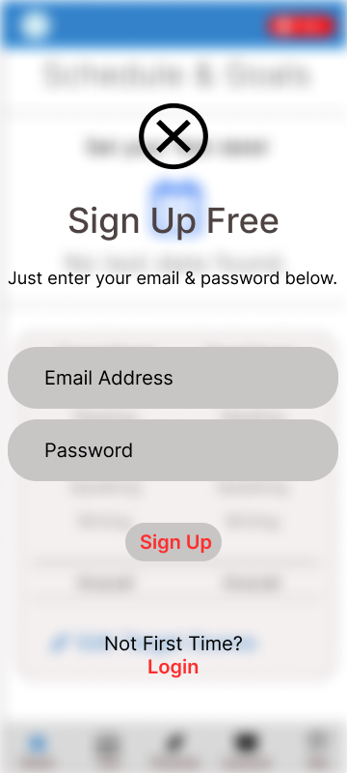
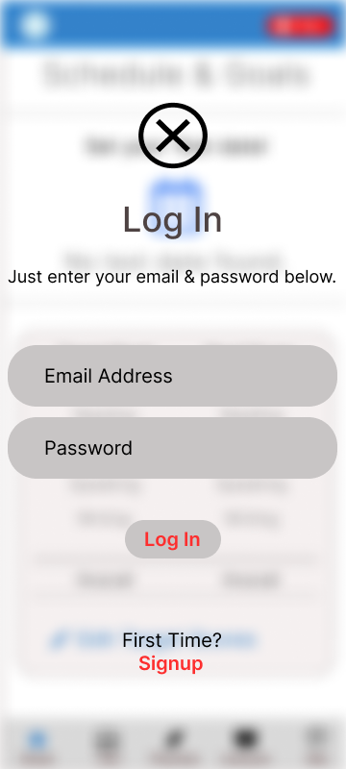
Sign Up & Login Page

Slide 5
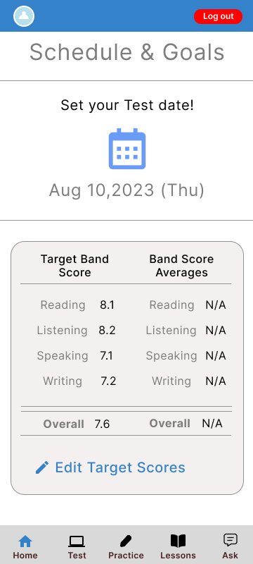
Home Screen for listening App

Slide 6
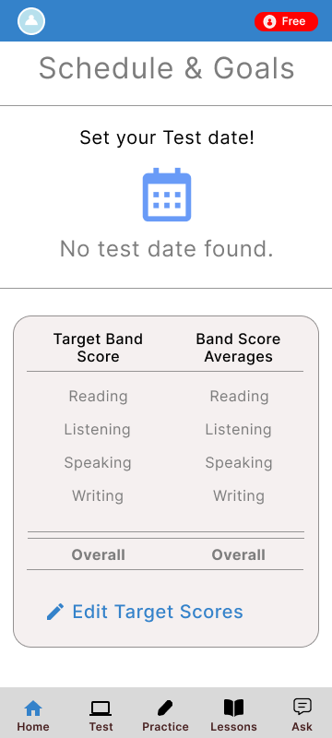
Schedule and goal

Slide 7

Interactive Lessons
Immersive audio experience: High-quality audio recordings with adjustable playback speed to suit learners' preferences.
Interactive transcripts: Real-time transcripts highlighting spoken words, aiding comprehension and vocabulary building.
Vocabulary aid: Instant word meanings and pronunciation guide for unfamiliar terms.

Slide 8
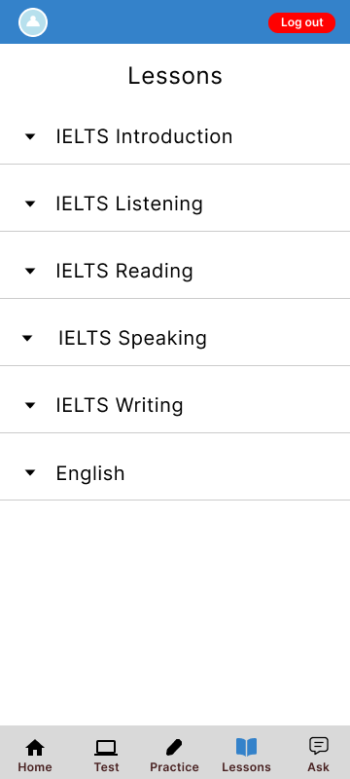
Listening Lesson 1 page

Slide 9

Practice Tests
Exam simulation: Mock tests replicating the IELTS exam format, preparing users for the real experience.
Time constraints: Timed challenges to enhance speed and accuracy, simulating exam pressure.
Performance analysis: Detailed feedback and analytics after each test to identify strengths and areas for improvement.

Slide 10
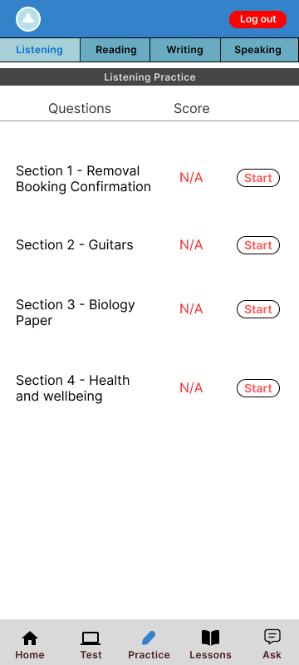
Question & Score Page

Slide 11

Conclusion
Our Best IELTS English Listening App offers an exceptional UI/UX design to create an enjoyable and effective language learning experience.
Join us in our mission to empower learners worldwide to achieve their IELTS goals and beyond.
Thank you for your attention! Questions and feedback are welcome.

Slide 12

Thank you

