Slide 1
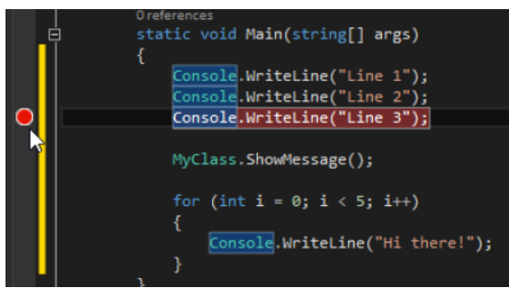
Debugging
1.What is Debugging in C#?
Debugging is the process of finding error during application execution. It does not mean syntax errors, with which the application cannot be compiled, but on logic errors.
Logic errors can only be noticed during application execution . This error occurs and the occurrence of such errors must be prevented . By adding simple checks , the errors can be prevented. Debugging helps precisely in these and similar situations when we can determine the origin of the logical error in the code .In such situations , Debug allows us to stop execution on a particular line, pass through the code line by line, and test the state of the application.
Debug Background code
The basic tool for achieving Debug application code in the Visual Studio development environment is break points. Break points are set by clicking on the margin on the left side of the code in the appropriate line.
In the case of the image, the break point is placed on the third line within the Main method.

Slide 2
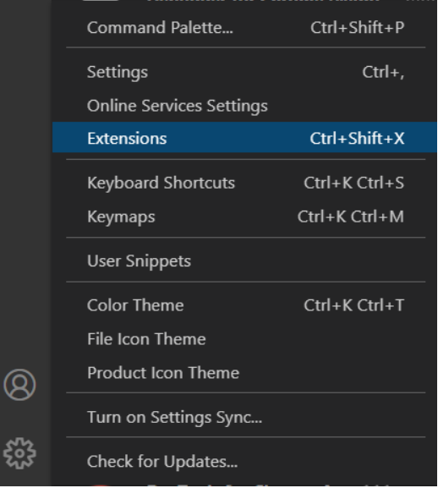
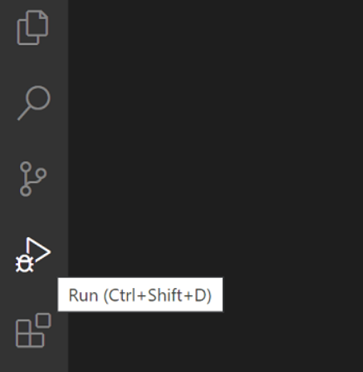
Debugging in Angular app
Step 1: Create an Angular application
Step 2:Install Debugger for chrome
In VS Code environment: Left Click Manage> Extensions
Open the Extensions view. Then type ‘chrome’ in the search box. You will see the extensions
Press the install button for Debugger for chrome
Step 3: Configure Debug Environment
In VS Code environment: Click Run Button on the left side

Slide 3
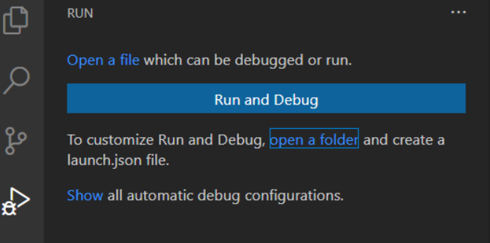
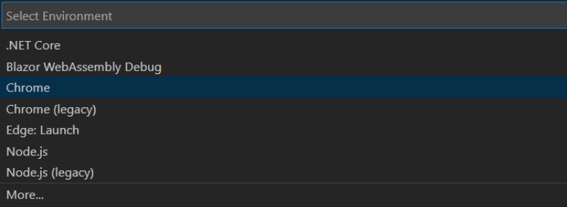
If running and debugging is not yet configured, VS Code shows the run
Click on Run and Debug button to open the Select Environment dialog box,
Select chrome, then VS Code will create an launch.json

Slide 4


Step 4: Start Debugging
Now , in VS Code, if you Click Run Button on the left side, you will have a debugging environment
Run the app from the Angular CLI- by command,
ng server –o
You will see the app running
Now, set your breakpoint and run debug
Once a debug- session starts, the Debug toolbar will appear on the top of the editor.
Continue/Pause F5
Step Over F10
Step Into F11
Step Out Shift+F11
Restart Ctrl+Shift+F5
Stop Shift+F5
How can we do debugging?
Debugging means to run your code step by step in a debugging tool like Visual Studio, to find the exact point where you made a programming mistake. You then understand what corrections you need to make in your code and debugging tools often allow you to make temporary changes so you can continue running the program.

