Slide 1

Project Title – Seasonal Agriculture Performance Analysis
DABETTA RAJESH
College Name : Vignan Institute of Technology and Science
AICTE STU ID : STU62584ac6a46761649953478

Slide 2

Problem Statement
Agricultural activities are influenced by seasonal variations in environmental conditions, farming practices, resource availability and market conditions. As a result, agricultural performance may differ from one season to another. However, raw agricultural data does not clearly explain how agricultural performance changes across seasons or what patterns can be observed in different seasonal conditions. The problem is to analyze the given agricultural dataset and investigate seasonal differences in agricultural performance by identifying meaningful patterns, trends, relationships and variations within the available data.

Slide 3
Seasonal Agriculture Performance Analysis is a Data Analytics project focused on understanding how agricultural performance changes across different farming seasons. The project uses a dataset containing information about crops, geographical locations, environmental conditions, farming resources, production, market prices, costs, revenue, and profit.
The main purpose of the project is to analyze agricultural data and identify meaningful seasonal patterns, differences, relationships, and performance variations. The analysis helps understand which seasons provide better crop yields and profitability and how environmental conditions and resource utilization are associated with agricultural outcomes.
Project Description

Slide 4

WHO ARE THE END USERS?

Slide 5

Technologies & Libraries Used
The project was implemented in Python using Google Colab.
The main libraries used were:
NumPy – numerical calculations and statistical computations.
Pandas – data loading, cleaning, transformation, grouping, and analysis.
Matplotlib – creating analytical charts and visualizations.
Seaborn – creating statistical and exploratory visualizations.

Slide 6
RESULTS

Slide 7
RESULTS
[Add screen shots of your code ]

Slide 8
RESULTS
[Add screen shots of your code ]

Slide 9
RESULTS
[Add screen shots of your code ]

Slide 10
RESULTS
[Add screen shots of your code ]

Slide 11
Future scope
Machine learning models can be added to predict crop yield and profitability for future seasons.
Real-time weather and rainfall data can be integrated for better forecasting and decision-making.
The project can be extended by analyzing multi-year agricultural data to identify long-term seasonal trends.
The analysis can be expanded to provide crop and irrigation recommendations based on soil and environmental conditions.
The system can also estimate water and fertilizer requirements to improve resource efficiency.
A Power BI or interactive dashboard can be developed for easier monitoring by farmers and decision-makers.
Future versions can support real-time alerts for unusual weather, pest risks, or expected yield changes.

Slide 12
GitHub Link
https://github.com/AswiniKumar55/-Seasonal-Agriculture-Performance-Analysis-.git

Slide 13
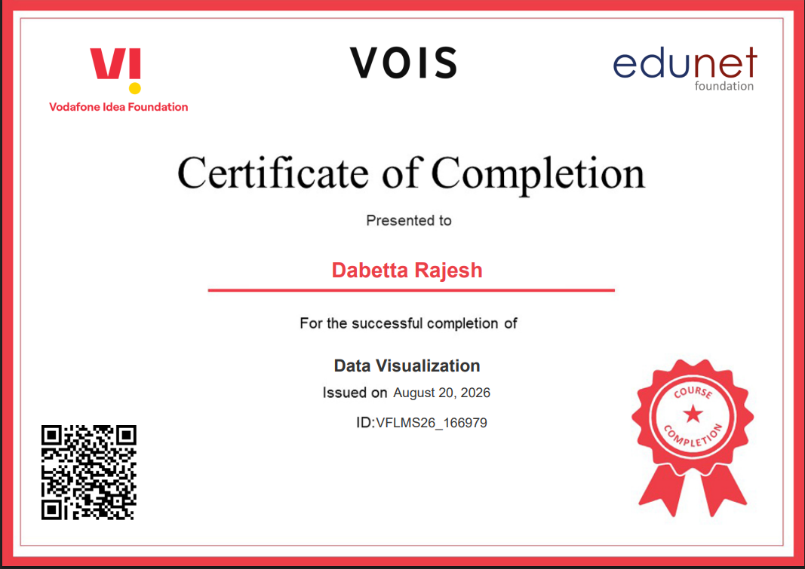
VOIS Course completion certificate -
Course name- Data Visualization

Slide 14
Thank you
.
.

