Slide 1
ACID Compliant
Distributed KVStore
Rajesh Jalisatgi
Vijaeendra Simha G A
Lakshmi Narasimhan Seshan

Slide 2
Agenda
Architecture (2min)
Transaction Implementation (2min)
Demo Video (2.5m)
Performance (30s)

Slide 3
KVStore-Design
Isolation: 2PL
Atomicity: 2PC (PrC)
Consensus: Raft Protocol
Inspired by Spanner, Cockroach DB
Components:
Transaction Manager (TM) :
Responsible for 2PC commit and 2PL
Raft Backed
Leader drives the Transaction
Replica Manager:
Service discovery of the system
Every Component sends heartBeat to Replica Manager
Components query for TM Leader nodes & Shard Leader Nodes
Responsible for managing the shards. (uses traditional hash for sharding)
Scale Shards, Scale Servers.
Replica Server:
Supports Multiple Shards Per Server
Shards Uniformly Distributed
Each Shards runs raft with the Peers.
Leader for each Shard is sent to Replica Server

Slide 4
Architecture
Server1
Server 2
Server3
Shard4
Shard Leader
Shard1
Shard1
Shard1
Shard2
Shard2
Periodic Shard Information
Shard2
Leader Query?
Shard3
Shard3
Shard3
Leader HeartBeats
Shard4
Shard4
Shard4
Transactions(2pc/2PL)
Replica Manager
TxnLeader
TxnFollower
Client
TxnFollower
TxnManager

Slide 5
Txn Implementation
Raft backed TxRecord and KvStore - FT
2PC/2PL implementation - Atomicity/Concurrency
PrC - Presumed commit
Does not keep log of committed transaction
On co-ordinator crash
Pending txn will be aborted after timeout by New Leader (Logged as Aborted in Raft State)
If txn outcome raft backed, cohort will enquire about the state of transaction (on conflict)
On cohort crash
Inflight transaction will be cancelled and aborted on timeout
Crashed cohort would replay from raft logs
Read Write / Read Only/Write Only Transactions

Slide 6
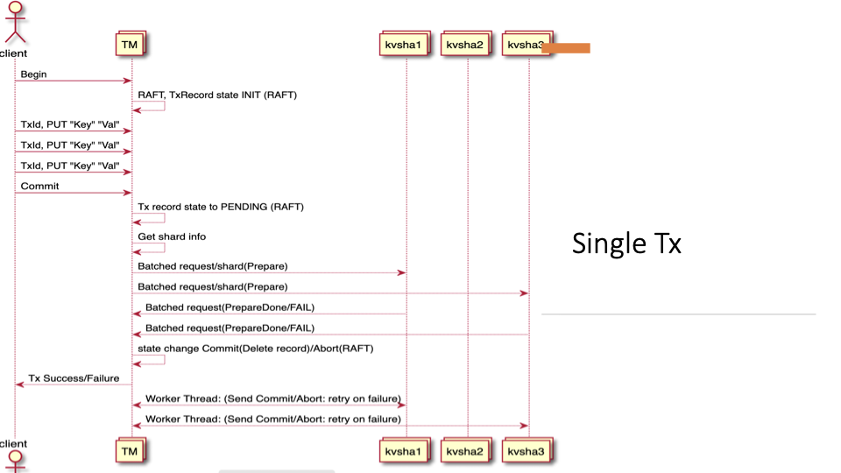

Slide 7
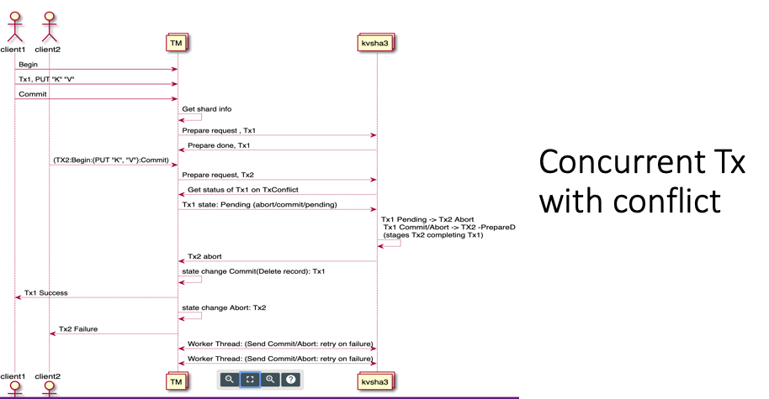

Slide 8
DEMO VIDEO
SETUP
Amzn EC2 Instance Same Region
5 Replica Server 3 Transaction Manager
1 Replica Manager 3 Shards

Slide 9
KV Replica Performance
Txm :3, Shard:3
As we increase the replicas, It reduces the txnPS

Slide 10
Shard Scaling
Replica: 5 TxM: 3, Op/txn: 3
Other Observations (Insufficient Data)
Crashing KV Store leader (with active txns) : 3 TxPS
Crashing Non-KV Store leader( with active txns) : Not much affected
Hotspots with lower shards for write oper??
Unexplainable reverse trend for Read operations for Shard 7. More experiments needed

