Slide 1
Spring Cloud
Oct 2016

Slide 2


About Spring Cloud
An open-source library–makes it easy to develop JVM applications for the cloud.
Provides tools for developers to quickly build some of the common patterns in distributed systems.
Helps in building self healing distributed systems.

Slide 3
Common challenges for building Distributed System
As we decompose the system into many distributed processes, how do we consistently and reliably distribute configuration to these processes?
When that configuration needs to change, how do we update that configuration without redeploying all of the processes?
Once deployed in a cloud environment, processes will come and go and change their locations. How do we determine the locations of the processes that my process needs to collaborate with?
Once we’ve determined a set of possible locations of one of my process’s dependencies, how do we choose which process instance to communicate with next?
How do we prevent faults (when instances communicates), from cascading into a failure?

Slide 4
Spring Cloud Components
Service discovery : Spring Cloud Eureka
Client-side load balancing : Spring Cloud Ribbon
Declarative Rest Client : Spring Cloud Feign
Circuit breaker : Spring Cloud Hystrix
API gateway : Spring Cloud Zuul
Configuration : Spring Cloud Config
Tracing : Spring Cloud Slueth & Zipkin

Slide 5
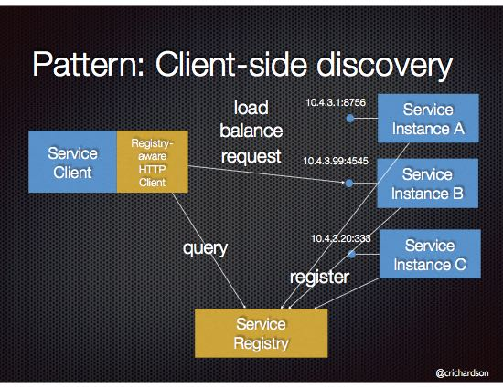
Service discovery : Spring Cloud Eureka
Problem : How does the client of a service - the API gateway or another service - discover the location of a service instance?
Eureka is a resilient service registry implementation. A service registry is one mechanism for implementing the Service Discovery pattern.

Slide 6
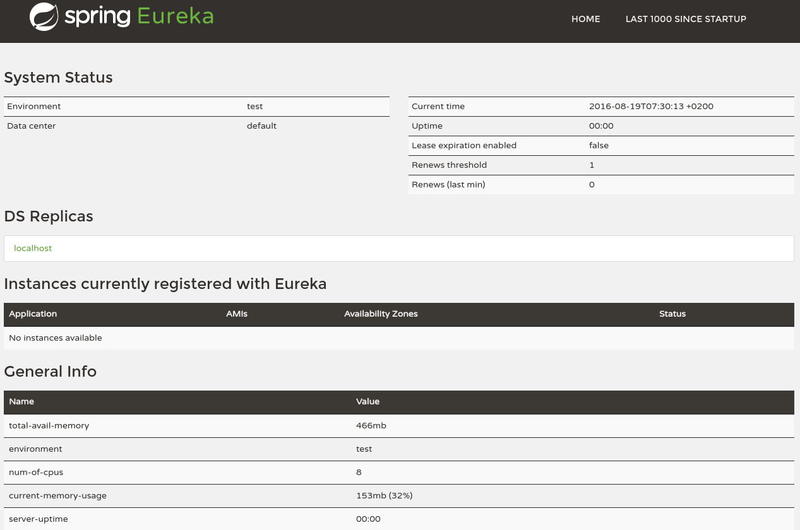
Eureka Server
Services register themselves with Eureka Server .
Provide meta-data, such as host and port, health indicator URL, home page, etc
Eureka receives heartbeat messages from each instance belonging to a service. If the heartbeat fails over a configurable timetable, the instance will be removed from the registry.
Provides Simple
Interface .

Slide 7
Eureka Server
spring-cloud-starter-eureka-server as dependency
@EnableEurekaServer
Default port : 8761
Properties configuration
server.port=8761
eureka.client.register-with-eureka=false
Example :
@SpringBootApplication
@EnableEurekaServer
public class EurekaApplication {
public static void main(String[] args) {
SpringApplication.run(EurekaApplication.class, args);
}
}

Slide 8
Eureka Client
spring-cloud-starter-eureka as dependency
@EnableEurekaClient
Property Configuration
server.port=8761
eureka.client.serviceUrl.defaultZone= http://localhost:8761/eureka/
Example :
@SpringBootApplication
@EnableEurekaClient
public class EurekaApplication {
public static void main(String[] args) {
SpringApplication.run(EurekaApplication.class, args);
}
}

Slide 9
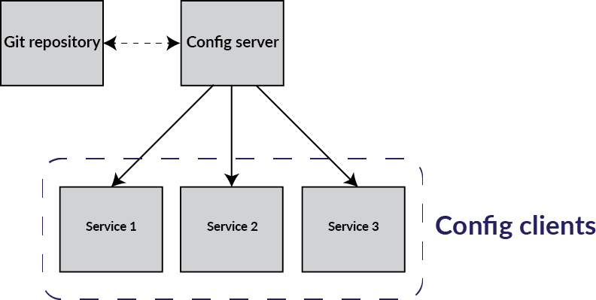
Configuration : Spring Cloud Config
Spring Cloud Config provides server and client-side support for externalized configuration in a distributed system.
Leverage a version control system as a configuration store, developers can easily version and audit configuration changes.

Slide 10
Config Server
To Setup the server
annotate the main application with @EnableConfigServer
add bootstrap.yml
add the repository uri in the key. spring.cloud.config.server.git.uri =
set the application name . spring.application.name=config-service
and the port . Server.port=8888
Example :
@SpringBootApplication
@EnableConfigServer
public class ConfigserverApplication
{
public static void main(String[] args)
{
SpringApplication.run(ConfigserverApplication.class, args);
}
}

Slide 11
Config Client
To Setup the client
add bootstrap.yml
set the application name. spring.application.name=config-client
add the uri to the cloud config server as below
spring:
application:
name: configclient
cloud:
config:
uri: http://localhost:8888

Slide 12
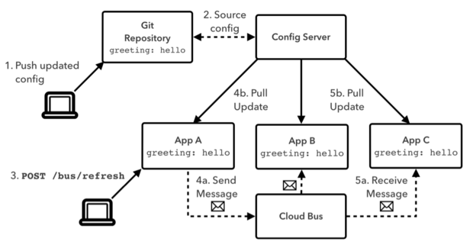
Spring Cloud Bus
Powerful mechanism for distributing configuration consistently across a set of application instances .
Provides ability to refresh application’s configuration without restart.
Links the services in a distributed system with a lightweight message broker (AMQP)

Slide 13
Spring Cloud Bus
App A requests the latest configuration from the Config Server. Any Spring Beans annotated with @RefreshScope are reinitialized with the new configuration.
App A sends a message to the AMQP exchange indicating it has received a refresh event.
Apps B and C, participating on the Cloud Bus by listening to the appropriate AMQP queue, receive the message and update their configuration in the same manner as App A.
Notes:
All of this makes microservices useful for cloudnative applications, which are designed to run in cloud environments with lots of commodity hardware resources that can dynamically respond to fluctuations in demand for certain applications

Slide 14
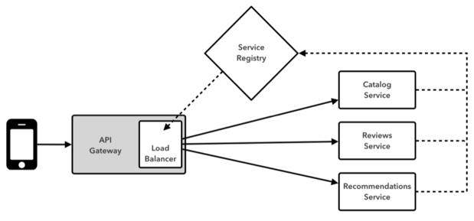
API gateway : Spring Cloud Zuul
The name 'Zuul' originates from the movie Ghostbusters where it appears as the Gatekeeper of Gozer .
Implementation of API Gateway pattern.
Security,Insights and monitoring
Dynamic routing
Static response handling

Slide 15
Configuring Zuul Proxy
@EnableZuulProxy
Add below in application.yml
zuul:
routes:
serviceA: /service-a/**
serviceB: /service-b/**
Example :
@SpringBootApplication
@EnableZuulProxy
public class ApiGatewayApplication
{
public static void main(String[] args)
{
SpringApplication.run(ApiGatewayApplication.class, args);
}
}
Notes:
Event ---- Each service publish an event when it updates its data

Slide 16
Client-side load balancing : Spring Cloud Ribbon
Provides library for configurable load balancing and fault tolerance .
Enable load balancing algorithms like availability filtering , weighted response times and others .
Property File configuration
say-hello:
ribbon:
eureka:
enabled: false
listOfServers: localhost:8090,localhost:9092,localhost:9999
ServerListRefreshInterval: 15000

Slide 17
Spring Cloud Ribbon
public class Config {
@LoadBalanced
@Bean
public RestTemplate restTemplate() {
return new RestTemplate();
}
}
@RequestMapping("/hi")
public String hi(@RequestParam(value="name", defaultValue="Artaban") String name) {
String greeting = this.restTemplate.getForObject("http://say-hello/greeting", String.class);
return String.format("%s, %s!", greeting, name);
}

Slide 18
Declarative Rest Client : Spring Cloud Feign
Declarative web service client
It makes writing web service clients easier.
Uses Ribbon internally for load balancing .
@EnableFeignClients enables full suite of a load balancer, circuit breaker, and HTTP client with a sensible ready-to-go default configuration.
To use Feign create an interface and annotate it as below
@FeignClient("participants-service")
interface ParticipantsClient {
@RequestMapping(method = RequestMethod.GET, value="/races/{raceId}")
List<Participant> getParticipants(@PathVariable("raceId") String raceId);
}

Slide 19
Circuit breaker : Spring Cloud Hystrix
Hystrix provides an implementation of common fault-tolerance patterns for distributed systems such as circuit breakers .
Use of the Circuit Breaker pattern can allow a microservice to continue operating when a related service fails, preventing the failure from cascading and giving the failing service time to recover.
When we apply a circuit breaker to a method, Hystrix watches for failing calls to that method, and if failures build up to a threshold, Hystrix opens the circuit so that subsequent calls automatically fail. While the circuit is open, Hystrix redirects calls to the method, and they’re passed on to our specified fallback method.
@EnableCircuitBreaker , @HystrixCommand , @EnableHystrixDashboard

Slide 20
Spring Cloud Hystrix
@HystrixCommand(fallbackMethod = "getProducerFallback")
public ProducerResponse getValue() {
return restTemplate.getForObject("http://producer", ProducerResponse.class);
}
private ProducerResponse getProducerFallback() {
return new ProducerResponse(42);
}
*Success|Short-Circuited|Timeout|Rejected|Failure|Error%

Slide 21
Tracing : Spring Cloud Slueth
Implements a distributed tracing solution .
Introduces unique IDs to your logging which are consistent between microservice calls which makes it possible to find how a single request travels from one microservice to the next.
Trace ID and Span ID
2016-06-17 16:12:36.902 INFO [slueth-sample,432943172b958030,432943172b958030,false] 12157 --- [nio-8080-exec-2] com.example.SleuthSampleApplication : calling home
2016-06-17 16:12:36.940 INFO [slueth-sample,432943172b958030,b4d88156bc6a49ec,false] 12157 --- [nio-8080-exec-3] com.example.SleuthSampleApplication : you called home
X-B3-SpanId:
X-B3-TraceId:
Spring Cloud Sleuth will send tracing information to any Zipkin server [or ELK,Splunk] you point it to when you include the dependency spring-cloud-sleuth-zipkin
Default Zipkin server port 9411

Slide 22
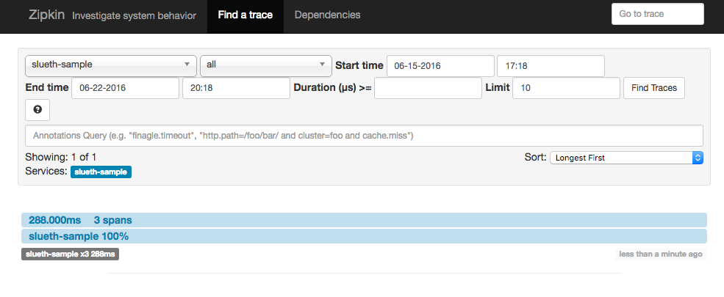
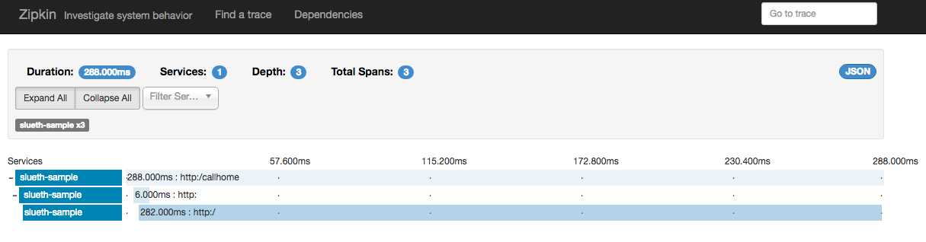
Zipkin

Slide 23
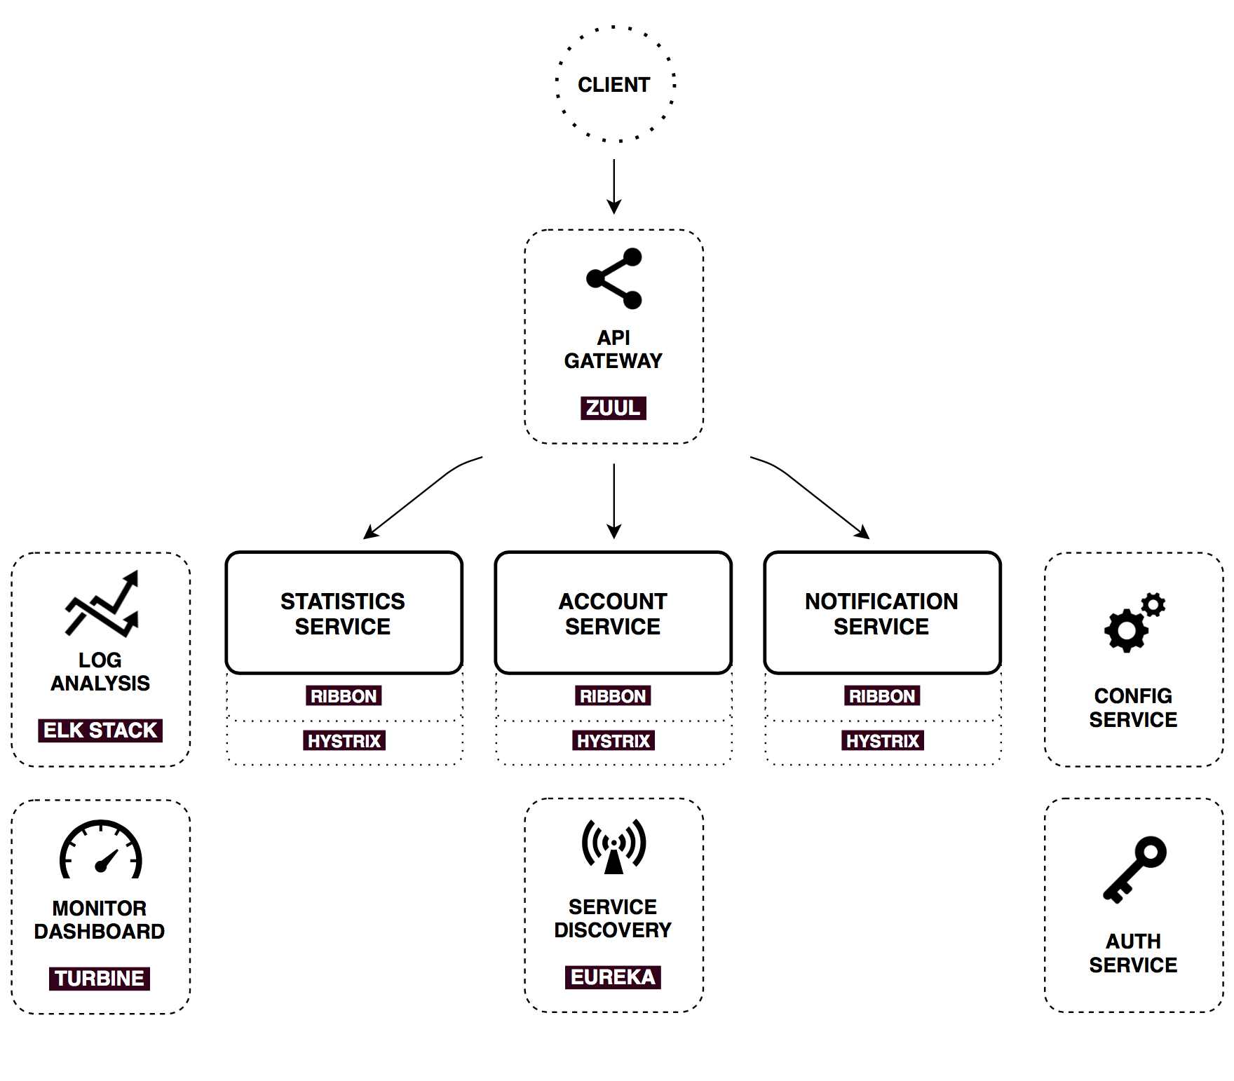
Sample Architecture

Slide 24
References
http://projects.spring.io/spring-cloud/#quick-start
https://dzone.com/articles/microservice-architecture-with-spring-cloud-and-do

Slide 25
Thank You !!!

