Slide 1
Web Services Description Language (WSDL)
Snehal Wani.

Slide 2
Service Oriented Architecture(SOA)
What is SOA
Service-oriented architecture (SOA) is a flexible set of design principles used during the phases of systems development and integration .
What is Web Services
A software system identified by a URI, which interacts with other systems using XML messages through internet based protocols.

Slide 3
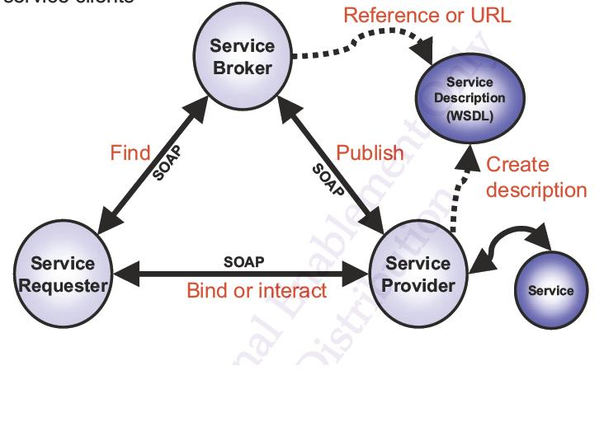
Where does WSDL Fit in SOA

Slide 4
WSDL is used by the service provider to describe the service that is being provided.
These description may be published in the
Service registry(UDDI) where they can be searched.
A service requester retrieves the WSDL definition of a service, so that it can invoke the service.

Slide 5
WHAT IS WSDL
WSDL (Web Services Description Language) provides an XML based standard for describing web services
Service providers use it to describe their web services so that service requesters can access them.

Slide 6
A WSDL document describes what the service does, where it can be found and how service can be invoked.
It details every aspect of web service.
WSDL is pronounced as 'wiz-dull' and spelled out as 'W-S-D-L'

Slide 7
History of WSDL
WSDL 1.0 (Sept. 2000) has been developed by IBM, Microsoft, and Ariba to describe Web Services for their SOAP toolkit. It was built by combining two service description languages: NASSL (Network Application Service Specification Language) from IBM and SDL (Service Description Language) from Microsoft.

Slide 8
WSDL 1.1, published in March 2001, is the formalization of WSDL 1.0. No major changes were introduced between 1.0 and 1.1.
WSDL 1.2 (June 2003) was a working draft at W3C, but has become WSDL 2.0. According to W3C: WSDL 1.2 is easier and more flexible for developers than the previous version

Slide 9
WSDL 1.2 attempts to remove non-interoperable features and also defines the HTTP 1.1 binding better. WSDL 1.2 was not supported by most SOAP servers/vendors.
WSDL 2.0 became a W3C recommendation on June 2007. WSDL 1.2 was renamed to WSDL 2.0 because it has substantial differences from WSDL 1.1.

Slide 10
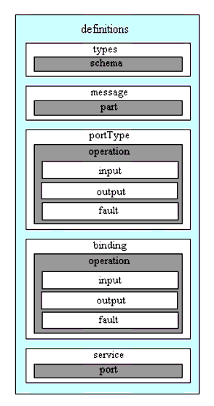
WSDL Document Structure

Slide 11
A WSDL document is simply a set of definitions.
There is a definitions element at the root, and
definitions inside.The grammar is as follows
Abstract part /Service Interface Definition
1. <types>
2. <message>
3. <portType>
Concrete part/Service Implementation Definition
1. <binding>
2. <service>

Slide 12
WSDL DOCUMENT STRUCTURE
<definitions>
<types> definition of types........ </types>
<message> definition of a message.... </message>
<portType> definition of a port....... </portType>
<binding> definition of a binding.... </binding>
<service> definition of a service…. </service>
</definitions>

Slide 13
Abstract Part
It provides data and port type definitions.
1.<types>
It is a container for data type definitions used by the web service to describe the messages exchanged.
Generally it uses the type system (such as XSD).
XML Schema syntax is used in general.

Slide 14
2.<message>
It describes abstract definition of the input ,output and fault messages used by a service.
3.<portType>
It includes the operations performed by the web service and the messages that are involved.

Slide 15
Operation Types
a) One-way
The operation can receive a message
but will not return a response
<wsdl:definitions .... >
<wsdl:portType .... >
<wsdl:operation name="nmtoken">
<wsdl:input name="nmtoken" message="qname"/>
</wsdl:operation>
</wsdl:portType >
</wsdl:definitions>

Slide 16
b) Request-response
The operation can receive a request and will
return a response.
<wsdl:definitions .... >
<wsdl:portType .... >
<wsdl:operation name="nmtoken" parameterOrder="nmtokens">
<wsdl:input name="nmtoken" message="qname"/> <wsdl:output name="nmtoken" message="qname"/> <wsdl:fault name="nmtoken" message="qname"/> </wsdl:operation>
</wsdl:portType >
</wsdl:definitions>

Slide 17
c) Solicit-response
The operation can send a request and will wait for a response .
<wsdl:definitions .... >
<wsdl:portType .... >
<wsdl:operation name="nmtoken" parameterOrder="nmtokens">
<wsdl:output name="nmtoken"message="qname"/> <wsdl:input name="nmtoken" message="qname"/> <wsdl:fault name="nmtoken" message="qname"/> </wsdl:operation>
</wsdl:portType >
</wsdl:definitions>

Slide 18
d) Notification
The operation can send a message but will not wait for a response
<wsdl:definitions .... >
<wsdl:portType .... >
<wsdl:operation name="nmtoken"> <wsdl:output name="nmtoken" message="qname"/>
</wsdl:operation>
</wsdl:portType >
</wsdl:definitions>

Slide 19
Concrete Part
It defines binding of prototypes to protocols and provides the locations of the service endpoints
1.<binding>
It specifies concrete protocol and data
format specifications for the operations and messages defined by a particular portType.

Slide 20
2.<service>
It is used to aggregate a set of related ports. Port specifies an address for a binding, thus defining a single communication endpoint.

Slide 21
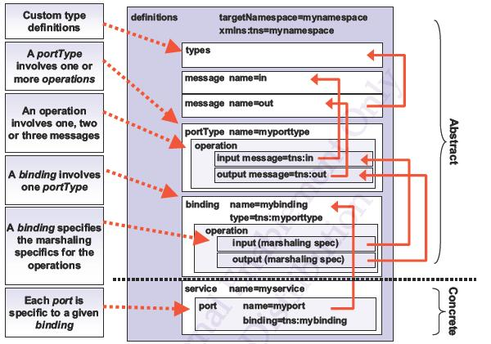
THE RELATIONSHIPS BETWEEN WSDL ELEMENTS

Slide 22
WSDL 1.1 vs. WSDL 2.0
Flexible Authoring Style
WSDL 1.1
<wsdl:import>
enables importing WSDL definitions defined in separate files with the same or different namespaces
WSDL 2.0
<wsdl:import>
for WSDL definitions with a different namespace
<wsdl:include>
for WSDL definitions with the same namespace.

Slide 23
Namespace
WSDL 1.1
http://schemas.xmlsoap.org/wsdl/
WSDL 2.0
http://www.WSDL2.0 w3.org/2004/08/wsdl

Slide 24
Supported Schema
WSDL 1.1
supports XML schema
WSDL 2.0
supports also other schemas,
such as RELAX NG and Schematron.

Slide 25
Thank You!

Slide 26
Method - Operation
Parameter - message
Exception - Fault
Interface - portType

