Slide 1
XSLT
Extensible Style sheet Language Transformations

Slide 2
What is XSL?
XSL is Style sheet Language like CSS
XSL is the XML style sheet language, used to define actions on XML files
XSL files are written in XML.
Commands in the XSLT language are
  a tag set (elements and attributes) defined by the W3C XSLT recommendation that looks like this (<xsl:sort> and <xsl:number>)

Slide 3
Why XSL is Required?
XML is not a fixed tag set (like HTML)
XML by itself has no (application) semantics
A generic XML processor has no idea what is "meant" by the XML
XML markup does not (usually) include formatting information
The information in an XML document may not be in the form in which it is desired to present it
Therefore there must be something in addition to the XML document that provides information on how to present or otherwise process the XML

Slide 4
CSS Vs XSL
XSL is the XML style sheet language, used to define actions on XML files
XSL files are written in XML.
CSS tells a browser or other agent how to display a HTML, XHTML or XML file.
CSS files are not written in XML .

Slide 5
What XSLT Does is “Transform”
Transform means change
Provides transformation and manipulation functions for XML files.
Designed to make XML into something else i,e Transforms XML documents into some other like HTML.

Slide 6
The Very Basics of XSLT Transforms
Transform
  does not change the input file.
  creates one (or more) new output file(s).
  Transform does not make something else into XML.
Two basic requirements
  known XML source (tag set, schema, DTD).
  known target.

Slide 7
Logical Components of an XSLT Application
Reads XML document(s) (tags and text)
Uses an XSLT stylesheet/transform (the program)
But XSLT does not work directly on XML documents
Runs using XSLT processing software (called an XSLT Engine). This Engine parses the XML and builds a tree
XSLT works on tree made from XML and Uses XPath to navigate Elements and attribute in XML
Produces output document(s)

Slide 8
Structure of an XSLT System
XSLT Stylesheet
XSLT Processor
XML File
Output

Slide 9
Introduction to XSLT Concepts
A series of rules (called template rules)
  Each rule is a sequence of XSLT commands
  Each command is an XML element with attributes
  A rule is executed when it matches some condition or is called by name
  Matching means finding in the XML and do this
    an element
    an element/attribute combination
    an element in a certain context

Slide 10
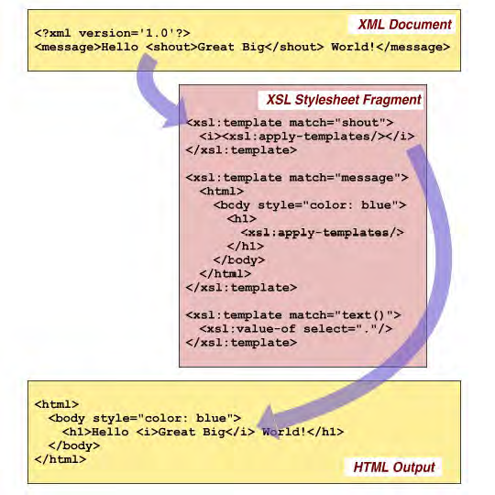
Introduction to XSLT Concepts

Slide 11
Approach for XSL Transformation
XSL Transformation can be done at Client side and server side
Approach1: Server Side
Web Server
XSLT
XML
to
HTML
Browser
Insert in Page
HTML
Approach2: Client Side
Browser
XSLT
XML
to
HTML
XML
Web Server
Service

Slide 12
XSLT Elements
<xsl:template> A template contains rules to apply when a specified node is matched .
<xsl:value-of> to extract value of an XML Element.
<xsl:for-each> to select every XML element
<xsl:sort> to sort the output.
<xsl:if> for conditions
  <xsl:for-each select="catalog/cd">
  <xsl:if test="price &gt; 10">
  <xsl:sort select="artist"/>
    <tr>
    <td><xsl:value-of select="catalog/cd/title"/></td>
    <td><xsl:value-of select="catalog/cd/artist"/></td>
    </tr>
    </ xsl:if>
  </xsl:for-each>

Slide 13
XSLT Elements
<xsl:choose> like if-else
<xsl:for-each select="catalog/cd">
<tr>
<td><xsl:value-of select="title"/></td>
<xsl:choose>
<xsl:when test="price &gt; 10">
<td bgcolor="#ff00ff">
<xsl:value-of select="artist"/></td>
</xsl:when>
<xsl:otherwise>
<td><xsl:value-of select="artist"/></td>
</xsl:otherwise>
</xsl:choose>
</tr>
</xsl:for-each>
<xsl:apply-templates>applies a template to the current element

Slide 14
https://www.google.co.in/#hl=en&sclient=psy-ab&q=How+can+we+use+HTML+coding+in+XSL+file%3F&oq=How+can+we+use+HTML+coding+in+XSL+file%3F&aq=f&aqi=&aql=&gs_l=hp.3...1919.13997.0.14345.39.29.0.10.10.0.317.3123.15j13j0j1.29.0...0.0.m3ukUlBQVMw&pbx=1&bav=on.2,or.r_gc.r_pw.r_qf.,cf.osb&fp=8462a46ed53d5c37&biw=1280&bih=885

