Slide 1
Introduction to Java Webservices
Rajesh Babu Viswanadhapalli
E-Mail : rajeshbabu.v@capgemini.com

Slide 2
What Is Distributed Computing?
Distributing Computing is a type of computing in which different components and objects comprising an application can be located on different computers connected to a network.
A distributed computing model provides an infrastructure enabling invocations of object functions located anywhere on the network.
The objects are transparent to the application and provide processing power as if they were local to the application calling them.

Slide 3
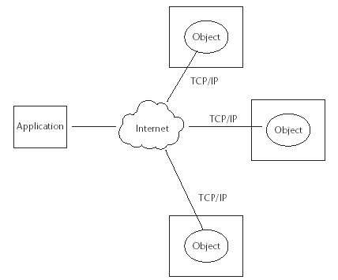

Continuation….

Slide 4
The Importance of Distributed Computing
The advantages of distributed computing are as given
Higher performance. Applications can execute in parallel and distribute the load across multiple servers.
Collaboration. Multiple applications can be connected through standard distributed computing mechanisms.
Higher reliability and availability. Applications or servers can be clustered in multiple machines.
Scalability. This can be achieved by deploying these reusable distributed components on powerful servers.
Extensibility. This can be achieved through dynamic (re)configuration of applications that are distributed across the network.

Slide 5
The Importance of Distributed Computing
The advantages of distributed computing continued…
Higher productivity and lower development cycle time. By breaking up large problems into smaller ones, these individual components can be developed by smaller development teams in isolation.
Reuse. The distributed components may perform various services that can potentially be used by multiple client applications. It saves repetitive development effort and improves interoperability between components.
Reduced cost. Because this model provides a lot of reuse of once developed components that are accessible over the network, significant cost reductions can be achieved.

Slide 6
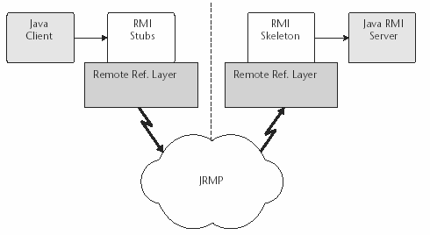
Distributed Computing- Java RMI
RMI provides an
architectural model of
distributed Java
application environment
by calling remote Java
objects and passing them
as arguments or return
values.
It uses Java object
serialization—a
lightweight object
persistence technique
that allows the
conversion of objects into
streams.

Slide 7
Distributed Computing- Java RMI
Although RMI had inherent advantages provided by the distributed object model of the Java platform, it also had some limitations:
RMI is limited only to the Java platform. It does not provide language independence in its distributed model as targeted by CORBA.
RMI-based application architectures are tightly coupled because of the connection-oriented nature. Hence, achieving high scalability in such an application model becomes a challenge.
RMI does not provide any specific session management support. In a typical client/server implementation, the server has to maintain the session and state information of the multiple clients who access it. Maintaining such information within the server application without a standard support is a complex task.

Slide 8
The Emergence of Web Services
The increasing demands of the industry for enabling B2B, application-to-application (A2A), communication has led to a growing requirement for service-oriented architectures.
Enabling service-oriented applications facilitates the exposure of business applications as service components enable business applications from other organizations to
link with these services for application interaction and data sharing without human intervention.
By adopting Web technologies, the service-oriented architecture model facilitates the delivery of services over the Internet by leveraging standard technologies such as XML.
It uses platform-neutral standards by exposing the underlying application components and making them available to any application, any platform, or any device, and at any location.
Today, this phenomenon is well adopted for implementation and is commonly referred to as Web services.

Slide 9
Service Oriented Architecture (SOA)
Web services promote an environment for systems that is loosely coupled and interoperable. Many of the concepts for Web services come from a conceptual architecture called service-oriented architecture (SOA).
SOA configures entities (services, registries, contracts, and proxies) to maximize loose coupling and reuse.
Software architecture describes the system's components and the way they interact at a high level.

Slide 10


Service Oriented Architecture (SOA)
The interactions between components are called connectors. The configuration of components and connectors describes the way a system is structured and behaves.
connector
Component
Component
Software architecture describes a system's components and connectors.
The software architecture of a program or computing system is the structure or structures of the system, which comprise software components, the externally visible properties of those components, and the relationships among them .
Service-oriented architecture is a special kind of software architecture that has several unique characteristics.

Slide 11
Service Oriented Architecture (SOA)
Software Architecture
Service Oriented Architecture
Implements
Web services

Slide 12
Service Oriented Architecture (SOA)
Web services are simply one set of technologies that can be used to implement SOA successfully.
The most important aspect of service-oriented architecture is that it separates the service's implementation from its interface.
Consumers expect that their interaction with the service will follow a contract, an agreed-upon interaction between two parties.
The way the service executes tasks given to it by service consumers is irrelevant. The service might fulfill the request by executing a servlet, a mainframe application, a Visual Basic application, or an EJB application. The only requirement is that the service send the response back to the consumer in the agreed-upon format.

Slide 13
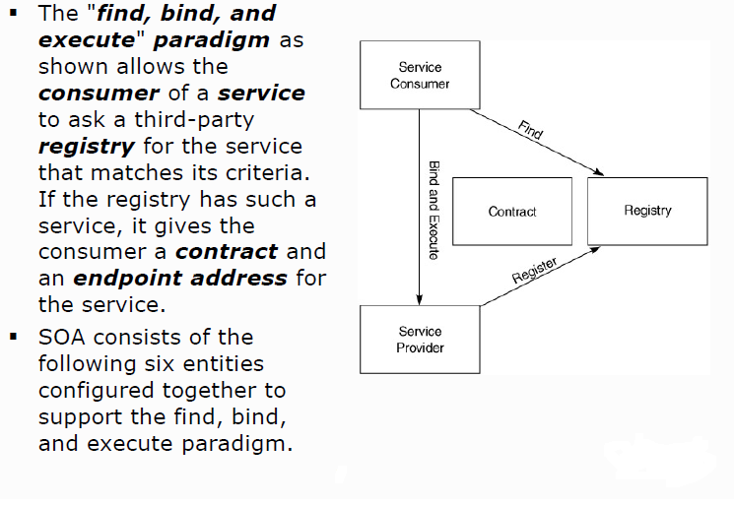
SOA Entities

Slide 14
SOA Entities-Service Consumer
Service Consumer is an application, service, or some other type of software module that requires a service.
Service Consumer is the entity that initiates the locating of the service in the registry, binding to the service over a transport, and executing the service function.
The service consumer executes the service by sending it a request formatted according to the contract.

Slide 15
SOA Entities-Service Provider
The service provider is the service, the network-addressable entity that accepts and executes requests from consumers.
Service provider can be a mainframe system, a component, or some other type of software system that executes the service request.
The service provider publishes its contract in the registry for access by service consumers.

Slide 16
SOA Entities-Service Registry
A service registry is a network-based directory that contains available services.
It is an entity that accepts and stores contracts from service providers and provides those contracts to interested service consumers

Slide 17
SOA Entities-Service Contract
A contract is a specification of the way a consumer of a service will interact with the provider of the service.
It specifies the format of the request and response from the service.
A service contract may require a set of preconditions and post conditions. The pre conditions and post conditions specify the state that the service must be in to execute a particular function.

Slide 18
SOA Entities-Service Proxy
The service provider supplies a service proxy to the service consumer.
The service consumer executes the request by calling an API function on the proxy.
The service proxy finds a contract and a reference to the service provider in the registry.
It then formats the request message and executes the request on behalf of the consumer.
The service proxy is a convenience entity for the service consumer.

Slide 19
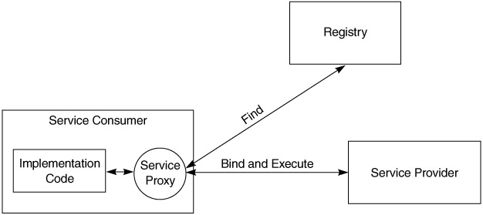
SOA Entities-Service Proxy

Slide 20
What Are Web Services?
Web services are based on the concept of service-oriented architecture (SOA).
SOA is the latest evolution of distributed computing, which enables software components, including application functions, objects, and processes from different systems, to be exposed as services.
According to Gartner research (June 15, 2001),“Web services are loosely coupled software components delivered over Internet standard technologies.”
Web services are self-describing and modular business applications that expose the business logic as services over the Internet through programmable interfaces and using Internet protocols for the purpose of providing ways to find, subscribe, and invoke those services.
Based on XML standards, Web services can be developed as loosely coupled application components using any programming language, any protocol, or any platform.
This facilitates delivering business applications as a service accessible to anyone, anytime, at any location, and using any platform.

Slide 21
What Are Web Services?
Web services are typically implemented based on open standards and technologies specifically leveraging XML.
The XML-based standards and technologies, such as Simple Object Access Protocol(SOAP); Universal Description, Discovery, and Integration(UDDI); Web Services Definition Language(WSDL) are commonly used as building blocks for Web services.

Slide 22
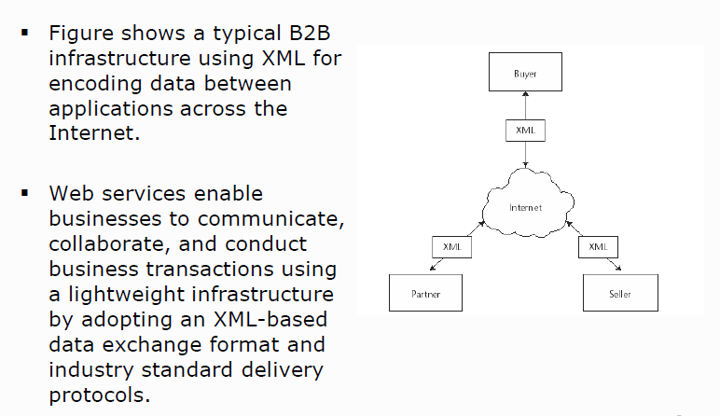
Web Services Motivation

Slide 23
Web Services Characteristics
The basic characteristics of a Web services application model are as follows:
Web services are based on XML messaging
Web services provide a cross-platform integration of business applications over the Internet.
To build Web services, developers can use any common programming language, such as Java, C, C++, Perl, Python, C#, and/or Visual Basic
Web services are not meant for handling presentations like HTML
Because Web services are based on loosely coupled application components, each component is exposed as a service with its unique functionality.

Slide 24
Web Services Characteristics
The basic characteristics of a Web services application model continued…:
Web services use industry-standard protocols like HTTP, and they can be easily accessible through corporate firewalls.
Web services can be used by many types of clients.
Web services vary in functionality from a simple request to a complex business transaction involving multiple resources.
All platforms including J2EE, CORBA, and Microsoft .NET provide extensive support for creating and deploying Web services.
Web services are dynamically located and invoked from public and private registries based on industry standards such as UDDI and ebXML.

Slide 25
Why Use Web Services?
The following are the major technical reasons for choosing Web services over Web applications:
Web services can be invoked through XML-based RPC mechanisms across firewalls.
Web services provide a cross-platform, cross-language solution based on XML messaging.
Web services facilitate ease of application integration using a lightweight infrastructure without affecting scalability.
Web services enable interoperability among heterogeneous applications.

Slide 26
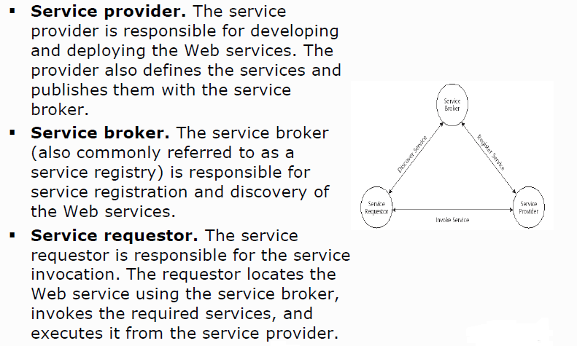
Basic Operational Model of Web Services

Slide 27
Core Web Services Standards
Extensible Markup Language (XML) plays a vital role as the common wire format in all forms of communication.
Simple Object Access Protocol (SOAP) is a standard for a lightweight XML-based messaging protocol. It enables an exchange of information between two or more peers and enables them to communicate with each other in a decentralized, distributed application environment.
Web Services Definition Language (WSDL) standard is an XML format for describing the network services and its access information.
Universal Description, Discovery, and Integration (UDDI) defines the standard interfaces and mechanisms for registries intended for publishing and storing descriptions of network services in terms of XML messages.

Slide 28
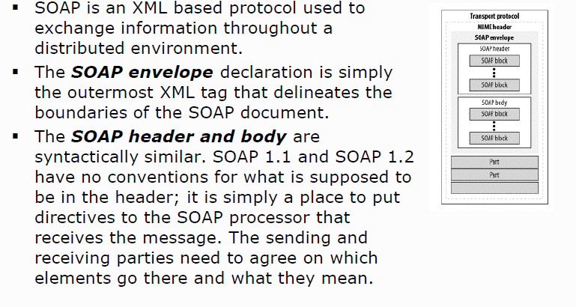
SOAP

Slide 29
SOAP….
While XML and SOAP are very good at describing data, many kinds of application data aren't well-suited for XML—for example, a piece of binary data such as an image, or a CAD file that contains schematic diagrams of parts being ordered electronically.
SOAP with Attachments (SwA) was born in recognition of this limitation.
SwA combines the SOAP protocol with the MIME format to allow any arbitrary data to be included as part of a SOAP message.

Slide 30
WSDL
WSDL (Web Services Description Language) provides an XML based standard for describing web services
Service providers use it to describe their web services so that service requesters can access them.
WSDL is used by the service provider to describe the service that is being provided.
These description may be published in the
Service registry(UDDI) where they can be searched.
A service requester retrieves the WSDL definition of a service, so that it can invoke the service.
A WSDL document describes what the service does, where it can be found and how service can be invoked.
It details every aspect of web service.
WSDL is pronounced as 'wiz-dull' and spelled out as 'W-S-D-L

Slide 31
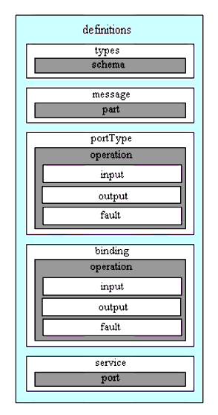
WSDL document Structure

Slide 32
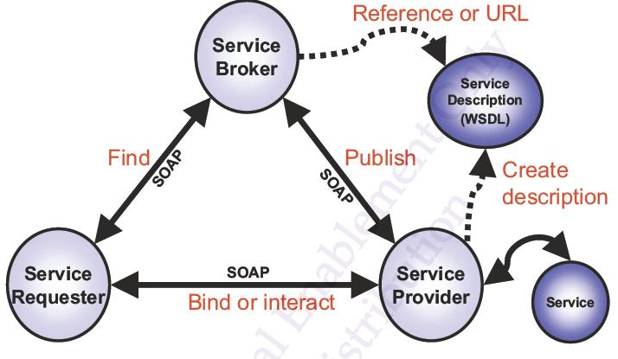
Where does WSDL fit in SOA

Slide 33
UDDI
The Universal Description, Discovery, and Integration (UDDI) provides
A standardized method for publishing and discovering information about web services.
The UDDI is an industry initiative that attempts to create a platform-independent, open framework for describing services, discovering businesses, and integrating business services.
UDDI focuses on the process of discovery in the service-oriented architecture.

Slide 34
Key Benefits of Web Services
The key benefits of implementing Web services are as follows:
Provides a simple mechanism for applications to become services that are accessible by anyone, anywhere, and from any device.
Defines a solution for businesses, which require flexibility and agility in application-to-application communication over the Internet.
Enables dynamic location and invocation of services through service brokers (registries).
Enables collaboration with existing applications that are modeled as services to provide aggregated Web services.

Slide 35
Web services - Design
Endpoint, operation
For example, we may make a web service accessible on the host www.XYZ.com and accessible as /BankService, so the full URL is http://www.XYZ.com/BankService. This is called the "endpoint“ of the web service
Our web service may support one or more operations. One operation may be named “createAccount“

Slide 36
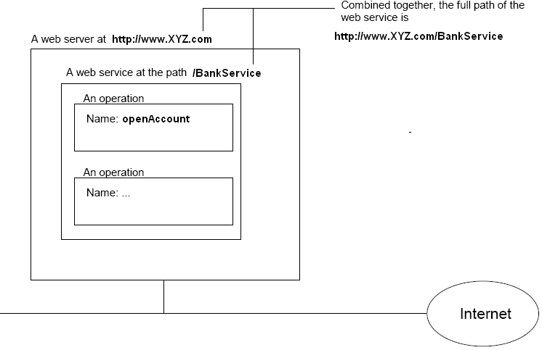
Continuation…

Slide 37
Continuation…
We’d like to provide a globally unique name to each operation so that we can have our “createAccount" operation while another person may have his/her "" operation.
So, in addition to the name, we may declare that the " createAccount " name above is in the "namespace" of http://XYZ.com/bs

Slide 38
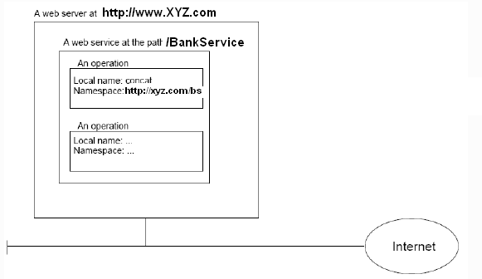
Continuation….

Slide 39
Continuation..
A namespace is just like a Java package, but it is not in a dot format like com.ttdev.foo;it is in the format of a URL. So, the full name of the operation will be “createAccount" in namespace http://xyz.com/bs.
The name “createAccount“ is called the "local name". The full name is called a "QName (qualified name)"
We may wonder what this http://xyz.com/bs namespace means??
The answer is that it has no particular meaning. Even though it is a URL, it does NOT mean that we can use a browser to access this URL to get a web page (if we do, we may get a file not found error).
The only important thing is that it must be globally unique.

Slide 40
Continuation….
Note that the namespace is a completely different concept from the endpoint.
The endpoint really is the location, while the namespace is just a unique id.
We could easily move the web service to another web server and thus it will have a different endpoint, but the namespaces of its operations will remain unchanged.

Slide 41
Input/output messages, parts
In web services, a method call is called an "input message" and a parameter is called a "part". The return value is called an "output message" and may contain multiple parts.

Slide 42
RPC and Document Style web services
IN RPC (Remote Procedure Call) style web service, the operation QName and the names of the parts are used to create the input and output messages.
In Document style web services, the input message will contain a single part only which is well defined in a schema. The same is true of the output message.
There is not much difference between RPC and document style web services. The significant difference is that
The former(RPC) can't be validated with a schema while the latter(document) can.
Therefore, document style web service is becoming the dominant style.

Slide 43
PortyType
A web service doesn't directly contain a list of operations. Instead, operations are grouped into one or more "port types".
A port type is like a Java class and each operation in it is like a static method.
For example, in the web service we are discussing, we could have a port type named "stringUtil" containing operations for strings, while having another port type named "dateUtil" containing operations for dates. The name of a port type must also be a QName

Slide 44
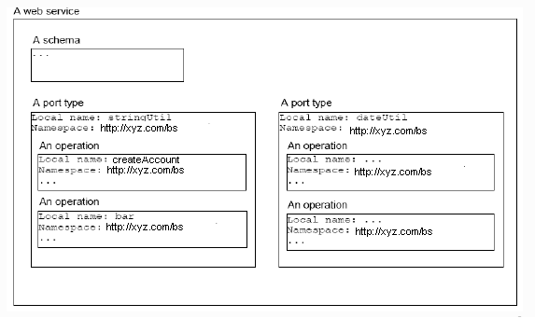
PortTypes : continuation…

Slide 45
Binding
Actually, a port type may allow us to access it using different message formats.
The message format that we have seen is called the "Simple Object Access Protocol (SOAP)" format.
It is possible that, say, the stringUtil port type may also support a plain text format
In addition to the message format, a port type may allow the message to be carried (transported) in an HTTP POST request or in an email.
Each supported combination is called a "binding“.

Slide 46
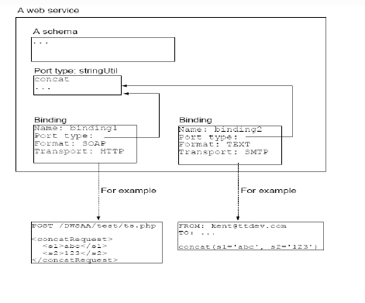
Binding: Continuation…

Slide 47
Port
Suppose that there are just too many people using our web service, we decide to make it available on more than one computers
For example, we may deploy the above binding 1 on computers c1, c2 and c3 and deploy binding 2 on c3.
In that case it is said that we have four ports Three ports are using binding 1 and one using binding 2:

Slide 48
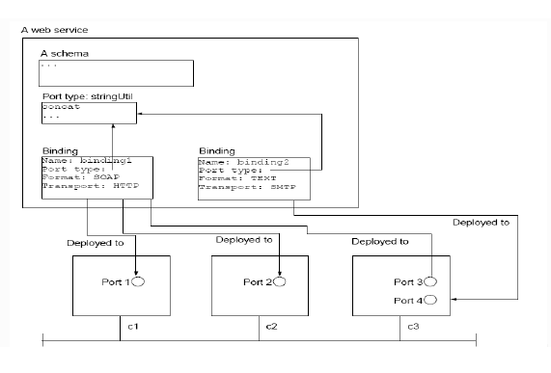
Port : continuation…

Slide 49
Target namespace
We have been using the same namespace for the operation names, port type names and etc. in this web service. Do they have to be in the same namespace??
By default, this is the case: There is a single namespace for a web service to put the names into. This is called the "target namespace" for the web service
Basically a namespace is good as long as it is globally unique
A namespace must be a URI. URI stands for Uniform Resource Identifier.
There are two kinds of URI.
One is URL such as http://www.foo.com/bar.
The other is URN. A URN takes the format of urn:<some-object-type>:<someobject-id>

Slide 50
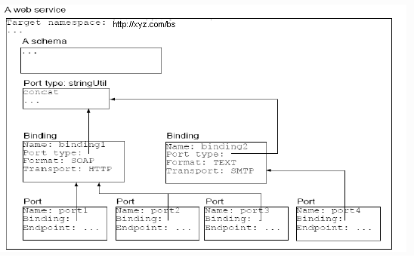
Target namespace: continuation…

Slide 51
Quick recap…
A web service is platform neutral, language neutral and can be accessed across the Internet.
A web service has one or more ports. Each port is a binding deployed at a certain network address (endpoint).
A binding is a port type using a particular message format and a particular transport protocol. A port type contains one or more operations.
An operation has an input message and an output message. Each message has one or more parts.
Each part is either a certain element defined in the schema of the web service, or any element belonging to a certain element type in that schema.
All above information is fully described in WSDL.

Slide 52
Continuation…
To call a RPC style web service, one will create an XML element with the name of the operation and a child element for each of its input message part.
To call a document style web service, one will just send the one and only part of its input message.
Because the XML element used to call a RPC style web service is not defined in any schema, for better interoperability, one should create document style web services.

Slide 53
JAX-WS - Introduction
JAX-WS 2.0 is a new programming model that simplifies application development through support of a standard, annotation-based model to develop Web Service applications and clients.
The JAX-WS 2.0 specification strategically aligns itself with the current industry trend towards a more document-centric messaging model and replaces the remote procedure call programming model as defined by JAX-RPC.
JAX-WS is the strategic programming model for developing Web services and is a required part of the Java Platform, Enterprise Edition 5 (Java EE 5).
The implementation of the JAX-WS programming standard provides the following enhancements for developing Web services and clients:

Slide 54
Enhancements in JAX-WS 2.0
Better platform independence for Java applications.
Using JAX-WS APIs, development of Web services and clients is simplified with better platform independence for Java applications.
JAX-WS takes advantage of the dynamic proxy mechanism to provide a formal delegation model with a pluggable provider. This is an enhancement over JAX-RPC, which relies on the generation of vendor-specific stubs for invocation.
Annotations
JAX-WS introduces support for annotating Java classes with metadata to indicate that the Java class is a Web service.
JAX-WS supports the use of annotations based on the Metadata Facility for the Java Programming Language (JSR 175) specification, the Web Services Metadata for the Java Platform (JSR 181) specification and annotations defined by the JAX-WS 2.0 specification.

Slide 55
Enhancements in JAX-WS 2.0
Annotations(continued)
Using annotations within the Java source and within the Java class simplifies development of Web services by defining some of the additional information that is typically obtained from deployment descriptorfiles,WSDLfiles, or mapping metadata from XML and WSDL files into the source artifacts.
For example, we can embed a simple @WebServicetag in the Java source to expose the bean as a Web service.
@WebService
public class QuoteBean implements StockQuote {
public float getQuote(String sym) { ... }
}

Slide 56
Enhancements in JAX-WS 2.0
Annotations (continued)
The @WebService annotation tells the server runtime to expose all public methods on that bean as a Web service.
Additional levels of granularity can be controlled by adding additional annotations on individual methods or parameters.
Using annotations makes it much easier to expose Java artifacts as Web services.
In addition, as artifacts are created from using some of the top-down mapping tools starting from a WSDL file, annotations are included within the source and Java classes as a way of capturing the metadata along with the source files.
Using annotations also improves the development of Web services within a team structure because we do not need to define every Web service in a single or common deployment descriptor as required with JAX-RPC Web services.
Taking advantage of annotations with JAX-WS Web services allows parallel developmentof the service and the required metadata.

Slide 57
Enhancements in JAX-WS 2.0
Using resource injection
JAX-WS supports resource injection to further simplify development of Web services.
JAX-WS uses this key feature of Java EE 5 to shift the burden of creating and initializing common resources in a Java runtime environment from our Web service application to the application container environment itself.
JAX-WS provides support for a subset of annotations that are defined in JSR-250 for resource injection and application lifecycle in its runtime.
Using resource injection (continued)
The following example illustrates using the @Resource annotation for resource injection:
@WebService
public class MyService {
@Resource
private WebServiceContext ctx;
public String echo (String input) {
//some code
}
}

Slide 58
Continuation…
Data binding with Java Architecture for XML Binding (JAXB) 2.0
JAX-WS leverages the JAXB 2.0 API and tools as the binding technology for mappings between Java objects and XML documents.
JAX-WS tooling relies on JAXB tooling for default data binding for two-way mappings between Java objects and XML documents.
Dynamic and static clients
The dynamic client API for JAX-WS is called the dispatch client (javax.xml.ws.Dispatch). The dispatch client is an XML messaging oriented client.
The static client programming model for JAX-WS is called the proxy client. The proxy client invokes a Web service based on a Service Endpoint interface (SEI) which must be provided.

Slide 59
Enhancements in JAX-WS 2.0
Support for Message Transmission Optimized Mechanism (MTOM)
Using JAX-WS, we can send binary attachments such as images or files along with Web services requests.
JAX-WS adds support for optimized transmission of binary data as specified by Message Transmission Optimization Mechanism (MTOM).
Multiple data binding technologies
JAX-WS exposes the following binding technologies to the end user:
•XML Source
•SOAP Attachments API for Java (SAAJ) 1.3, and
•Java Architecture for XML Binding (JAXB) 2.0.

Slide 60
Enhancements in JAX-WS 2.0
Support for SOAP 1.2
Support for SOAP 1.2 has been added to JAX-WS 2.0.
JAX-WS supports both SOAP 1.1 and SOAP 1.2 so that we can send binary attachments such as images or files along with Web services requests.
JAX-WS adds support for optimized transmission of binary data as specified by MTOM.

Slide 61
Enhancements in JAX-WS 2.0
New development tools
JAX-WS provides the wsgen and wsimport command-line tools for generating portable artifacts for JAX-WS Web services.
When creating JAX-WS Web services, we can start with either a WSDL file or an implementation bean class.
If we start with an implementation bean class, use the wsgen command-line tool to generate all the Web services server artifacts, including a WSDL file if requested.
If we start with a WSDL file, use the wsimport command-line tool to generate all the Web services artifacts for either the server or the client.
The wsimport command line tool processes the WSDL file with schema definitions to generate the portable artifacts, which include the service class, the service endpoint interface class, and the JAXB 2.0 classes for the corresponding XML schema.

Slide 62
Developing JAX-WS Web services (bottom-up development)
When developing a JAX-WS Web service starting from JavaBeans, we can use a bean that already exists and then enable the implementation for JAX-WS Web services.
The use of annotations simplifies the enabling of a bean for Web services. Adding the @WebService annotation to the bean defines the application as a Web service and how a client can access the Web service.
JavaBeans can have a service endpoint interface, but it is not required.
Enabling JavaBeans for Web services includes annotating the bean and the optional service endpoint interface, assembling all artifacts required for the Web service, and deploying the application.
We are not required to develop a WSDL file because the use of annotations can provide all of the WSDL information necessary to configure the service endpoint or the client. It is, however, a best practice to develop a WSDL file.

Slide 63
Developing JAX-WS Web services (top-down development )
We can use a top-down development approach to create a JAX-WS Web service with an existing WSDL file using JavaBeans.
We can use the JAX-WS tool, wsimport, to process a WSDL file and generate portable Java artifacts that are used to create a Web service. The portable Java artifacts created using the wsimport tool are:
Service endpoint interface (SEI)
Service class
Exception class that is mapped from the wsdl:fault class (if any)
Java Architecture for XML Binding (JAXB) generated type values which are Java classes mapped from XML schema types

Slide 64
Service Implementation Bean (SIB)
WS-Metadata 2.0 defines the requirements for deploying a Java class as a Web service. Classes that meet these requirements are called service implementation beans (SIBs).
While JAX-RPC required services to be implemented using service endpoint interfaces (SEIs) that had to extend java.rmi.Remote, that requirement no longer applies with JAX-WS and WS-Metadata.
In addition, both POJOs and EJBs that conform to the service implementation bean requirements can be deployed as Web services. This is a big improvement over J2EE 1.4, which has two different bean specifications—
one for EJB deployment (which requires a Web service to be implemented with the stateless session bean interfaces)
and one for Web container (servlet) deployment

Slide 65
Different Endpoints
WSEE 1.2 specifies that a POJO, as long as it meets the requirement spelled out in WS-Metadata for a SIB, can be used to implement a Web service deployed to the Web container. This is commonly referred to as a servlet endpoint
WSEE 1.2 specifies that a stateless session bean can be used to implement a Web service to be deployed in the EJB container. This is commonly referred to as an EJB endpoint.
The requirements for creating a SIB from a stateless session bean are spelled out in WSEE.

Slide 66
Developing JAX-WS clients
The JAX-WS client programming model supports both the Dispatch client API and the Dynamic Proxy client API.
The Dispatch client API is a dynamic client programming model, whereas the static client programming model for JAX-WS is the Dynamic Proxy client.
The Dispatch and Dynamic Proxy clients enable both synchronous and asynchronous invocation of JAX-WS Web services.
Dispatch client: Use this client when we want to work at the XML message level or when we want to work without any generated artifacts at the JAX-WS level.
Dynamic Proxy client: Use this client when we want to invoke a Web service based on a service endpoint interface.

