Slide 1
PROJECT NAME 7210 SMART PARKING
Team Members
S. Rabiya Basree
S.Shabeena
K. Rajesh
Chakali Anusha
Y.C .Anusha Yadav

Slide 2
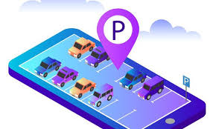
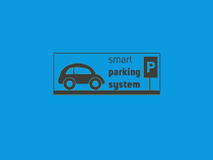
CONTENTS
1. Introduction
2.Problem Definition
3.Design Thinking

Slide 3
Introduction
Smart parking is a cutting-edge technological solution revolutionizing the way we approach parking in urban areas. Unlike traditional parking systems, which often lead to frustration and wasted time, smart parking leverages advanced sensors, data analytics, and mobile applications to streamline the entire parking experience. It aims to make finding, reserving, and managing parking spaces more convenient and efficient for both drivers and parking operators. With the potential to reduce traffic congestion, lower emissions, and improve overall urban mobility, smart parking represents a crucial innovation in modern city planning and transportation management.

Slide 4
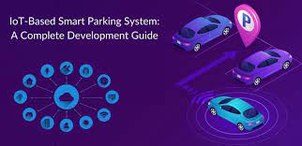
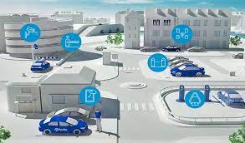
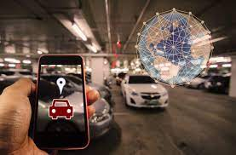

Slide 5
Problem Definition
"Increasing urbanization and a growing number of vehicles on the road have led to a pressing issue of limited and inefficient parking spaces in urban areas. Conventional parking systems often result in traffic congestion, wasted time, and environmental concerns due to the constant search for available parking spaces. This problem negatively impacts the quality of life for city residents, contributes to air pollution, and poses challenges for businesses and local governments in managing urban mobility effectively.
Smart parking seeks to address these issues by providing a comprehensive solution that leverages advanced technologies, such as sensors, data analytics, and mobile apps, to optimize parking space utilization. The goal is to make parking easier to find, reserve, and manage, reducing congestion, improving environmental sustainability, and enhancing the overall urban experience for both residents and visitors."
.

Slide 6
Design thinking
Project Objectives:
The project objectives for a smart parking system can include:
Improved Efficiency: Develop a system that significantly improves the efficiency of parking operations by reducing the time it takes for drivers to find available parking spaces.
Enhanced User Experience: Create a user-friendly interface and mobile application that allows drivers to easily locate and reserve parking spots, providing a seamless parking experience.
Optimized Space Utilization: Maximize the utilization of parking spaces by using sensors and data analytics to monitor and allocate spaces effectively, reducing congestion and the need for additional parking infrastructure.
Reduced Traffic Congestion: Decrease traffic congestion in urban areas by reducing the number of vehicles circling in search of parking, leading to a more streamlined flow of traffic.

Slide 7
5.Environmental Impact: Minimize the environmental impact of parking through reduced fuel consumption and emissions resulting from reduced time spent searching for parking.
6.Revenue Generation: Implement a payment system that allows for easy, secure, and efficient collection of parking fees, potentially increasing revenue for parking operators or municipalities.
7.Safety and Security: Enhance safety and security in parking areas through features such as well-lit spaces, surveillance cameras, and real-time monitoring of parking facilities.
8.Data Insights: Collect and analyze data on parking patterns and user behavior to gain insights into parking demand, allowing for data-driven decisions in urban planning and infrastructure development.

Slide 8
IOT SENSOR DESIGN:
Designing IoT (Internet of Things) sensors for smart parking involves creating a system that can accurately detect the presence or absence of vehicles in parking spaces, transmit this data to a central server or cloud platform, and provide real-time information to users via mobile apps or other interfaces. Here's a high-level overview of the key components and considerations for designing IoT sensors for smart parking:

Slide 9
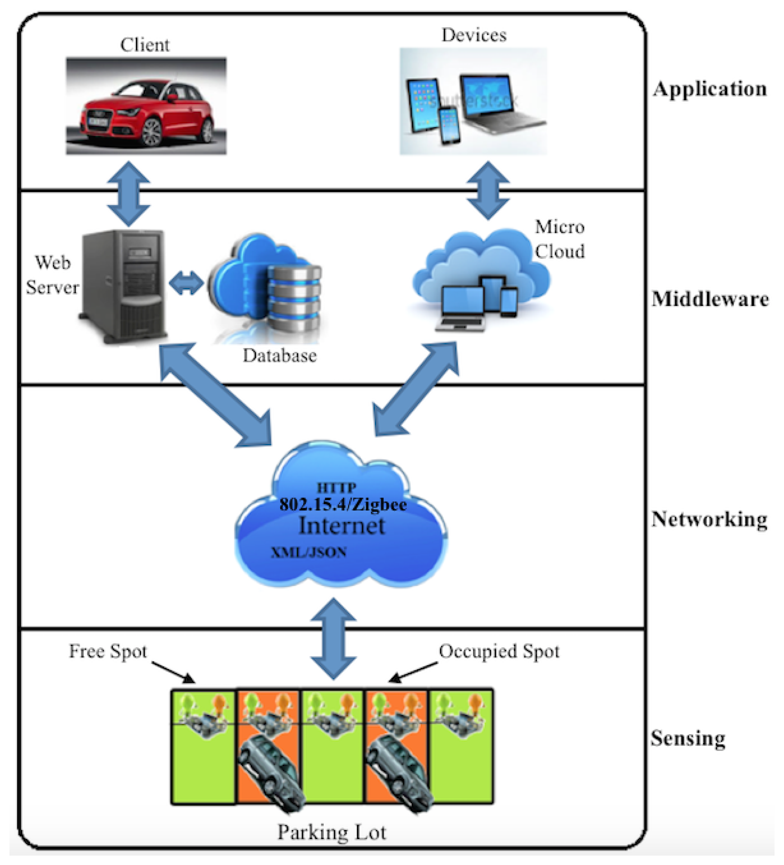

Slide 10
Sensor Selection:
Choose appropriate sensors for vehicle detection. Common options include ultrasonic sensors, infrared sensors, magnetic sensors, or cameras.
Consider the sensor's accuracy, reliability, power consumption, and cost when making your selection.
Power Source:
Decide on a power source for the sensors. Options include battery-powered sensors, solar-powered sensors, or sensors that tap into existing power sources.
Communication:
Implement wireless communication protocols like Wi-Fi, LoRaWAN, or cellular (e.g., 4G/5G) to transmit data from the sensors to a central server or cloud platform.
Ensure that the chosen communication method offers sufficient range and reliability for the specific parking environment.

Slide 11
3.Data Transmission:
Design a secure and efficient data transmission protocol to send vehicle status updates to the central server in real-time.
Consider data encryption and authentication mechanisms to protect the integrity and confidentiality of data.
4.Power Management:
Implement power-saving features to extend the sensor's battery life or reduce power consumption, especially in battery-powered devices.
Utilize sleep modes and wake-up triggers to conserve energy when the sensor is not actively detecting vehicles.

Slide 12
5.Scalability:
Ensure that the sensor design is scalable to accommodate a large number of parking spaces in various configurations.
Design the sensors to work seamlessly in both outdoor and indoor parking environments.
6.Durability and Weatherproofing:
Design the sensors to withstand harsh weather conditions (rain, snow, extreme temperatures) and potential physical impacts.
Incorporate weatherproof enclosures or housings as needed.
7.Data Security and Privacy:
Implement security measures to protect sensor data and ensure user privacy.
Comply with relevant data protection regulations and standards.

Slide 13
Real Time Transit Information Platform:
Creating a real-time transit information platform for smart parking
involves designing a system that provides users with up-to-the-minute
data on transit options and parking availability in a given area. Here are
the key components and considerations for developing such a platform:
Data Sources:
Integrate data sources such as GPS tracking systems for buses and trains, traffic sensors, and real-time parking space occupancy data from IoT sensors.

Slide 14
User-Friendly Interface:
Develop a user-friendly mobile app or web interface that allows users to access real-time transit and parking information conveniently.
Include features for easy navigation and searching for transit routes and parking facilities.
Real-Time Data Integration:
Implement mechanisms to gather, process, and display real-time transit data, including bus and train schedules, current vehicle locations, estimated arrival times, and parking space availability.
Ensure data accuracy and reliability through continuous monitoring and updates.

Slide 15
3.Route Planning and Navigation:
Provide route planning functionality that suggests the most efficient transit options based on a user's location, destination, and preferences.
Incorporate maps and navigation features to guide users to their chosen parking facility or transit stop.
4.Parking Space Availability:
Display real-time parking space availability information, including the number of available spots, pricing, and location.
Implement a reservation system for parking spaces, allowing users to reserve spots in advance.

Slide 16
Integration Approach
An integrated approach for smart parking involves combining various technologies, data sources, and strategies to create a cohesive system that optimizes parking management, enhances the user experience, and contributes to more sustainable urban mobility. Here are key components and considerations for implementing such an integrated approach:
IoT Sensors and Infrastructure:
Deploy IoT sensors, such as ultrasonic, infrared, or magnetic sensors, to monitor parking space occupancy in real-time.
Install a robust sensor infrastructure that covers a wide range of parking facilities, including street parking, garages, and lots.

Slide 17
Data Collection and Management:
Collect data from sensors, including parking space occupancy, duration of stay, and vehicle types.
Centralize and manage data in a cloud-based platform, ensuring scalability and data security.
Real-Time Data Processing:
Implement real-time data processing to provide users with up-to-the-minute parking availability information.
Utilize data analytics to identify patterns, trends, and anomalies in parking demand.

Slide 18
Traffic Management:
Use real-time data to improve traffic flow by directing drivers to less congested areas.
Implement dynamic traffic management solutions to reduce congestion around parking facilities.
Security and Safety:
Ensure the safety and security of parking facilities through surveillance cameras, emergency call systems, and well-lit areas.
Implement cybersecurity measures to protect the data and infrastructure.

Slide 19
CONCLUSION
In conclusion, smart parking represents a transformative solution to address the growing challenges associated with urban parking and transportation. By harnessing advanced technologies, data analytics, and user-friendly interfaces, smart parking systems offer a range of benefits for cities, businesses, and individuals alike.
Smart parking optimizes the utilization of parking spaces, reducing the time and frustration associated with finding parking spots. Real-time availability information helps drivers make informed decisions.

Slide 20
THANK YOU

