Slide 1
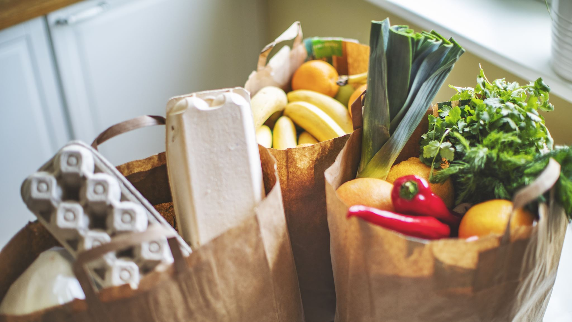

Desi Mart (Online Grocery shopping App)
Designed By:
Rajesh Lakanavarapu

Slide 2
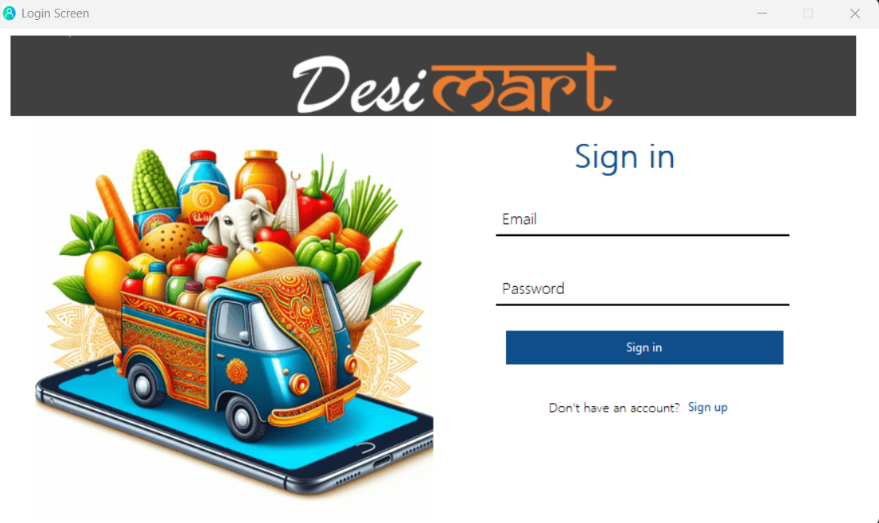
Accessing Your DesiMart Account
If you already have a DesiMart account:
Enter your email address in the email field. This is the email address you used to create your DesiMart account.
Enter your password in the password field. This is the password you chose when you created your account.
Click the "Sign In" button. This will attempt to log you in to your DesiMart account.
Make sure you are entering the correct email address and password.

Slide 3
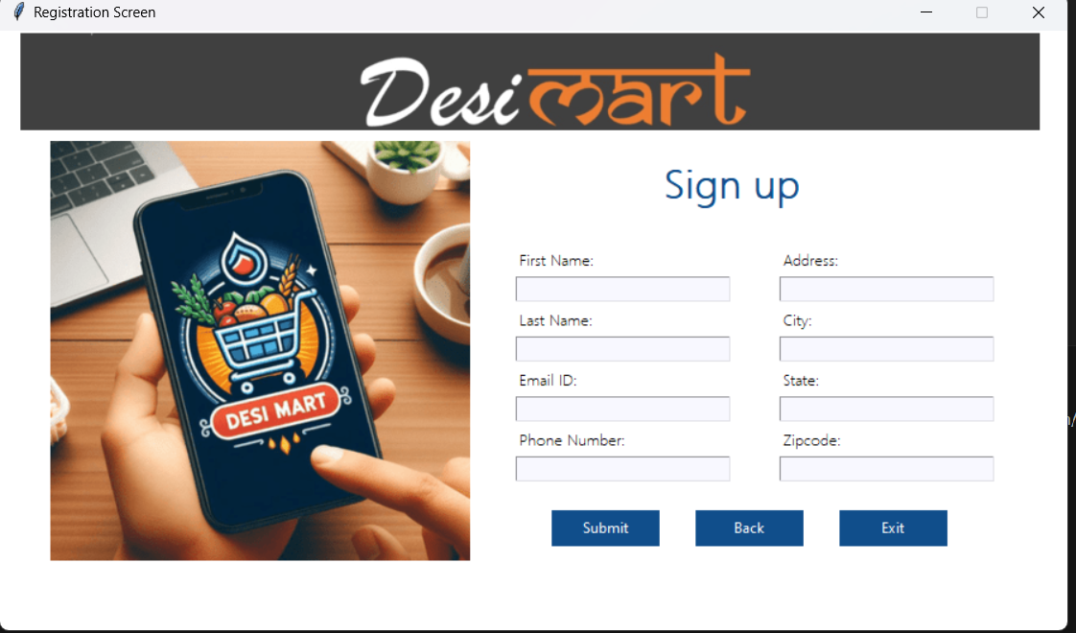
Create Your DesiMart Account
Here's a breakdown of the information requested on the DesiMart signup page:
First Name & Last Name
Email ID
Phone Number
Address (City, State, Zipcode)
Below the information fields, there are three buttons:
Submit (presumably to create the new account after filling out the form)
Back (return to the previous screen, which is the login screen)
Exit (exit the DesiMart website entirely)

Slide 4
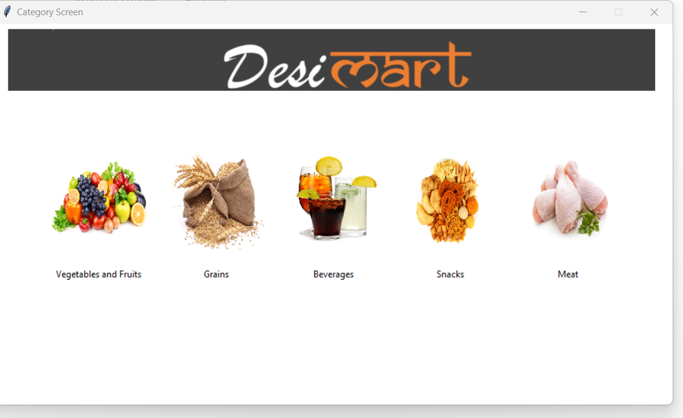
Explore DesiMart Categories
The screen likely displays a list of categories relevant to Indian groceries.
This might include categories like:
Vegetables & fruits
Grains & Flours (Rice, Dal, etc.)
Meet
Sweets & Snacks
Packaged Foods & Beverages
Users can typically click or tap on a category to view the specific products available within that category.

Slide 5
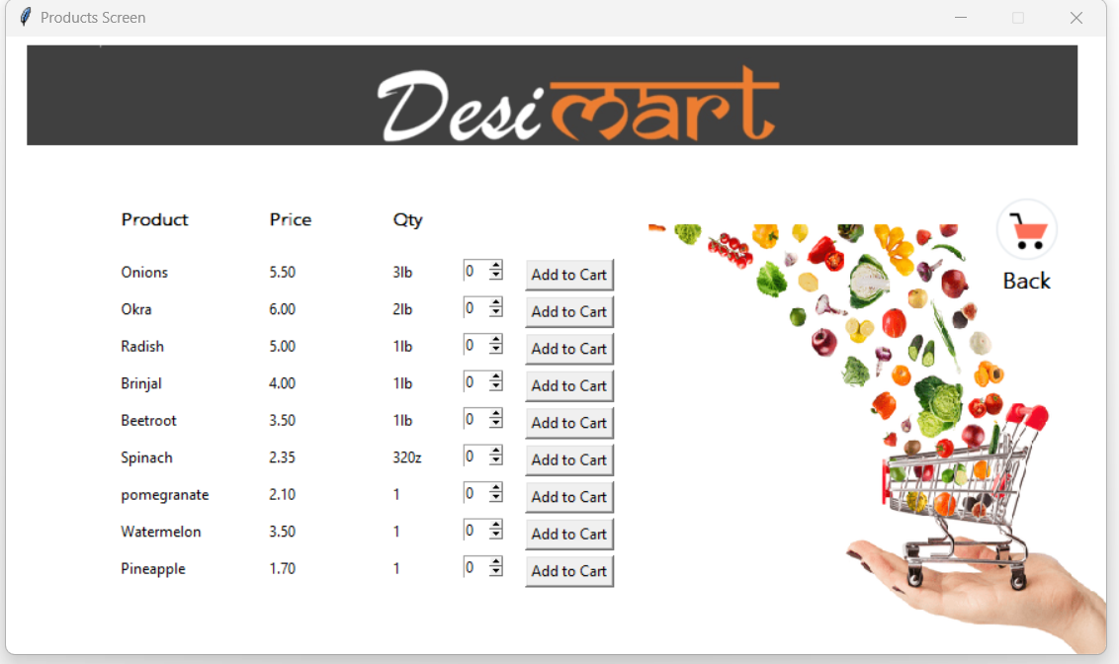
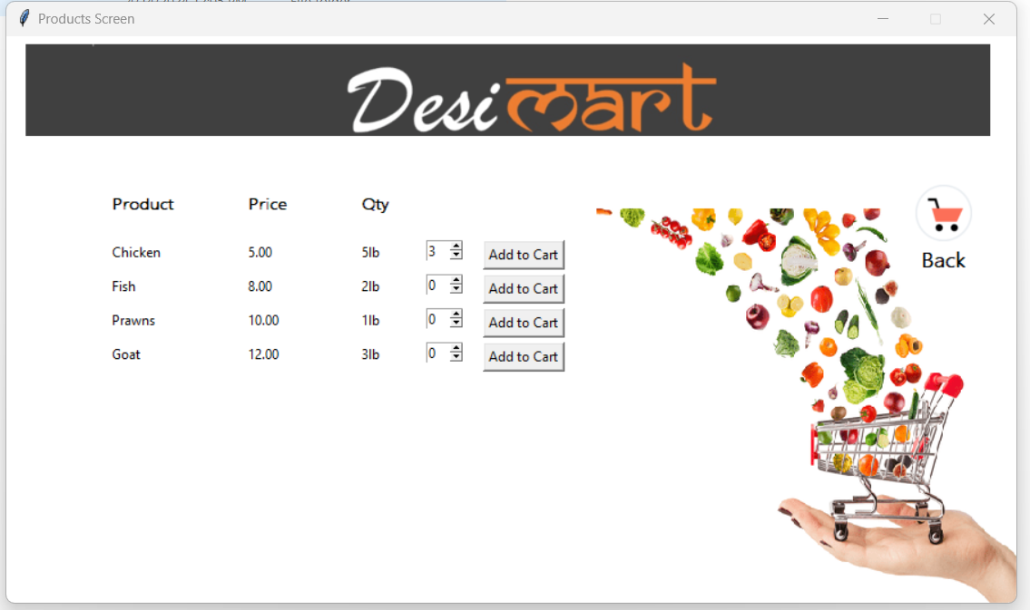
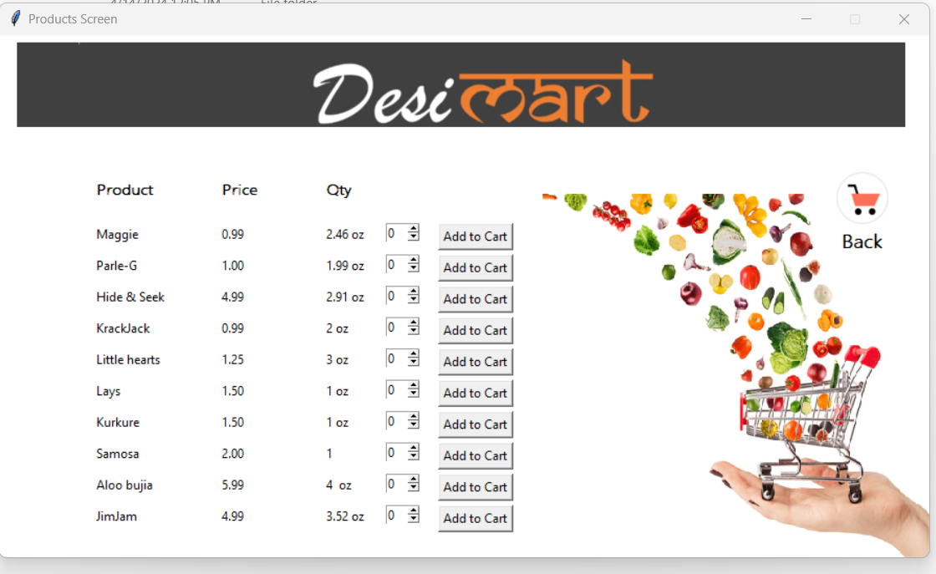
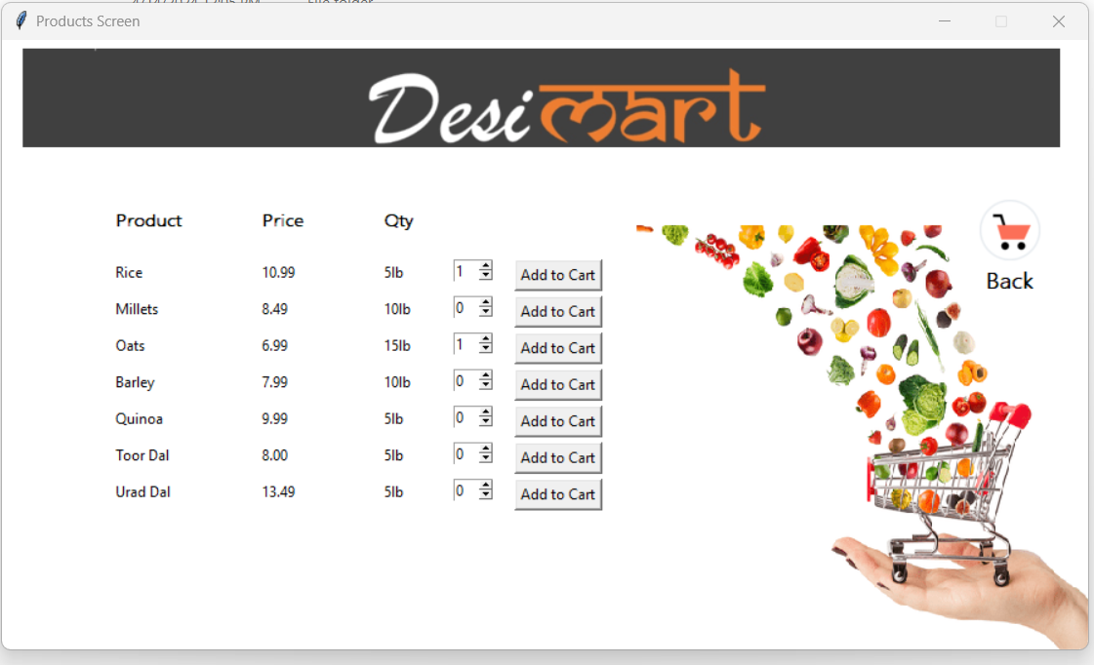
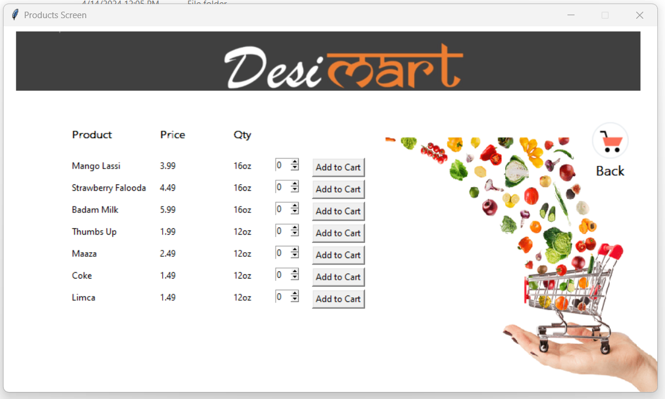
Browse Products:
Users can scroll through the list of available products within the chosen category (e.g., different brands or flavors of Mango Lassi).
View Product Details :
Add Items to Cart:.
Adjust Quantity :.

Slide 6
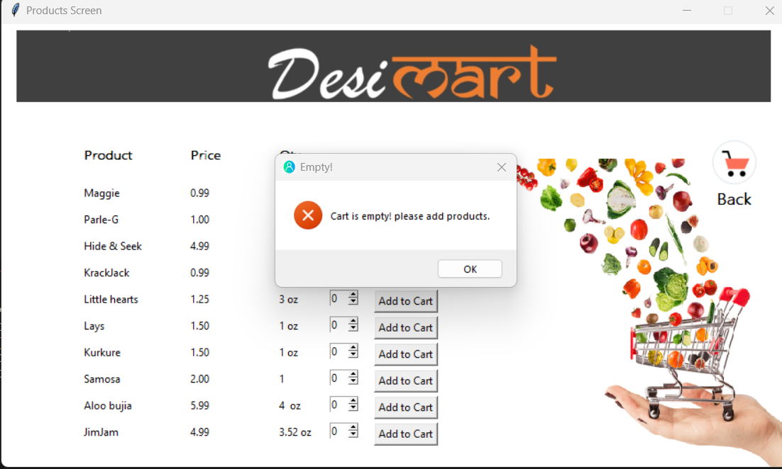
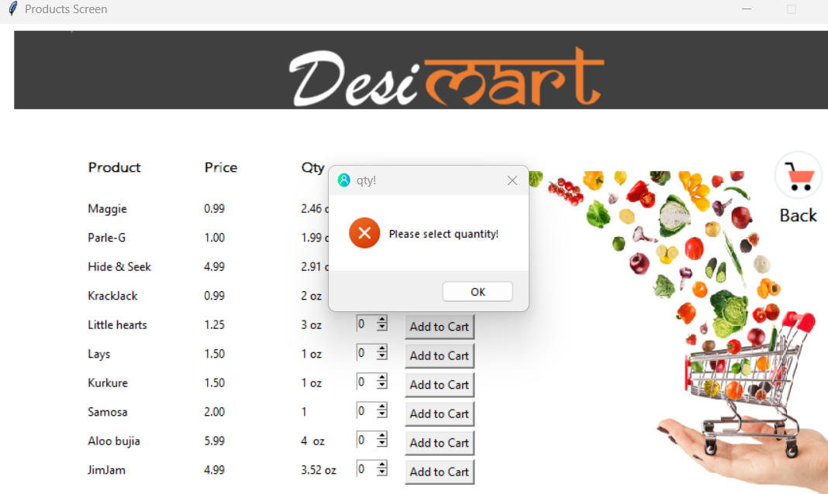
DesiMart Shopping Cart Errors

Slide 7
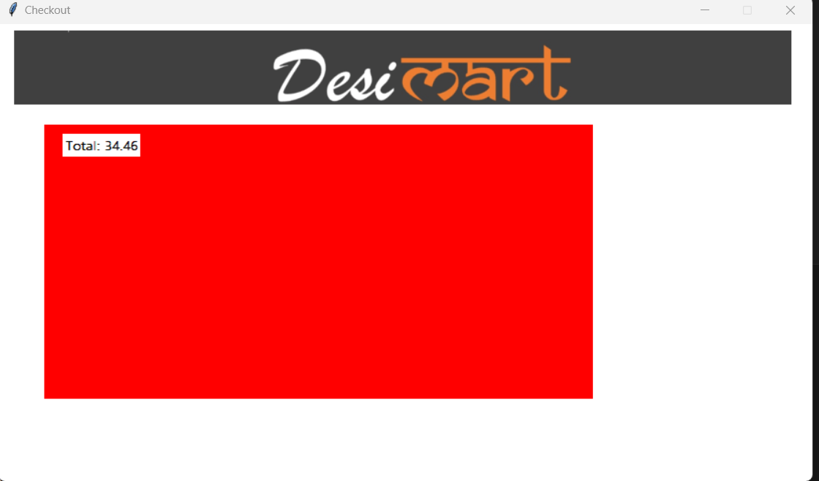
Checkout screen
Order Total:
This section likely displays the total cost of the order, which may include the subtotal of the items, any applicable taxes, and shipping costs.

Slide 8

Thank you

