Slide 1
SMARTRECRUIT
AI RECRUITMENT PLATFORM
A Next-Generation Talent Acquisition Ecosystem Powered by Google Gemini · Multi-lingual RAG · Real-time AI Interviews
Post Graduate Dept. of Computer Science & Technology Sardar Patel University · 2024–2026 | IR Info Tech Pvt. Ltd.

Slide 2
01
The Problem We Solve
⏳ Time-to-Hire
⚖️ Hiring Bias
Average 42 days globally. 70% spent manually screening resumes.
Unconscious bias in manual screening leads to diverse-talent loss.
📉 Poor Scale
🤖 No AI in HR
Hundreds of applicants per role; HR teams are overwhelmed.
Most HR tools lack real AI — they use keyword matching, not intelligence.

Slide 3
02
SmartRecruit: The Complete Solution
🔍
AI Resume Parser
📝
Auto Assessments
🎙️
AI Interview (R3)
Multi-lingual RAG + Semantic Embeddings
AI-generated Aptitude + Practical MCQs
Voice, Code, Sentiment, Face Proctoring
🌿
Botanist HR (R4)
📊
Analytics
🎁
Offer & Onboard
Behavioral STAR-method AI evaluation
Hiring funnel, retention prediction, bias report
PDF generation, salary negotiation AI, roadmap

Slide 4
03
The 4-Round AI Hiring Pipeline
R1
R2
R3
R4
Aptitude Test
Practical Test
AI Interview
HR Interview
AI-generated MCQs Timed | Anti-cheat Pass: 70%
Domain-specific MCQs Code submission Pass: 70%
Voice + Code + Camera Sentiment analysis Pass: 75%
Botanist STAR engine Multi-lingual voice Recruiter approved
→
→
→

Slide 5
04
Technology Stack
Backend
AI/ML Engines
Python 3.11 · Django 4.x · Django REST Framework · JWT
Google Gemini 1.5 Flash · Groq (LLaMA3) · HuggingFace (Mistral-7B)
NLP/Embeddings
Real-time
text-embedding-004 · SentenceTransformers · langdetect · spaCy
Django Channels · Redis · WebSockets
Frontend
Authentication
Bootstrap 5 · Vanilla JS · Chart.js · Monaco Editor
django-allauth · Azure AD · Okta SAML · bcrypt
Database
Deployment
SQLite (dev) · PostgreSQL (prod) · Django ORM
WhiteNoise · Gunicorn · Nginx · PWA Service Worker

Slide 6
05
AI Engine: 3-Tier Graceful Fallback
Zero-downtime: If Gemini hits quota, traffic auto-routes to Groq → Hugging Face
PRIMARY
FALLBACK 1
FALLBACK 2
Google Gemini 1.5 Flash
Groq API (LLaMA3-8B)
HuggingFace Mistral-7B
High-context AI Resume parsing, JD generation, Interview evaluation, Architecture scoring
Ultra-low latency Voice assistant, Chat, typing analysis
Ultimate offline backup All tasks via HF Inference API
↓ fallback
↓ fallback

Slide 7
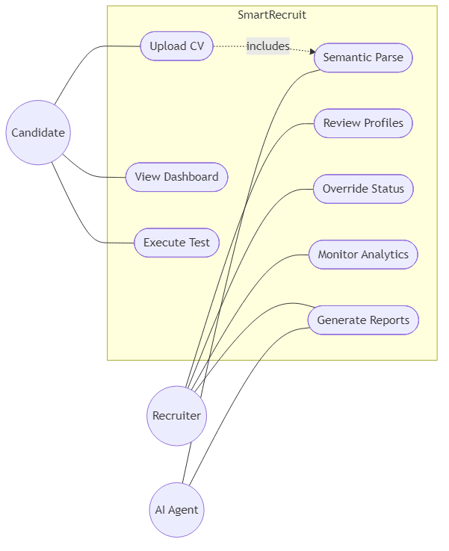
06
Use Case Diagram
33 use cases across 3 actors: Candidate, Recruiter, Admin

Slide 8
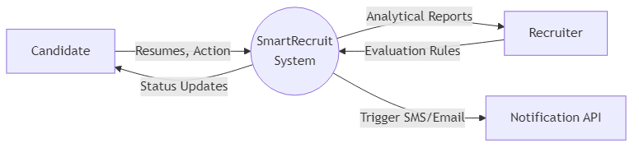
07
Data Flow Diagram — Level 0 (Context)
System boundary with all 6 external entities

Slide 9
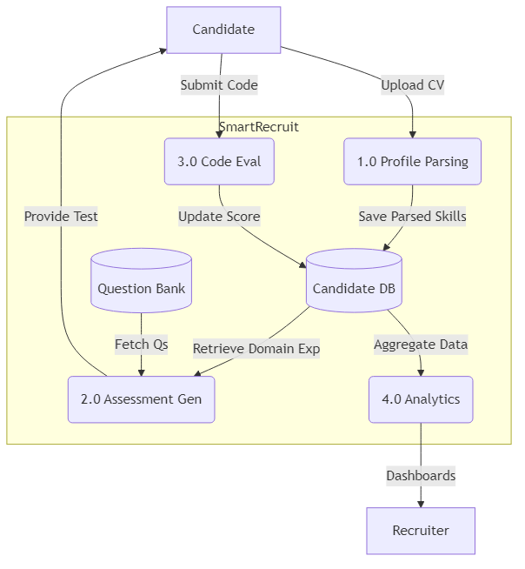
08
Data Flow Diagram — Level 1 (Processes)
7 major sub-processes and 7 data stores

Slide 10
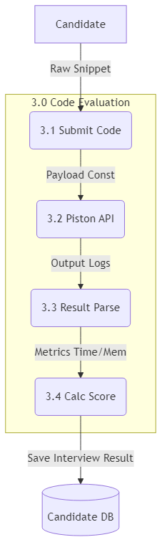
09
DFD Level 2 — Resume Intelligence Deep-Dive
From PDF upload → multilingual detect → embed → score → shortlist/reject

Slide 11
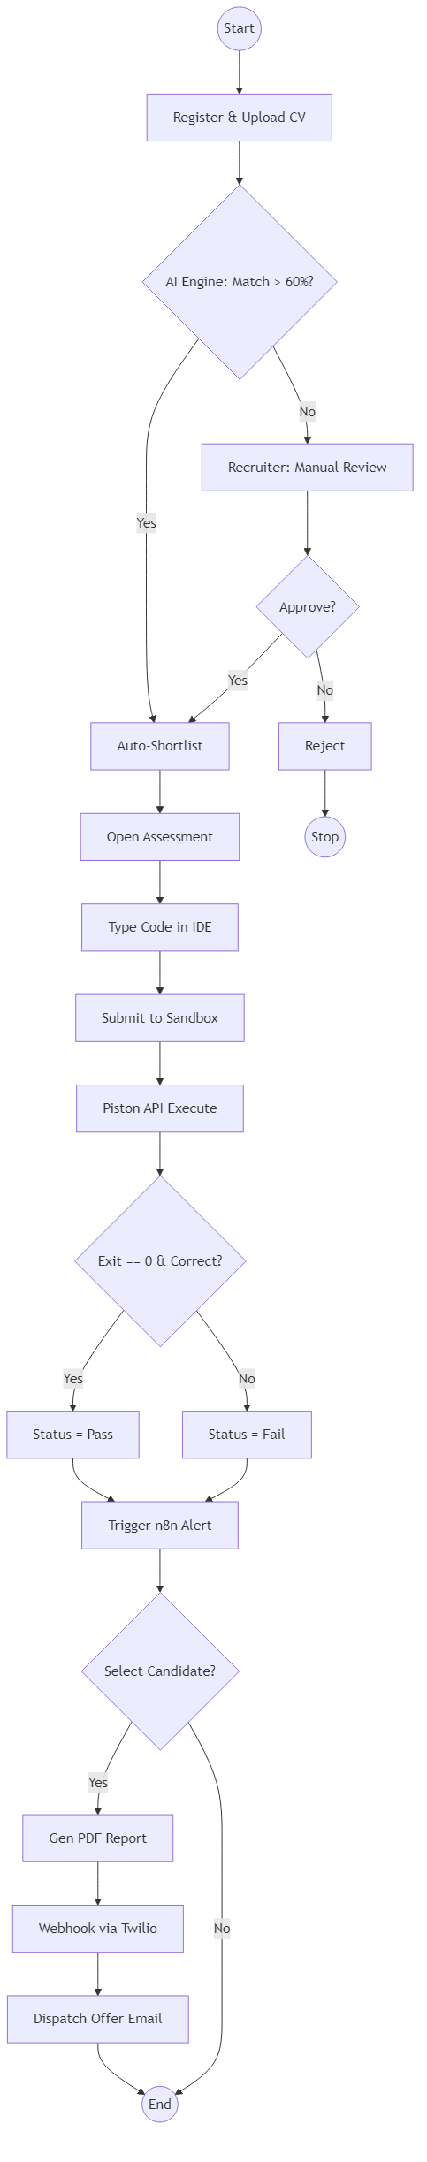
10
Activity Diagram — Full Hiring Pipeline
4-round elimination with all decision gates and email triggers

Slide 12
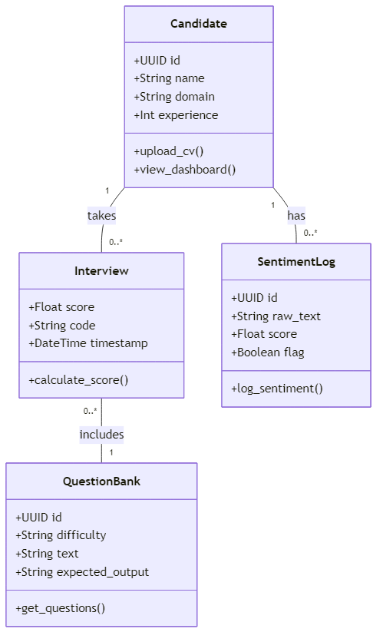
11
Class Diagram — Core Data Models
9 core classes with attributes, methods, and multiplicities

Slide 13
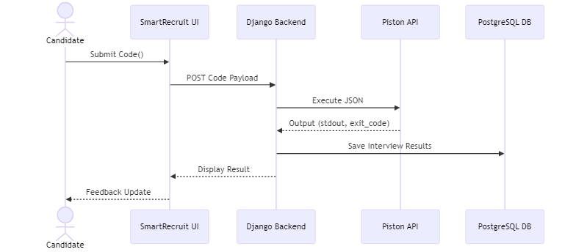
12
Sequence Diagram — End-to-End Hiring Flow
Apply → Parse → Assess → Interview → Offer → Onboard — with async email & AI calls

Slide 14
13
Database Design: 35+ Models
User
[core]
JobPosting
[jobs]
Candidate
[jobs]
Custom auth model with role flags
Full JD with round config
Profile + AI-enriched fields
Application
[jobs]
Assessment
[jobs]
Interview
[jobs]
22-status pipeline state machine
R1/R2 results + JSON details
AI session data + code + scores
Offer
[jobs]
SentimentLog
[jobs]
Notification
[jobs]
Salary, joining date, PDF link
Per-frame emotion, proctoring flags
In-app bell notifications
NegotiationSession
[jobs]
CodingChallenge
[jobs]
OnboardingRoadmap
[jobs]
AI salary negotiation chat
XP, test cases, multi-language
30-60-90 day AI plan

Slide 15
14
Security Architecture
🔐 JWT Authentication
🛡️ CSRF Protection
15-min expiry access tokens + refresh
Built-in Django middleware on all forms
💉 SQL Injection
🔒 HTTPS Enforced
ORM only — zero raw SQL strings
HSTS max-age 1 year + SSL redirect
🎭 Blind Hiring
📸 Proctoring
Toggle masks candidate name/photo
Face detection, tab-switch, flag system
⛓️ Blockchain
📁 File Safety
SHA-256 credential verification
MIME + extension whitelist, 5 MB cap

Slide 16
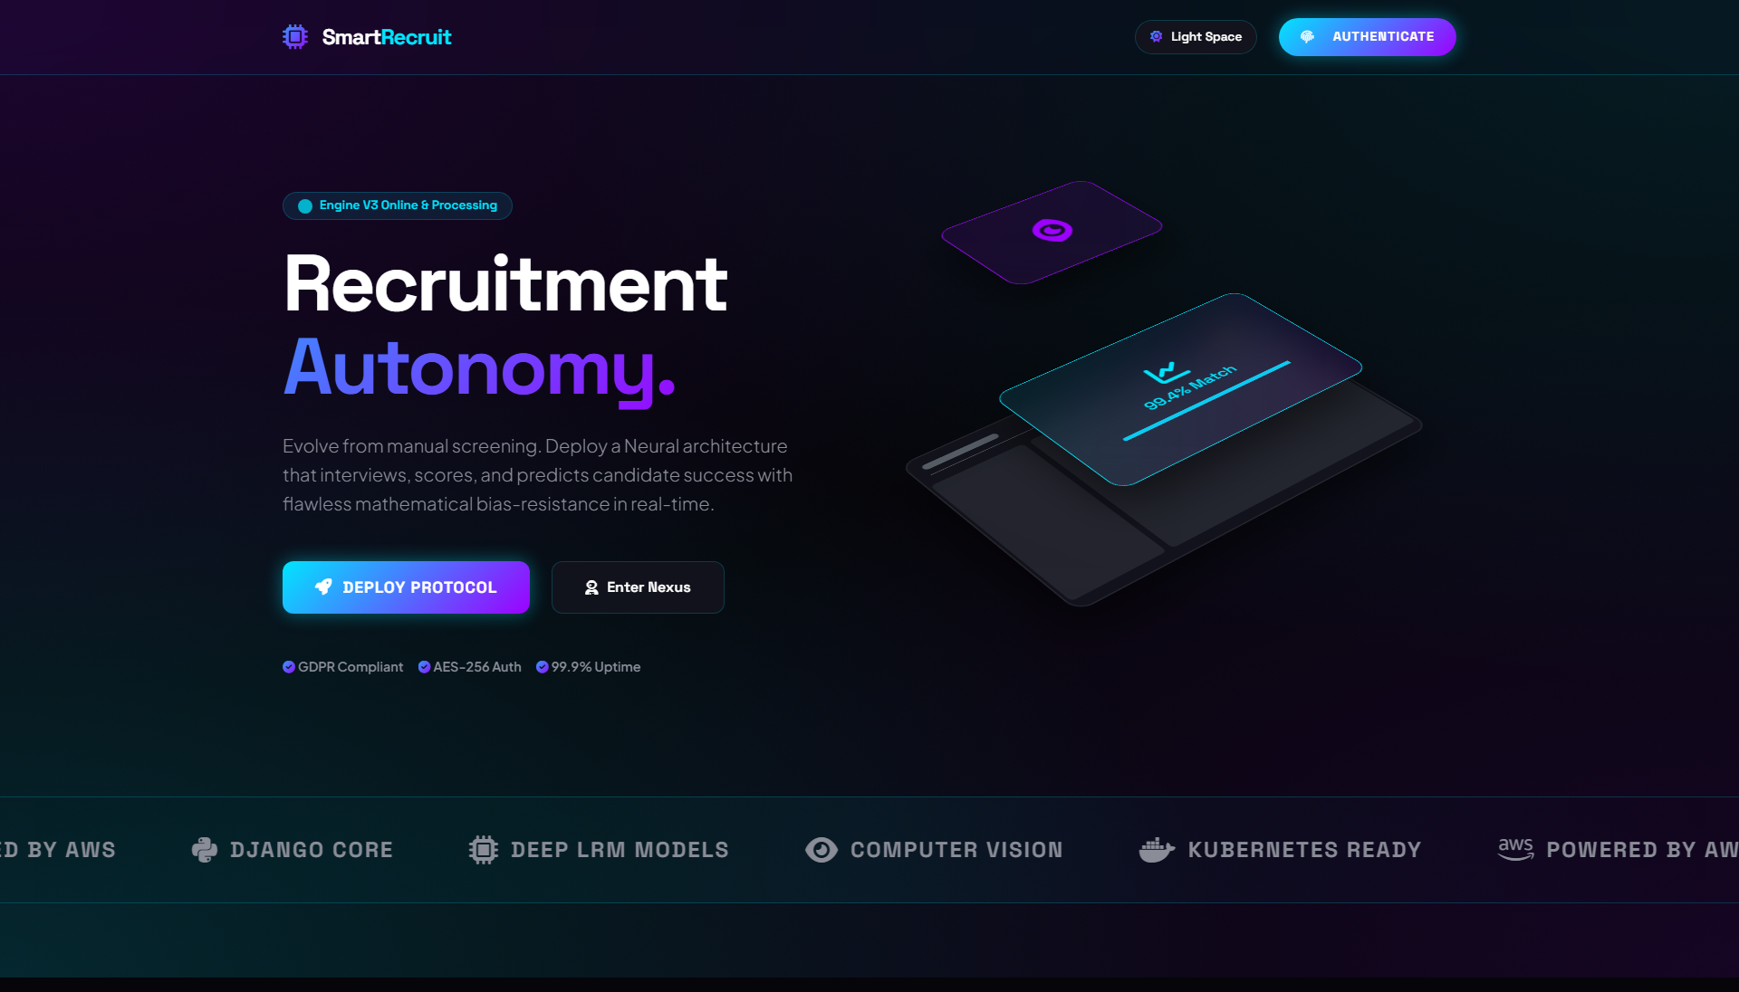
15
System UI: Landing Page
Premium glassmorphism design with Dark / Light theme switching

Slide 17
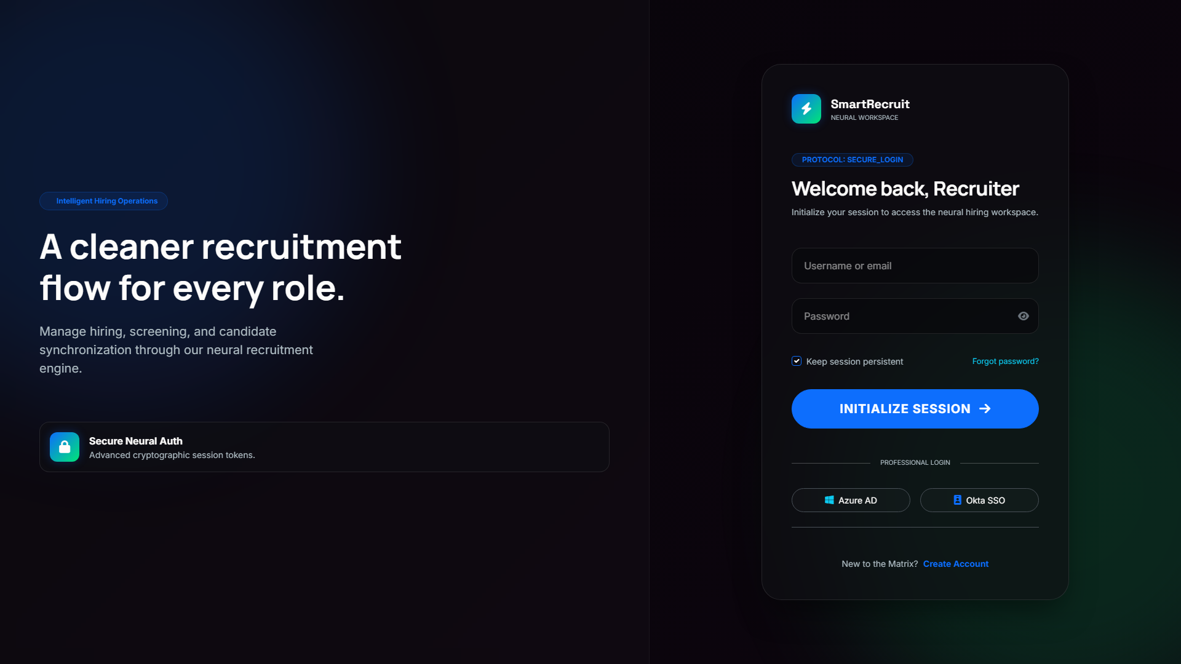
16
System UI: Neural Job Matrix
AI match scores, advanced filters, pagination — candidate-facing job board

Slide 18
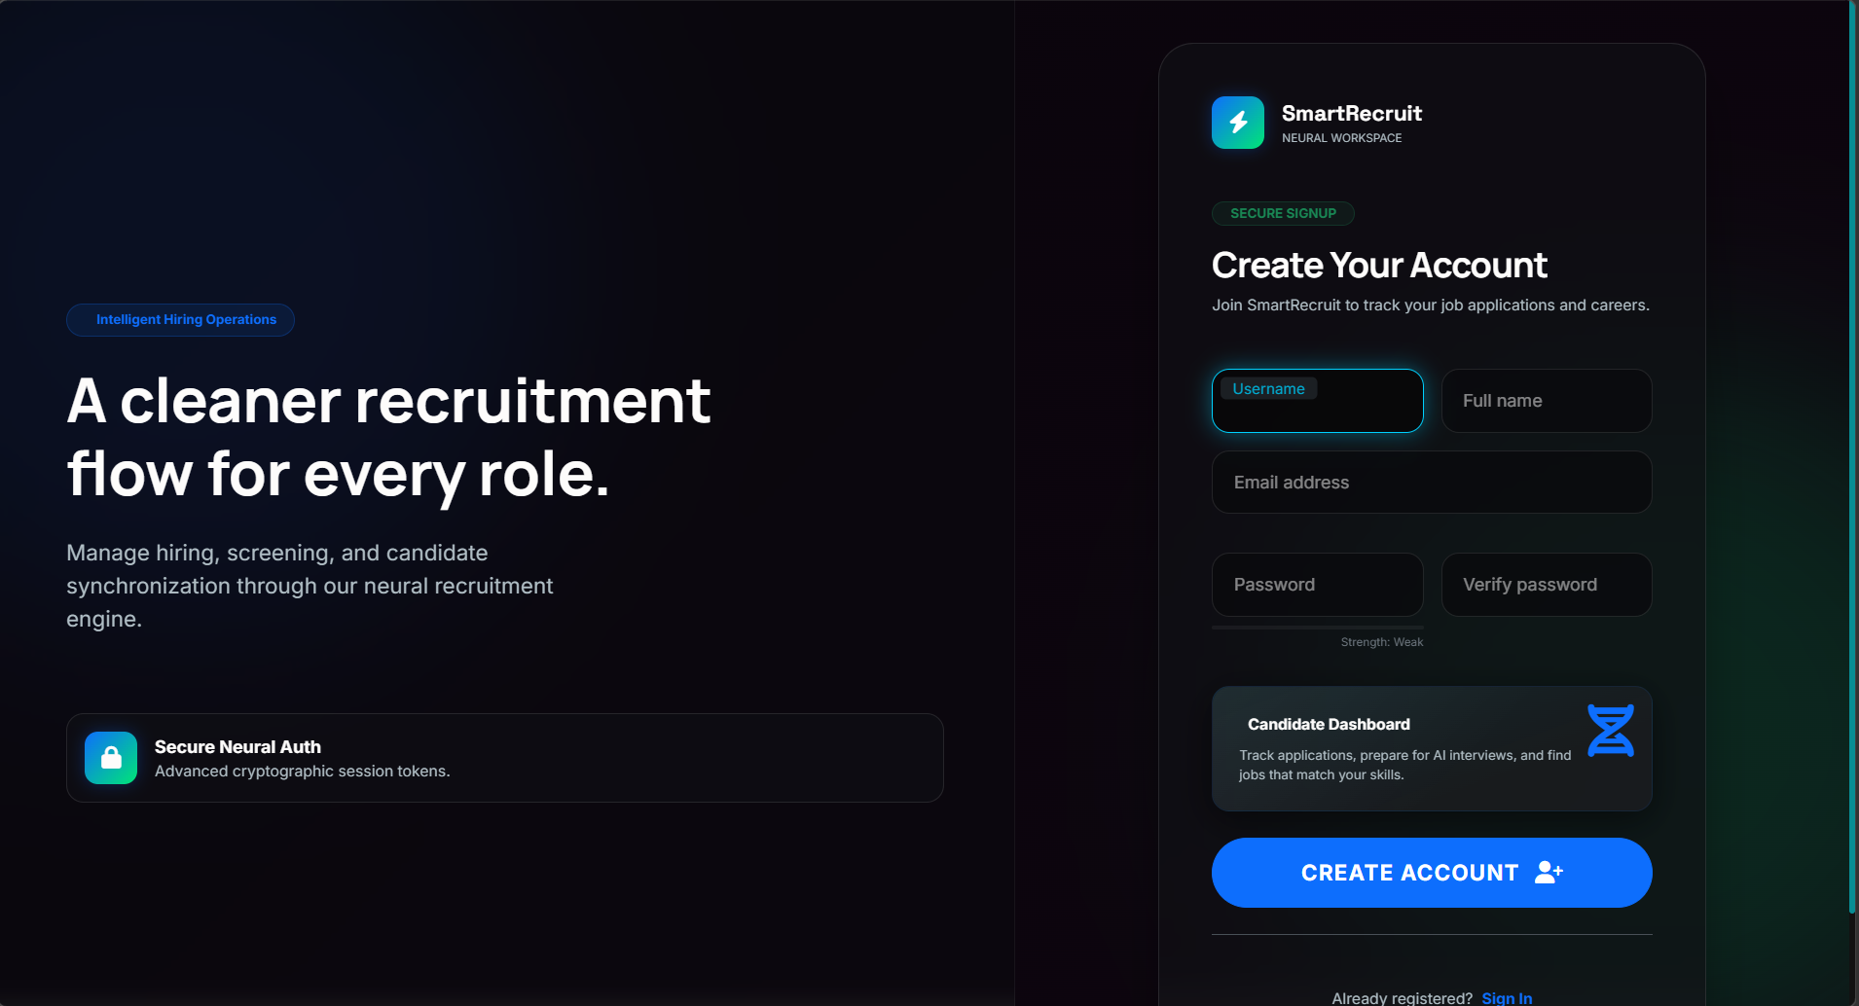
17
System UI: Candidate Registration

Slide 19
18
Key Achievements
✅ 0 Django Errors — python manage.py check — 0 issues silenced
✅ 35+ Data Models — Complete hiring pipeline state machine
✅ 3-Engine AI — Gemini → Groq → HuggingFace graceful fallback
✅ Multi-lingual — 30+ languages via multilingual embeddings
✅ Real-time — WebSocket proctoring, live interview, chat
✅ PWA Ready — Offline cache, install prompt, service worker
✅ SSO Enterprise — Azure AD + Okta SAML + JWT
✅ Blockchain — Credential tamper-proof verification
✅ Dark + Light — Full dual-theme CSS system (4000+ lines)
✅ Auto Emails — Branded HTML emails via async threading

Slide 20
19
Future Scope
▸ LinkedIn / Naukri / Indeed auto job syndication
▸ 3D face liveness detection (anti-spoofing proctoring)
▸ RL-based question difficulty adaptation per candidate
▸ Multi-tenant SaaS white-labelling for enterprises
▸ Predictive HR analytics with regression ML models
▸ GDPR right-to-erasure automation and data anonymization

Slide 21
20
Conclusion
SmartRecruit successfully demonstrates that Artificial Intelligence can be applied end-to-end across the complete talent acquisition lifecycle — from resume parsing to onboarding roadmap generation. The platform reduces time-to-shortlist from days to seconds, eliminates human bias from the screening process, and delivers a world-class, data-driven experience to both candidates and recruiters. With a three-tier zero-downtime AI engine, 4-round automated evaluation pipeline, and enterprise-grade security — SmartRecruit is production-ready.

Slide 22
Thank You
SmartRecruit AI Recruitment Platform
Questions & Discussion

