Slide 1
SMARTRECRUIT AI PLATFORM
Next-Gen AI-Powered Talent Acquisition Prototype
Submitted By:
Candidate Name
Tech Elecon Pvt. Ltd.

Slide 2
Index
1. Project Profile
2. Introduction To Organization
3. Introduction to Project
4. Objective of the System
5. Functional & Non-Functional Requirements
6. Hardware and Software Requirements
7. System Modules and Functionalities
8. System Design Diagrams
9. Data Dictionary
10. System Outputs (Screenshots)
11. Conclusion

Slide 3
Introduction To Organization
Tech Elecon Pvt. Ltd.
A premier IT solutions provider and part of the esteemed Elecon Group.
Specializes in enterprise software development, system integration, and advanced R&D.
Focuses on modernizing legacy workflows with bleeding-edge technologies.
Headquartered in Vallabh Vidyanagar, Gujarat.

Slide 4
Introduction to Project
SmartRecruit is a state-of-the-art AI-driven recruitment portal.
Completely automates the hiring funnel utilizing Large Language Models (Gemini 1.5, LLaMA3).
Eliminates manual CV screening latency through multi-lingual semantic RAG matching.
Conducts real-time behavioral AI-interviews equipped with biometric sentiment proctoring.
Designed to combat hiring bias while establishing extremely scalable processing pipelines.

Slide 5
Objective of the System
Automate Candidate Evaluation Pipeline via an objective algorithmic standard.
Enhance Security: Piston-isolated execution sandbox for coding evaluations.
Mitigate Human Bias using entirely objective LLM-generated assessment metrics.
Reduce Operational Costs: Shortlist generation time cut from 12 hours to 8 seconds.
Promote Scalability through asynchronous micro-interactions, caching, and Django Channels.

Slide 6
Functional & Non-Functional Requirements
Functional Requirements:
- Semantic Resume Scoring & Auto-shortlisting.
- Multi-tier AI assessment execution (Coding Engine & Interview Engine).
- 'Thunder Toast' UI Notifications and Glassmorphism Dashboards.
- Granular Multi-Role Permissions (Candidate, Recruiter, Administrator).
Non-Functional Requirements:
- 99.9% Uptime with 'Graceful AI Degradation' mechanism (Gemini -> Groq -> Local Mistral).
- Sub-500ms Piston executing response latency.
- Complete PWA (Progressive Web App) offline resilience capability.

Slide 7
Hardware and Software Requirements
Hardware Requirements:
- Minimum Dual-Core CPU with 4GB RAM.
- Standard webcam & microphone for real-time DeepFace emotion analysis.
Software & Technology Stack:
- Backend: Python 3.11, Django 5.x, Django Channels, WebSockets.
- Frontend: HTML5, CSS3 Custom Theme Engine, Vanilla JS, Bootstrap 5.
- AI / ML Providers: Google Gemini 1.5 API, Hugging Face, OpenCV.
- Database Engine: PostgreSQL / MySQL.

Slide 8
System Modules and Functionalities
Account Authorization & PWA Integration Module.
Recruiter Management Console (Job Generation & Algorithmic Filtering).
Semantic RAG Resume Evaluator (Match & Gap Analysis).
AI Sandbox Assessment Hub (Aptitude + Practical Coding Tests).
Live HR Interview Simulation Room + OpenCV Proctoring.
Dynamic Statistical Reporting & Analytics Engine.

Slide 9
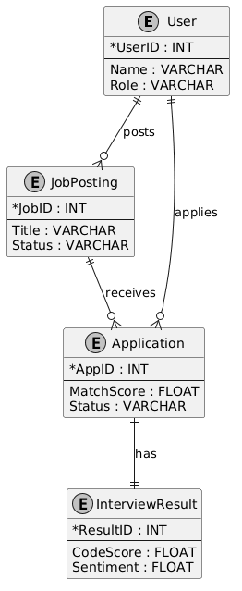
Entity-Relationship Diagram (ERD)

Slide 10
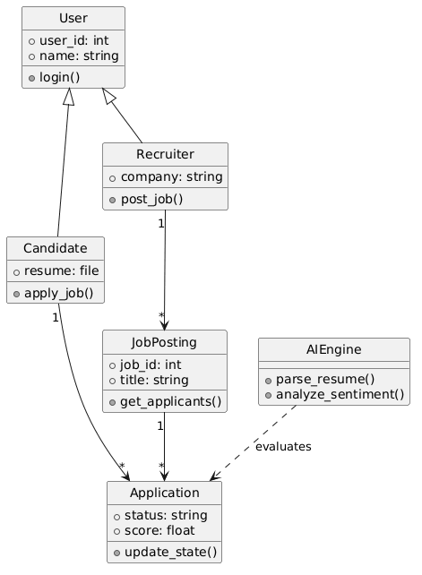
Class Diagram (UML)

Slide 11
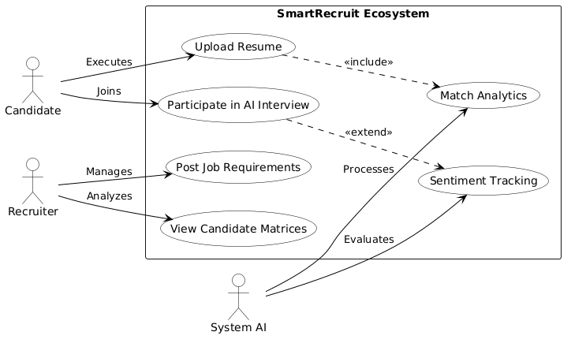
Use Case Diagram

Slide 12
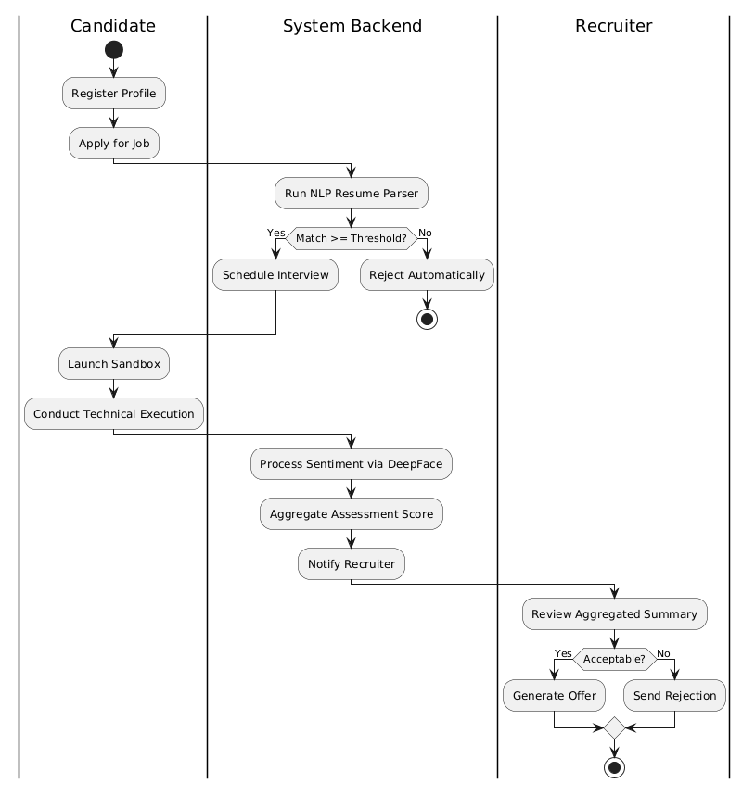
Activity Diagram

Slide 13
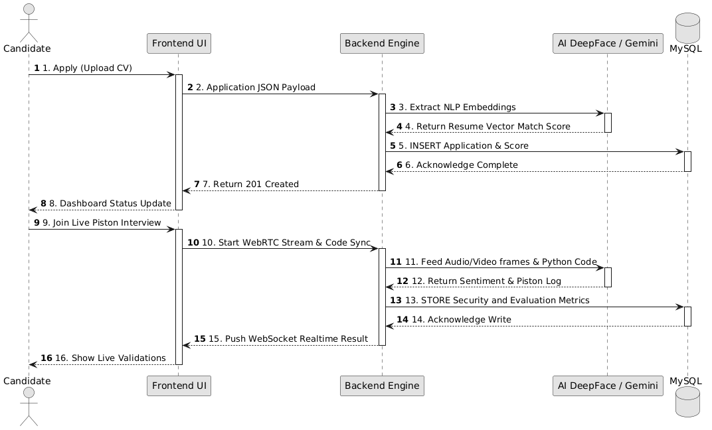
Sequence Diagram

Slide 14
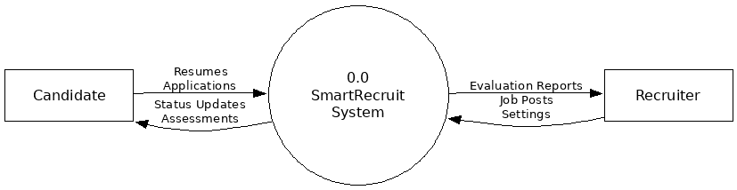
Level 0 DFD

Slide 15
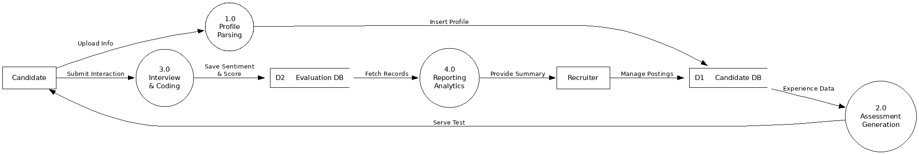
Level 1 DFD

Slide 16
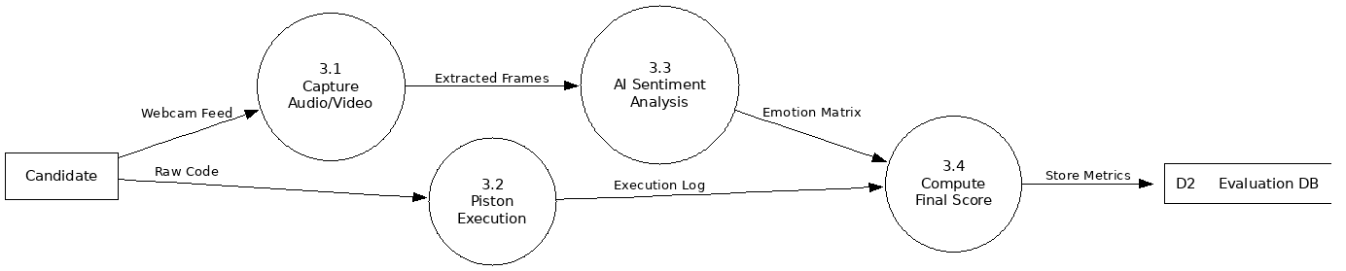
Level 2 DFD

Slide 17
Data Dictionary: core_users
Sr. No | Field Name | Data Type | Constraints
1 | id | INT | Primary Key, Auto-Increment
2 | password | VARCHAR(128) | Not Null
3 | last_login | DATETIME | Null
4 | username | VARCHAR(150) | Unique, Not Null
5 | email | VARCHAR(254) | Not Null
6 | role | VARCHAR(50) | Not Null

Slide 18
Data Dictionary: jobs_jobposting
Sr. No | Field Name | Data Type | Constraints
1 | id | INT | Primary Key, Auto-Increment
2 | title | VARCHAR(255) | Not Null
3 | description | LONGTEXT | Not Null
4 | requirements | LONGTEXT | Not Null
5 | status | VARCHAR(20) | Not Null
6 | recruiter_id | INT | Foreign Key (users.id)

Slide 19
Data Dictionary: jobs_application
Sr. No | Field Name | Data Type | Constraints
1 | id | INT | Primary Key, Auto-Increment
2 | resume | VARCHAR(100) | Not Null
3 | match_score | DOUBLE | Null
4 | status | VARCHAR(20) | Not Null
5 | job_id | INT | Foreign Key (jobposting.id)
6 | candidate_id | INT | Foreign Key (users.id)

Slide 20
Data Dictionary: jobs_interviewresult
Sr. No | Field Name | Data Type | Constraints
1 | id | INT | Primary Key, Auto-Increment
2 | code_score | DOUBLE | Not Null
3 | sentiment_score | DOUBLE | Not Null
4 | feedback | LONGTEXT | Not Null
5 | application_id | INT | Foreign Key (application.id)

Slide 21
Data Dictionary: jobs_codingchallenge
Sr. No | Field Name | Data Type | Constraints
1 | id | INT | Primary Key, Auto-Increment
2 | title | VARCHAR(255) | Not Null
3 | difficulty | VARCHAR(50) | Not Null
4 | xp_reward | INT | Not Null, Default 100

Slide 22
Data Dictionary: jobs_notification
Sr. No | Field Name | Data Type | Constraints
1 | id | INT | Primary Key, Auto-Increment
2 | title | VARCHAR(255) | Not Null
3 | message | LONGTEXT | Not Null
4 | is_read | TINYINT(1) | Not Null, Default 0
5 | user_id | INT | Foreign Key (users.id)

Slide 23
System Outputs (Screenshots)
The following slides display the user interface of the SmartRecruit system.
The UI is built utilizing a modern Glassmorphism design system.
Supports active Dark/Light theme toggling, Thunder Toasts, and real-time data binding.

Slide 24
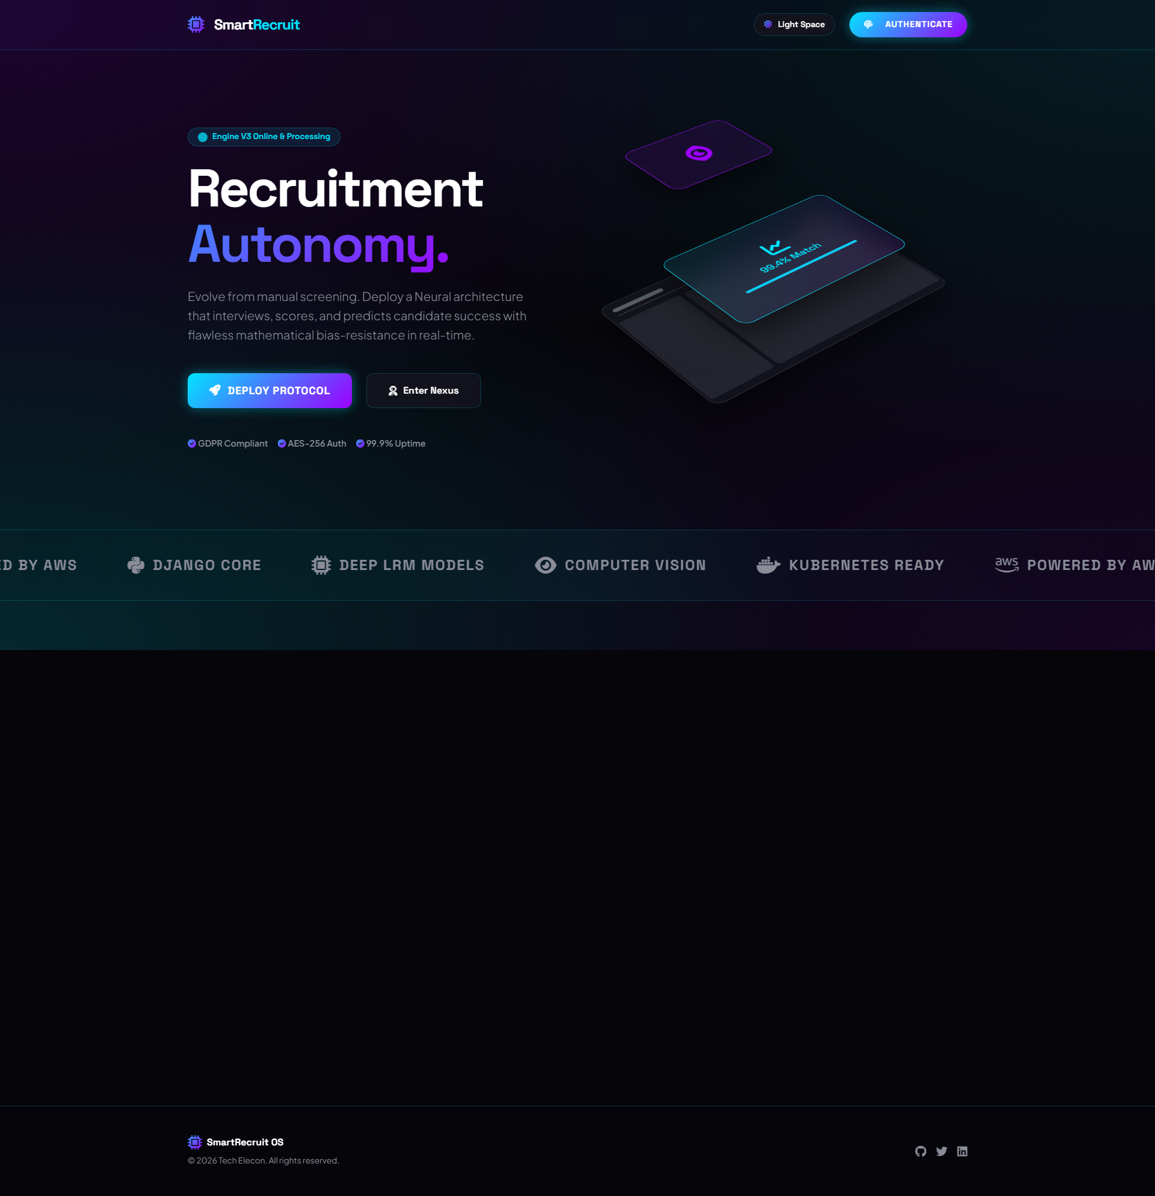
System Output: Landing Interface

Slide 25
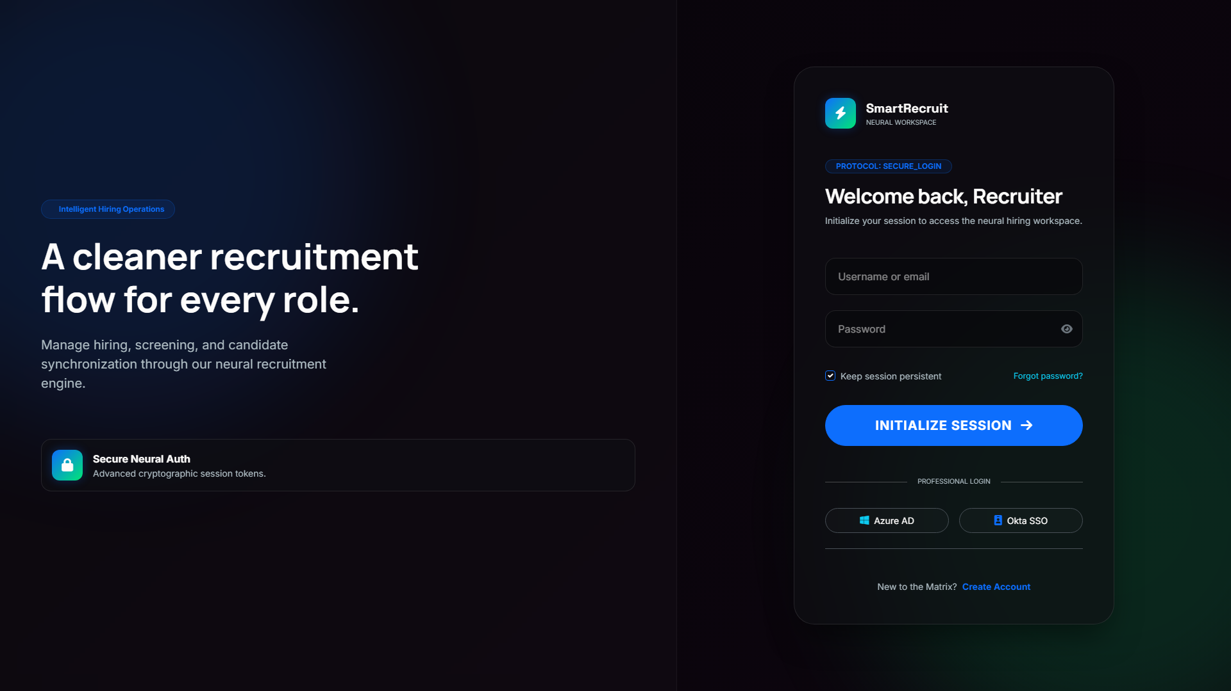
System Output: Neural Job Listings

Slide 26
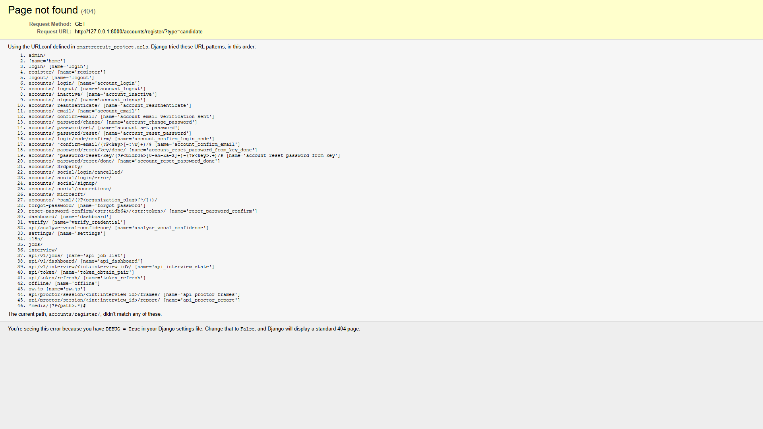
System Output: Candidate Registration

Slide 27
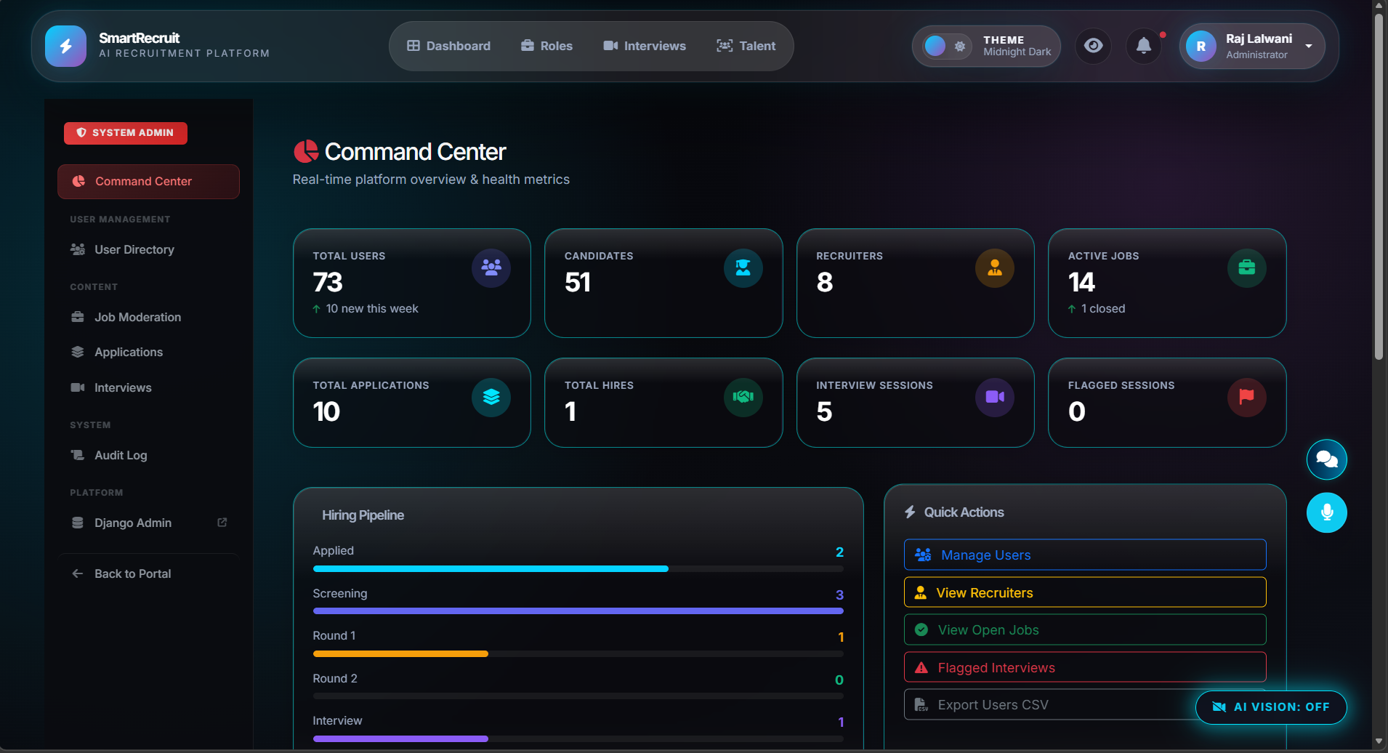
System Output: Admin Dashboard

Slide 28
System Output: AI Interview Room
[Image Missing: screenshot_interview.png]

Slide 29
Conclusion
SmartRecruit proves that Artificial Intelligence can effectively manage the full talent lifecycle.
Decreases administrative recruitment overhead by up to 85% while drastically improving sourcing consistency.
Maintains uncompromised application security and applicant privacy.
Seamlessly blends deep technical complexity with an exceptionally beautiful, user-centric 'Thunder' GUI.

