Slide 1


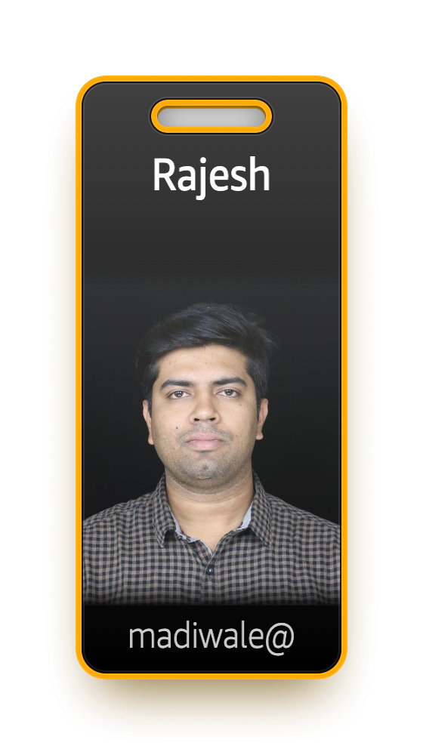
PgConf-India
05/03/2025
Database Schema Changes
with
Minimal/No-Downtime
B HariKrishana
Sr-Lead Consultant
Rajesh Madiwale
Lead Consultant

Slide 2
Agenda
Introduction
Why schema changes are required
Risk involved in schema changes
Mitigations
Considerations during schema changes
Live demo
Best practices
Conclusion
Q&A

Slide 3
Agenda and session details
Topic | Time
Introductions of Trainers & Attendees | 9:00 AM to 9:10 AM
Introduction and Objective of training | 9:10 AM to 9:20 AM
Why Schema changes are required, scenarios and Mitigations | 9:20 AM to 10:45 AM
Break for 15 Mins
Tools with best practices, Demo | 11:00 AM to 12:10 PM
Conclusion & Key Takeaways | 12:10 PM to 12:20 PM
Quiz | 12:20 PM to 12:30 PM
Notes:
1

Slide 4
Key Takeaways
Critical Best Practices
Always test migrations in staging first
Perform changes during low-traffic periods
Break large changes into smaller batches
Have a tested rollback plan ready
Monitor system performance throughout
Backup before major changes
Essential Techniques
-- Use concurrent operations when possible
CREATE INDEX CONCURRENTLY idx_name ON tabtable_name (column);
-- Batch large operations
DO $$
BEGIN
FOR i IN 1..10 LOOP
UPDATE table_name
SET column = value
WHERE id BETWEEN (i-1)*1000 + 1 AND i*1000;
COMMIT;
END LOOP;
END $$;

Slide 5
Key Takeaways – Contd..
Zero-Downtime Migration Pattern
-- 1. Create new table
CREATE TABLE new_table (LIKE original_table);
-- 2. Add new structure
ALTER TABLE new_table ADD COLUMN new_col type;
-- 3. Copy data incrementally
INSERT INTO new_table
SELECT *, default_value
FROM original_table
WHERE id BETWEEN x AND y;
-- 4. Switch tables
BEGIN;
ALTER TABLE original_table RENAME TO table_old;
ALTER TABLE new_table RENAME TO original_table;
COMMIT;
Critical Monitoring Points
-- Check lock queues
SELECT relation::regclass, mode, granted FROM pg_locks WHERE relation IN (SELECT oid FROM pg_class WHERE relname = 'table_name'); -- Monitor progress SELECT phase, blocks_done, blocks_total FROM pg_stat_progress_alter_table;
Monitor progress
SELECT phase, blocks_done, blocks_total FROM pg_stat_progress_alter_table;

Slide 6
Key Takeaways – Contd..
Risk Mitigation Checklist
Verify disk space availability
Check replication lag
Monitor transaction wraparound
Watch for connection pile-ups
Track query performance
Observe lock queues
Performance Considerations
Key configuration parameters
maintenance_work_mem = 256MB
statement_timeout = 3600000 # 1 hour
lock_timeout = 60000 # 1 minute
Emergency Response Plan
Have cancel/terminate commands ready
Maintain old structures until verified
Monitor application error rates
Keep rollback scripts prepared
Remember: The goal is to balance minimal disruption with data integrity and system stability.

Slide 7
Quiz Time

Slide 8
Questions
Thank you

