Slide 1
Access Modifiers

Slide 2
Last Topic
OOP Inheritance.

Slide 3
Access Modifiers
The visibility of a property, a method or a constant can be defined by prefixing the declaration with the access modifiers.
It allows you to control where your class members can be accessed from, for instance to prevent a certain variable to be modified from outside the class.

Slide 4


Types of Access Modifiers
Access Modifier | Class Level | Function Level | Variable Level
Public
Protected
Private
Abstract
Final
Static

Slide 5
Types of Access Modifiers
Public - It can be accessed from everywhere.
Private - It can only be accessed within the class.
Protected - It can be accessed by the class declared it and by the classes that inherit the above declared class.

Slide 6


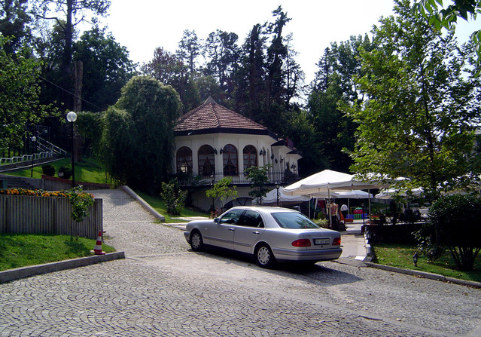
Example
Public Public Parking Slot. | Protected Protected Parking Slot | Private Private Parking Slot

Slide 7
Why Access Modifiers?
There are two reasons.
To validate and restrict data.
To keep private things private.

Slide 8
What we have learnt?
OOP Access Modifiers.

Slide 9
Next Topic
OOP Abstract Class.

