Slide 1
Advanced PHP

Slide 2
Object Oriented Programming Structure (OOPS)

Slide 3

What is Programming?
“Instruct the computer to perform various tasks.”

Slide 4
Programming Methods
Procedure Oriented Programming (POP).
Object Oriented Programming (OOP).

Slide 5
OOP vs. POP
Parameters | Object Oriented Programming (OOP) | Procedure Oriented Programming (POP)
Problem Solving | Importance is given to objects. | Importance is given to functions or procedures.
Approach | It follows bottom up approach. | It follows top down approach.
Code Reusability | The existing code can be reused by the feature called inheritance. | There is no such feature.

Slide 6
OOP vs. POP
Data Hiding | The data is kept secure in class using access specifiers private and protected. | The data is less secure as this pattern doesn’t provide any way to hide it.
Modification | Addition and modifications of new feature(s) is easier. | Addition and modifications of new feature(s) is difficult.
Problem Size | It is suitable for solving huge problems. | It is not suitable for solving huge problems.
Example | PHP, C++, Java and Python. | C, Fortran and Pascal.

Slide 7

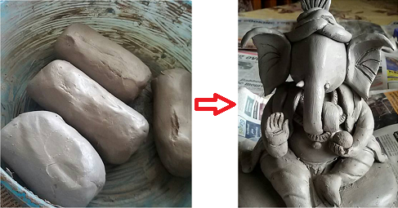
OOP vs. POP
Object oriented programming (OOP) | Procedure oriented programming (POP)

Slide 8
What we have learnt?
Advanced PHP introduction.
POP vs OOP.

Slide 9
Next Topic
OOP Introduction.

