Slide 1
Python
Introduction, start application development & Examples

Slide 2
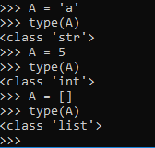
What is python?
High level , interpreted programming language.
Interpreted language : Each programming statement is translated into sequence of one or more executable instructions (machine instructions) in runtime.
other interpreted languages : Matlab, perl, JavaScript ., etc
Advantages :
  No compilation time required – quick prototyping.
  Dynamic typing (Type declarations not required)
  so assign any data type to any variable without any problem.

Slide 3
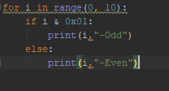
Continue..
Advantages
  3. Python has syntax that allows developers to write programs with fewer lines than other programming languages
  4.Python uses new lines to complete a command, as opposed to other programming languages which often use semicolons or parentheses.
  5. Python relies on indentation, using whitespace, to define scope; such as the scope of loops, functions and classes. Other programming languages often use curly-brackets for this purpose.
  6. Platform independent, runs on
  Windows, Mac, Linux, Raspberry Pi, etc

Slide 4
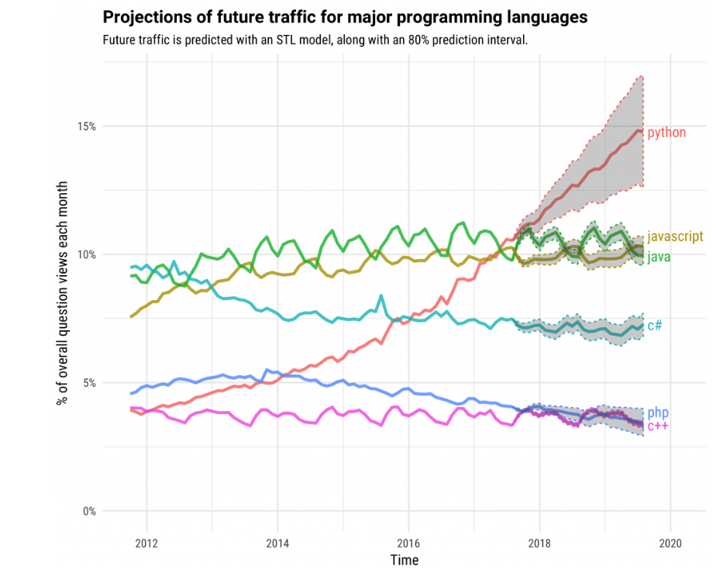
Why python?

Slide 5
Continue..
Applications:
  Artificial intelligence – Chatbots are build using NLTK library of python, Tensorflow libraries for face, voice recognition.
  Web Frameworks and web applications – Django, Pyramid, Web2py ., etc
  GUI-Based Desktop applications – PyQt, tinkter, kivy ., etc
  Graphics – Matplotlib, Plotly, Bokeh.. etc
  Libraries for scientific applications – Numpy, SciPy. etc

Slide 6
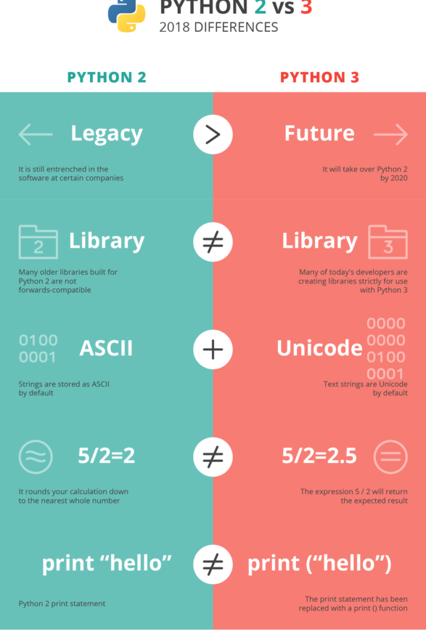
Getting started
Decide python interpreters Python2 (Base version in 2000) / Python 3 (Base version in 2008).
Python2 will retire on January 1 2020, - not recommended to start with now. – no official support 2020 onwards.
Download python interpreter from:
https://www.python.org/downloads/

Slide 7
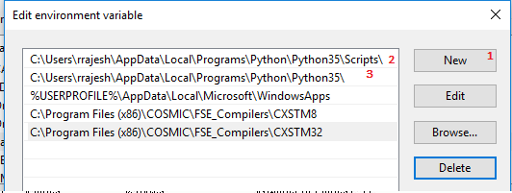
Continue..
Install the downloaded executable, add python installation paths to environmental variable – PATH.
Installation paths:
  C:\Users\you\AppData\Local\Programs\Python\Python35
  C:\Users\you\AppData\Local\Programs\Python\Python35\Scripts

Slide 8
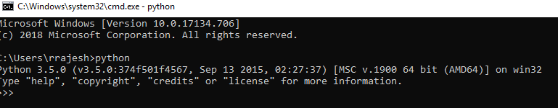
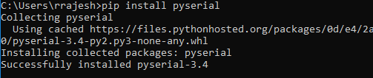
Continue..
Check if installation is ok. – Type “Python” in command prompt
Installing any python library required. - > pip install library_name

Slide 9
Continue..
Default python IDE with the interpreter – IDLE.
Other python supportive IDEs – Pycharm, Atom, visual studio ., etc
Pycharm download:
https://www.jetbrains.com/pycharm/download
To do:
Execute python statements in .py file / in command prompt.
Setup project in Pycharm.

Slide 10
Strings in python
‘string’ / “string”
String concatenation:
concatenated string = string1 + string2
Example :
string1 = “Elon”
string2 = “Musk”
string = string1 + “ “ + string2
print(string)
>> “Elon Musk”

Slide 11
String methods
s.lower(), s.upper() -- returns the lowercase or uppercase version of the string
s.strip() -- returns a string with whitespace removed from the start and end
s.isalpha()/s.isdigit()/s.isspace()... -- tests if all the string chars are in the various character classes
s.startswith('other'), s.endswith('other') -- tests if the string starts or ends with the given other string
s.find('other') -- searches for the given other string (not a regular expression) within s, and returns the first index where it begins or -1 if not found
s.replace('old', 'new') -- returns a string where all occurrences of 'old' have been replaced by 'new'
s.split('delim') -- returns a list of substrings separated by the given delimiter. The delimiter is not a regular expression, it's just text. 'aaa,bbb,ccc'.split(',') -> ['aaa', 'bbb', 'ccc']. As a convenient special case s.split() (with no arguments) splits on all whitespace chars.
s.join(list) -- opposite of split(), joins the elements in the given list together using the string as the delimiter. e.g. '---'.join(['aaa', 'bbb', 'ccc']) -> aaa---bbb---ccc

Slide 12

Lists in python – []
A list can contain any data type.
Example : my_list = [1, “uranium”, 5.6, ‘R’, True]
List assignment: A list assigned to another list shares same memory.
Example:
A = [1, 2, 3]
B = A
B[1] = ‘R’
print(A)
>[1, ‘R’, 3]

Slide 13
List methods
list.append(elem) -- adds a single element to the end of the list. Common error: does not return the new list, just modifies the original.
list.insert(index, elem) -- inserts the element at the given index, shifting elements to the right.
list.extend(list2) adds the elements in list2 to the end of the list. Using + or += on a list is similar to using extend().
list.index(elem) -- searches for the given element from the start of the list and returns its index. Throws a ValueError if the element does not appear (use "in" to check without a ValueError).
list.remove(elem) -- searches for the first instance of the given element and removes it (throws ValueError if not present)
list.sort() -- sorts the list in place (does not return it). (The sorted() function shown later is preferred.)
list.reverse() -- reverses the list in place (does not return it)
list.pop(index) -- removes and returns the element at the given index. Returns the rightmost element if index is omitted (roughly the opposite of append()).

Slide 14
Google’s python exercise to learn python coding
Reference :https://developers.google.com/edu/python/
Download google’s python exercise workspace:
https://developers.google.com/edu/python/google-python-exercises.zip

Slide 15
Download and install PyQt5 (for python3.5) designer:
https://sourceforge.net/projects/pyqt/files/PyQt5/PyQt-5.6/PyQt5-5.6-gpl-Py3.5-Qt5.6.0-x64-2.exe/download
Install PyQt5 packages using command prompt:
>pip install pyqt5
ToDo:
Exercise : Button press counter.

Slide 16
PyQt designer
PyQt desiner is used to build the user interface of the application.
The output file format of the designed user interface is “.ui”.
The user interface shall be converted to python file “.py”:
>pyuic5 –x user_interface.ui –o main.py
The converted main.py shall be written with required backend logic for the user interface events.

Slide 17
Image Steganography
Steganography is the practice of concealing a file, message, image, or video within another file, message, image, or video.

Slide 18
Thank you

