Slide 1
E - Commerce Purchase Data Analysis
M. Tech. – DSML → Team 7
Date: 2nd Sep 2020
NPV – Project Presentation
PRAVEEN MANOHAR G
RAHUL A
RAJESH RAMACHANDER
RANJITH GNANA SUTHAKAR ALPHONSE RAJ
YASHASWI GURUMURTHY

Slide 2
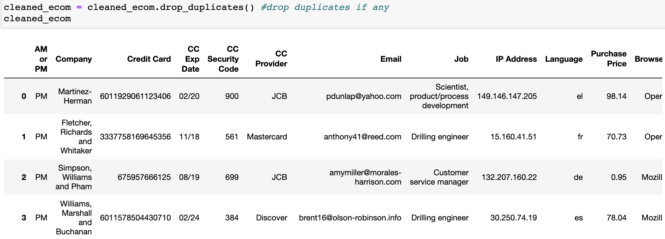
Project Overview & Process
Dataset Provided: E-Commerce purchase data with Purchaser and Purchase details
The dataset was cleaned and transformed
Analysis Objective:
Characterize customer purchases from the E-commerce purchase data to identify patterns or trends for related insights
Analysis Steps/ Approach:
Initial exploration of the dataset
Interpreting and transforming the dataset
Impute the data
Identify 5 key questions to be answered from the data
Exploring and Analysing the data
E - Commerce Purchase Data Analysis – Team 7

Slide 3
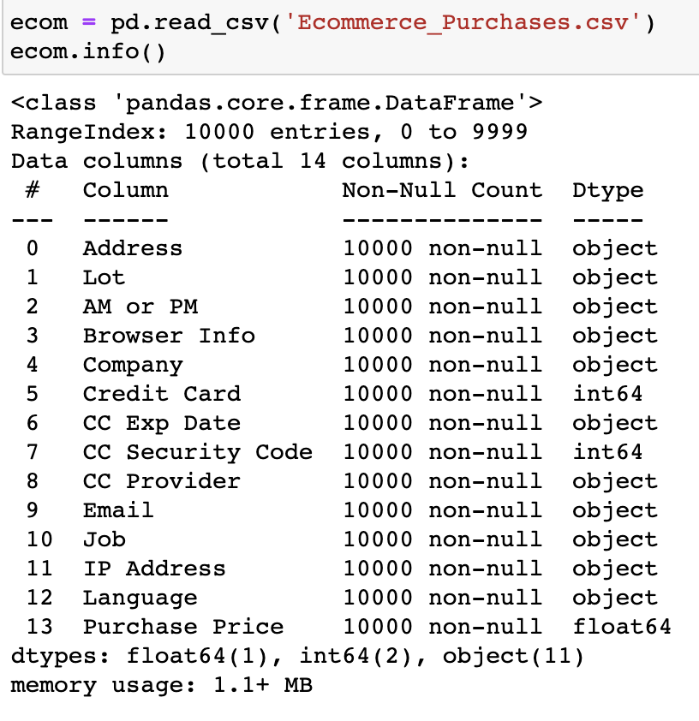
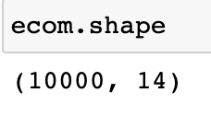
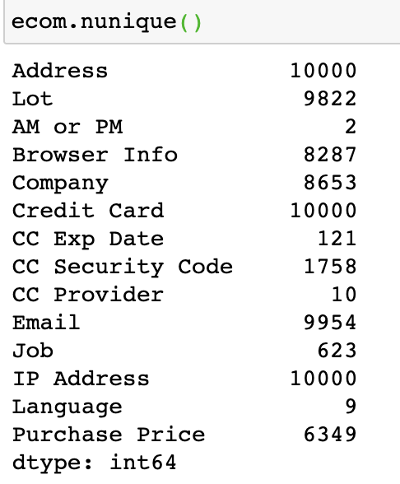
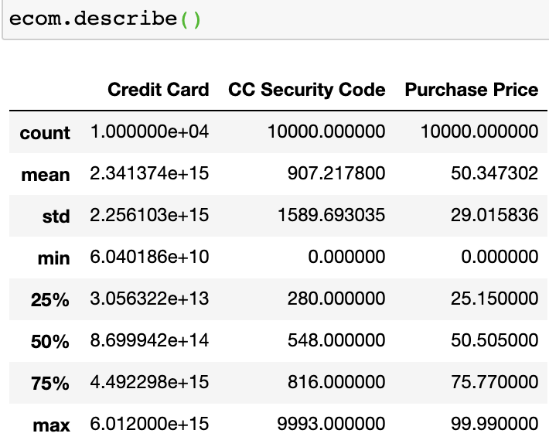
Initial Exploration Of The Dataset
E-Commerce purchase data with Purchaser and Purchase details
Data overview:
Shape:
Rows → 10000
Columns → 14
Data types:
Categorical → 12
Numerical → 3
‘Credit Card’ & ‘CC Security Code’ are NOT usable as Numerical
NO null values present
Count of unique data points per column:
Description of Numerical variables:
E - Commerce Purchase Data Analysis – Team 7

Slide 4
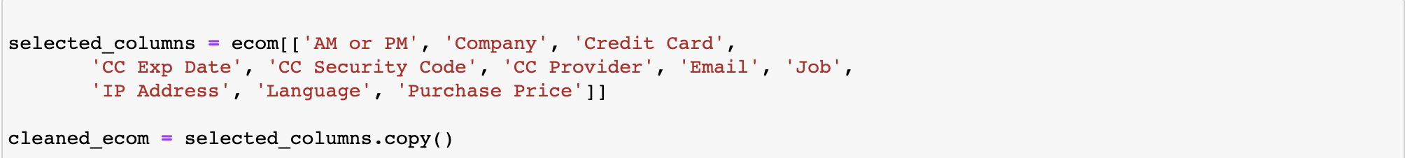
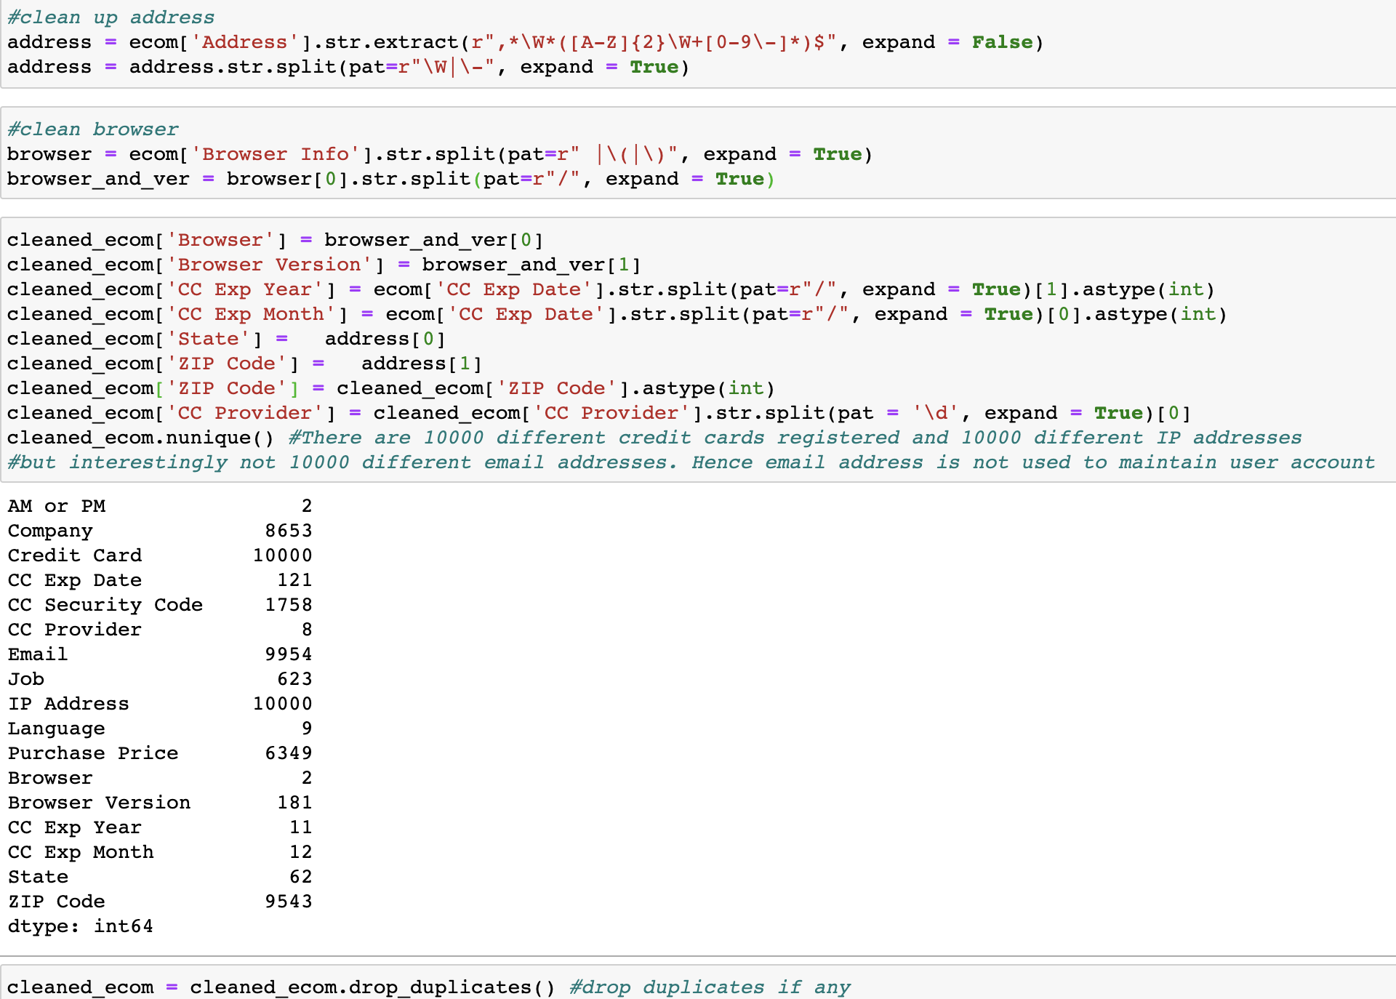
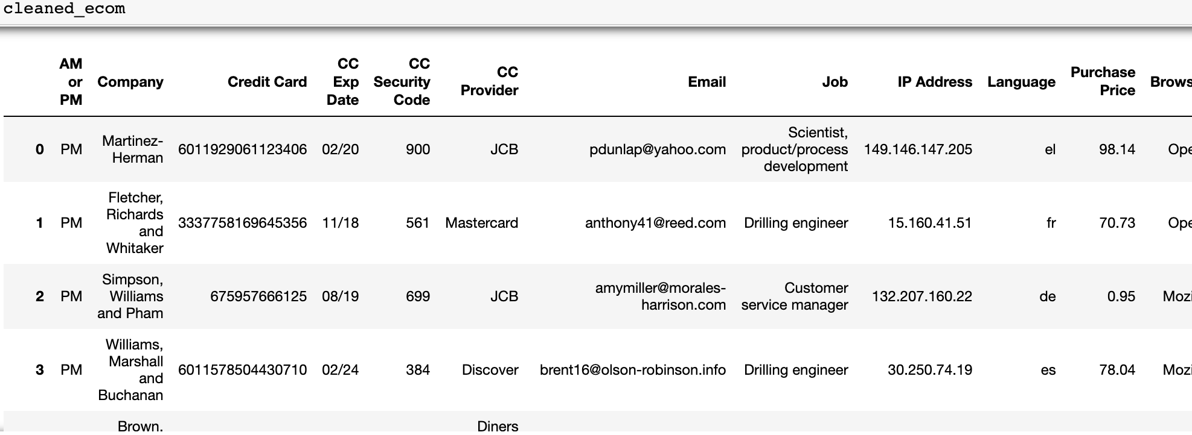
Interpreting And Transforming The Dataset
Select clean columns from original dataset
Clean address, browser add columns, and remove duplicates
Data overview:
E - Commerce Purchase Data Analysis – Team 7

Slide 5
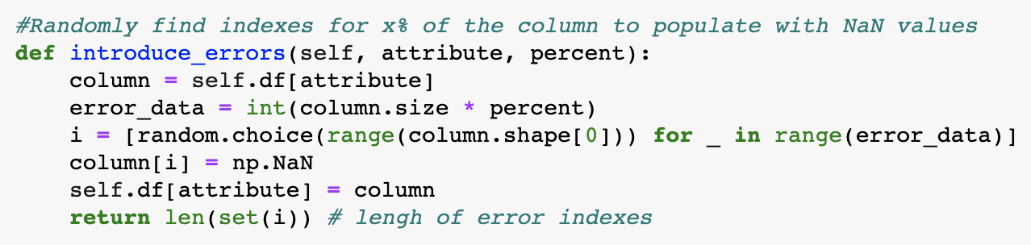
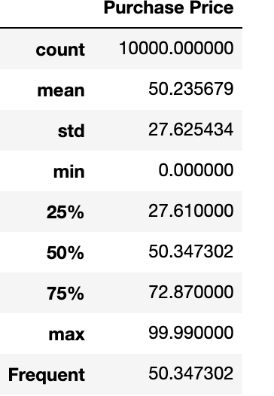
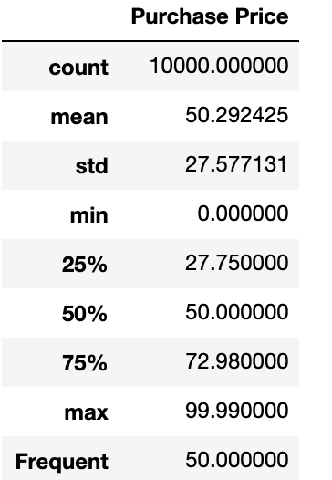
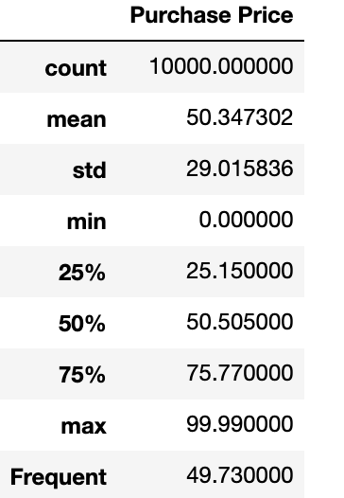
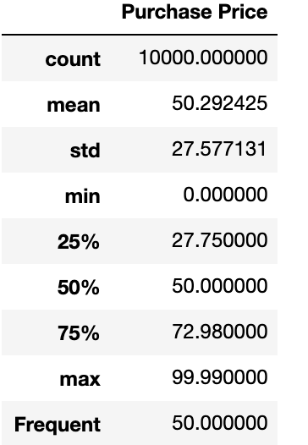
Data Imputation Techniques
Since dataset provided does not have any NULL (NaN) values, 10% of the ‘Purchase Price’ column data is randomly removed to try out imputation techniques and its impact
Imputation types tried:
Replacing with Mean and Median value
Using Forward and Backfill integrated to replace NaN
Using Random
Using Constant
Imputed with Mean
Impute with Mean Values: Gives best result
Original
data
Imputed with Fill
Introduce Erros
Impute with back and forward fill: Gives closer statistics to original clean data but changes frequent occurrence substantially
Imputed by const
Take away:
Multiple techniques described above provide outcome closer to cleaner data. Amongst the approaches The Mean, Fill and Const seem to be constantly giving good results w.r.t. original clean data. Refer to jupytr code.
Impute with constant value: Gives good result based on the value we choose for the constant. Cannot be relied without insight into the data.
E - Commerce Purchase Data Analysis – Team 7

Slide 6
Identify 5 key questions to be answered from the data
Find relationship between Job designation and purchases?
Analyse the bi-variate relationships between profession, purchases and browsers
Which states have maximum purchases?
Who are the top credit card providers and time of purchases?
What are the top five locations where purchases occur?
Add a footer

Slide 7
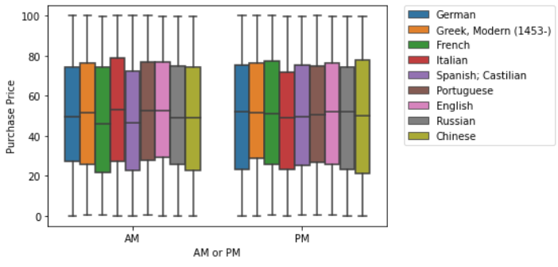
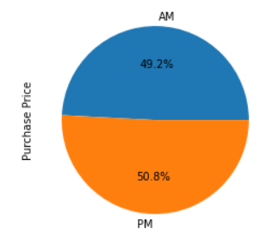
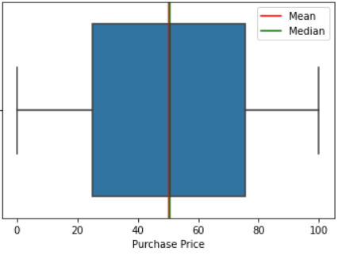
Data Analysis, Visualization & Insights
Q1: How does purchase value depend on ‘Language’ and time of purchase ‘AM or PM’?
Insights
Add a footer

Slide 8
Data Analysis, Visualization & Insights
Q2: How does purchase value depend on ‘CC Provider’?
Insights
Add a footer

Slide 9
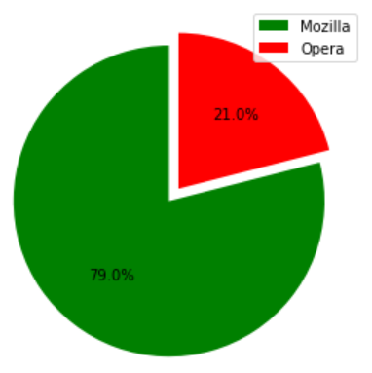


Data Analysis, Visualization & Insights
Q3: How does purchase value depend on the Internet Browser used?
Insights
Add a footer

Slide 10
Data Analysis, Visualization & Insights
Q3: How does purchase value depend on the Internet Browser used?
Insights
Add a footer

Slide 11
Key Observations & Inferences
TBD
E - Commerce Purchase Data Analysis – Team 7

