Slide 1
E - Commerce Purchase Data Analysis
M. Tech. – DSML → Team 7
Date: 2nd Sep 2020
NPV – Project Presentation
PRAVEEN MANOHAR G
RAHUL A
RAJESH RAMACHANDER
RANJITH GNANA SUTHAKAR ALPHONSE RAJ
YASHASWI GURUMURTHY

Slide 2
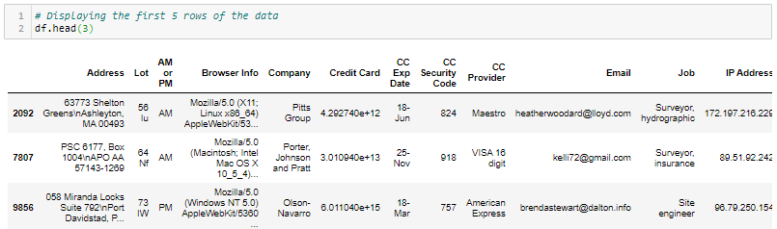
Project Overview & Process
Dataset Provided:
E-Commerce purchase data with Purchaser and Purchase details
Analysis Objective:
Characterize customer purchases from the E-commerce purchase data to identify patterns or trends for related insights
Analysis Steps/ Approach:
Identify 5 key questions to be answered from the data
Understanding the Data
Data Exploration
Data Imputation Techniques
Data Analysis & Visualization for insights
Insights & interpretations
5 Questions:
How does purchase value depend on ‘Language’ and time of purchase ‘AM or PM’?
How does purchase value depend on ‘CC Provider’?
How does purchase value depend on the Internet Browser used? Question?
Question?
Question?

Slide 3
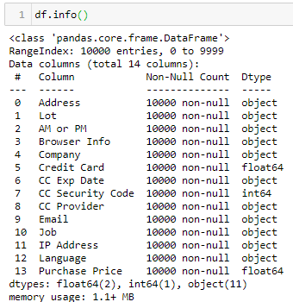

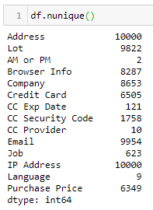
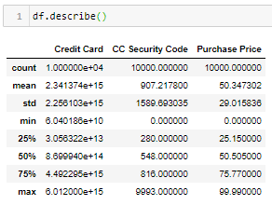
Understanding the Data
E-Commerce purchase data with Purchaser and Purchase details
Data overview:
Shape:
Rows → 10000
Columns → 14
Data types:
Categorical → 12
Numerical → 3
‘Credit Card’ & ‘CC Security Code’ are NOT usable as Numerical
NO null values present
Count of unique data points per column:
Description of Numerical variables:

Slide 4

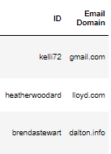
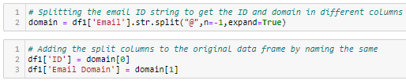
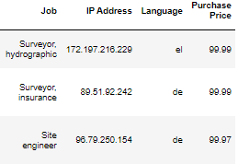
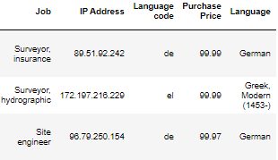
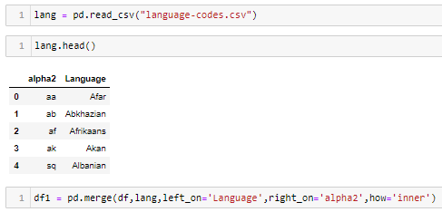
Data Exploration
Two ways are explored:
Extracting features from the existing data
Getting domain from the ‘Email’ variable based on ‘@’ special character
Enriching the data by joining the data with other data sources
Getting description of the language codes present in the table by joining it with another data file containing the descriptions
Splitting the ‘Email’ column to ‘ID’ and ‘Email Domain’
Joining with another .csv file with language code descriptions

Slide 5
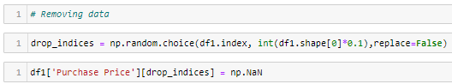
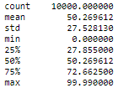
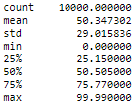
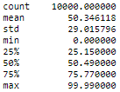
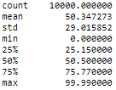
Data Imputation Techniques
Since dataset provided does not have any NULL (NaN) values, 10% of the ‘Purchase Price’ column data is randomly removed to try out imputation techniques and its impact
Imputation types tried:
Replacing with Mean value
Using Backfill
Using Interpolation
Imputed with Mean
Mean value has not changed significantly, however percentiles have, probably indicating removed values being higher than the mean
Imputed with Backfill
Original data
No major changes in the statistics. Imputation has had very little impact.
Take away:
With the 3 imputation techniques explored, ‘Interpolation’ method looks the best, closely followed by ‘Backfill’ method based on the negligible impact on the statistics compared to the original data
Imputed by Interpolation
No major changes in the statistics. Imputation has had very little impact.

Slide 6
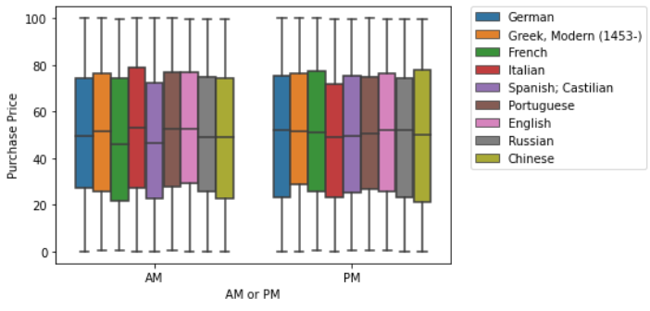
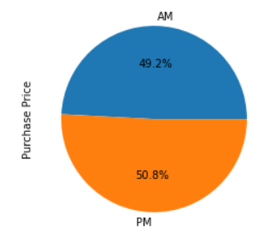
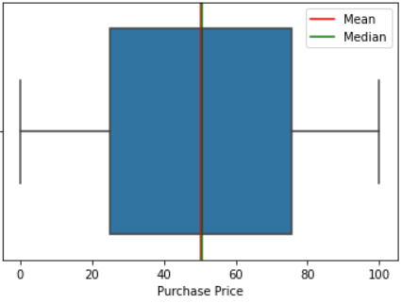
Data Analysis, Visualization & Insights
Q1: How does purchase value depend on ‘Language’ and time of purchase ‘AM or PM’?
Insights

Slide 7
Data Analysis, Visualization & Insights
Q2: How does purchase value depend on ‘CC Provider’?
Insights

Slide 8
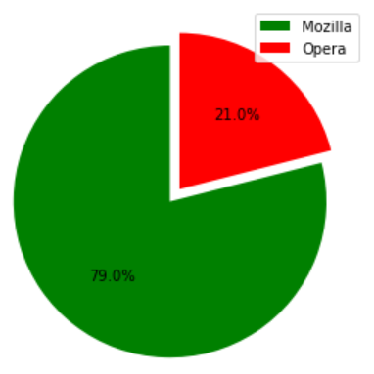


Data Analysis, Visualization & Insights
Q3: How does purchase value depend on the Internet Browser used?
Insights

Slide 9
Data Analysis, Visualization & Insights
Q3: How does purchase value depend on the Internet Browser used?
Insights

Slide 10
Key Observations & Inferences
TBD

