Slide 1

International University of Applied Sciences
Enhancing Machine Learning Development Efficiency through DevOps and MLOps
Knowledge Distillation & Neural Architecture Search
https://github.com/RajeshRamadas/yolov8-model-optimization
Student Rajesh Kumar Ramadas
Matriculation: 92125100
Course Of Study Master Of Computer Science
University Supervisor Dr. Aditya Mushyam
Course Name Master Thesis
Submission Date 13th June 2025

Slide 2




Research Overview
Agenda
Neural Architecture Search (NAS)
Automated architecture optimization techniques
Knowledge Distillation Fundamentals
Theory, benefits, and implementation approaches
Results & Production Deployment
Performance metrics and CI/CD integration
YOLOv8 Implementation
Practical application and pipeline integration

Slide 3



Research Overview
PROBLEM
Large-scale ML models (YOLOv8x) achieve high accuracy but are computationally expensive and unsuitable for real-time edge deployment in highway vehicle tracking systems.
QUESTION
How can knowledge distillation enable efficient model while maintaining detection accuracy for vehicle tracking applications?
METHODOLOGY
Implementation of knowledge distillation techniques
Neural Architecture Search (NAS) for optimal model design
MLOps pipeline integration with automated CI/CD
Performance evaluation on highway vehicle tracking dataset

Slide 4
Traditional Approach Limitations
Performance vs Efficiency Trade-off
📍 https://github.com/ultralytics/ultralytics
Model | mAP@0.5 | Size | Inference Speed (CPU) | Summary
YOLOv8x | ~53% | 130MB | ~15–20 FPS | High accuracy, slow on CPU
YOLOv8n | ~37% | 6MB | 30–60+ FPS | Fast, lightweight, lower accuracy
Key Limitations
Binary Choice: Traditional approaches force selection between accuracy OR speed
Manual Design: Human-designed architectures based on intuition, not systematic optimization
One-Size-Fits-All: Same model architecture regardless of deployment constraints

Slide 5
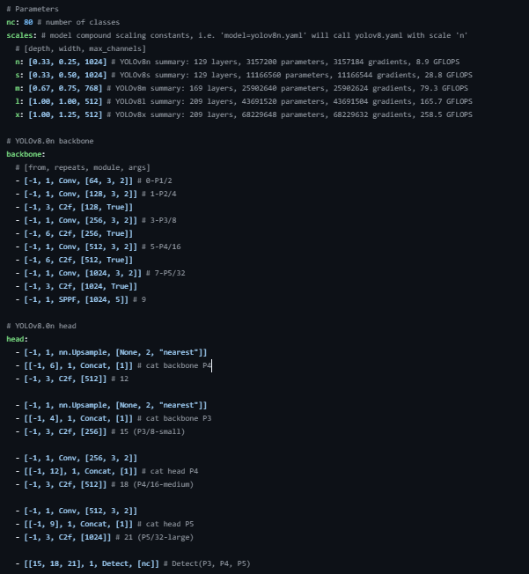
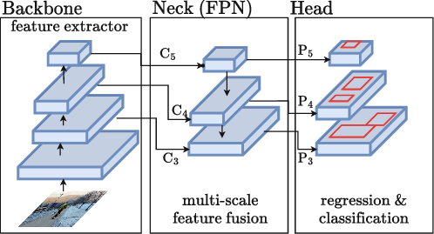
YoloV8 Architecture
YOLO Architecture: Key Components
Backbone: Extracts features from input images (edges, textures) and generates multi-scale representations.
Neck: Fuses features from different scales, integrates contextual information, and reduces resolution for efficient computation.
Head: Outputs bounding boxes and confidence scores, and sorts detected objects by category.

Slide 6

Width vs Depth Scaling
Depth
Width
Max Channels
Number of repeats in blocks
like C2f, C3, or Bottleneck.
[-1, 6, C2f, [256, True]] (Example)
repeats = max(round(6 * 0.33), 1) = 2
[-1, 2, C2f, [256, True]]
repeats = max(round(6 * 1), 1) = 6
[-1, 6, C2f, [256, True]]
Number of output channels (filters) in
Conv/C2f/SPPF.
- [-1, 1, Conv, [256, 3, 2]] (Example)
filters = int(256 * 0.25) = 64
- [-1, 1, Conv, [64, 3, 2]]
filters = int(256 * 1) = 256
- [-1, 1, Conv, [256, 3, 2]]
Number of output channels (filters) in
Conv/C2f/SPPF.
- [-1, 1, Conv, [1024, 3, 2]] # 7-P5/32
- [-1, 3, C2f, [1024, True]]
- [-1, 1, SPPF, [1024, 5]] # 9
scales:
l: [1.0, 1.0, 512] # depth, width, max_channels
x: [1.0, 1.25, 512]
- [-1, 1, Conv, [512, 3, 2]] # 7-P5/32
- [-1, 3, C2f, [512, True]]
- [-1, 1, SPPF, [512, 5]] # 9

Slide 7
Neural Architecture Search (NAS)
Search Space
Definition
Architecture Sampling
Training & Evaluation
Best Architecture Selection
Define architectural parameters and constraints
Generate candidate architectures
Assess performance metrics
Select optimal configuration
Search Space Parameters
Optimization Results
basic_search_space:
depth_multiple: [0.33, 0.5, 0.67, 1.0]
width_multiple: [0.25, 0.5, 0.75, 1.0]
advanced_search_space:
optimizer: [SGD, Adam, AdamW]
kernel_size: [1, 3, 5, 7]
img_size: [320, 448, 640]
Optimal depth_multiple: 0.67
Optimal width_multiple: 0.5
Best optimizer: Adam
Optimal kernel size: 3
img_size:640

Slide 8
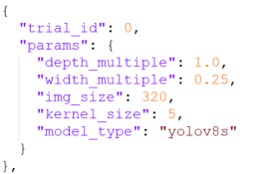
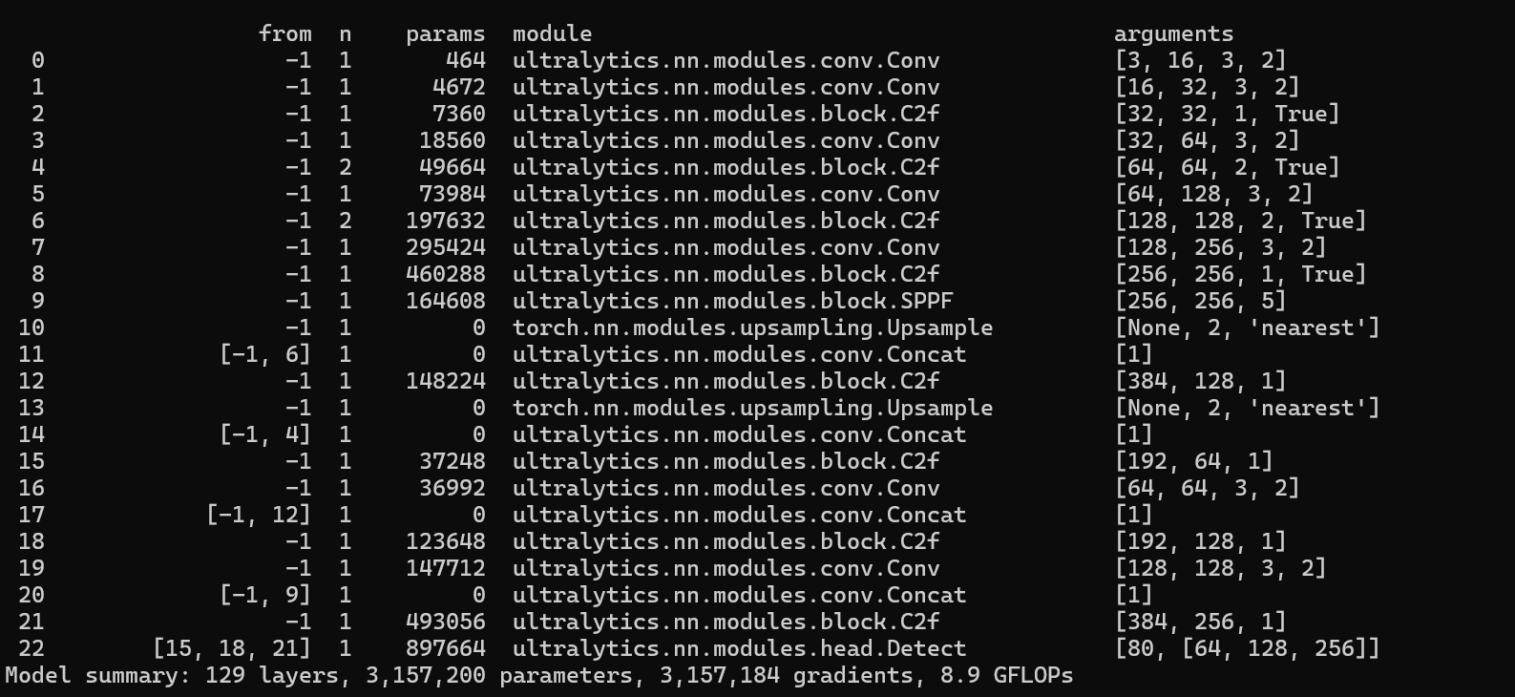
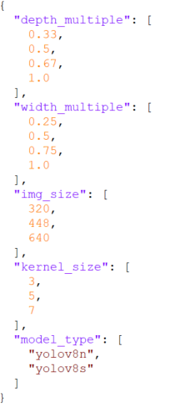
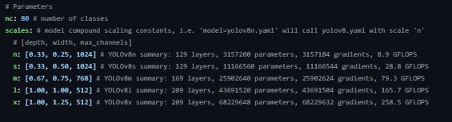
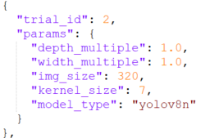
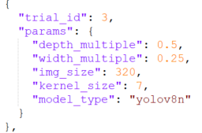
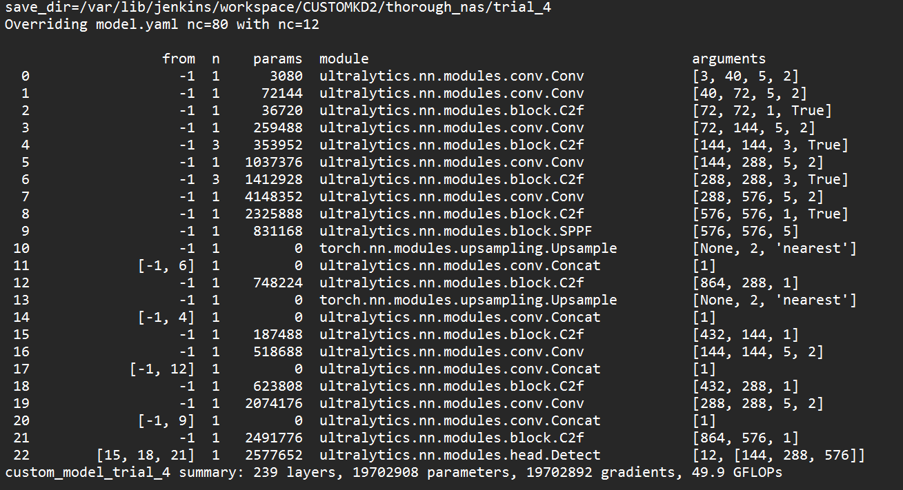
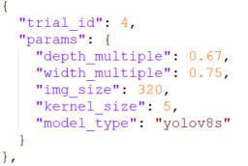
NAS Training Configuration
Yolov8n Config
search_space.json
trial_configs.json
Yolov8 Custom Config

Slide 9
NAS Best Model Selection - Key Metrics
Accuracy (mAP50-95)
Primary metric: Mean Average Precision at IoU thresholds 0.5-0.95 Range: 0.0 - 1.0 (higher is better) Weight: 1.0 (highest priority) Impact: Directly measures detection quality
Combined Score Calculation
Inference Speed (FPS)
Measures: Frames processed per second Range: 0+ (higher is better) Weight: 0.3 (moderate priority) Impact: Real-time deployment capability
Combined Score = (1.0 × norm_mAP) + (0.3 × norm_FPS) + (0.2 × norm_Size)
Speed => Weight: 0.3
Accuracy => Weight: 1.0
Size => Weight: 0.2
Model Size (MB)
Measures: Model file size in megabytes Range: 0+ (smaller is better) Weight: 0.2 (lower priority) Impact: Memory usage and deployment efficiency
*All metrics normalized to 0-1 scale for fair comparison

Slide 10
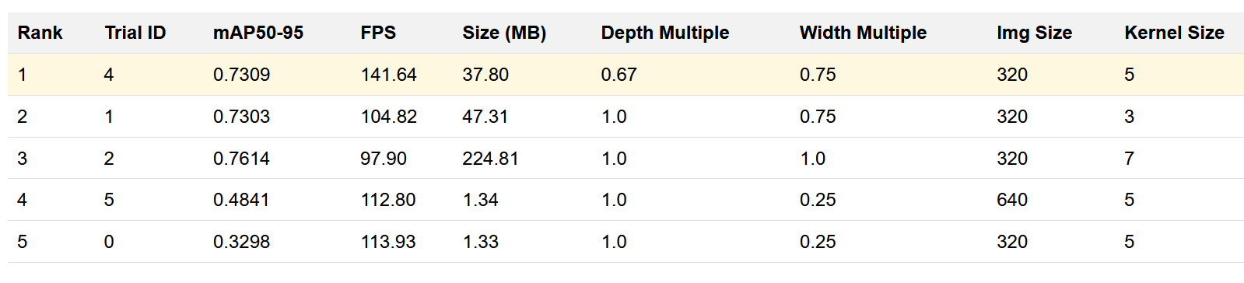
NAS Result Analysis
Step-by-Step Calculation for Trial 4
Normalize mAP50-95:
norm_mAP = 0.7309 (already normalized)
Normalize FPS:
norm_FPS = min(141.64 / 100, 1.0) = min(1.4164, 1.0) = 1.0000
Normalize Size (smaller is better):
norm_Size = max(0, 1.0 - min(37.80 / 100, 0.9))
= max(0, 1.0 - min(0.378, 0.9)) = max(0, 1.0 - 0.378) = 0.6220
Combined Score = (1.0 × 0.7309) + (0.3 × 1.0000) + (0.2 × 0.6220)
= 0.7309 + 0.3000 + 0.1244 = 1.1553
Key Trade-offs Observed
Trial 4 wins with optimal balance: 73% accuracy, 142 FPS, 38MB
Trial 2 has highest accuracy (76%) but 6x larger size and slower inference
Trials 5 & 0 are smallest/fastest but with unacceptable accuracy loss
Architecture parameters significantly impact the accuracy-speed-size triangle

Slide 11
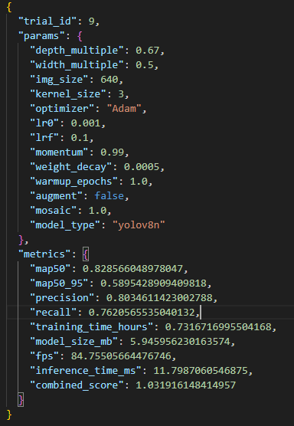
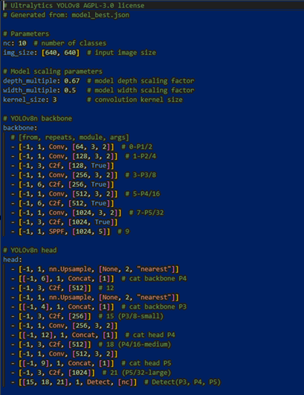
Yolov8n Custom Config
NAS BEST MODEL CONFIG
YOLOV8 CUSTOM CONFIGURATION

Slide 12
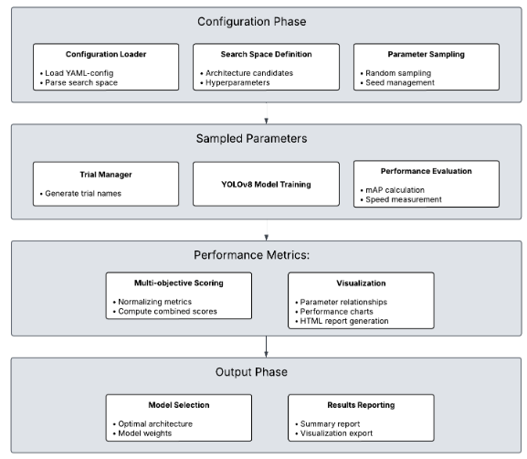
NAS Implementation

Slide 13
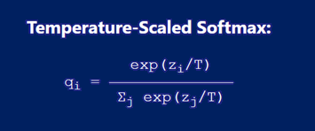
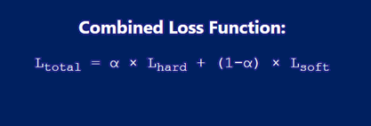
Knowledge Distillation Methodology
Distilling the Knowledge in a Neural Network by Geoffrey Hinton
Teacher Model
Knowledge Transfer
Student Model
YOLOv8x Large, Accurate
Soft Targets Temperature Scaling
Custom YOLOv8 Small, Efficient
Mathematical Framework
Alpha determines how much the student should trust the teacher versus the ground truth.
Temperature controls how "soft" or "hard" the teacher's predictions are, directly affecting how much knowledge can be transferred.
qi = probability for class i
zi = logit (raw output) for class i
T = temperature parameter
Σj = sum over all classes
α = weighting parameter (0 to 1)
Lhard = hard loss (cross-entropy with ground truth)
Lsoft = soft loss (KL divergence with teacher predictions)
(1−α) = complementary weight for soft loss
Current Configuration
Temperature (T): 3.0 - Controls softness of probability distribution
Alpha (α): 0.5 - Balance between knowledge distillation and hard loss
Optimization: Standard YOLO loss + KL divergence

Slide 14
Knowledge Distillation: Temperature
Without Temperature (T=1, Standard Softmax):
Temperature (T=2, Standard Softmax):
# Raw logits: [4.0, 2.5, 1.0]
exp_values = [exp(4.0), exp(2.5), exp(1.0)]
exp_values = [54.6, 12.2, 2.7]
sum_exp = 69.5 # Standard softmax
probabilities = [54.6/69.5, 12.2/69.5, 2.7/69.5] probabilities = [0.79, 0.17, 0.04]
Teacher Raw Logits (before softmax):
t_cls = [4.0, 2.5, 1.0] # [Car, Truck, Bus]
2. Apply Temperature Scaling:
t_cls_scaled = t_cls / self.temperature # T = 2.0
t_cls_scaled = [4.0/2.0, 2.5/2.0, 1.0/2.0]
t_cls_scaled = [2.0, 1.25, 0.5]
3. Compute Temperature-Scaled Softmax:
# Calculate exponentials
exp_values = [exp(2.0), exp(1.25), exp(0.5)]
exp_values = [7.39, 3.49, 1.65] # Sum all exponentials
sum_exp = 7.39 + 3.49 + 1.65 = 12.53 # Calculate softmax probabilities
q_car = 7.39 / 12.53 = 0.59
q_truck = 3.49 / 12.53 = 0.28
q_bus = 1.65 / 12.53 = 0.13
probabilities = [0.59, 0.28, 0.13] # Much softer!

Slide 15
Knowledge Distillation : KL Divergence Formula
KL divergence measures how different two probability distributions are - it's like a "distance" between distributions
KL(P||Q) = Σ P(x) × log(P(x)/Q(x))
P = target distribution (teacher probabilities)
Q = predicted distribution (student probabilities)
x = each possible outcome/class
Σ = sum over all classes
# Teacher distribution (rich knowledge)
Teacher = [car=0.6, truck=0.3, bus=0.1] # "Mostly car, some truck features"
# Student distribution (learning)
Student = [car=0.7, truck=0.2, bus=0.1]
# "Definitely car"
# KL divergence measures how well student matches teacher's wisdom
KL_loss = KL(Teacher || Student)
# Perfect knowledge transfer: KL(Teacher || Student) = 0
# Student exactly matches teacher
# Poor knowledge transfer: KL(Teacher || Student) = high value
# Student very different from teacher

Slide 16


Knowledge Distillation : KL Divergence Calculation
# Teacher scaled: [2.5/2, 4.0/2, 1.2/2] = [1.25, 2.0, 0.6]
# Student scaled: [1.8/2, 3.2/2, 0.9/2] = [0.9, 1.6, 0.45]
# Teacher exponentials:
exp_t = [exp(1.25), exp(2.0), exp(0.6)] = [3.49, 7.39, 1.82]
sum_t = 3.49 + 7.39 + 1.82 = 12.70
# Teacher probabilities (P):
P = [3.49/12.70, 7.39/12.70, 1.82/12.70] = [0.275, 0.582, 0.143]
# Student exponentials:
exp_s = [exp(0.9), exp(1.6), exp(0.45)] = [2.46, 4.95, 1.57]
sum_s = 2.46 + 4.95 + 1.57 = 8.98
# Student log_softmax (input):
log_softmax = [0.9 - log(8.98), 1.6 - log(8.98), 0.45 - log(8.98)]
log_softmax = [0.9 - 2.195, 1.6 - 2.195, 0.45 - 2.195]
log_softmax = [-1.295, -0.595, -1.745]
# PyTorch formula: KL = Σ target(x) × [log(target(x)) - input(x)] #
For Car class:
kl_car = 0.275 × [log(0.275) - (-1.295)]
= 0.275 × [-1.291 - (-1.295)]
= 0.275 × [-1.291 + 1.295]
= 0.275 × 0.004 = 0.0011
# For Truck class:
kl_truck = 0.582 × [log(0.582) - (-0.595)]
= 0.582 × [-0.541 - (-0.595)]
= 0.582 × [-0.541 + 0.595]
= 0.582 × 0.054 = 0.0314
# For Bus class:
kl_bus = 0.143 × [log(0.143) - (-1.745)]
= 0.143 × [-1.944 - (-1.745)]
= 0.143 × [-1.944 + 1.745]
= 0.143 × (-0.199) = -0.0285
# Total KL divergence:
KL = 0.0011 + 0.0314 + (-0.0285) = 0.004

Slide 17
MLOps Implementation
Technology Stack
Automated Pipeline
CI/CD: Jenkins with automated pipeline
Storage: Amazon S3 for model artifacts
ML Libraries: YOLOv8, scikit-learn
Source Control: Git/GitHub with version control
Initialize Workspace
Create Virtual Environment
Download Dataset
Dataset Validation & Augmentation
Neural Architecture Search
Knowledge Distillation
Model Performance Evaluation
Upload Best Model to S3
Generate Reports & Trigger Mail

Slide 18
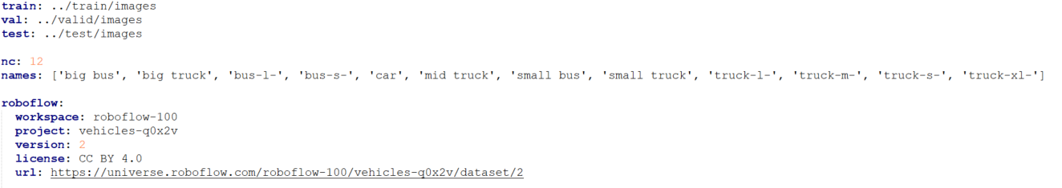
Dataset : Computer Vision
Part of the Roboflow 100 (RF100) benchmark initiative by Intel to evaluate object detection model generalizability.
Originally created by Yudha Bhakti Nugraha and Kris.
Contains 12 vehicle classes, including various types of buses, cars, and trucks.
Supports object detection tasks and is compatible with YOLOv5 and above.
Publicly available dataset with high engagement in terms of views and downloads.
FILE : DATA.YAML

Slide 19
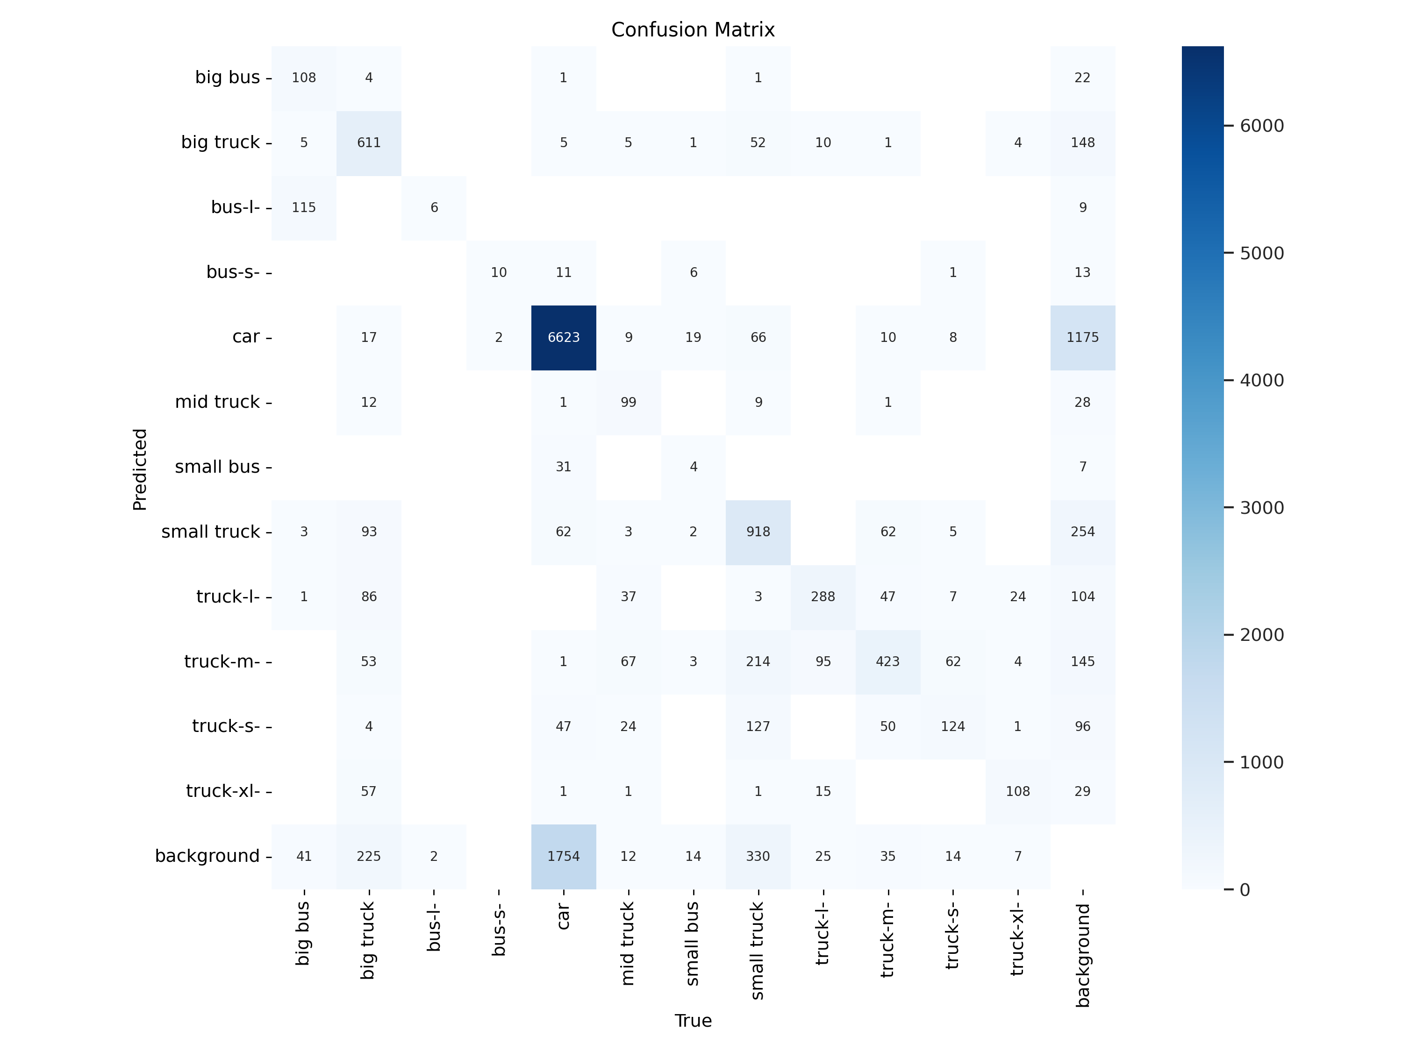
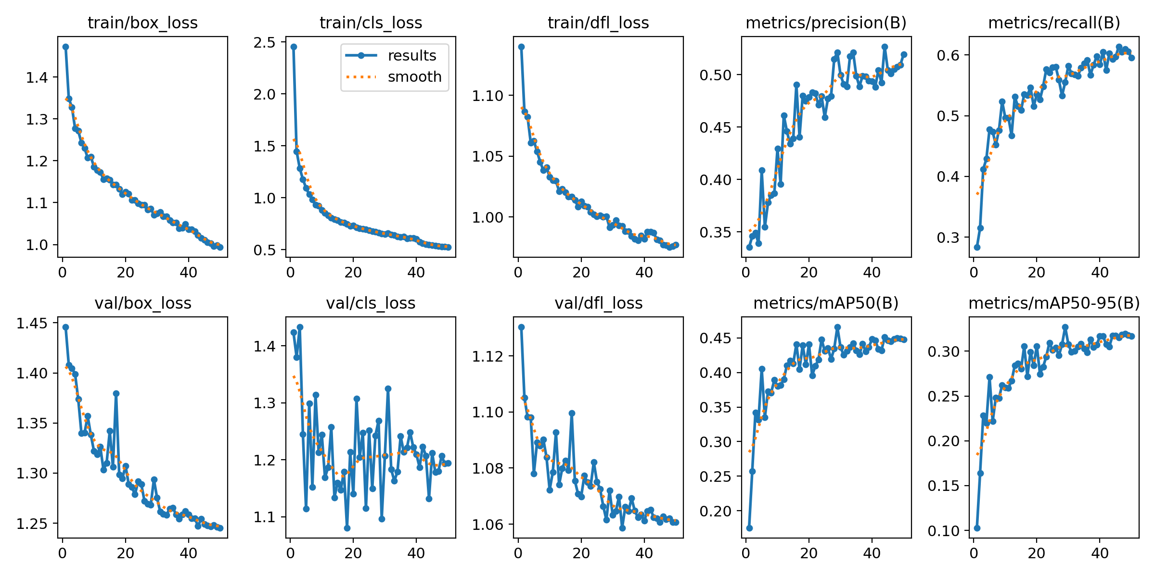
Model Performance before Augmentation
Confusion matrix
Performance matrix

Slide 20
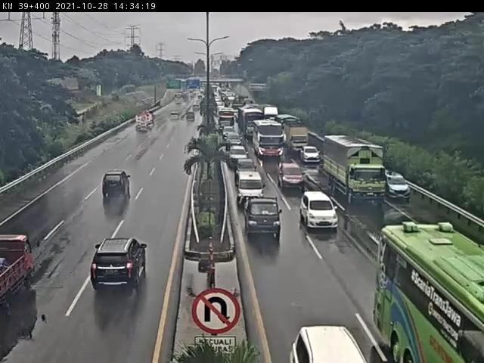
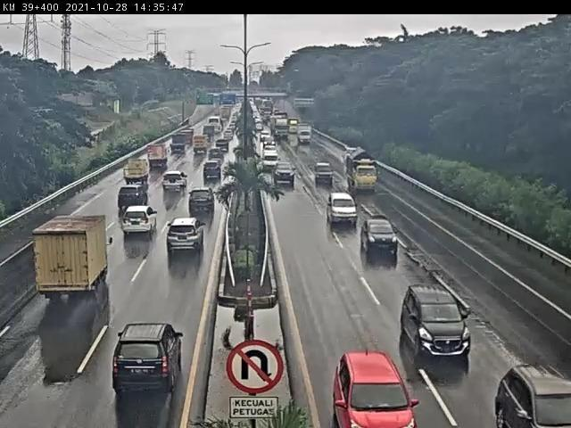
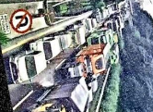
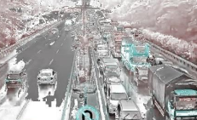
Augmentation Technique
Targeted Augmentation Strategy
Dataset Processing Results
Minority Class Identification: Classes with object percentages below a configurable threshold (default: 10%) are tagged as "minority".
Augmentation Factor: Each image containing minority classes is augmented multiple times (default: 5
Original training images: 2,634
Augmented images generated: 27,260
Final training set size: 29,894
Balances class distribution to improve model generalization.
Class balance improvement: Disparity reduced from 15-20% to 3-5%
mAP@50 improvement: From 0.45 to 0.97 with same training configuration
Applied Augmentation Techniques
RandomBrightnessContrast
HueSaturationValue
RandomRotate90
Blur
RandomShadow
RandomFog
Affine
RandomSunFlare
ISONoise
RandomSnow
CLAHE
ChannelShuffle
ColorJitter
BEFORE AUGMENTATION
AFTER AUGMENTATION

Slide 21
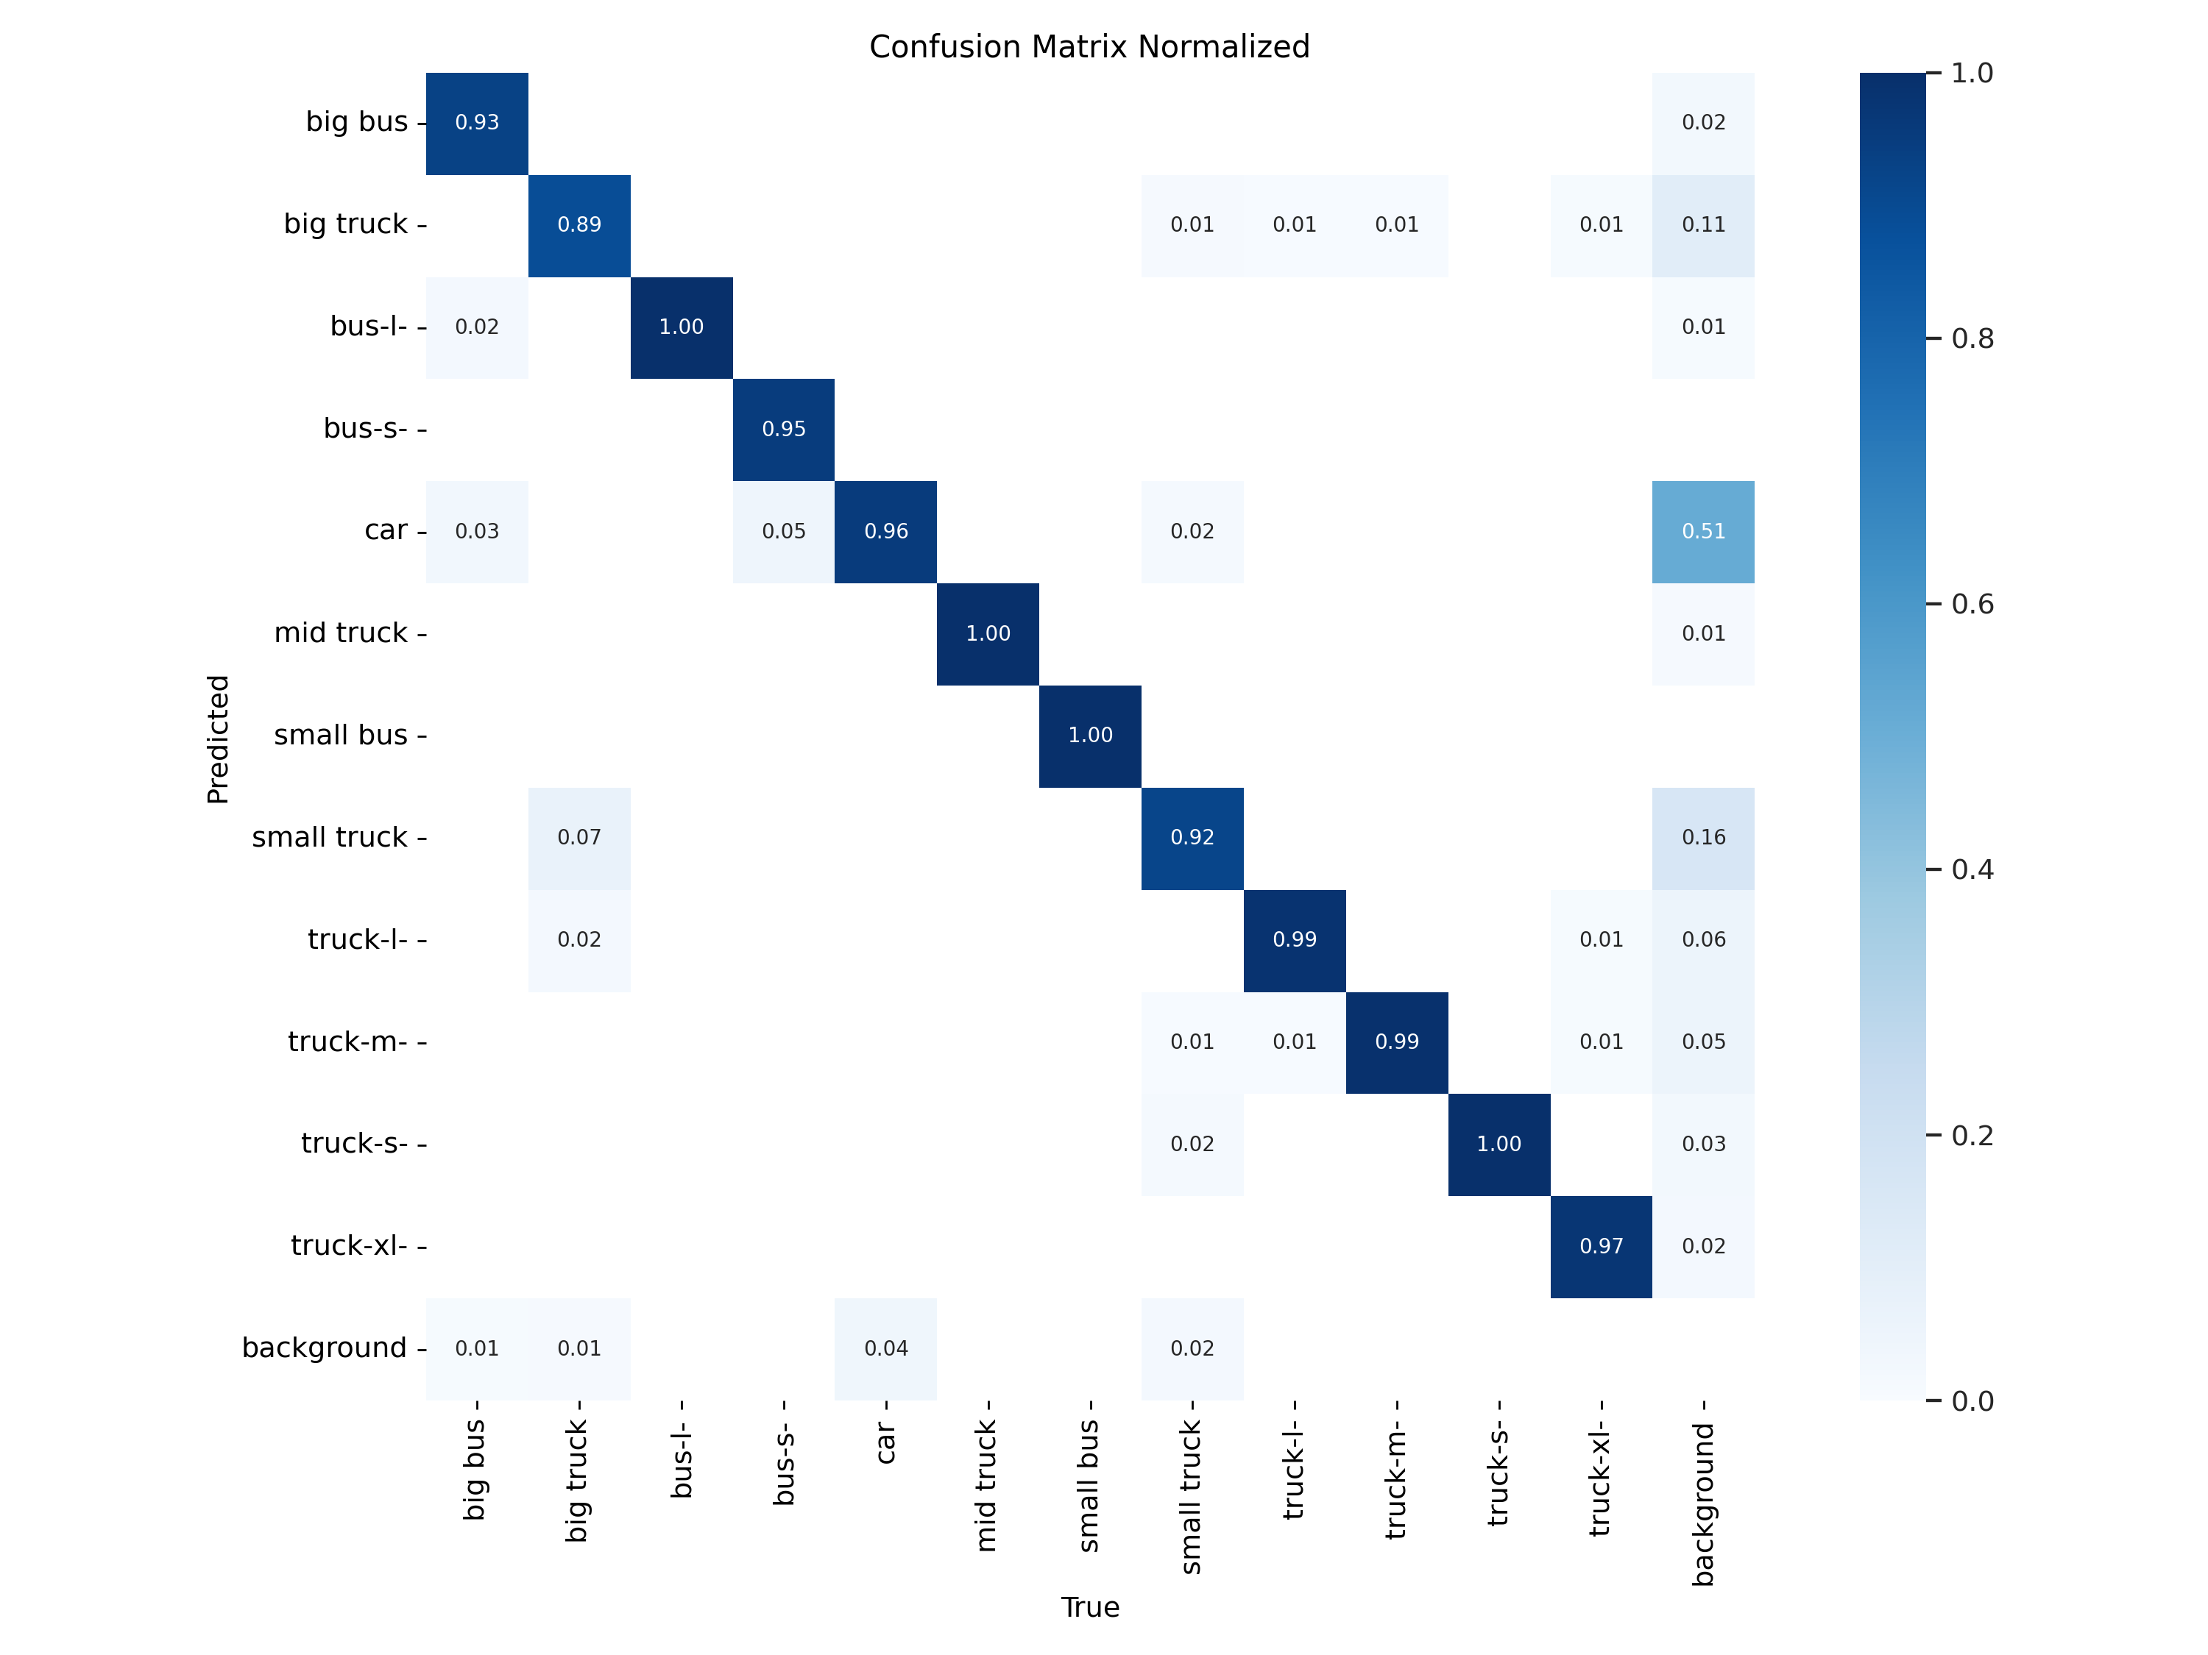
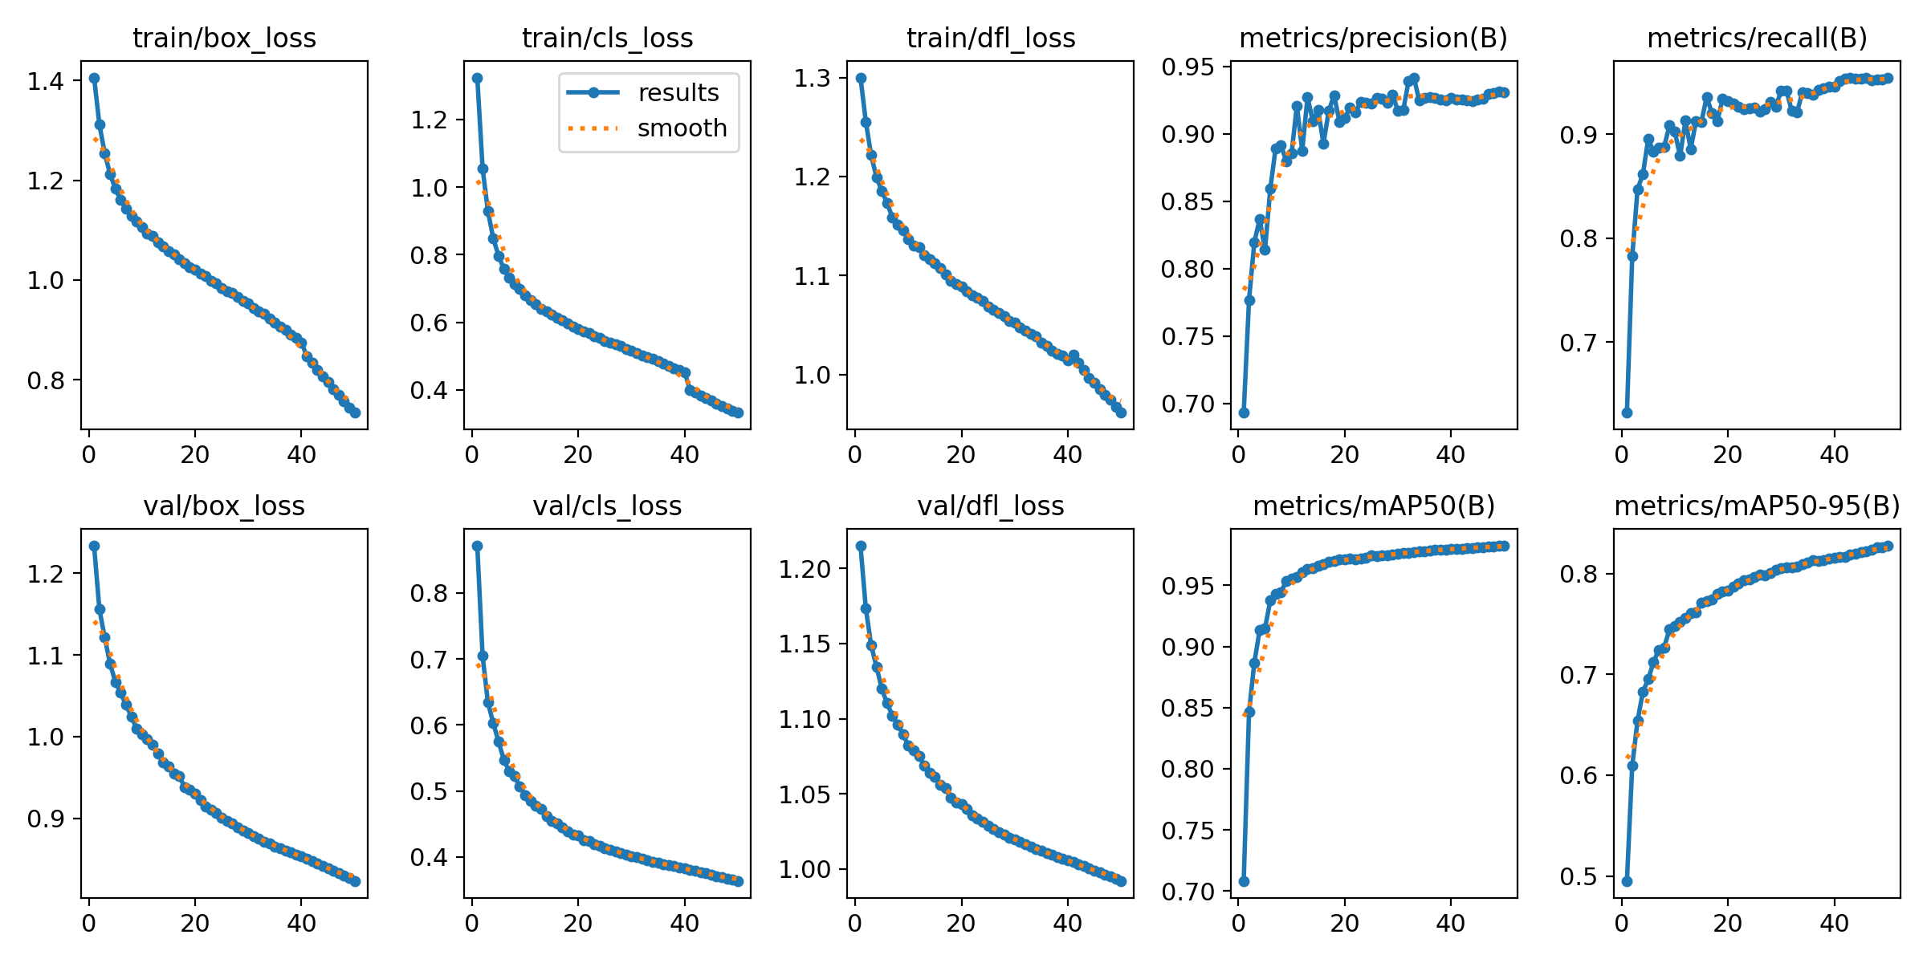
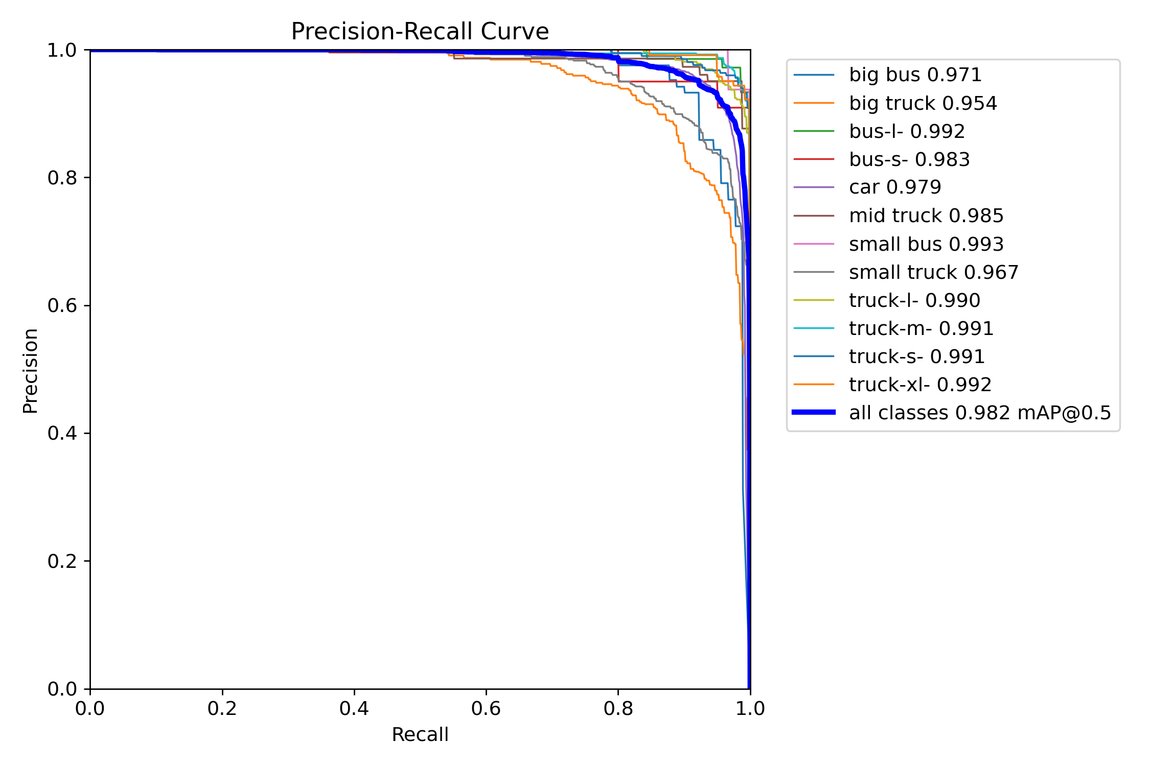
Knowledge Distillation Teacher Analysis
Performance matrix

Slide 22

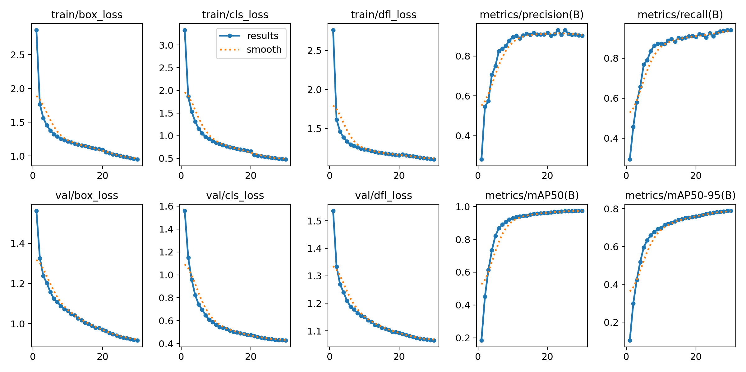
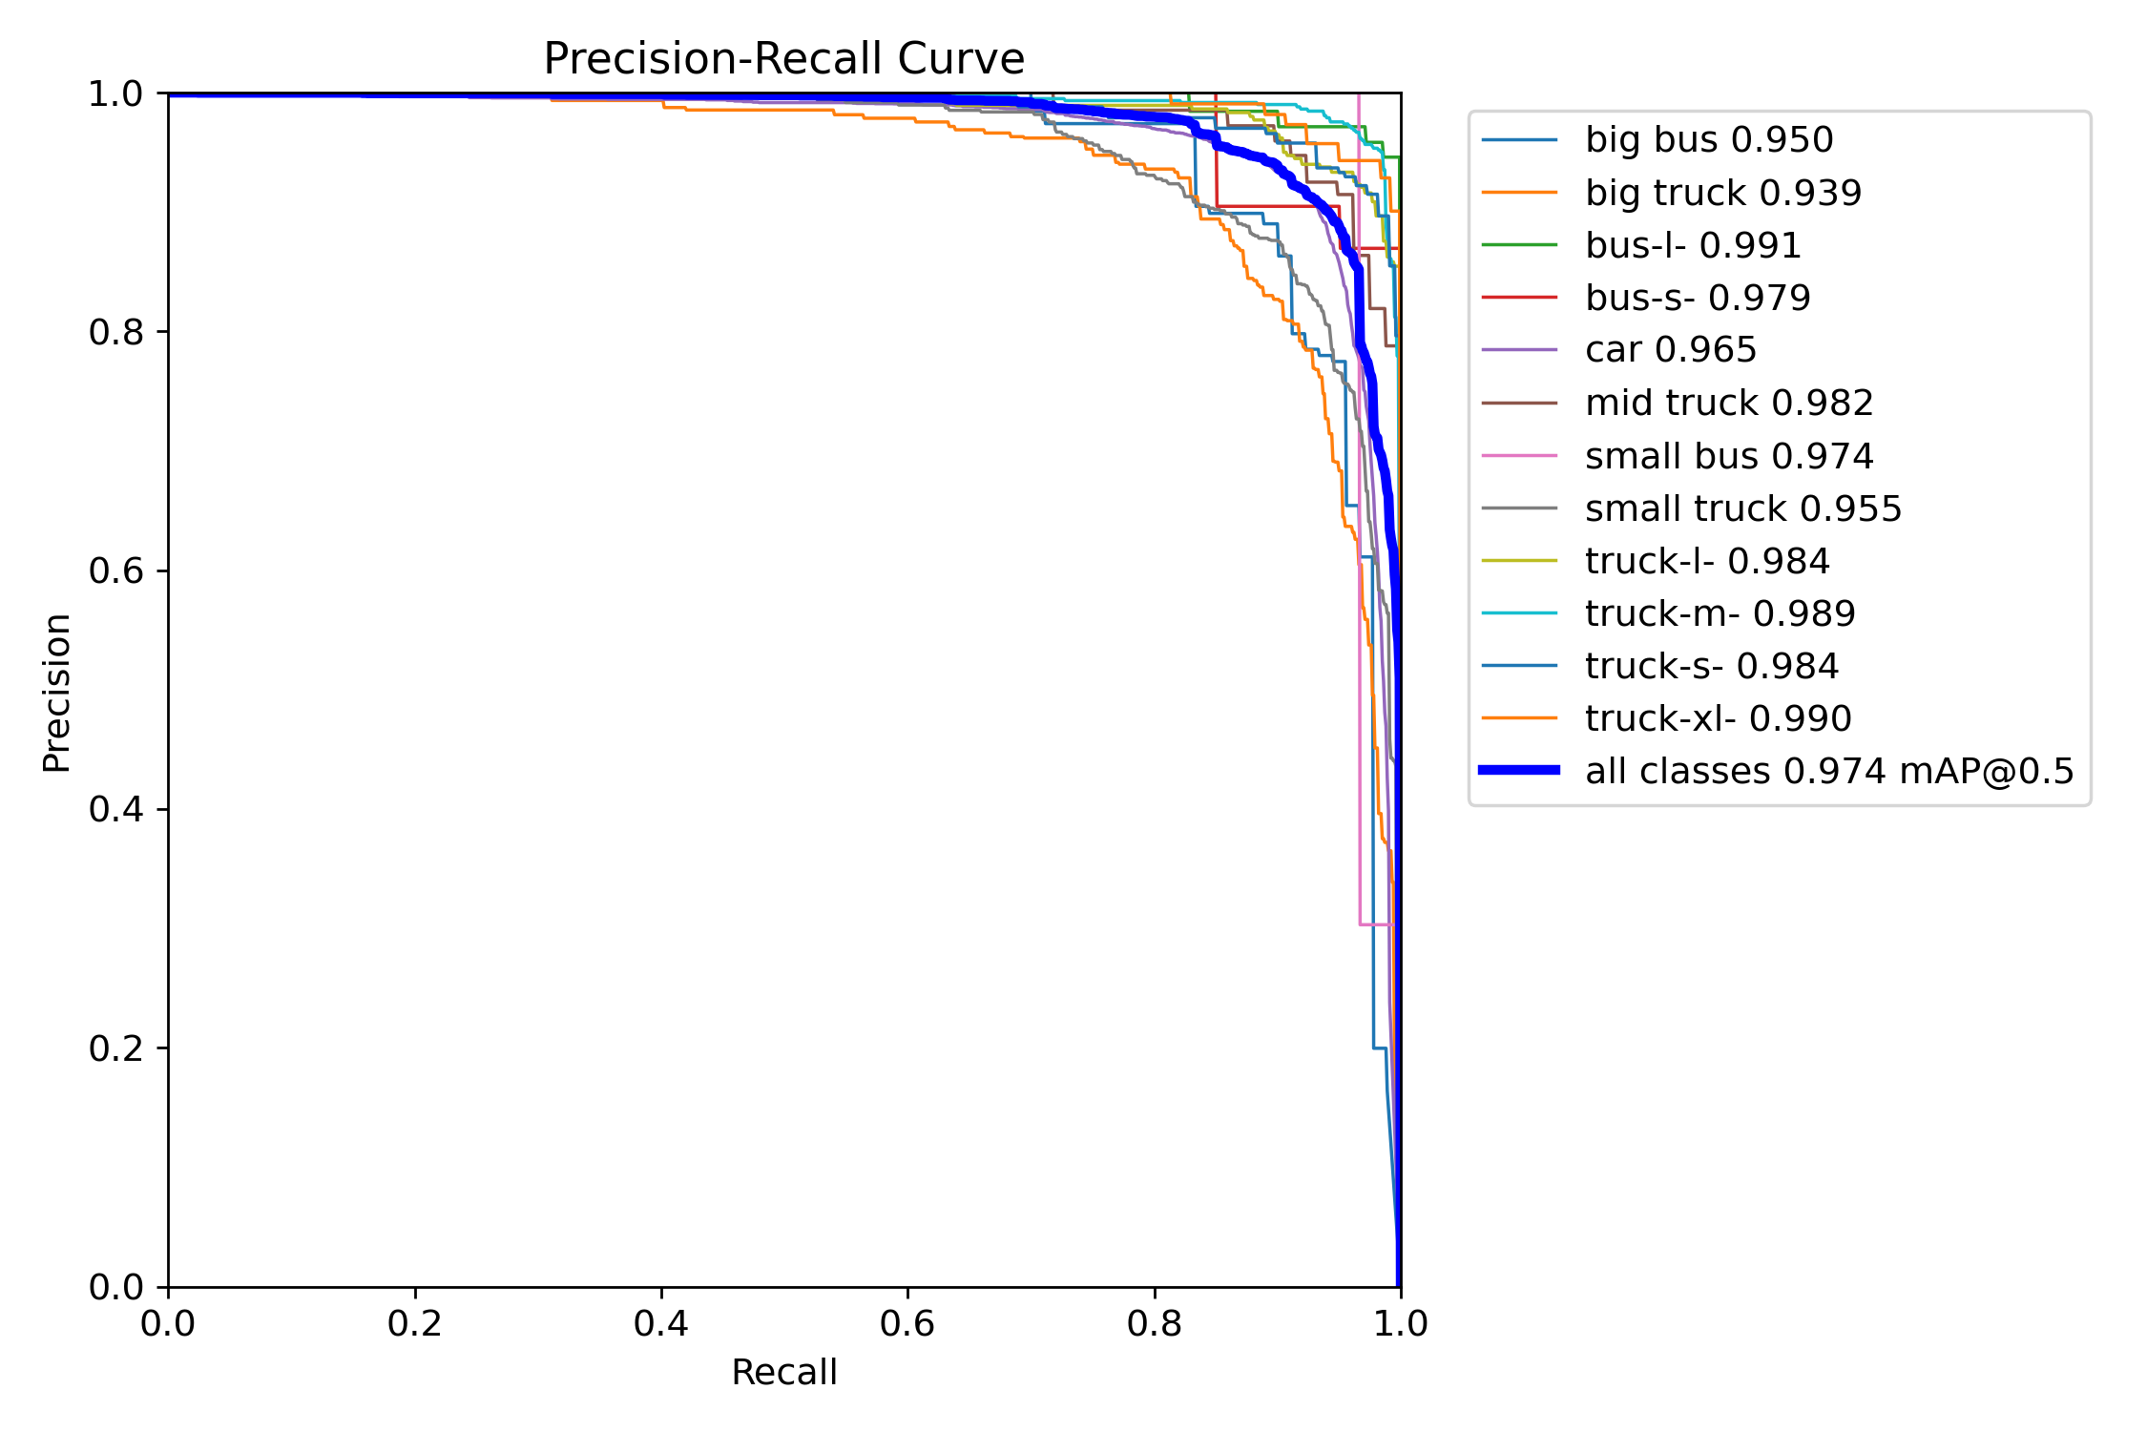
Knowledge Distillation Custom Student Analysis
Performance matrix

Slide 23

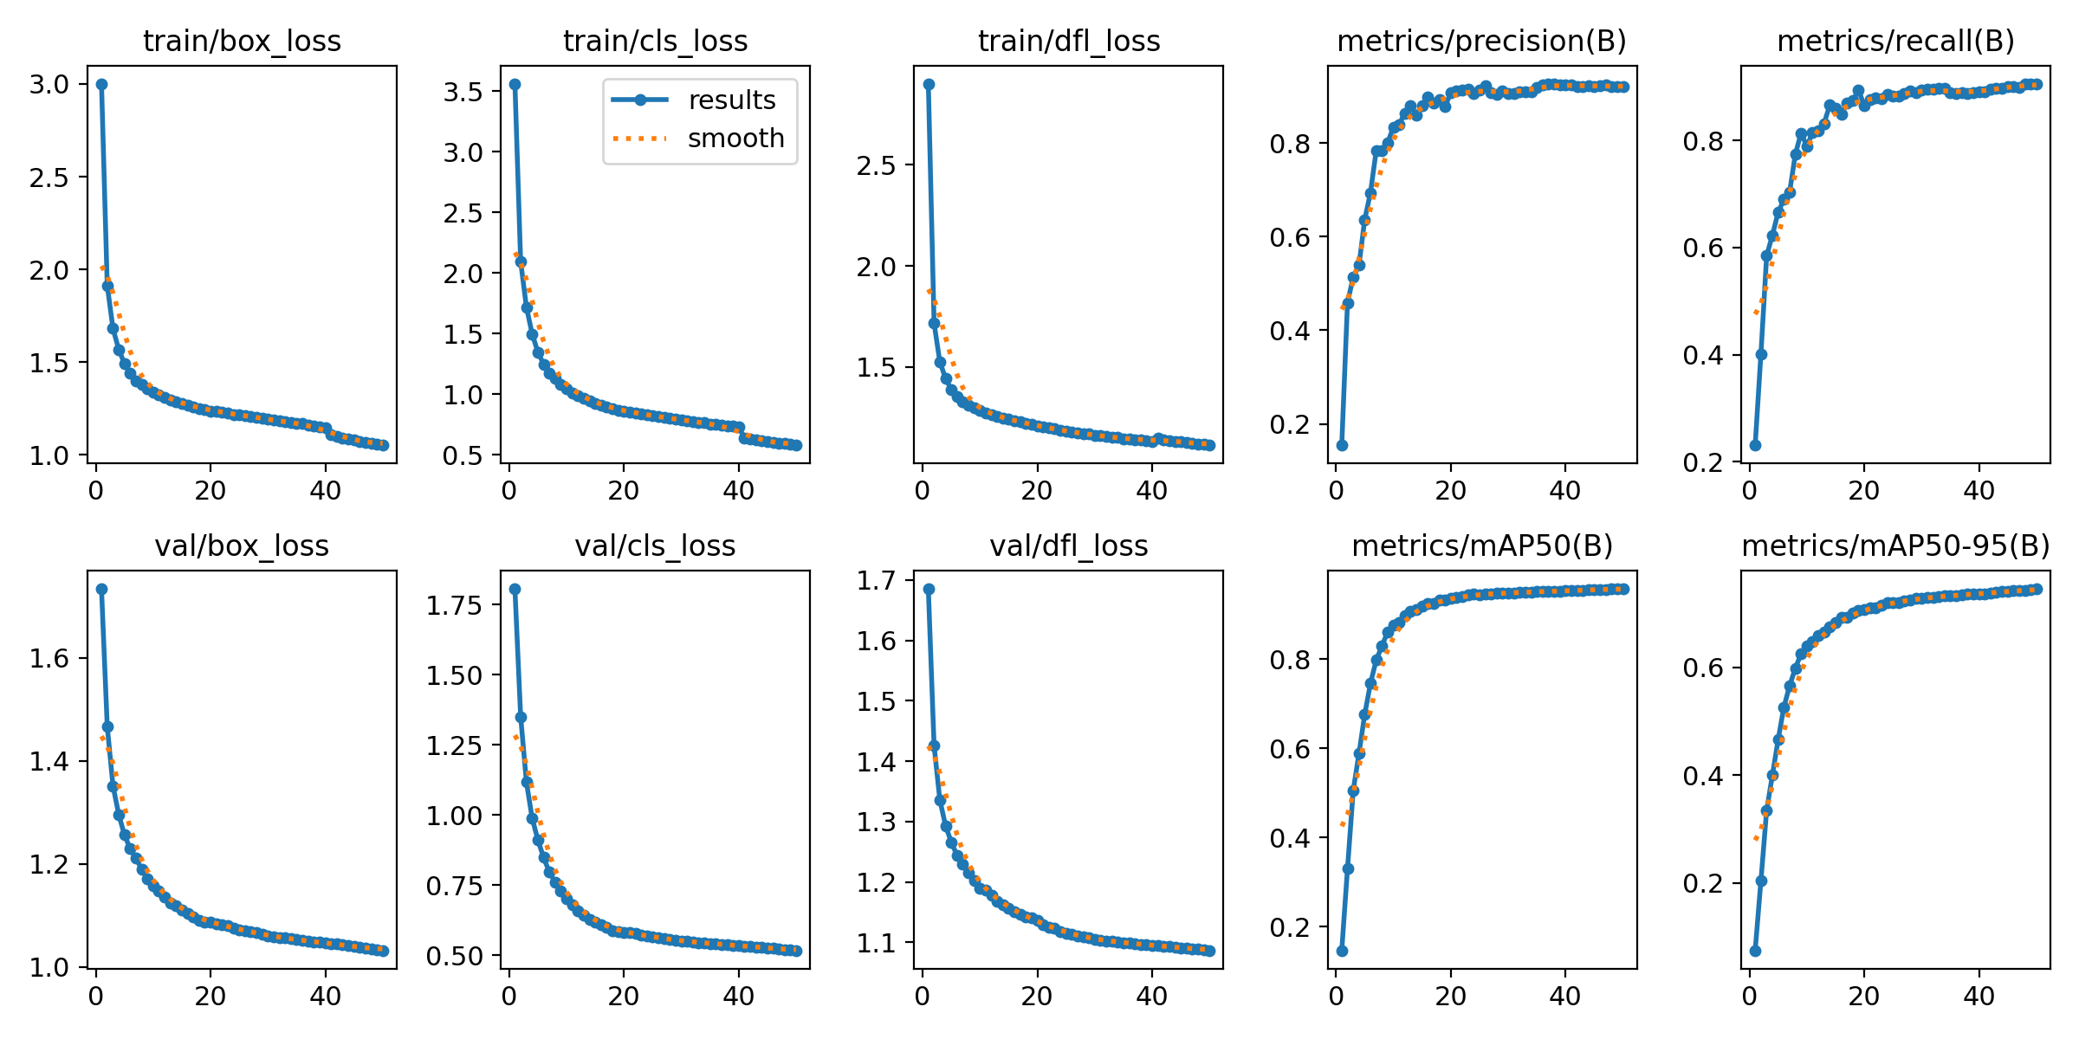
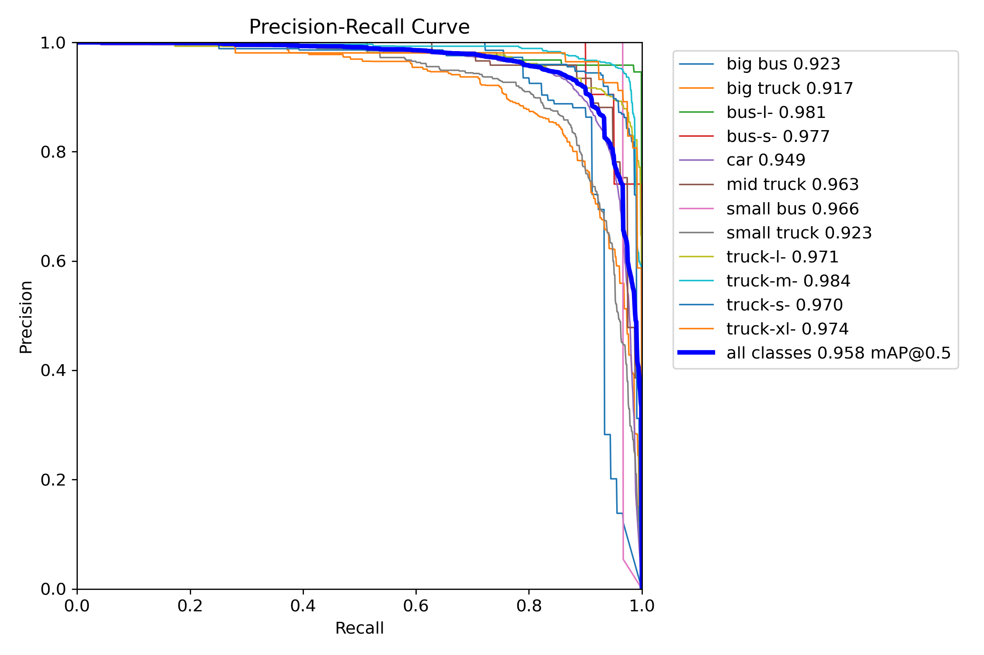
Knowledge Distillation Yolov8n Analysis
Performance matrix

Slide 24
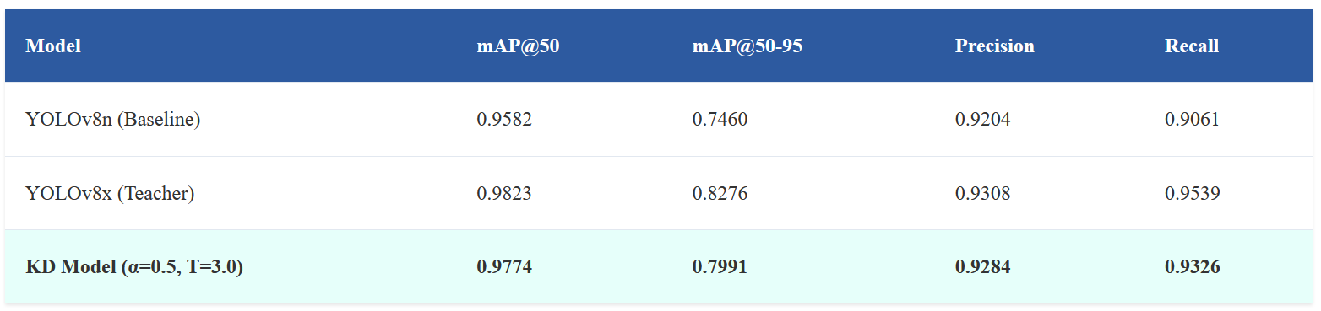
Results and Performance Analysis
97.74%
99.5%
30+
30MB
Final Model Accuracy
(mAP@50)
Knowledge Retention
FPS Achieved
Model Size
-1% vs Baseline
mAP@50 Retention
Real-time Performance
76.92% Size Reduction
Comprehensive Performance Metrics

Slide 25
Conclusion
Key Achievements
Successfully broke the traditional performance-efficiency trade-off
Achieved 99.5% knowledge retention from teacher to student model
Maintained high accuracy (97.74%) while achieving real-time performance (30+ FPS)
Reduced model size by 76% (130MB → 30MB)
Implemented production-ready MLOps pipeline
Practical Applications
Highway vehicle tracking and counting systems
Edge deployment for real-time traffic monitoring
Scalable MLOps framework for model optimization
Future Research Directions
Extension to other object detection architectures
Multi-teacher knowledge distillation approaches
Real-time architecture adaptation based on hardware constraints

Slide 26
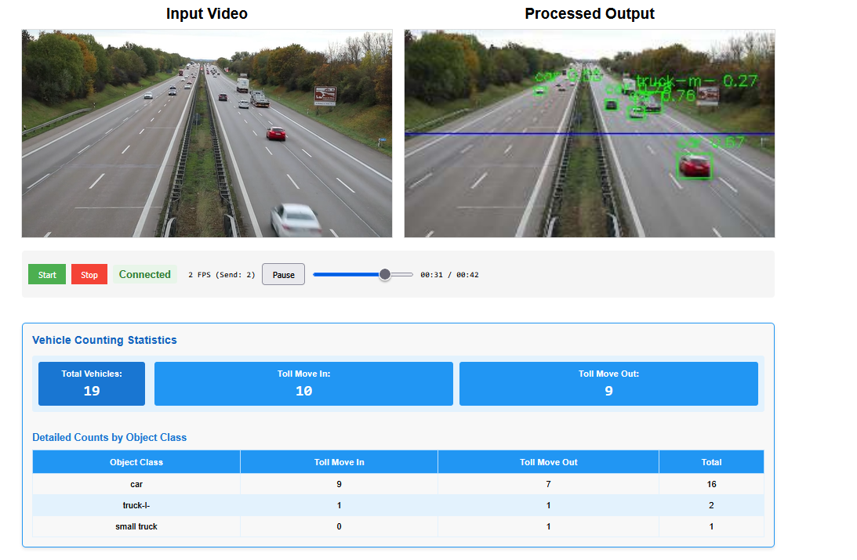
Demo : Highway Vehicle Tracking

Slide 27
Repository
Main Repository:
https://github.com/RajeshRamadas/yolov8-model-optimization/tree/main
Knowledge distillation:
https://github.com/RajeshRamadas/yolov8-model-optimization/tree/main/02-Implementation/knowledge_distillation
Application:
https://github.com/RajeshRamadas/highway-vehicle-tracker/tree/75d96c9aa849d52c155dc343237ff121f7ebbb99
Report & Documentation
https://github.com/RajeshRamadas/yolov8-model-optimization/tree/main/01-Project-management
Dataset:
https://universe.roboflow.com/roboflow-100/vehicles-q0x2v

Slide 28


