Slide 1
HUMAN BLOOD GROUP . SYSTEM
Karl land steiner

Slide 2
Agenda
Rh factor
Rh antigenS
Antibodies in Rh antigens
Frequencies of rh genes
ABO blood group system

Slide 3
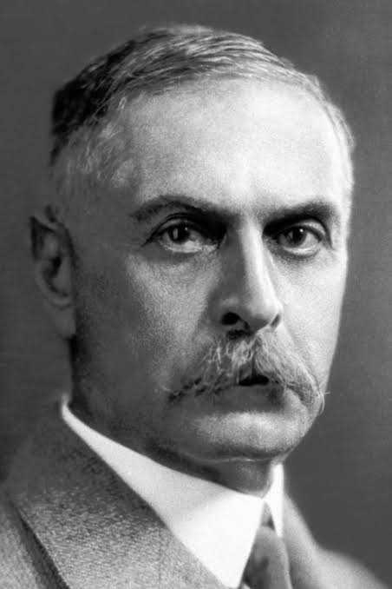
Karl landsteiner

Slide 4
Rh factor
An antigen present on the surface of red blood cells
It can be positive or negative
Rh stands for Rhesus monkey
1940 Karl landsteiner in rabbits and guinea pigs

Slide 5
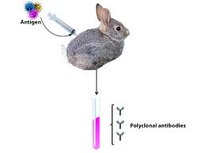
Antigen injecting experiment

Slide 6
Rh antigens
Rh D C E c and e
Rh antigens are 97% identical
Especially RhD antigen

Slide 7
Frequency of Rh antigens
D:99%
C:93%
E:39%
C:47%
e:96%
Identical to the human beings
Fitst discovered from Rhesus monkey

Slide 8
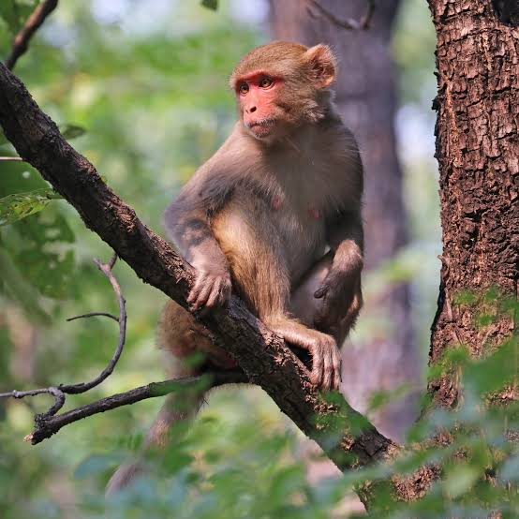
Rhesus monkey

Slide 9
Antibodies in Rh anti gens
Mainly igM and rarely igG
igM: immunoglobin M
igG: immunoglobin G
igM presents in B cells and controlled the B cells activation
igG present/ found in the blood circulation
IgG is responsible for serum production

Slide 10
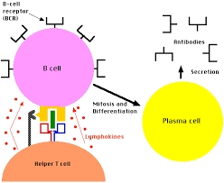
B cells
They are B lymphocytes Type of white blood cells
They controls the human immune systems

Slide 11
T cells
T lymphocytes
They are called helper cells
Two types
1:CD4+ T helper cells
2:CD8+ T helper cells
CD4+cells active other cells to respond to antigen
CD8+ cells killed the infected target cells

Slide 12
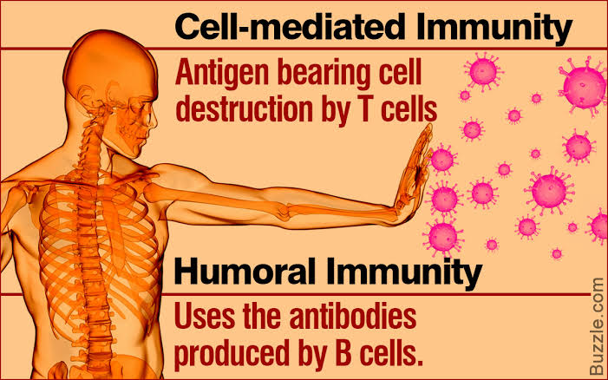

Slide 13
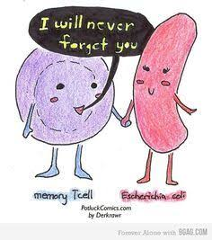
Memory cells

Slide 14
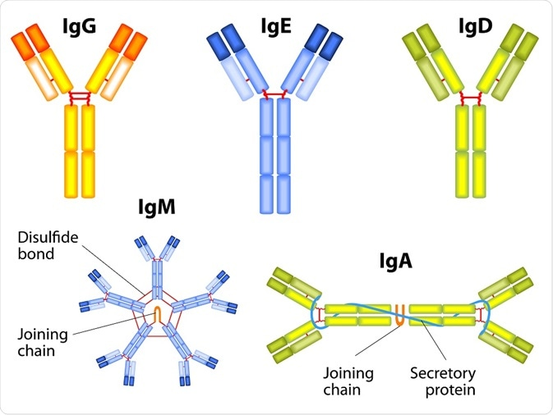
Shapes of different antibodies

Slide 15
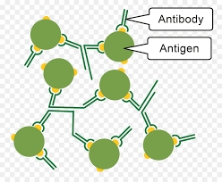
What is antibody and antigen?

Slide 16
Antigen:substances that stimulate the immune system to produce anti bodies
Antibidy: antibodies are immunoglobins. they are in Y shaped in structure
They produces B cells

Slide 17
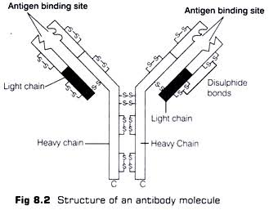
Structure of antibody

Slide 18
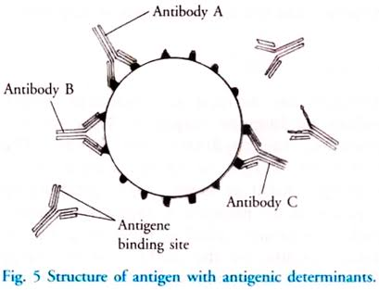
Structure of antigen

Slide 19
ABO BLOOD GROUP SYSTEM
TYPES of blood groups A: iAiA (or)iAi
B:iBiB(or)iBi
AB:iAiB
O: iOiO(or) ii

Slide 20
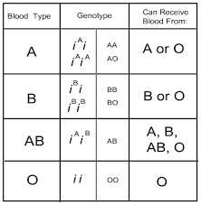
Allele form of blood groups

Slide 21
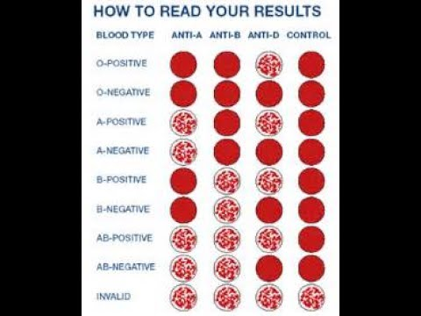
Blood grouping

Slide 22
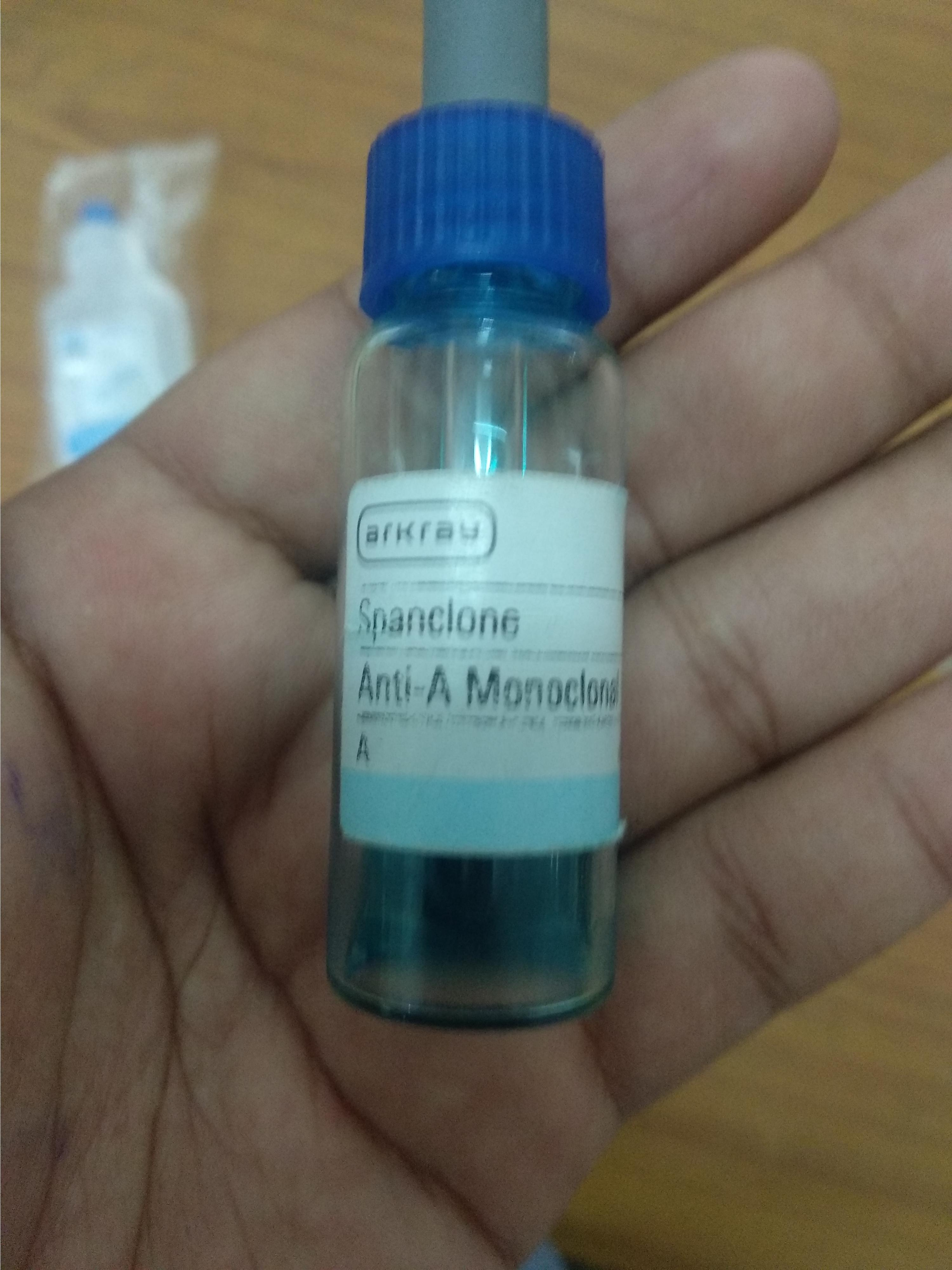
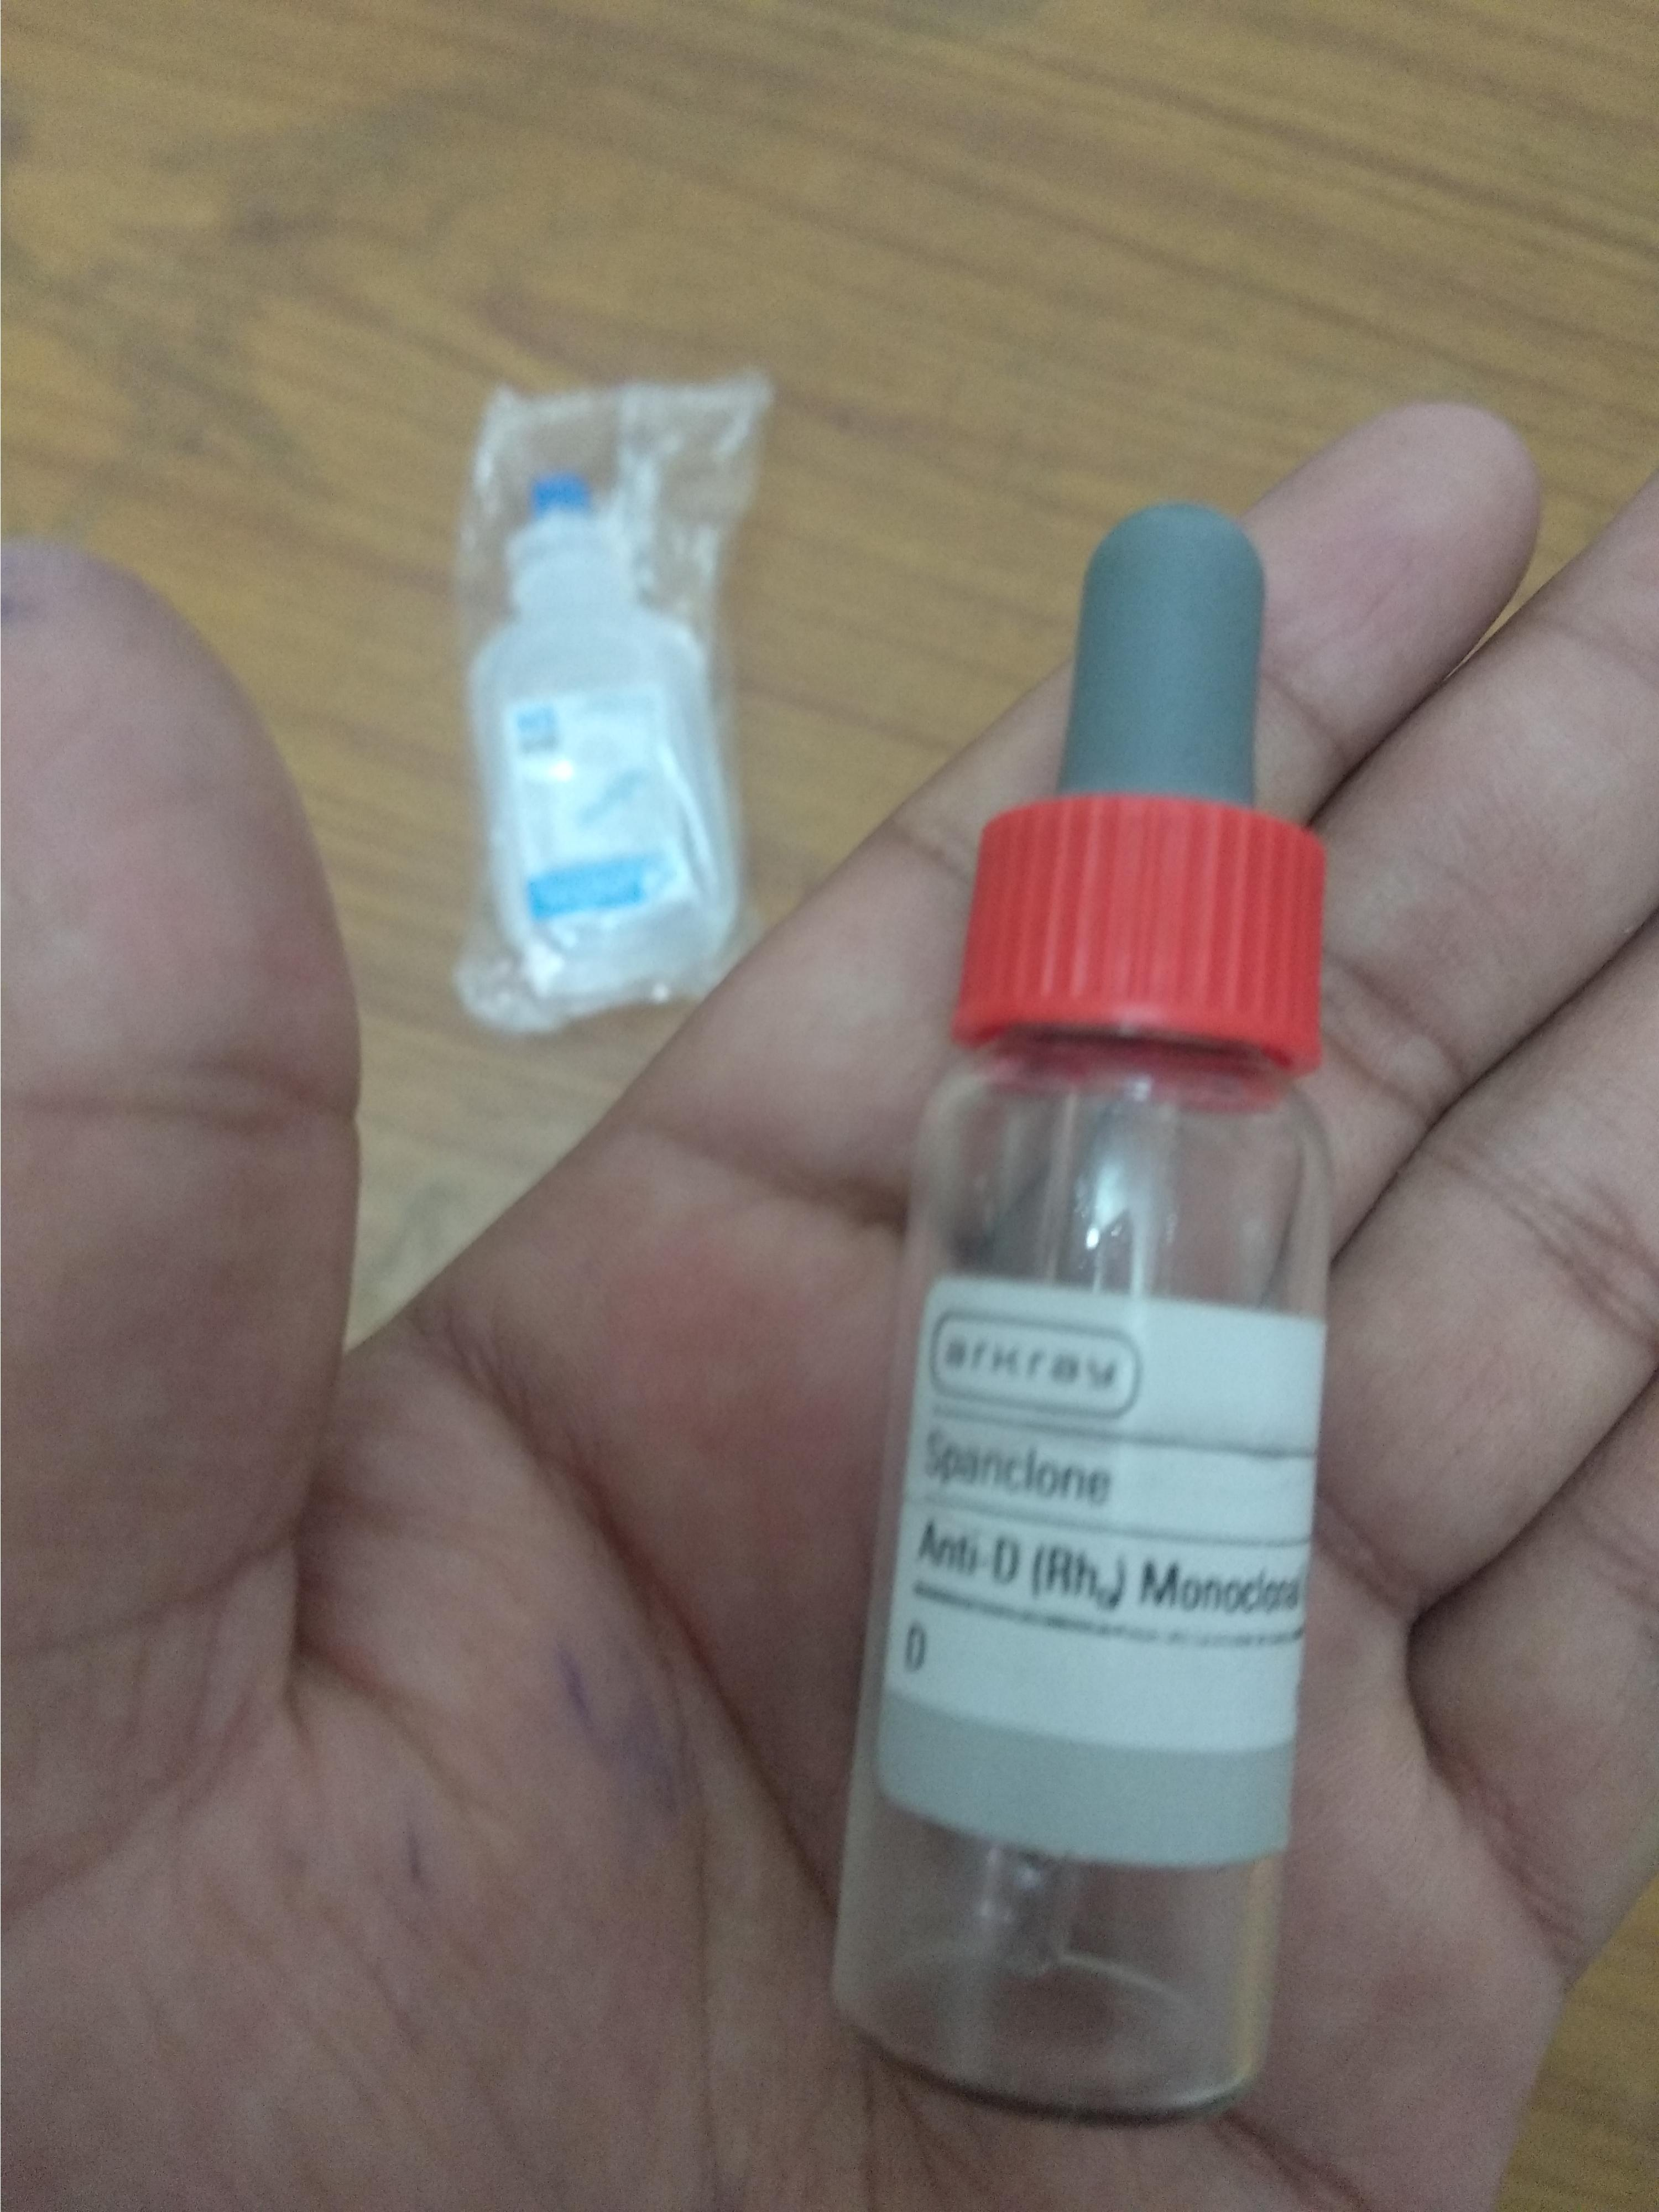
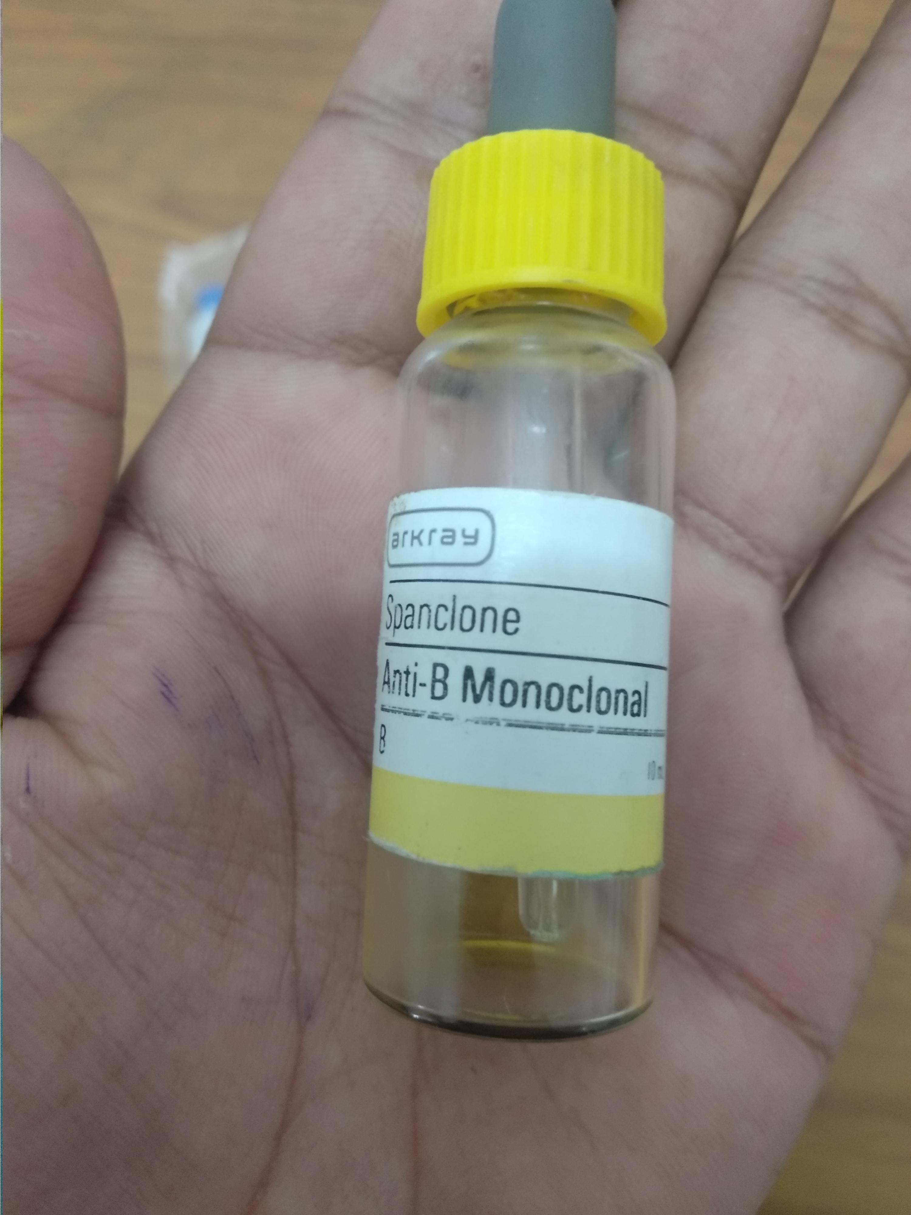
Antiserums

Slide 23
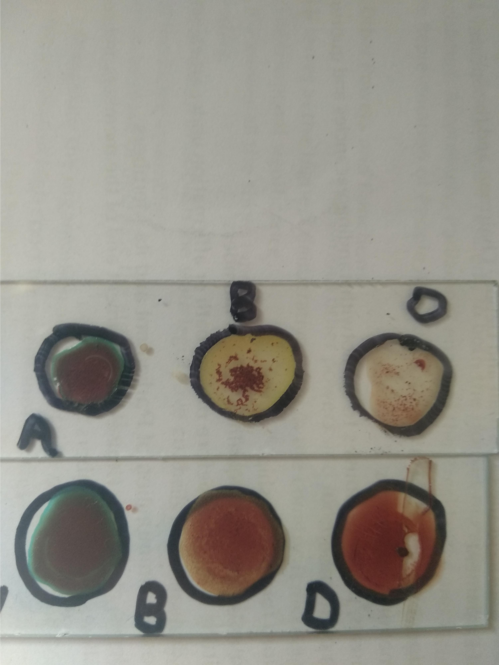
B+ve and B-ve blood groups

Slide 24

Any questions

Slide 25
Thankyou

