Slide 1

Automatic Vulnerability Scanner - NETSPARKER
Website: http://zero.webappsecurity.com/

Slide 2
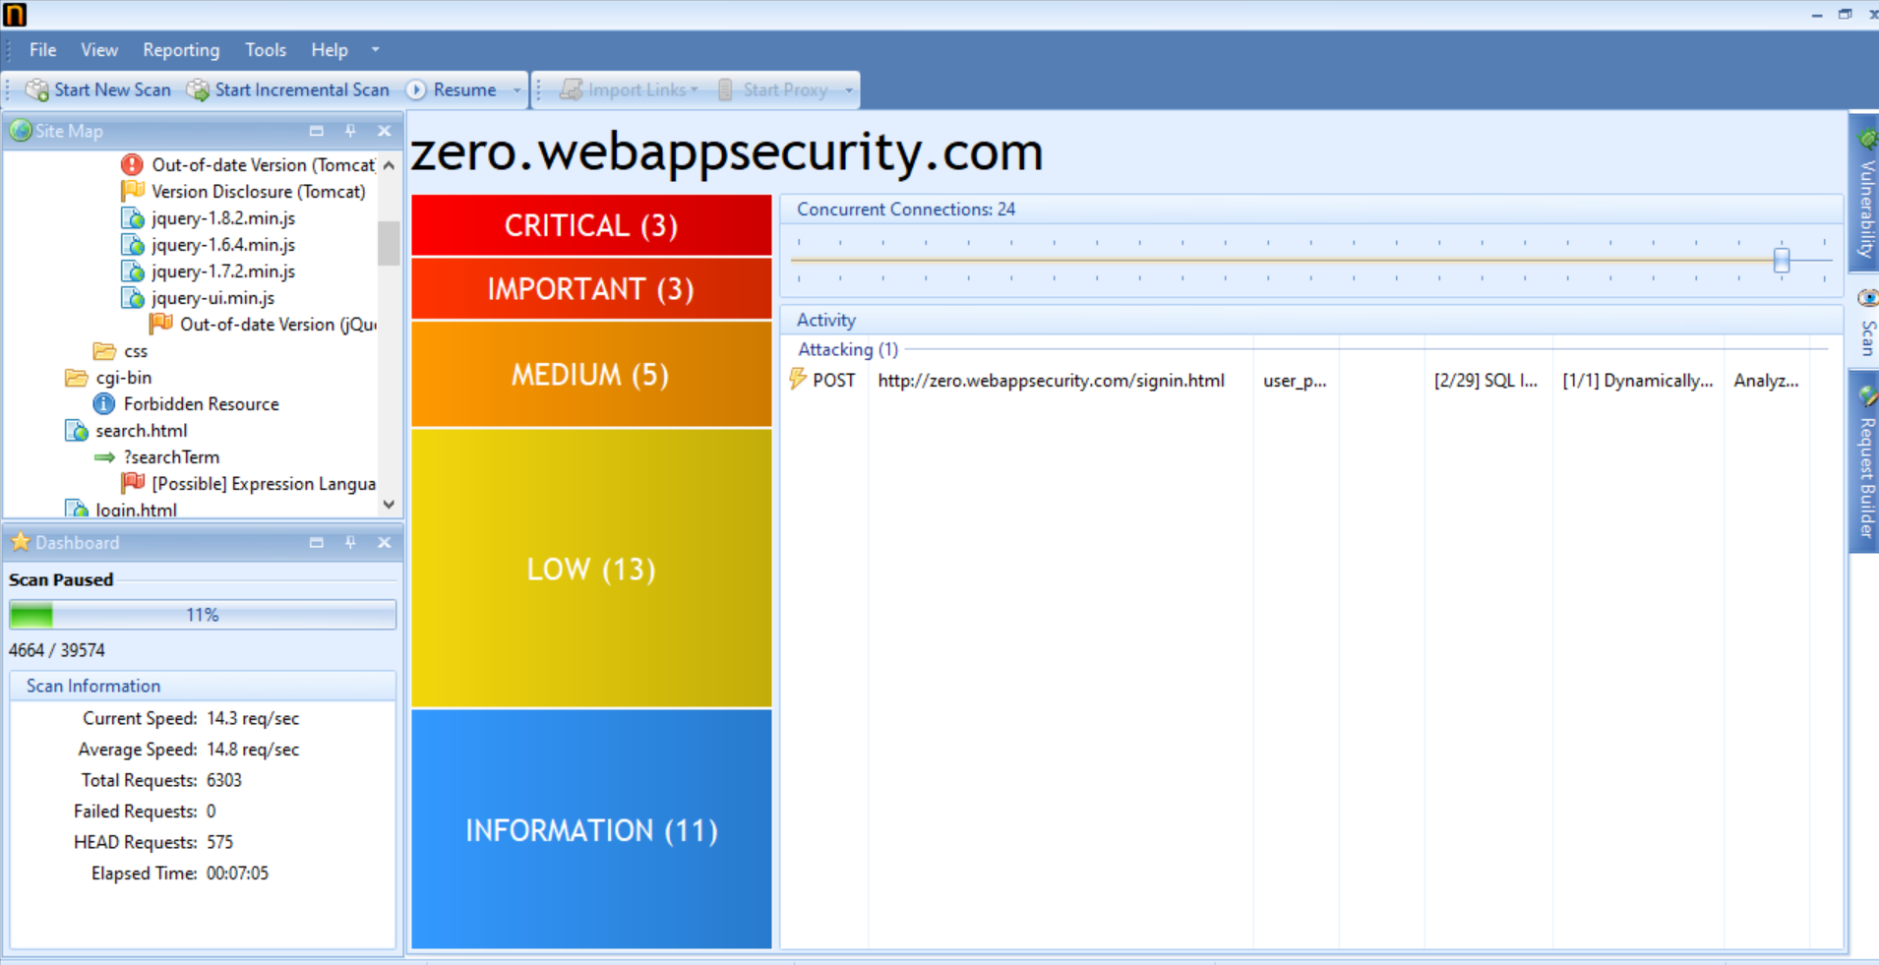

Slide 3
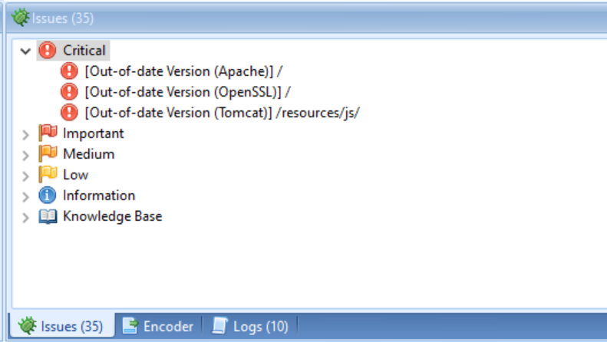

Slide 4
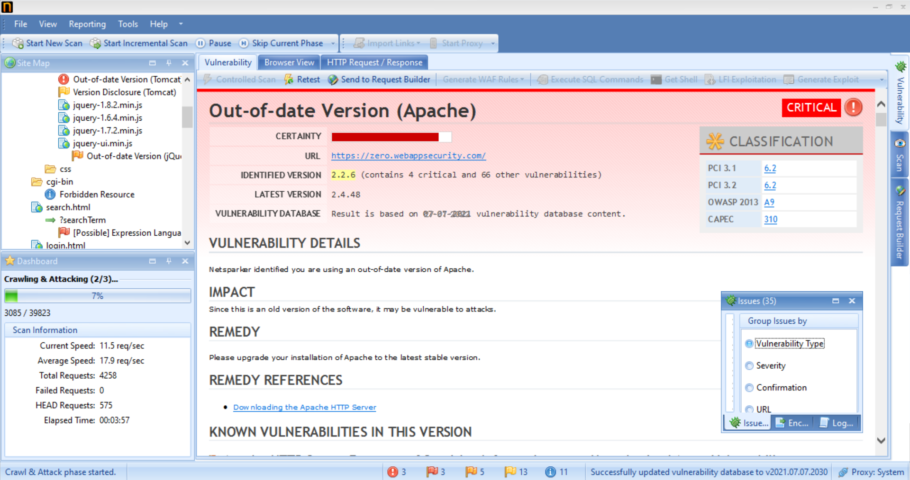

Slide 5
VULNERABILITY REPORT: VULNERABLITIY DETAILS : Netsparker identified that you are using an out of date version of Apache. SEVERITY : high INSTANCE : URL -https://zero.webappsecurity.com/ PROOF OF CONCEPT : Screen shot of Netsparker. IMPACT : Since this is an old version of the software, it may be vulnerable to attacks. Allow remote attackers to obtain sensitive information via a crafted request that triggers access to memory locations associated with an earlier request. REMEDY : Upgrade your installation of Apache to the latest stable version.

Slide 6
THANK YOU

