Slide 1

Shahjalal University of Science and Technology
Project Name: Abusive Comment Detection on Social Media
Submitted By
Limon Mia
Reg : 2013331002
Rajesh Singha
Reg : 2013331063
Supervised By
Marium-E-Jannat
Assistant Professor
Md Saiful Islam
Assistant Professor

Slide 2
Purpose
To help people to avoid being harassed in social media.
We are trying to build a system that can detect abusive comment on Facebook.

Slide 3
Previous Work
Sulaiman Khan and Al Musabbir Tuhin
Sabik Safkat and Taramin Haque

Slide 4
Classes
Positive – 0
Online Sexual Harassments – 1
Cyber Bulling – 2
Religious Extremism – 3
Political - 4

Slide 5
Working Procedure
Data Collection
Data Preprocessing
Dataset
Implementation

Slide 6
Data Collection & Preprocessing
Get 18,000 tagged data from Sabik Safkat and Taramin Haque
Scrape additional 2000 data
Remove all comment except Bangla

Slide 7
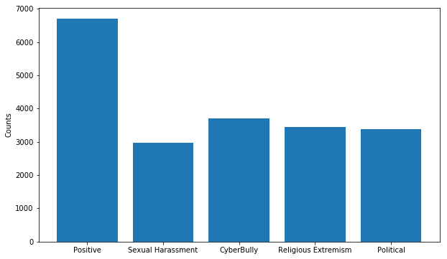
Dataset
Our dataset consists of 20,000 tagged data.
Categorized in Five classes

Slide 8
Algorithms
Naive Bayes(NB)
Support Vector Machine(SVM)
Logistic Regression(LR)
Neural Network(MLP)

Slide 9
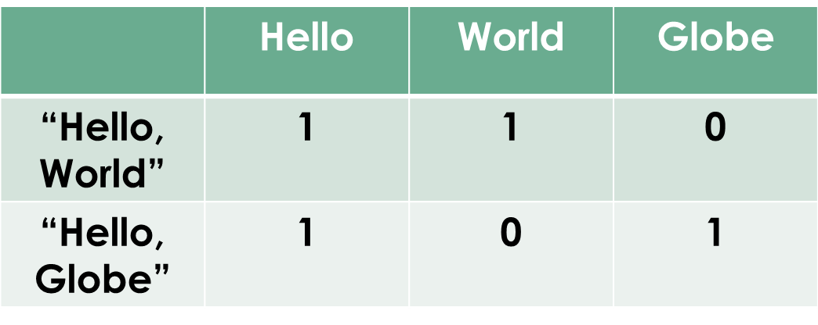
Feature Vector
Two texts:
“Hello, World”
“Hello, Globe”
Bag: [“Hello” “World” “Globe”]

Slide 10
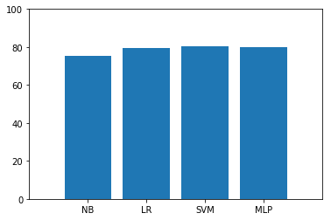
Results
79.5%
80.4%
79.8%
75.4%
Fig: Accuracy

Slide 11
Future Work
Enrich dataset.
More analysis.

Slide 12
User Interface

Slide 13
Thanks !!!

Slide 14
Questions???

