Slide 1
Reinforcement Learning for Predictive Maintenance
Progress Presentation
Rajesh Siraskar
Supervisor: Dr. Satish Kumar
Co-supervisor: Dr. Shruti Patil
Co-Supervisor: Dr. Ambarish Kulkarni
07-Feb-2026
Mode: Part-Time
PRN: 2107 900 1012
Confirmation: 16-Feb-2023

Slide 2
Agenda
Xx
Xxx
xxx

Slide 3
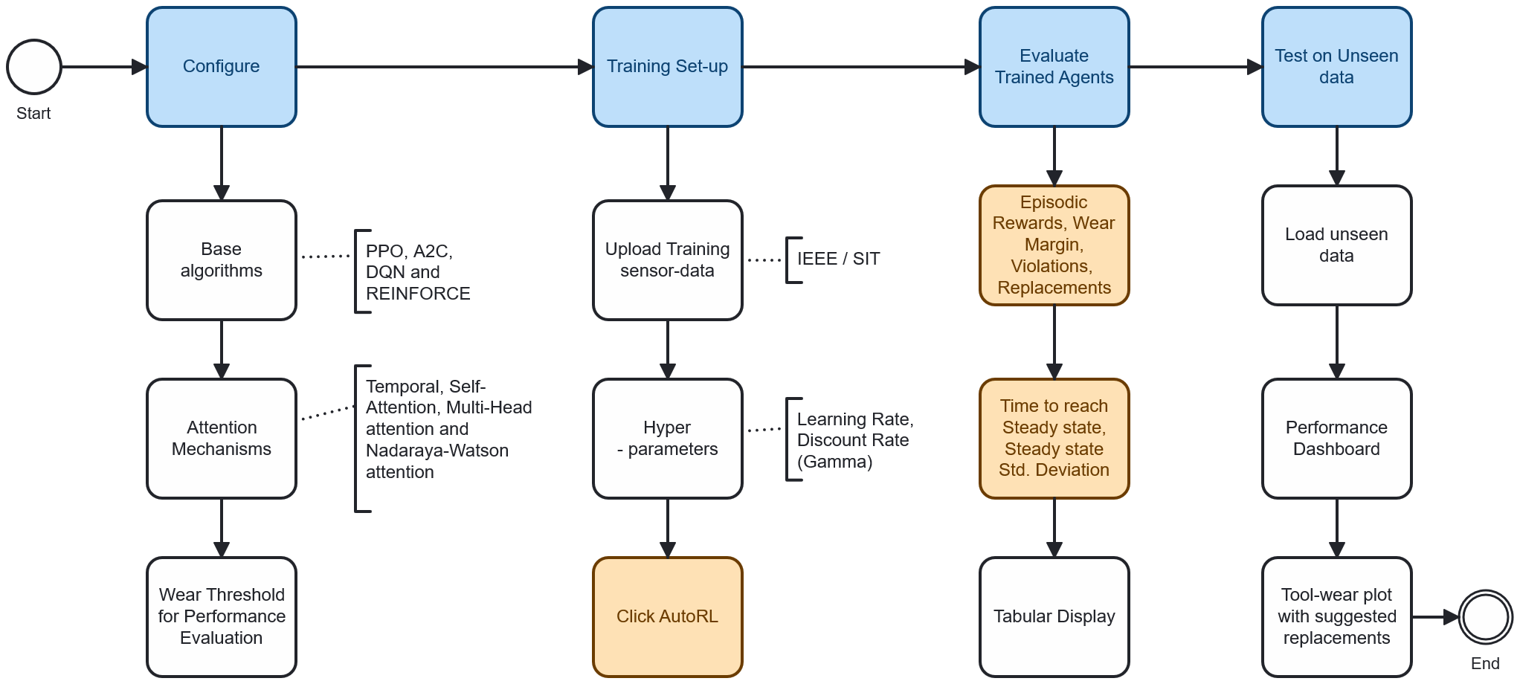
AutoRL – Framework Flow

Slide 4
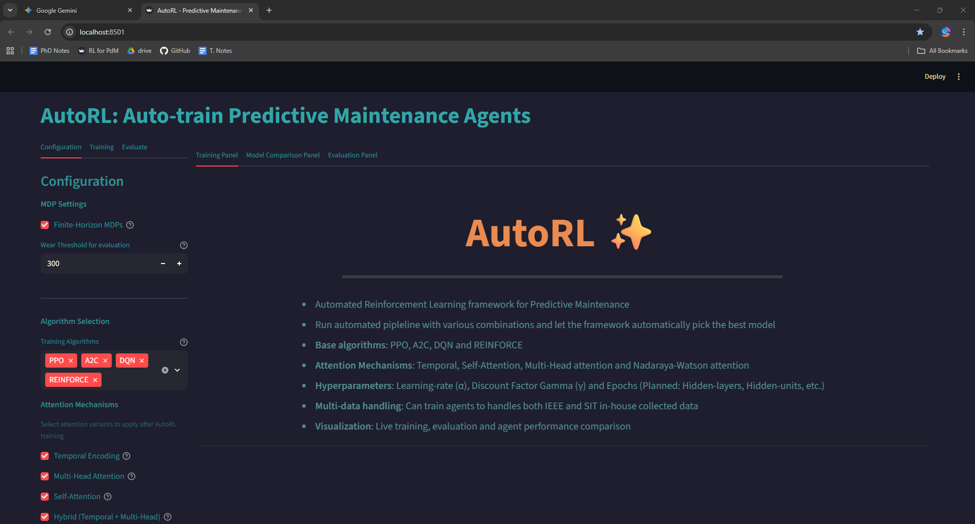
AutoRL – Application Framework

Slide 5
AutoRL – Application Framework
Main area panels
Live-training plots
Trained models performance comparison
Evaluate trained model on unseen test data
Set-up panels
1. Configuration
2. Training
3. Evaluation

Slide 6
Configuration Panel
Configuration Panel
Base algorithms:
  PPO
  A2C
  DQN and
  REINFORCE
Attention Mechanisms:
  Temporal Attention
  Self-Attention
  Multi-Head attention and
  Nadaraya-Watson attention
Wear Threshold for Performance Evaluation

Slide 7
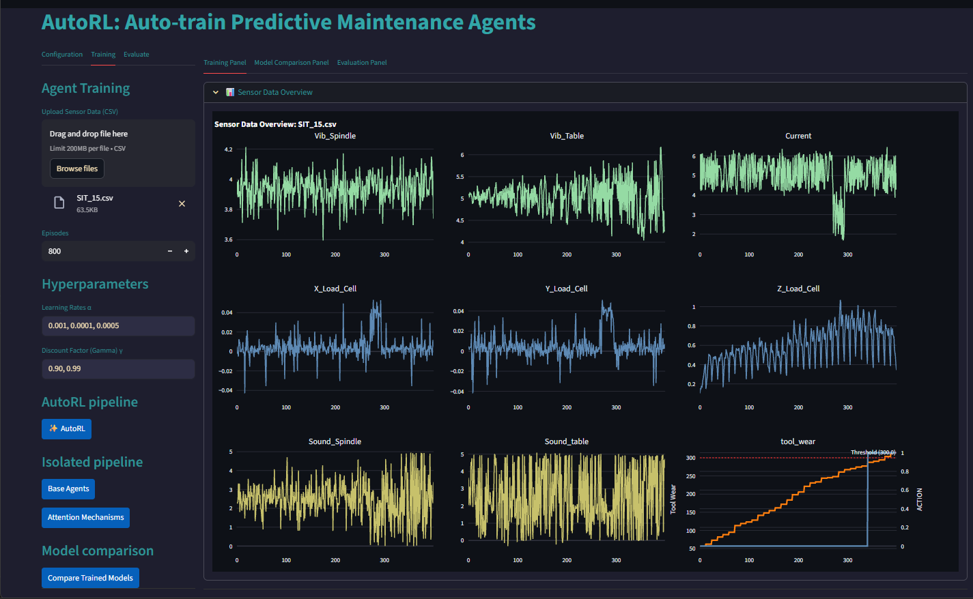
Training Set-up Panel
Training Set-up Panel
Select sensor data
  IEEE data
  SIT data
Hyper-parameters:
  Multiple Learning Rates
  Multiple Discount Rates (Gamma)
Load sensor training data
Multiple learning-rates (Alpha)
Multiple discount-rate (Gamma)
AutoRL – Run fully automated pipeline

Slide 8
Training Set-up Panel – SIT data loaded
Training Set-up Panel
Select sensor data
  IEEE data
  SIT data
Hyper-parameters:
  Multiple Learning Rates
  Multiple Discount Rates (Gamma)

Slide 9
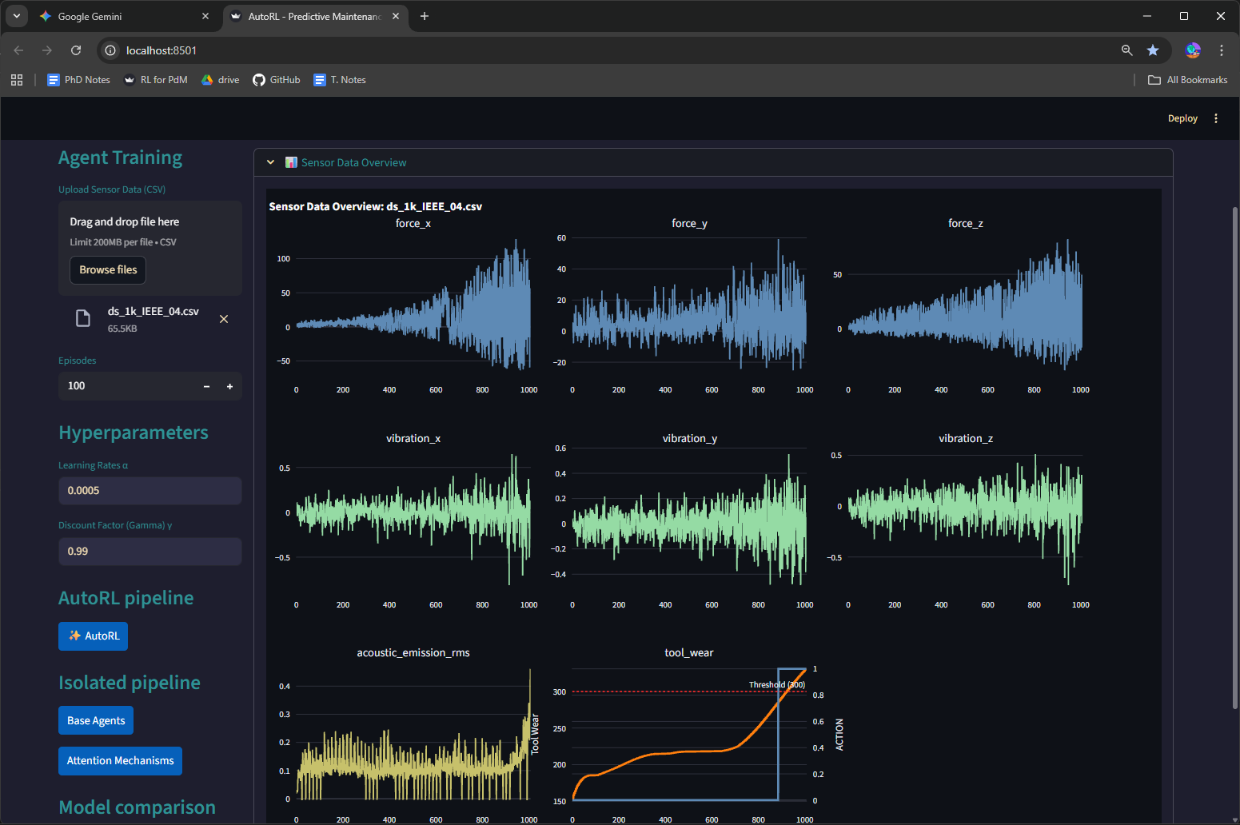
Training Set-up Panel – IEEE data loaded

Slide 10
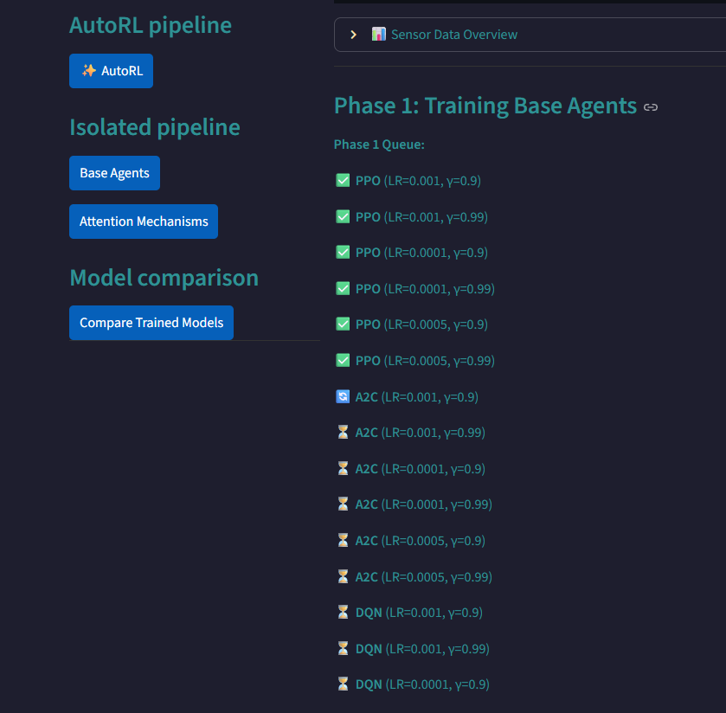
Training Queue
AutoRL Training Queue
In Phase-1: AutoRL automatically creates a queue of all training combinations – based on user-inputs.
Example:
24 combinations = 4 Algorithms x 3 Learning-rates x 2 Discount Rate (Gamma)

Slide 11
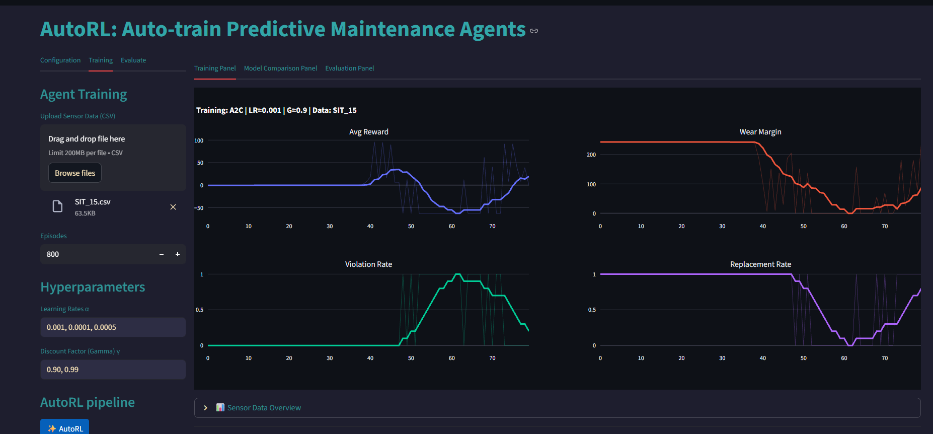
Training: Live training plots

Slide 12
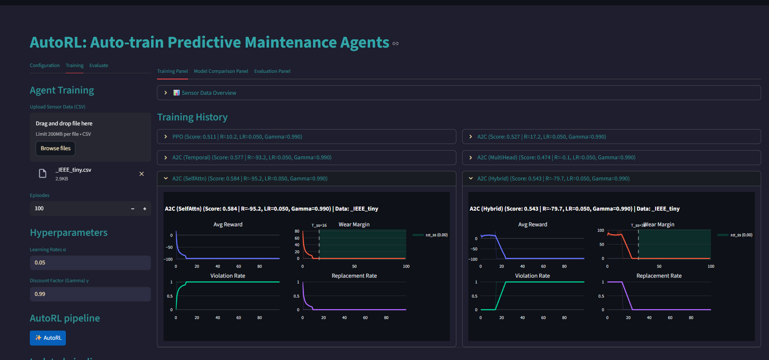
Training Logs – All training plots saved in log

Slide 13
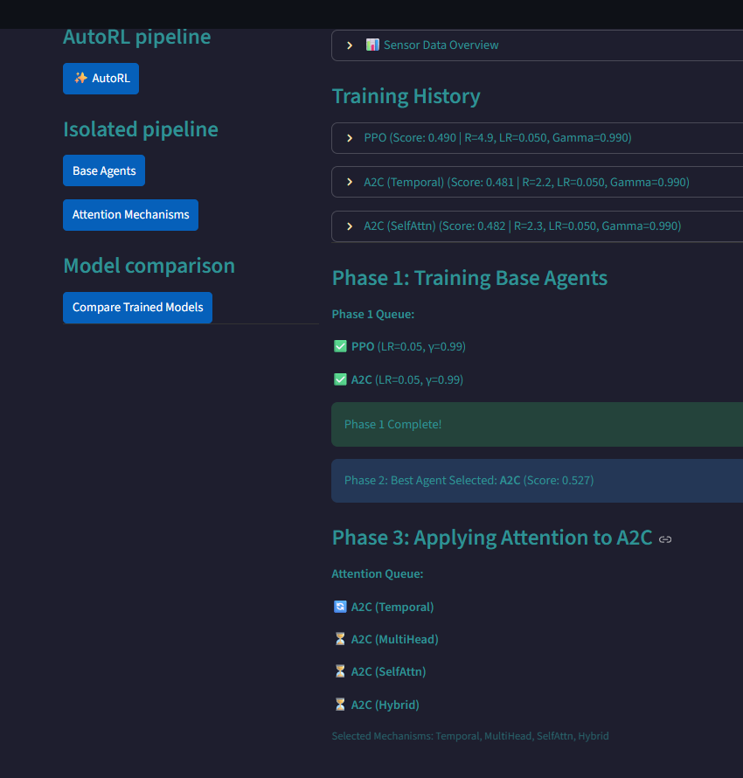
Training – Phase 2 and Phase 3
AutoRL Training Queue
In Phase-2: Best algorithm and hyper-parameter selected automatically
In Phase-3: Queue created automatically for applying attention mechanism to best combination

Slide 14
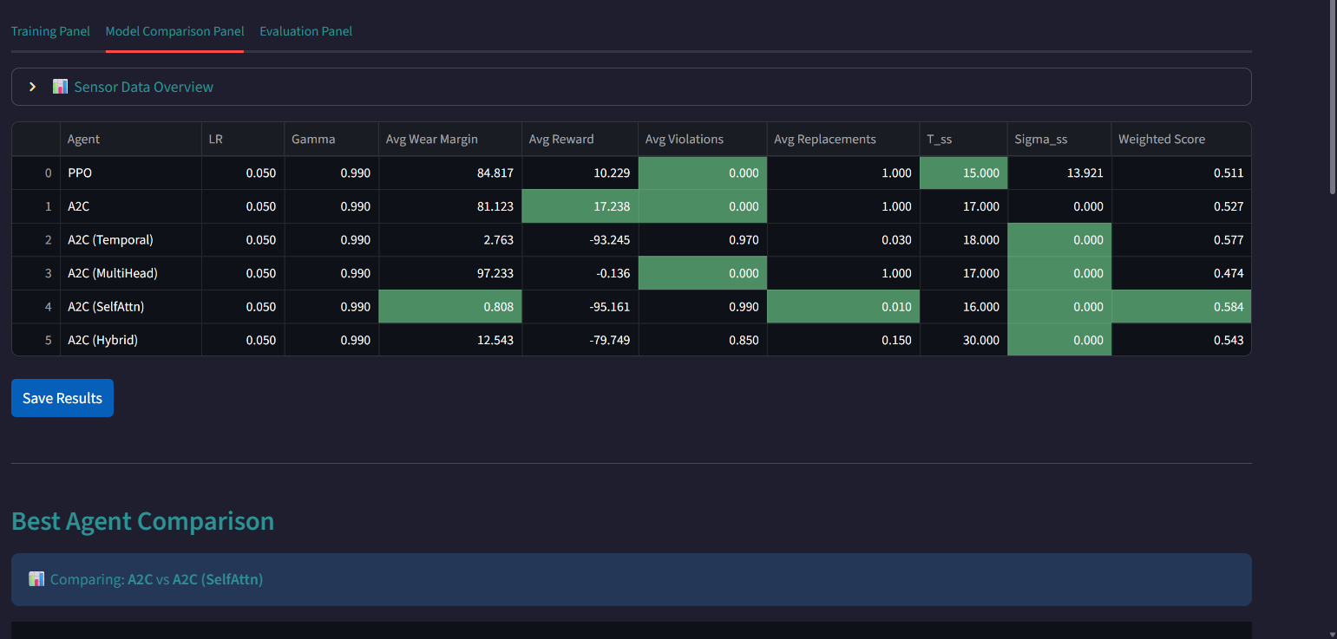
Training – Performance comparison
Best model highlighted using six parameters: (1) Episodic Rewards, (2) Wear Margin, (3) Number of Violations, (4) Number of Replacements, (5) Time to reach Steady state for Wear-margin, (6) Steady state Std. Deviation

Slide 15
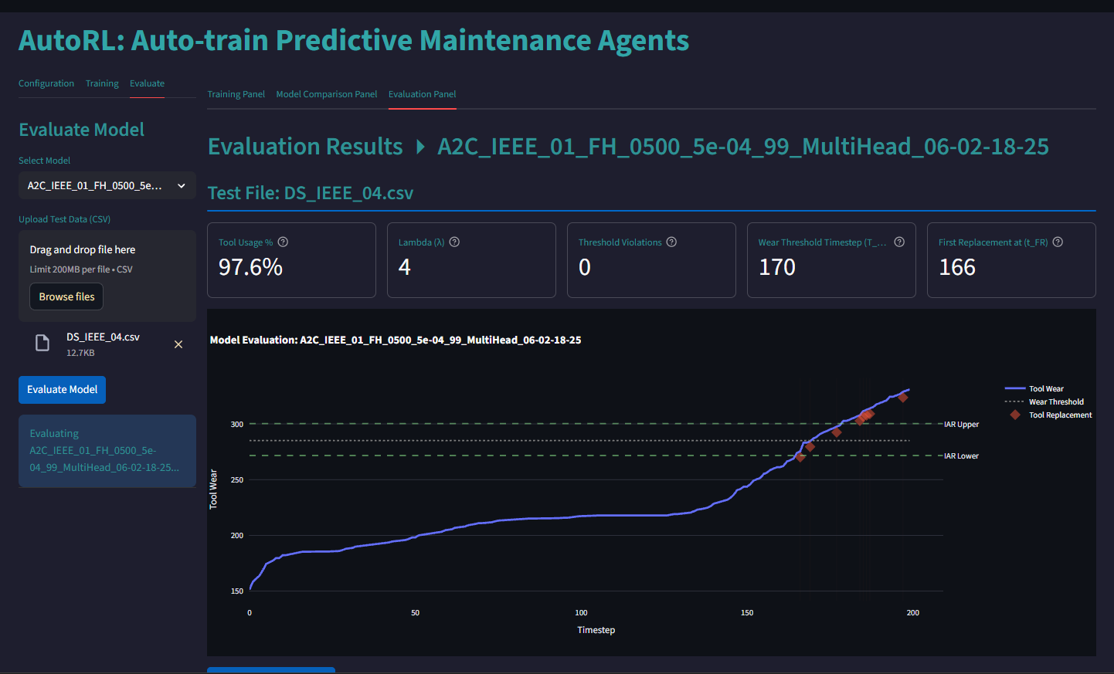
Evaluation – Evaluate on new machine data
Evaluation Dashboard:
Tool usage %
Lambda – Wear margin on first replacement
Violations

Slide 16
Thank you

