Slide 1
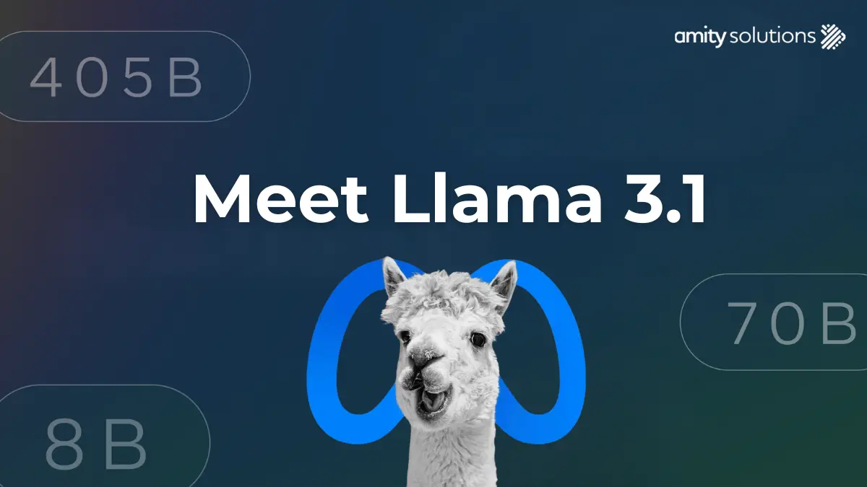
LLAMA-3.1

Slide 2
Agenda
Play with llama3.1 405B parameter
01
Use Llama 3.1 programmatically
02
Fine-tune to get more precise result
03
Save the model and reuse it for the future inferencing
04

