Slide 1

Mistral explained (7B and 8x7B)
Rajesh Thakur
Downloaded from: https://github.com/RajeshThakur1/Mistral
Not for commercial use
https://github.com/RajeshThakur1/Mistral

Slide 2
Prerequisites
Topics
Structure of the Transformer model and how the attention mechanism works.
Topics not covered
The following topics will not be covered in the current video, as they have already been explained in my previous video on LLaMA.
RMS Normalization
Rotary Positional Encoding
Grouped Query Attention
Architectural differences between the vanilla Transformer and Mistral
Sliding Window Attention
Review of self-attention
Receptive field
KV-Cache
Motivation
How it works
Rolling Buffer Cache
Pre-fill and chunking
Sparse Mixture of Experts
Model Sharding
Pipeline Parallelism
Understanding the Mistral model’s code
Block attention in xformers
https://github.com/RajeshThakur1/Mistral

Slide 3
Topics
Architectural differences between the vanilla Transformer and Mistral
Sliding Window Attention
Review of self-attention
Receptive field
KV-Cache
Motivation
How it works
Rolling Buffer Cache
Pre-fill and chunking
Sparse Mixture of Experts
Model Sharding
Pipeline Parallelism
Understanding the Mistral model’s code
Block attention in xformers

Slide 4
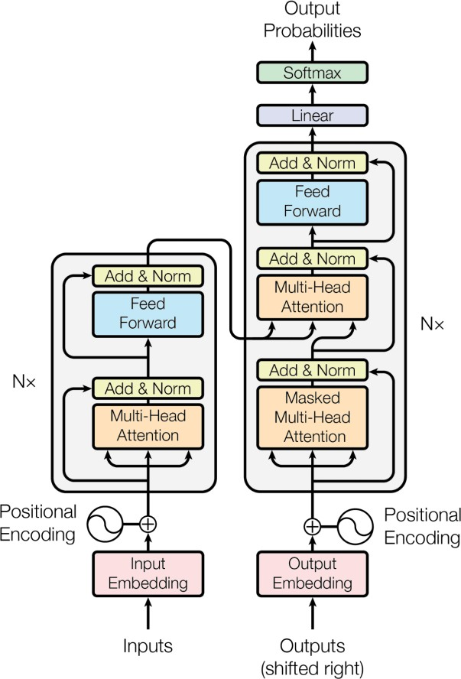

Transformer vs Mistral
Softmax
Linear
RMS Norm
(MoE) Feed Forward
SILU
RMS Norm
Nx
Self-Attention with Sliding Window Attention
,Grouped Query Attention, and Rolling Buffer KV- Cache
Q K
V
Rotary
Positional Encodings
RMS Norm
Embeddings
Input
Transformer
(“Attention is all you need”)
Mistral

Slide 5
Models
Parameter | Description | Value (7B) | Value (8x7B) | Notes
dim | Size of the embedding vector | 4096 | 4096
n_layers | Number of encoder layers | 32 | 32
head_dim | dim / n_heads | 128 | 128
hidden_dim | Hidden dimension in the feedforward layer | 14336 | 14336
n_heads | Number of attention heads (Q) | 32 | 32 | Different numbers because of Grouped Query Attention
n_kv_heads | Number of attention heads (K, V) | 8 | 8
windows_size | Size of the sliding window for attention calculation and Rolling Cache | 4096 | N / A | window_size is not set in the params.json of the 8x7B model
context_len | Context on which model was trained upon | 8192 | 32000 | For 8x7B, values are from the official announcement page
vocab_size | Number of tokens in the vocabulary | 32000 | 32000 | The tokenizer is the SentencePiece tokenizer
num_experts_per_tok | Number of expert models for each token | N / A | 2 | Sparse Mixture of Experts only available for 8x7B
num_experts | Number of exper models | N / A | 8

Slide 6
Topics
Architectural differences between the vanilla Transformer and Mistral
Sliding Window Attention
Review of self-attention
Receptive field
KV-Cache
Motivation
How it works
Rolling Buffer Cache
Pre-fill and chunking
Sparse Mixture of Experts
Model Sharding
Pipeline Parallelism
Understanding the Mistral model’s code
Block attention in xformers

Slide 7
What is Self-Attention?
Self-Attention allows the model to relate words to each other. Imagine we have the
following sentence: “The cat is on a chair”
Here I show the product of the Q and the K matrix before we apply the softmax.
𝑄𝐾^{𝑇}
𝐴𝑡𝑡𝑒𝑛𝑡𝑖𝑜𝑛 𝑄, 𝐾, 𝑉
= softmax
𝑑_{𝑘}
𝑉
 | THE | CAT | IS | ON | A | CHAIR
THE | 0.268 | 0.119 | 0.134 | 0.148 | 0.179 | 0.152
CAT | 0.124 | 0.278 | 0.201 | 0.128 | 0.154 | 0.115
IS | 0.147 | 0.132 | 0.262 | 0.097 | 0.218 | 0.145
ON | 0.210 | 0.128 | 0.206 | 0.212 | 0.119 | 0.125
A | 0.146 | 0.158 | 0.152 | 0.143 | 0.227 | 0.174
CHAIR | 0.195 | 0.114 | 0.203 | 0.103 | 0.157 | 0.229
Q
(6, 4096)
_{K}T
(4096, 6)
X
=
* all values are random.
4096
(6, 6)

Slide 8
Let’s apply a causal mask
After applying the causal mask we apply the softmax, which makes the remaining values on the row in such a way that the row sums up to 1.
Now, let’s look at the sliding window attention.
𝑄𝐾^{𝑇}
𝐴𝑡𝑡𝑒𝑛𝑡𝑖𝑜𝑛 𝑄, 𝐾, 𝑉
= softmax
𝑑_{𝑘}
𝑉
 | THE | CAT | IS | ON | A | CHAIR
THE | 0.268 | −∞ | −∞ | −∞ | −∞ | −∞
CAT | 0.124 | 0.278 | −∞ | −∞ | −∞ | −∞
IS | 0.147 | 0.132 | 0.262 | −∞ | −∞ | −∞
ON | 0.210 | 0.128 | 0.206 | 0.212 | −∞ | −∞
A | 0.146 | 0.158 | 0.152 | 0.143 | 0.227 | −∞
CHAIR | 0.195 | 0.114 | 0.203 | 0.103 | 0.157 | 0.229
Q
(6, 4096)
_{K}T
(4096, 6)
X
=
* all values are random.
4096
(6, 6)

Slide 9
Let’s apply sliding window attention
The sliding window size is 3
𝑄𝐾^{𝑇}
𝐴𝑡𝑡𝑒𝑛𝑡𝑖𝑜𝑛 𝑄, 𝐾, 𝑉
= softmax
𝑑_{𝑘}
𝑉
 | THE | CAT | IS | ON | A | CHAIR
THE | 0.268 | −∞ | −∞ | −∞ | −∞ | −∞
CAT | 0.124 | 0.278 | −∞ | −∞ | −∞ | −∞
IS | 0.147 | 0.132 | 0.262 | −∞ | −∞ | −∞
ON | −∞ | 0.128 | 0.206 | 0.212 | −∞ | −∞
A | −∞ | −∞ | 0.152 | 0.143 | 0.227 | −∞
CHAIR | −∞ | −∞ | −∞ | 0.103 | 0.157 | 0.229
Q
(6, 4096)
_{K}T
(4096, 6)
X
=
* all values are random.
4096
(6, 6)

Slide 10
Sliding Window Attention: details
Reduces the number of dot-products to perform, and thus, performance during training and inference.
Sliding window attention may lead to degradation in the performance of the model, as some “interactions” between tokens will not be captured.
The model mostly focuses on the local context, which depending on the size of the window, is enough for most cases.
This makes sense if you think about a book: the words in a paragraph on chapter number 5 depend on the paragraphs in the same chapter but may be totally unrelated to the words used in chapter 1.
Sliding window attention can still allow one token to watch tokens outside the window, using a reasoning similar to the receptive field
in convolutional neural networks.

Slide 11
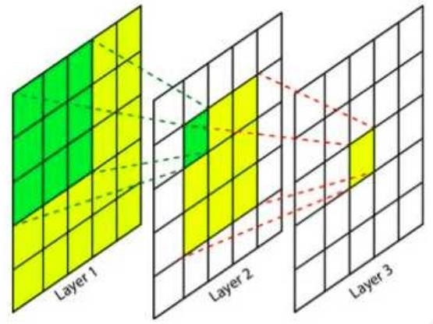
Receptive field in CNNs
This feature depends directly on 9 features of the previous layers, but indirectly on all the features of the initial layers, since each feature of the intermediate layer depends on 9 features of the previous layer. This means that a change in any of the features of the layer 1 will influence this features as well.
Image source: https://theaisummer.com/receptive-field/

Slide 12
Sliding Window Attention: information flow (1)
After applying the softmax, all the –Infinity have become 0, while the other values in the row are changed in such a way that they sum up to one. The output of the softmax can be thought of as a probability distribution.
𝑄𝐾^{𝑇}
𝐴𝑡𝑡𝑒𝑛𝑡𝑖𝑜𝑛 𝑄, 𝐾, 𝑉
= softmax
𝑑_{𝑘}
𝑉
 | THE | CAT | IS | ON | A | CHAIR
THE | 1.0 | 0 | 0 | 0 | 0 | 0
CAT | 0.461 | 0.538 | 0 | 0 | 0 | 0
IS | 0.3219 | 0.317 | 0.361 | 0 | 0 | 0
ON | 0 | 0.316 | 0.341 | 0.343 | 0 | 0
A | 0 | 0 | 0.326 | 0.323 | 0.351 | 0
CHAIR | 0 | 0 | 0 | 0.313 | 0.331 | 0.356
Q
X
_{K}T
softmax
=
(6, 4096)
(4096, 6)
4096

Slide 13
Sliding Window Attention: information flow (2)
𝐴𝑡𝑡𝑒𝑛𝑡𝑖𝑜𝑛 𝑄, 𝐾, 𝑉 = softmax
𝑄𝐾^{𝑇}
𝑉
𝑑_{𝑘}
 | THE | CAT | IS | ON | A | CHAIR
THE | 1.0 | 0 | 0 | 0 | 0 | 0
CAT | 0.461 | 0.538 | 0 | 0 | 0 | 0
IS | 0.3219 | 0.317 | 0.361 | 0 | 0 | 0
ON | 0 | 0.316 | 0.341 | 0.343 | 0 | 0
A | 0 | 0 | 0.326 | 0.323 | 0.351 | 0
CHAIR | 0 | 0 | 0 | 0.313 | 0.331 | 0.356
V
(6, 4096)
Output
(6, 4096)
The output of the Self-Attention is a matrix of the same shape as the input sequence, but where each token now captures information about other tokens according to the mask applied. In our case, the last token of the output captures information about itself and the two preceding tokens.
X
=
(6, 6)

Slide 14
Sliding Window Attention: information flow (3)
THE
CAT
IS
ON
A
CHAIR
THE
THE, CAT
THE, CAT, IS
CAT, IS, ON
IS, ON, A
ON, A, CHAIR
THE
THE, CAT
THE, CAT, IS
THE, CAT, IS, ON
THE, CAT, IS, ON, A
CAT, IS, ON, A, CHAIR
Layer 1
Layer 2
(6, 4096)
(6, 4096)
(6, 4096)
With a sliding window size 𝑊 = 3, every layer adds information about (𝑊 – 1) = 2 tokens.
This means that after 𝑁 layers, we will have an information flow in the order of 𝑊 × 𝑁.
You can test all the future configurations using the Python Notebook provided in the GitHub repository.

Slide 15
Sliding Window Attention: information flow (4)
 | THE | THE/CAT | THE/CAT /IS | CAT/IS/ ON | IS/ON/A | ON/A/C HAIR
THE | 1.0 | 0 | 0 | 0 | 0 | 0
THE/CA T | 0.461 | 0.538 | 0 | 0 | 0 | 0
THE/CA T/IS | 0.3219 | 0.317 | 0.361 | 0 | 0 | 0
CAT/IS/ ON | 0 | 0.316 | 0.341 | 0.343 | 0 | 0
IS/ON/ A | 0 | 0 | 0.326 | 0.323 | 0.351 | 0
ON/A/C HAIR | 0 | 0 | 0 | 0.313 | 0.331 | 0.356
V
(6, 4096)
Output
(6, 4096)
X
=
(6, 6)

Slide 16
Sliding Window Attention: information flow (5)
As you can see, the information flow is very similar to the receptive field of a CNN.
Image source: Mistral 7B paper

Slide 17
Topics
Architectural differences between the vanilla Transformer and Mistral
Sliding Window Attention
Review of self-attention
Receptive field
KV-Cache
Motivation
How it works
Rolling Buffer Cache
Pre-fill and chunking
Sparse Mixture of Experts
Model Sharding
Pipeline Parallelism
Understanding the Mistral model’s code
Block attention in xformers

Slide 18
Next Token Prediction Task
Softmax
Linear
RMS Norm
Imagine we want to train a model to write Dante
Alighieri’s Divine Comedy’s 5th Canto from the Inferno.
(MoE) Feed Forward
SILU
Amor, ch'al cor gentil ratto s'apprende, prese costui de la bella persona
che mi fu tolta; e 'l modo ancor m'offende.
RMS Norm
Amor, ch'a nullo amato amar perdona, mi prese del costui piacer sì forte,
che, come vedi, ancor non m'abbandona.
Nx
Amor condusse noi ad una morte. Caina attende chi a vita ci spense.
Self-Attention with Sliding Window Attention
,Grouped Query Attention, and Rolling Buffer KV- Cache
Q K
V
Rotary
Positional Encodings
Love, that can quickly seize the gentle heart, took hold of him because of the fair body
taken from me—how that was done still wounds me.
RMS Norm
Love, that releases no beloved from loving, took hold of me so strongly through his beauty that, as you see, it has not left me yet.
Embeddings
Love led the two of us unto one death. Caina waits for him who took our life.”
Input
Source: https://digitaldante.columbia.edu/dante/divine-comedy/inferno/inferno-5/

Slide 19
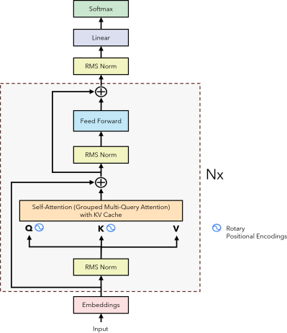
Next Token Prediction Task
Target Love that can quickly seize the gentle heart [EOS]
Training
Input
[SOS] Love that can quickly seize the gentle heart

Slide 20
Next Token Prediction Task: Inference
Output
Love
Inference T = 1
Input
[SOS]

Slide 21
Next Token Prediction Task: Inference
Output
Love that
Inference T = 2
Input
[SOS] Love
Umar Jamil – https://github.com/hkproj/mistral-llm-notes

Slide 22
Next Token Prediction Task: Inference
Output
Love that can
Inference T = 3
Input
[SOS] Love that
Umar Jamil – https://github.com/hkproj/mistral-llm-notes

Slide 23
Next Token Prediction Task: Inference
Output
Love that can quickly
Inference T = 4
Input
[SOS] Love that can
Umar Jamil – https://github.com/hkproj/mistral-llm-notes

Slide 24
Next Token Prediction Task: Inference
Output
Love that can quickly seize
Inference T = 5
Input
[SOS] Love that can quickly
Umar Jamil – https://github.com/hkproj/mistral-llm-notes

Slide 25
Next Token Prediction Task: Inference
Output
Love that can quickly seize the
Inference T = 6
Input
[SOS] Love that can quickly seize
Umar Jamil – https://github.com/hkproj/mistral-llm-notes

Slide 26
Next Token Prediction Task: Inference
Output
Love that can quickly seize the gentle
Inference T = 7
Input
[SOS] Love that can quickly seize the
Umar Jamil – https://github.com/hkproj/mistral-llm-notes

Slide 27
Next Token Prediction Task: Inference
Output
Love that can quickly seize the gentle heart
Inference T = 8
Input
[SOS] Love that can quickly seize the gentle
Umar Jamil – https://github.com/hkproj/mistral-llm-notes

Slide 28
Next Token Prediction Task: Inference
Output
Love that can quickly seize the gentle heart [EOS]
Inference T = 9
Input
[SOS] Love that can quickly seize the gentle heart

Slide 29
Next Token Prediction Task: the motivation behind the KV cache
At every step of the inference, we are only interested in the last token output by the model, because we already have the previous ones. However, the model needs access to all the previous tokens to decide on which token to output, since they constitute its context (or the “prompt”).
Is there a way to make the model do less computation on the token it has already seen during inference? YES! The solution is the KV cache!

Slide 30
Self-Attention during Next Token Prediction Task
𝑄𝐾^{𝑇}
_{𝐾}𝑇
T 1 - T 1 | T 1- T 1 | T 1 - T 1 | T 1 - T 1 | T 1 - T 1 | T 1 - T 1 | T 1 - T 1 | T 1 - T 1 | T 1 - T 1
T 1 - T 1 | T 1- T 1 | T 1 - T 1 | T 1 - T 1 | T 1 - T 1 | T 1 - T 1 | T 1 - T 1 | T 1 - T 1 | T 1 - T 1
T 1 - T 1 | T 1- T 1 | T 1 - T 1 | T 1 - T 1 | T 1 - T 1 | T 1 - T 1 | T 1 - T 1 | T 1 - T 1 | T 1 - T 1
T 1 - T 1 | T 1- T 1 | T 1 - T 1 | T 1 - T 1 | T 1 - T 1 | T 1 - T 1 | T 1 - T 1 | T 1 - T 1 | T 1 - T 1
T 1 - T 1 | T 1- T 1 | T 1 - T 1 | T 1 - T 1 | T 1 - T 1 | T 1 - T 1 | T 1 - T 1 | T 1 - T 1 | T 1 - T 1
T 1 - T 1 | T 1- T 1 | T 1 - T 1 | T 1 - T 1 | T 1 - T 1 | T 1 - T 1 | T 1 - T 1 | T 1 - T 1 | T 1 - T 1
T 1 - T 1 | T 1- T 1 | T 1 - T 1 | T 1 - T 1 | T 1 - T 1 | T 1 - T 1 | T 1 - T 1 | T 1 - T 1 | T 1 - T 1
T 1 - T 1 | T 1- T 1 | T 1 - T 1 | T 1 - T 1 | T 1 - T 1 | T 1 - T 1 | T 1 - T 1 | T 1 - T 1 | T 1 - T 1
T 1 - T 1 | T 1- T 1 | T 1 - T 1 | T 1 - T 1 | T 1 - T 1 | T 1 - T 1 | T 1 - T 1 | T 1 - T 1 | T 1 - T 1
𝑄
𝑉
𝐴𝑡𝑡𝑒𝑛𝑡𝑖𝑜𝑛
TOKEN 1
TOKEN 2
TOKEN 3
TOKEN 4
TOKEN 5
TOKEN 6
TOKEN 7
TOKEN 8
TOKEN 9
TOKEN 1
TOKEN 2
TOKEN 3
TOKEN 4
TOKEN 5
TOKEN 6
TOKEN 7
TOKEN 8
TOKEN 9
OUTPUT TOKEN 1
OUTPUT TOKEN 2
OUTPUT TOKEN 3
OUTPUT TOKEN 4
OUTPUT TOKEN 5
OUTPUT TOKEN 6
OUTPUT TOKEN 7
OUTPUT TOKEN 8
OUTPUT TOKEN 9
T O K E N 1 | T O K E N 2 | T O K E N 3 | T O K E N 4 | T O K E N 5 | T O K E N 6 | T O K E N 7 | T O K E N 8 | T O K E N 9
𝑋
=
𝑋
=
(9, 4096)
(4096, 9)
(9, 4096)
(9, 4096)
𝑄𝐾^{𝑇}
𝐴𝑡𝑡𝑒𝑛𝑡𝑖𝑜𝑛 𝑄, 𝐾, 𝑉
= softmax
𝑉
(9, 9)
𝑑_{𝑘}

Slide 31
Self-Attention during Next Token Prediction Task
𝑄𝐾^{𝑇}
_{𝐾}𝑇
T 1 - T 1
𝑄
𝑉
𝐴𝑡𝑡𝑒𝑛𝑡𝑖𝑜𝑛
TOKEN 1
TOKEN 1
OUTPUT TOKEN 1
T O K E N 1
𝑋
=
𝑋
=
(1, 4096)
(4096, 1)
(1, 4096)
(1, 4096)
𝑄𝐾^{𝑇}
𝐴𝑡𝑡𝑒𝑛𝑡𝑖𝑜𝑛 𝑄, 𝐾, 𝑉
= softmax
𝑉
Inference
T = 1
(1, 1)
𝑑_{𝑘}

Slide 32
Self-Attention during Next Token Prediction Task
𝑄𝐾^{𝑇}
_{𝐾}𝑇
T 1 - T 1 | T 1 - T 2
T 2 - T 1 | T 2 - T 2
𝑄
𝑉
𝐴𝑡𝑡𝑒𝑛𝑡𝑖𝑜𝑛
TOKEN 1
TOKEN 2
TOKEN 1
TOKEN 2
OUTPUT TOKEN 1
OUTPUT TOKEN 2
T O K E N 1 | T O K E N 2
𝑋
=
𝑋
=
(2, 4096)
(4096, 2)
(2, 4096)
(2, 4096)
𝑄𝐾^{𝑇}
𝑑_{𝑘}
Inference
T = 2
𝐴𝑡𝑡𝑒𝑛𝑡𝑖𝑜𝑛 𝑄, 𝐾, 𝑉
= softmax
𝑉
(2, 2)

Slide 33
Self-Attention during Next Token Prediction Task
𝑄𝐾^{𝑇}
_{𝐾}𝑇
T 1 - T 1 | T 1 - T 2 | T 1 - T 3
T 2 - T 1 | T 2 - T 2 | T 2 - T 3
T 3 - T 1 | T 3 - T 2 | T 3 - T 3
𝑄
𝑉
𝐴𝑡𝑡𝑒𝑛𝑡𝑖𝑜𝑛
TOKEN 1
TOKEN 2
TOKEN 3
TOKEN 1
TOKEN 2
TOKEN 3
OUTPUT TOKEN 1
OUTPUT TOKEN 2
OUTPUT TOKEN 3
T O K E N 1 | T O K E N 2 | T O K E N 3
𝑋
=
𝑋
=
(3, 4096)
(4096, 3)
(3, 4096)
(3, 4096)
𝑄𝐾^{𝑇}
𝑑_{𝑘}
Inference
T = 3
𝐴𝑡𝑡𝑒𝑛𝑡𝑖𝑜𝑛 𝑄, 𝐾, 𝑉
= softmax
𝑉
(3, 3)

Slide 34
Self-Attention during Next Token Prediction Task
𝑄𝐾^{𝑇}
_{𝐾}𝑇
T 1 - T 1 | T 1 - T 2 | T 1 - T 3 | T 1 - T 4
T 2 - T 1 | T 2 - T 2 | T 2 - T 3 | T 2 - T 4
T 3 - T 1 | T 3 - T 2 | T 3 - T 3 | T 3 - T 4
T 4 - T 1 | T 4 - T 2 | T 4 - T 3 | T 4 - T 4
𝑄
𝑉
𝐴𝑡𝑡𝑒𝑛𝑡𝑖𝑜𝑛
TOKEN 1
TOKEN 2
TOKEN 3
TOKEN 4
TOKEN 1
TOKEN 2
TOKEN 3
TOKEN 4
OUTPUT TOKEN 1
OUTPUT TOKEN 2
OUTPUT TOKEN 3
OUTPUT TOKEN 4
T O K E N 1 | T O K E N 2 | T O K E N 3 | T O K E N 4
𝑋
=
𝑋
=
(4, 4096)
(4096, 4)
(4, 4096)
(4, 4096)
𝑄𝐾^{𝑇}
𝑑_{𝑘}
Inference
T = 4
𝐴𝑡𝑡𝑒𝑛𝑡𝑖𝑜𝑛 𝑄, 𝐾, 𝑉
= softmax
𝑉
(4, 4)

Slide 35
1. We already computed these dot products In the previous steps. Can we cache them?
2. Since the model is causal, we don’t care about the attention
of a token with its successors, but only with the tokens before it.
3. We don’t care about these, as we want to predict the next token and we already predicted the previous ones.
𝑄𝐾^{𝑇}
_{𝐾}𝑇
T 1 - T 1 | T 1 - T 2 | T 1 - T 3 | T 1 - T 4
T 2 - T 1 | T 2 - T 2 | T 2 - T 3 | T 2 - T 4
T 3 - T 1 | T 3 - T 2 | T 3 - T 3 | T 3 - T 4
T 4 - T 1 | T 4 - T 2 | T 4 - T 3 | T 4 - T 4
4. We are only interested In this last row!
𝑄
𝑉
𝐴𝑡𝑡𝑒𝑛𝑡𝑖𝑜𝑛
TOKEN 1
TOKEN 2
TOKEN 3
TOKEN 4
TOKEN 1
TOKEN 2
TOKEN 3
TOKEN 4
OUTPUT TOKEN 1
OUTPUT TOKEN 2
OUTPUT TOKEN 3
OUTPUT TOKEN 4
T O K E N 1 | T O K E N 2 | T O K E N 3 | T O K E N 4
𝑋
=
𝑋
=
(4, 4096)
(4096, 4)
(4, 4096)
(4, 4096)
𝑄𝐾^{𝑇}
𝑑_{𝑘}
Inference
T = 4
𝐴𝑡𝑡𝑒𝑛𝑡𝑖𝑜𝑛 𝑄, 𝐾, 𝑉
= softmax
𝑉
(4, 4)

Slide 36


Slide 37
Self-Attention with KV-Cache
𝑄𝐾^{𝑇}
_{𝐾}𝑇
T 1 - T 1
𝑄
𝑉
𝐴𝑡𝑡𝑒𝑛𝑡𝑖𝑜𝑛
TOKEN 1
TOKEN 1
OUTPUT TOKEN 1
T O K E N 1
𝑋
=
𝑋
=
(1, 4096)
(4096, 1)
(1, 4096)
(1, 4096)
𝑄𝐾^{𝑇}
𝐴𝑡𝑡𝑒𝑛𝑡𝑖𝑜𝑛 𝑄, 𝐾, 𝑉
= softmax
𝑉
Inference
T = 1
(1, 1)
𝑑_{𝑘}

Slide 38
Self-Attention with KV-Cache
𝑄𝐾^{𝑇}
_{𝐾}𝑇
T T
2 2
- -
T T
1 2
𝑄
𝑉
𝐴𝑡𝑡𝑒𝑛𝑡𝑖𝑜𝑛
TOKEN 2
TOKEN 1
TOKEN 2
OUTPUT TOKEN 2
T O K E N 1 | T O K E N 2
𝑋
=
𝑋
=
(1, 4096)
(4096, 2)
(2, 4096)
(1, 4096)
𝑄𝐾^{𝑇}
𝑑_{𝑘}
Inference
T = 2
𝐴𝑡𝑡𝑒𝑛𝑡𝑖𝑜𝑛 𝑄, 𝐾, 𝑉
= softmax
𝑉
(1, 2)

Slide 39
Self-Attention with KV-Cache
𝑄𝐾^{𝑇}
_{𝐾}𝑇
T 3 - T 1 | T 3 - T 2 | T 3 - T 3
𝑄
𝑉
𝐴𝑡𝑡𝑒𝑛𝑡𝑖𝑜𝑛
TOKEN 3
TOKEN 1
TOKEN 2
TOKEN 3
OUTPUT TOKEN 3
T O K E N 1 | T O K E N 2 | T O K E N 3
𝑋
=
𝑋
=
(1, 4096)
(4096, 3)
(3, 4096)
(1, 4096)
𝑄𝐾^{𝑇}
𝐴𝑡𝑡𝑒𝑛𝑡𝑖𝑜𝑛 𝑄, 𝐾, 𝑉
= softmax
𝑉
Inference
T = 3
(1, 3)
𝑑_{𝑘}

Slide 40
Self-Attention with KV-Cache
𝑄𝐾^{𝑇}
_{𝐾}𝑇
T 4 - T 1 | T 4 - T 2 | T 4 - T 3 | T 4 - T 4
𝑄
𝑉
𝐴𝑡𝑡𝑒𝑛𝑡𝑖𝑜𝑛
TOKEN 4
TOKEN 1
TOKEN 2
TOKEN 3
TOKEN 4
OUTPUT TOKEN 4
T O K E N 1 | T O K E N 2 | T O K E N 3 | T O K E N 4
𝑋
=
𝑋
=
(1, 4096)
(4096, 4)
(4, 4096)
(1, 4096)
𝑄𝐾^{𝑇}
𝐴𝑡𝑡𝑒𝑛𝑡𝑖𝑜𝑛 𝑄, 𝐾, 𝑉
= softmax
𝑉
Inference
T = 4
(1, 4)
𝑑_{𝑘}

Slide 41
Rolling Buffer Cache
Since we are using Sliding Window Attention (with size W), we don’t need to keep all the previous tokens in the KV-Cache, but we can
limit it to the latest W tokens.

Slide 42
The motivation
Since our sliding window size is 4, we only want the dot-product of the current token with the previous 4 (including the token itself)
We don’t care about these either, as we want the output token to only depend on the previous 4 tokens!
𝑄𝐾^{𝑇}
_{𝐾}𝑇 |  |  |  |  |  |  |  |  | T 8 - T 1 | T 8 - T 2 | T 8 - T 3 | T 8 - T 4 | T 8 - T 5 | T 8 - T 6 | T 8 - T 7 | T 8 - T 8
T O K E N 1 | T O K E N 2 | T O K E N 3 | T O K E N 4 | T O K E N 5 | T O K E N 6 | T O K E N 7 | T O K E N 8 | =
(4096, 8)
𝑄
𝑉
𝐴𝑡𝑡𝑒𝑛𝑡𝑖𝑜𝑛
TOKEN 8
TOKEN 1
TOKEN 2
TOKEN 3
TOKEN 4
TOKEN 5
TOKEN 6
TOKEN 7
TOKEN 8
(8, 4096)
OUTPUT TOKEN 8
𝑋
𝑋
=
(1, 4096)
(1, 4096)
𝑄𝐾^{𝑇}
𝐴𝑡𝑡𝑒𝑛𝑡𝑖𝑜𝑛 𝑄, 𝐾, 𝑉
= softmax
𝑉
Inference
T = 4
(1, 8)
𝑑_{𝑘}

Slide 43
Rolling Buffer Cache: how it works
We keep track of write pointer that tells us where we added the last token in the rolling buffer cache.
Let’s add the sentence “The cat is on a chair”

Slide 44
Rolling Buffer Cache: how it works
We add a new token and move the pointer forward
Let’s add the sentence “The cat is on a chair”
THE
Write pointer

Slide 45
Rolling Buffer Cache: how it works
We add a new token and move the pointer forward
Let’s add the sentence “The cat is on a chair”
THE | CAT
Write pointer

Slide 46
Rolling Buffer Cache: how it works
We add a new token and move the pointer forward
Let’s add the sentence “The cat is on a chair”
THE | CAT | IS
Write pointer

Slide 47
Rolling Buffer Cache: how it works
We add a new token and move the pointer forward
Let’s add the sentence “The cat is on a chair”
THE | CAT | IS | ON
Write pointer

Slide 48
Rolling Buffer Cache: how it works
We add a new token and move the pointer forward
Let’s add the sentence “The cat is on a chair”
A | CAT | IS | ON
Write pointer

Slide 49
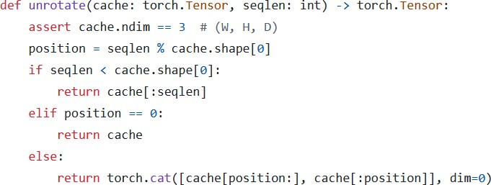
Rolling Buffer Cache: unrolling
Imagine we want to “unroll” the cache because we want to calculate the attention of the incoming token. It’s very easy! We just need to use the write pointer to understand how to order the items: we first take all the items AFTER the write pointer, and then all the items from the 0th index to the position of the write pointer.
A | CAT | IS | ON
Write pointer
CAT | IS | ON | A
Since the cache is not full yet, ignore unfilled items.
Since the cache is not full yet, ignore unfilled items. Rotate the cache around the write pointer

Slide 50
Pre-fill and chunking
When generating text using a Language Model, we use a prompt and then generate tokens one by one using the previous tokens. When dealing with a KV-Cache, we first need to add all the prompt tokens to the KV-Cache so that we can then exploit it to generate the next tokens.
Since the prompt is known in advance (we don’t need to generate it), we can prefill the KV-Cache using the tokens of the prompt. But what if the prompt is very big? We can either add one token at a time, but this can be time-consuming, otherwise we can add all the tokens of the prompt at once, but in that case the attention matrix (which is 𝑁 × 𝑁) may be very big and not fit in the memory.
The solution is to use pre-filling and chunking. Basically, we divide the prompt into chunks of a fixed size set to W (except the last one), where W is the size of the sliding window of the attention.
Imagine we have a large prompt, with a sliding window size of 𝑊 = 4.
For simplicity, let’s pretend that each word is a token.
Prompt: “Can you tell me who is the richest man in history”

Slide 51
Pre-fill and chunking: first chunk
Prompt: “Can you tell me who is the richest man in history”
The KV-Cache
 | CAN | YOU | TELL | ME
CAN | 0.268 | −∞ | −∞ | −∞
YOU | 0.124 | 0.278 | −∞ | −∞
TELL | 0.147 | 0.132 | 0.262 | −∞
ME | 0.132 | 0.128 | 0.206 | 0.212
At every step, we calculate the attention using the tokens of the KV-Cache + the tokens of the current chunk as Keys and Values, while only the tokens of the incoming chunk as Query.
During the first step of pre-fill, the KV-Cache is initially empty.
After calculating the attention, we add the tokens of the current chunk to the KV-Cache. This is different from token generation in which we first add the previously-generated token to the KV-Cache and then calculate the attention. We will see layer why.
The attention
mask

Slide 52
Pre-fill and chunking: second chunk
Prompt: “Can you tell me who is the richest man in history”
The KV-Cache
CAN | YOU | TELL | ME
 | CAN | YOU | TELL | ME | WHO | IS | THE | RICHEST
WHO | −∞ | 0.132 | 0.262 | 0.132 | 0.951 | −∞ | −∞ | −∞
IS | −∞ | −∞ | 0.956 | 0.874 | 0.148 | 0.253 | −∞ | −∞
THE | −∞ | −∞ | −∞ | 0.132 | 0.262 | 0.259 | 0.456 | −∞
RICHES T | −∞ | −∞ | −∞ | −∞ | 0.132 | 0.687 | 0.159 | 0.357
You may have noticed that the size of the attention mask is bigger than the size of the KV-Cache. This is done on purpose, otherwise the newly added tokens will not have their dot products calculated with items that were previously in the cache (for example the word “Who” will not have its attention calculated with the previous tokens). This mechanism is only used during pre-fill of the prompt.
Why do we do like this? Because the KV-Cache has a fixed size, but at the same time we need all these attentions computed.
The attention
mask
Let’s review how this is implemented in code

Slide 53
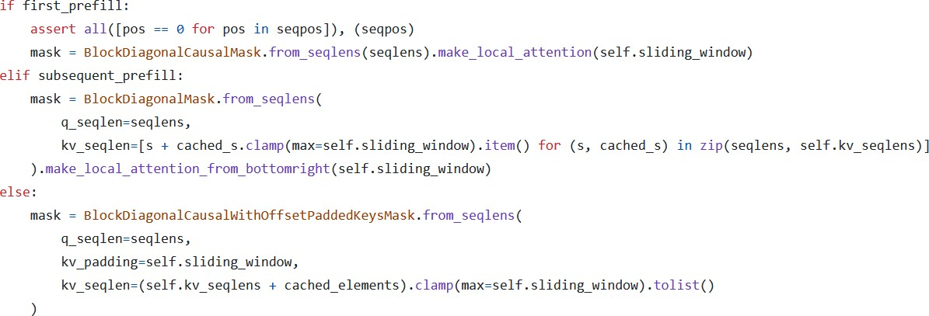
Pre-fill and chunking: code reference
Only during prefill the attention is calculated using an attention mask that is bigger than the KV-Cache.
As you can see, during the prefill of the first chunk and the subsequent chunks, we use the size of the KV-Cache and the number of tokens in
the current chunk to generate the attention mask.
During pre-fill, the attention mask is calculated using the KV-Cache + the tokens in the current chunk, so the size of the attention mask can be bigger than that of the KV-Cache (W).
During generation, we first add the previous token to the KV-Cache and then use the contents of the KV-Cache to generate the attention mask. During generation, the size of the attention mask is the size of the KV-Cache (W).
First chunk (KV-Cache is empty)
Subsequent chunks (KV-Cache is not empty)
Token generation

Slide 54
Pre-fill and chunking: last chunk
Prompt: “Can you tell me who is the richest man in history”
The KV-Cache
WHO | IS | THE | RICHEST
 | WHO | IS | THE | RICHEST | MAN | IN | HISTOR Y
MAN | −∞ | 0.132 | 0.262 | 0.132 | 0.951 | −∞ | −∞
IN | −∞ | −∞ | 0.956 | 0.874 | 0.148 | 0.253 | −∞
HISTOR Y | −∞ | −∞ | −∞ | 0.132 | 0.262 | 0.259 | 0.456
The last chunk may be smaller, that’s why we have less rows.
The attention
mask

Slide 55
Topics
Architectural differences between the vanilla Transformer and Mistral
Sliding Window Attention
Review of self-attention
Receptive field
KV-Cache
Motivation
How it works
Rolling Buffer Cache
Pre-fill and chunking
Sparse Mixture of Experts
Model Sharding
Pipeline Parallelism
Understanding the Mistral model’s code
Block attention in xformers

Slide 56
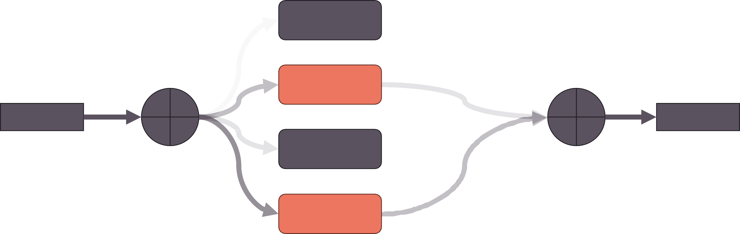
Mixture of Experts: an introduction
Mixture of Experts is an ensemble technique, in which we have multiple “expert” models, each trained on a subset of the data, such that each model specializes on it and then the output of the experts are combined (usually a weighted sum or by averaging) to produce one single output.
In the case of Mistral 8x7B, we talk about Sparse Mixture of Experts (SMoE), because only 2 out of 8 experts are used for every token. The gate produces logits which are used to select the top-k experts. The top-k logits are then run through a softmax to produce weights.
0.6
Expert 1
Gate
1.5
Weighted Sum
Expert 2
40%
Input
Output
1.2
Expert 3
60%
3.4
*Numbers are randomly generated
Expert 4

Slide 57


Mistral 8x7B: expert feed-forward layers
In the case of Mistral 8x7B, the experts are the Feed-Forward layers present at every Encoder layer. Each Encoder layer is comprised of a single Self-Attention mechanism, followed by a mixture of experts of 8 FFN. The gate function selects the top 2 experts for each incoming token. The output is combined with a weighted sum.
This allows to increase the parameters of the model, but without impacting the computation time, since the input will only pass through the top 2 experts, so the intermediate matrix multiplications will be performed only on the selected experts.
Weighted Sum
(MoE) Feed Forward
SILU
8xfeed-forward layers
Gate
RMS Norm
Self-Attention with Sliding Window Attention
,Grouped Query Attention, and Rolling Buffer KV- Cache
Q K
V
RMS Norm

Slide 58
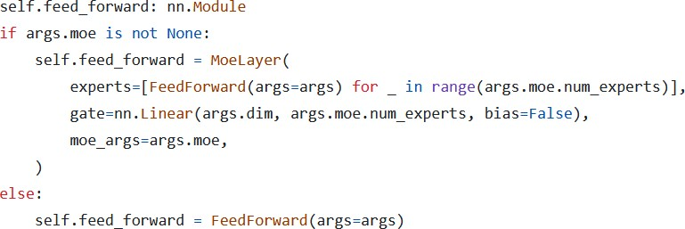
Mistral 8x7B : the gating function
The gating function is just a linear layer (in_features=4096, out_feature=8, bias=False) that’s trained along with the rest of the model.
For each token embedding, it produces 8 logits, which indicate which expert to select.
Mistral 8x7B
Mistral 7B

Slide 59
Mixture of Experts: why we apply the softmax after selecting the top-k experts?
If we apply the softmax directly to the output of the gate function, this will result in a “probability distribution” (weights that sum up to 1) over all the experts. But since we are only going to use the top-k of them, we want a “probability distribution” over only the selected experts.
This also makes it easier to compare two models trained on different number of experts, since the sum of the weights applied to the output will always be 1 independently on the number of experts chosen by the gate function.

Slide 60
Topics
Architectural differences between the vanilla Transformer and Mistral
Sliding Window Attention
Review of self-attention
Receptive field
KV-Cache
Motivation
How it works
Rolling Buffer Cache
Pre-fill and chunking
Sparse Mixture of Experts
Model Sharding
Pipeline Parallelism
Understanding the Mistral model’s code
Block attention in xformers

Slide 61
Model sharding
When we have a model that is too big to fit in a single GPU, we can divide the model into “groups of layers” and place each group of layers in a GPU.
When we inference iteratively: the output of each GPU is fed as input to the next GPU, and so on…
This technique is known as model sharding.
In the case of Mistral, since we have 32 Encoder layers, if we have 4 GPUs, we can store 8 of them in each GPU.
Embeddings
LAYER 1
LAYER 8
LAYER 9
LAYER 16
LAYER 17
LAYER 24
LAYER 25
LAYER 32
Linear Layer + Softmax
GPU 1
Layer 1 … 8
GPU 2
Layer 9 … 16
GPU 3
Layer 17 … 24
GPU 4
Layer 25 … 32
A pipeline like this one works fine, but it is not very efficient, because at any time only one GPU is working. A better approach (not implemented in the open-source release of Mistral), used especially during training, is to work on multiple batches at the same time, but shift them on the time scale. This approach is known as Pipeline Parallelism. Let’s see how it works.

Slide 62
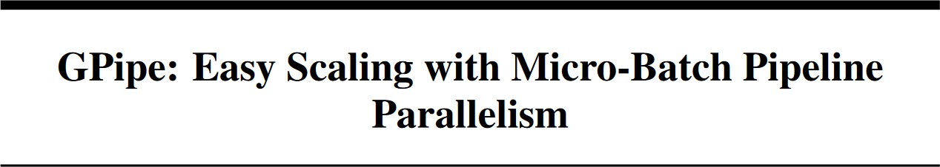
Pipeline Parallelism

Slide 63
Pipeline Parallelism: the problem
Imagine we want to train our sharded model on a single batch: it will take 8 timesteps to do it, and at each time step, only one GPU is working while the others are waiting idle.
Timestep | 0 | 1 | 2 | 3 | 4 | 5 | 6 | 7
GPU 4 |  |  |  | FORWARD | BACKWARD
GPU 3 |  |  | FORWARD |  |  | BACKWARD
GPU 2 |  | FORWARD |  |  |  |  | BACKWARD
GPU 1 | FORWARD |  |  |  |  |  |  | BACKWARD

Slide 64
Pipeline Parallelism: the solution
We divide our batch into smaller microbatches, and shift each microbatch’s forward and backward step on the timeline.
Each timestep in this case takes less, since we are working on a small microbatch. The gradients for each microbatch is accumulated
(gradient accumulation) and then we can run the optimizer to update the weights.
Timestep | 0 | 1 | 2 | 3 | 4 | 5 | 6 | 7 | 8 | 9 | 10 | 11 | 12 | 13
GPU 4 |  |  |  | FW-1 | FW-2 | FW-3 | FW-4 | BCW-4 | BCK-3 | BCK-2 | BCK-1
GPU 3 |  |  | FW-1 | FW-2 | FW-3 | FW-4 |  |  | BCW-4 | BCK-3 | BCK-2 | BCK-1
GPU 2 | FWD-1 |  | FW-2 | FW-3 | FW-4 | Bubble |  |  |  | BCW-4 | BCK-3 | BCK-2 | BCK-1
GPU 1 | FWD-1 | FW-2 | FW-3 | FW-4 |  |  |  |  |  |  | BCW-4 | BCK-3 | BCK-2 | BCK-1
We still have timesteps in which not all GPUs are working (called “bubbles”). To avoid bubbling, we can increase the size of the batch

Slide 65
Topics
Architectural differences between the vanilla Transformer and Mistral
Sliding Window Attention
Review of self-attention
Receptive field
KV-Cache
Motivation
How it works
Rolling Buffer Cache
Pre-fill and chunking
Sparse Mixture of Experts
Model Sharding
Pipeline Parallelism
Understanding the Mistral model’s code
Block attention in xformers

Slide 66
Optimizing inference with multiple prompts
Imagine you are running an AI company providing LLM inference service: you have many customers that send their prompts and want to run inference on your models. Each prompt may have a different lengths. For simplicity, suppose that each word is a token.
Consider the following prompts:
Prompt 1: “Write a poem” (3 tokens)
Prompt 2: “Write a historical novel” (4 tokens)
Prompt 3: “Tell me a funny joke” (5 tokens)
If we want to fully exploit our GPU, we should put all the prompts in a batch, but since they have different lengths, we have to pad them with a [PAD] token, and when the model produces the output, we should only look at the output corresponding to the last non-padding token, discarding any future tokens.
Write | a | poem | [PAD] | [PAD]
Write | a | historical | novel | [PAD]
Tell | me | a | funny | joke
LLM
TOK1_1 | TOK1_2 | TOK1_3 | TOK1_4 | TOK1_5
TOK2_1 | TOK2_2 | TOK2_3 | TOK2_4 | TOK2_5
TOK3_1 | TOK3_2 | TOK3_3 | TOK3_4 | TOK3_5
Linear Layer + Softmax

Slide 67
Optimizing inference with multiple prompts
Write | a | poem | [PAD] | [PAD]
Write | a | historical | novel | [PAD]
Tell | me | a | funny | joke
LLM
TOK1_1 | TOK1_2 | TOK1_3 | TOK1_4 | TOK1_5
TOK2_1 | TOK2_2 | TOK2_3 | TOK2_4 | TOK2_5
TOK3_1 | TOK3_2 | TOK3_3 | TOK3_4 | TOK3_5
Linear Layer + Softmax
To select the next token to generate, we will check the embedding corresponding to the last non-padding token, which are highlighted in
the output above. Because our modal is an LLM, we will apply a causal mask. This mask works fine for all the three sequences.
We cannot use a different mask for each prompt, because all the prompts
are of the same length, so the mask must be 5x5 for each prompt!
0 | −∞ | −∞ | −∞ | −∞
0 | 0 | −∞ | −∞ | −∞
0 | 0 | 0 | −∞ | −∞
0 | 0 | 0 | 0 | −∞
0 | 0 | 0 | 0 | 0
The problem here is that we are calculating a lot of dot products, especially for the first
and the second prompt that will not be used! Let’s see with an example.

Slide 68
Optimizing inference with multiple prompts
All the useless dot-products are highlighted in red.
 | WRITE | A | POEM | [PAD] | [PAD]
WRITE | 0.268 | −∞ | −∞ | −∞ | −∞
A | 0.124 | 0.278 | −∞ | −∞ | −∞
POEM | 0.147 | 0.132 | 0.262 | −∞ | −∞
[PAD] | 0.210 | 0.128 | 0.206 | 0.212 | −∞
[PAD] | 0.146 | 0.158 | 0.152 | 0.143 | 0.227
 | WRITE | A | HISTORI CAL | NOVEL | [PAD]
WRITE | 0.268 | −∞ | −∞ | −∞ | −∞
A | 0.124 | 0.278 | −∞ | −∞ | −∞
HISTORI CAL | 0.147 | 0.132 | 0.262 | −∞ | −∞
NOVEL | 0.210 | 0.128 | 0.206 | 0.212 | −∞
[PAD] | 0.146 | 0.158 | 0.152 | 0.143 | 0.227
 | TELL | ME | A | FUNNY | JOKE
TELL | 0.268 | −∞ | −∞ | −∞ | −∞
ME | 0.124 | 0.278 | −∞ | −∞ | −∞
A | 0.147 | 0.132 | 0.262 | −∞ | −∞
FUNNY | 0.210 | 0.128 | 0.206 | 0.212 | −∞
JOKE | 0.146 | 0.158 | 0.152 | 0.143 | 0.227
There is also the problem of the KV-Cache: each prompt may have a different KV-Cache size (imagine one prompt with only 10 tokens and another one with 500 tokens!). We must find a better solution!

Slide 69
Combining multiple prompts into a single sequence
The solution is to combine all the tokens of all the prompts into a single sequence and keep track of the length of each prompt when we
calculate the output.
Write | a | poem | Write | a | historical | novel | Tell | me | a | funny | joke
LLM
TOK1_1 | TOK1_2 | TOK1_3 | TOK2_1 | TOK2_2 | TOK2_3 | TOK2_4 | TOK3_1 | TOK3_2 | TOK3_3 | TOK3_4 | TOK3_5
Linear Layer + Softmax
You may be wondering: how do we build an attention mask for such a sequence? Simple! We use xformers BlockDiagonalCausalMask!

Slide 70
xformers BlockDiagonalCausalMask
 | Write | a | poem | Write | a | histori cal | novel | Tell | me | a | funny | joke
Write | 0 | −∞ | −∞ | −∞ | −∞ | −∞ | −∞ | −∞ | −∞ | −∞ | −∞ | −∞
a | 0 | 0 | −∞ | −∞ | −∞ | −∞ | −∞ | −∞ | −∞ | −∞ | −∞ | −∞
poem | 0 | 0 | 0 | −∞ | −∞ | −∞ | −∞ | −∞ | −∞ | −∞ | −∞ | −∞
Write | −∞ | −∞ | −∞ | 0 | −∞ | −∞ | −∞ | −∞ | −∞ | −∞ | −∞ | −∞
a | −∞ | −∞ | −∞ | 0 | 0 | −∞ | −∞ | −∞ | −∞ | −∞ | −∞ | −∞
histor ical | −∞ | −∞ | −∞ | 0 | 0 | 0 | −∞ | −∞ | −∞ | −∞ | −∞ | −∞
novel | −∞ | −∞ | −∞ | 0 | 0 | 0 | 0 | −∞ | −∞ | −∞ | −∞ | −∞
Tell | −∞ | −∞ | −∞ | −∞ | −∞ | −∞ | −∞ | 0 | −∞ | −∞ | −∞ | −∞
me | −∞ | −∞ | −∞ | −∞ | −∞ | −∞ | −∞ | 0 | 0 | −∞ | −∞ | −∞
a | −∞ | −∞ | −∞ | −∞ | −∞ | −∞ | −∞ | 0 | 0 | 0 | −∞ | −∞
funny | −∞ | −∞ | −∞ | −∞ | −∞ | −∞ | −∞ | 0 | 0 | 0 | 0 | −∞
joke | −∞ | −∞ | −∞ | −∞ | −∞ | −∞ | −∞ | 0 | 0 | 0 | 0 | 0
The mask may be different in case we use Sliding Window Attention.
Let’s have a look at the code!

Slide 71
Thanks for watching!
Don’t forget to subscribe for more amazing content on AI and Machine Learning!

